Slide 1


GoGetGrocery.com
Order, Manage, Graph your grocery expenses.
Presentation By:
R Sanjay
Nikhil Grover
Sahil Saini

Slide 2
Problem Statement :
Adam is having trouble getting groceries every month.
Average time spent on grocery shopping per month for an individual in Montreal.
Total hrs = 2hrs * number of individuals(bi weekly).
Ie. Monthly 4 hrs, Yearly : 48 hrs.
Often forget some or the other items to bring along.
Go to multiple places for specific products.

Slide 3
Solution: Automate your grocery shopping
Will do your work without taking a lot of your time.
You might forget what you need, application does not.
Distribute your products into categories of usages.
Records your daily products usage and order it automatically on a scheduled time.

Slide 4
Features:
Ability to make a list Once.
Personalise or Customise the list.
Schedule your orders.
Pay at the store or pay online.
Responsive and multi device compatible.
Recipie's Book

Slide 5
High Level Architecture Design:
Register a User.
Authenticate User to login.
Input the list for future
MAIN PAGE
Application will ask for confirmation of the order and order it.
Application will track usage of the products. (Home Page)
Order products &
Categorize

Slide 6




Technologies used
Angular
Bootstrap
Font Awesome
Java
My SQL

Slide 7
Why we chose this technology stack:
First of All.. OPEN SOURCE
Angular (Frontend JavaScript and jQuery framework) : Responsive Design, Speed and Angular puts you in control over scalability.
Bootstrap, Font Awesome (CSS) - Intuitive design and make it look beautiful.
Java : Backend Support for the interaction with the database used.
My SQL: Database we know for now.

Slide 8
Requirements Functional & Non Functional
Functional
Register user
Login credentials
Adding products into cart
Accessing the Recipe’s book
Non Functional
It should be easy to use.
Application has to be available all time.
It has to be scalable in terms of user’s database.
It should have simple design.

Slide 9
Future Possible Enhancements:
Pick a Store.
Compare Prices between and choose the best prices for the groceries.
Home Delivery.
Recipe's Book.

Slide 10
GUI SCREENS

Slide 11
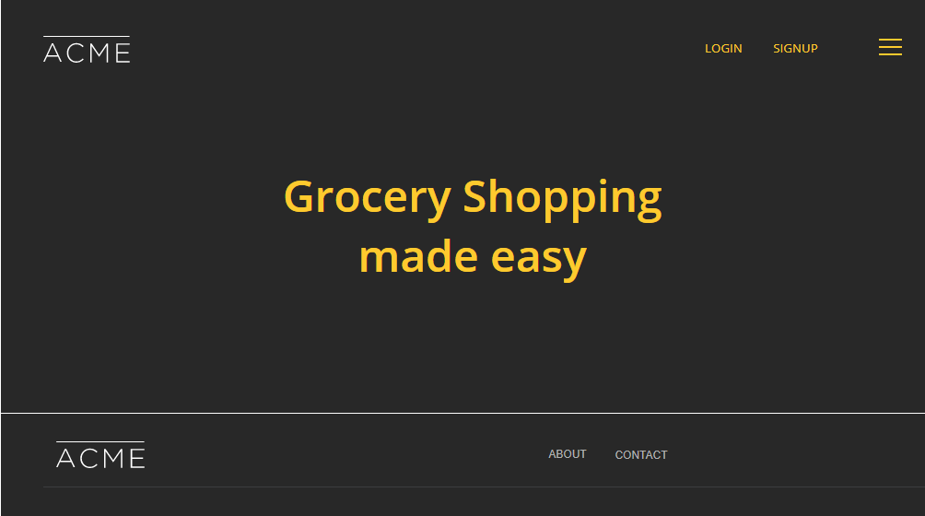
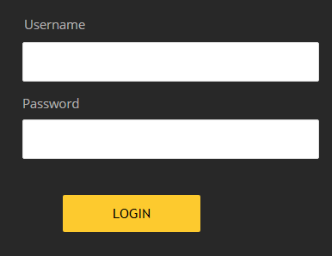

Slide 12
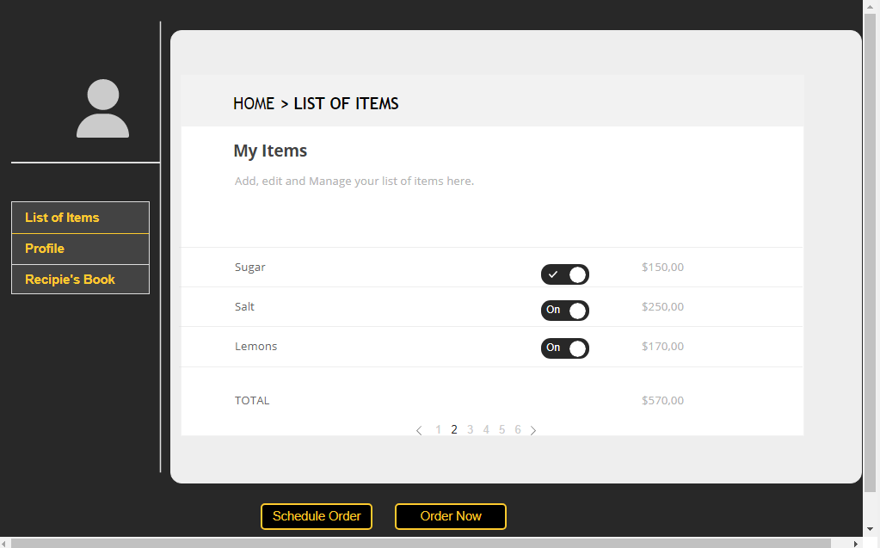

Slide 13
Working Team
R Sanjay – Backend, Frontend and Database.
Nikhil Grover – Frontend & Database.
Sahil Saini – Frontend.

Slide 14
Thank You

