Slide 1
Horror Movies Database
Completed by Nick Gundobin

Slide 2
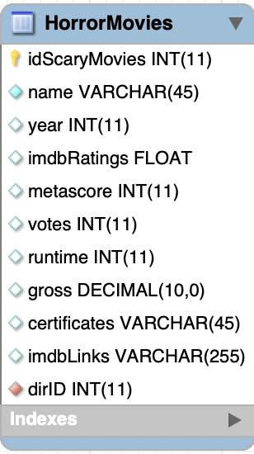
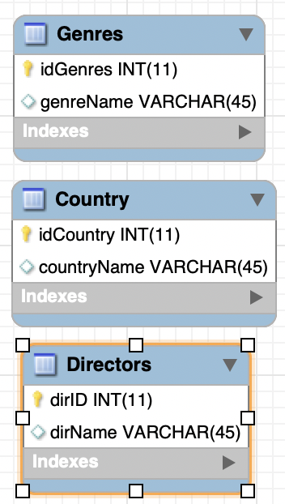
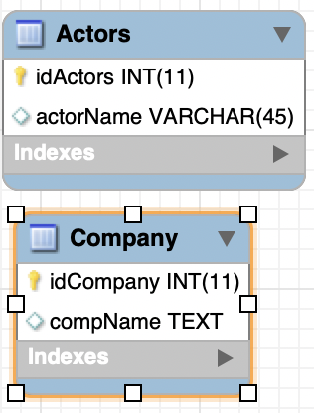
Entities

Slide 3
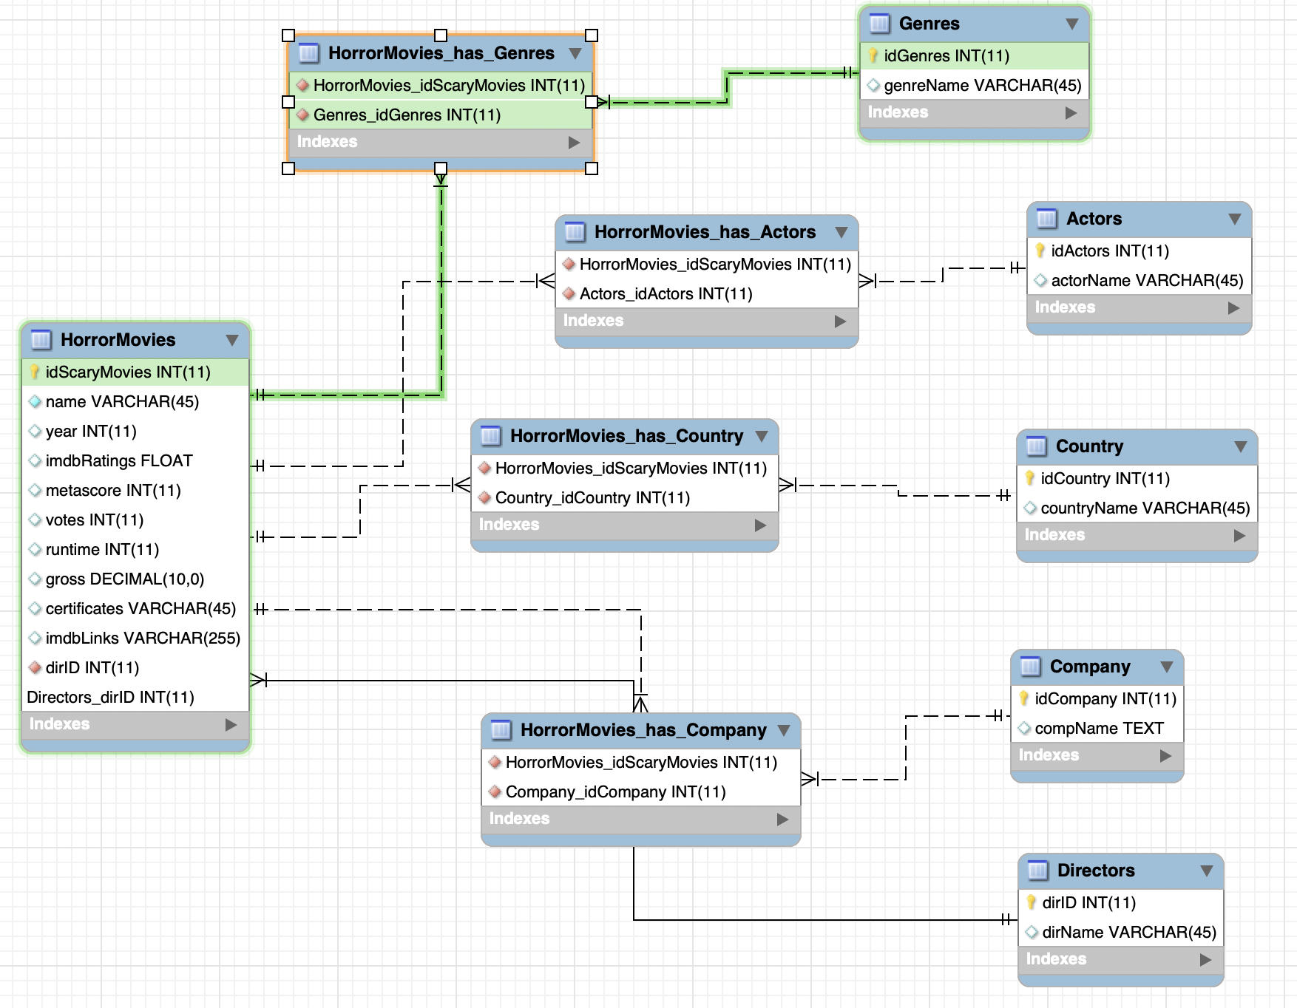
Full Relationship Picture

Slide 4
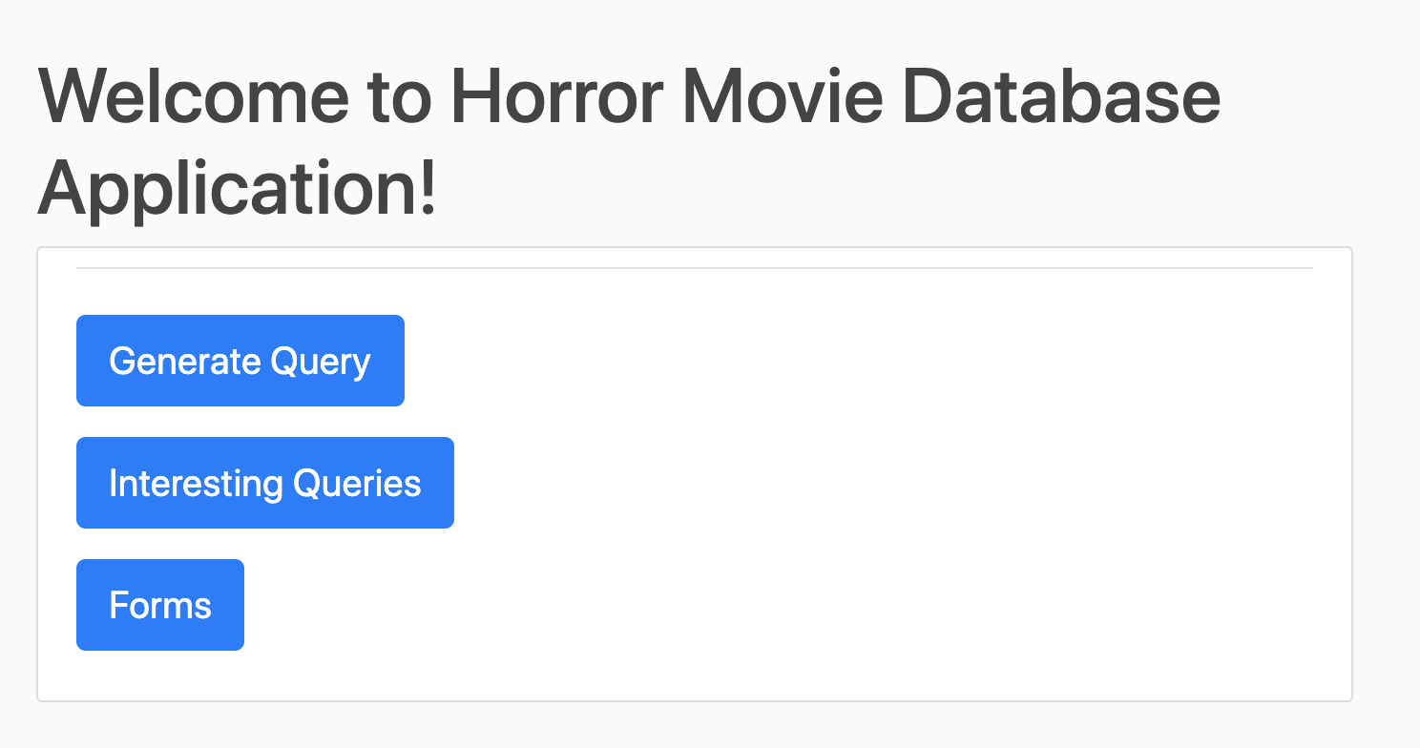
GUI INTERFACE

Slide 5
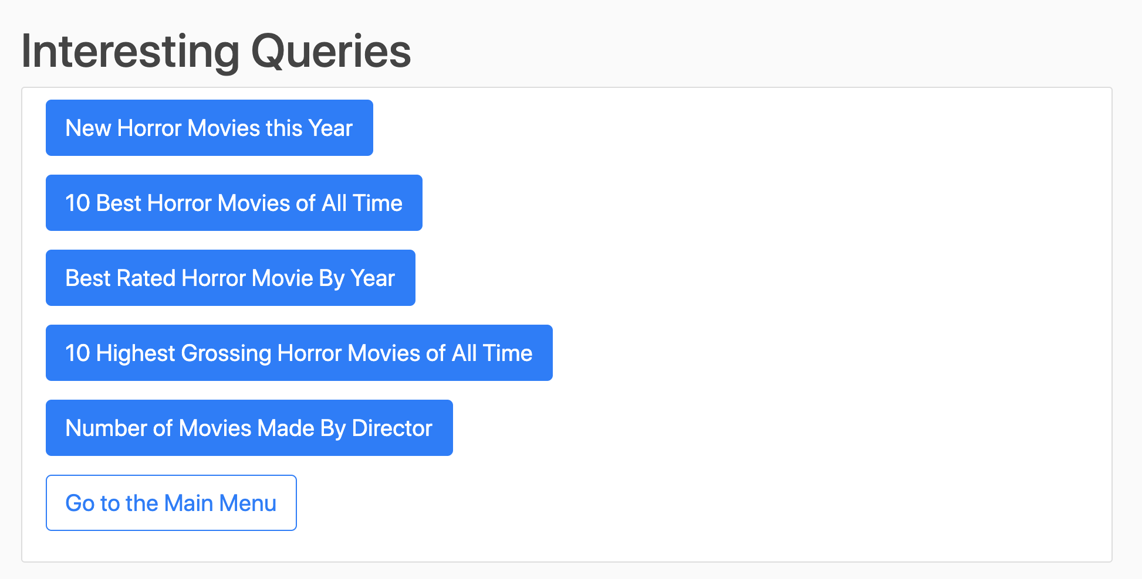
INTERESTING QUERIES

Slide 6

Forms

Slide 7
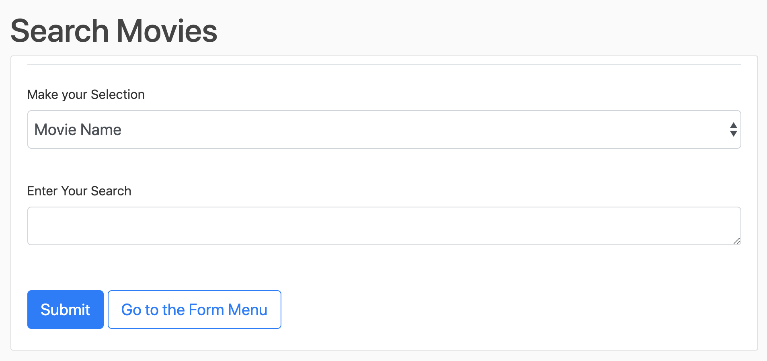
Search Form

Slide 8
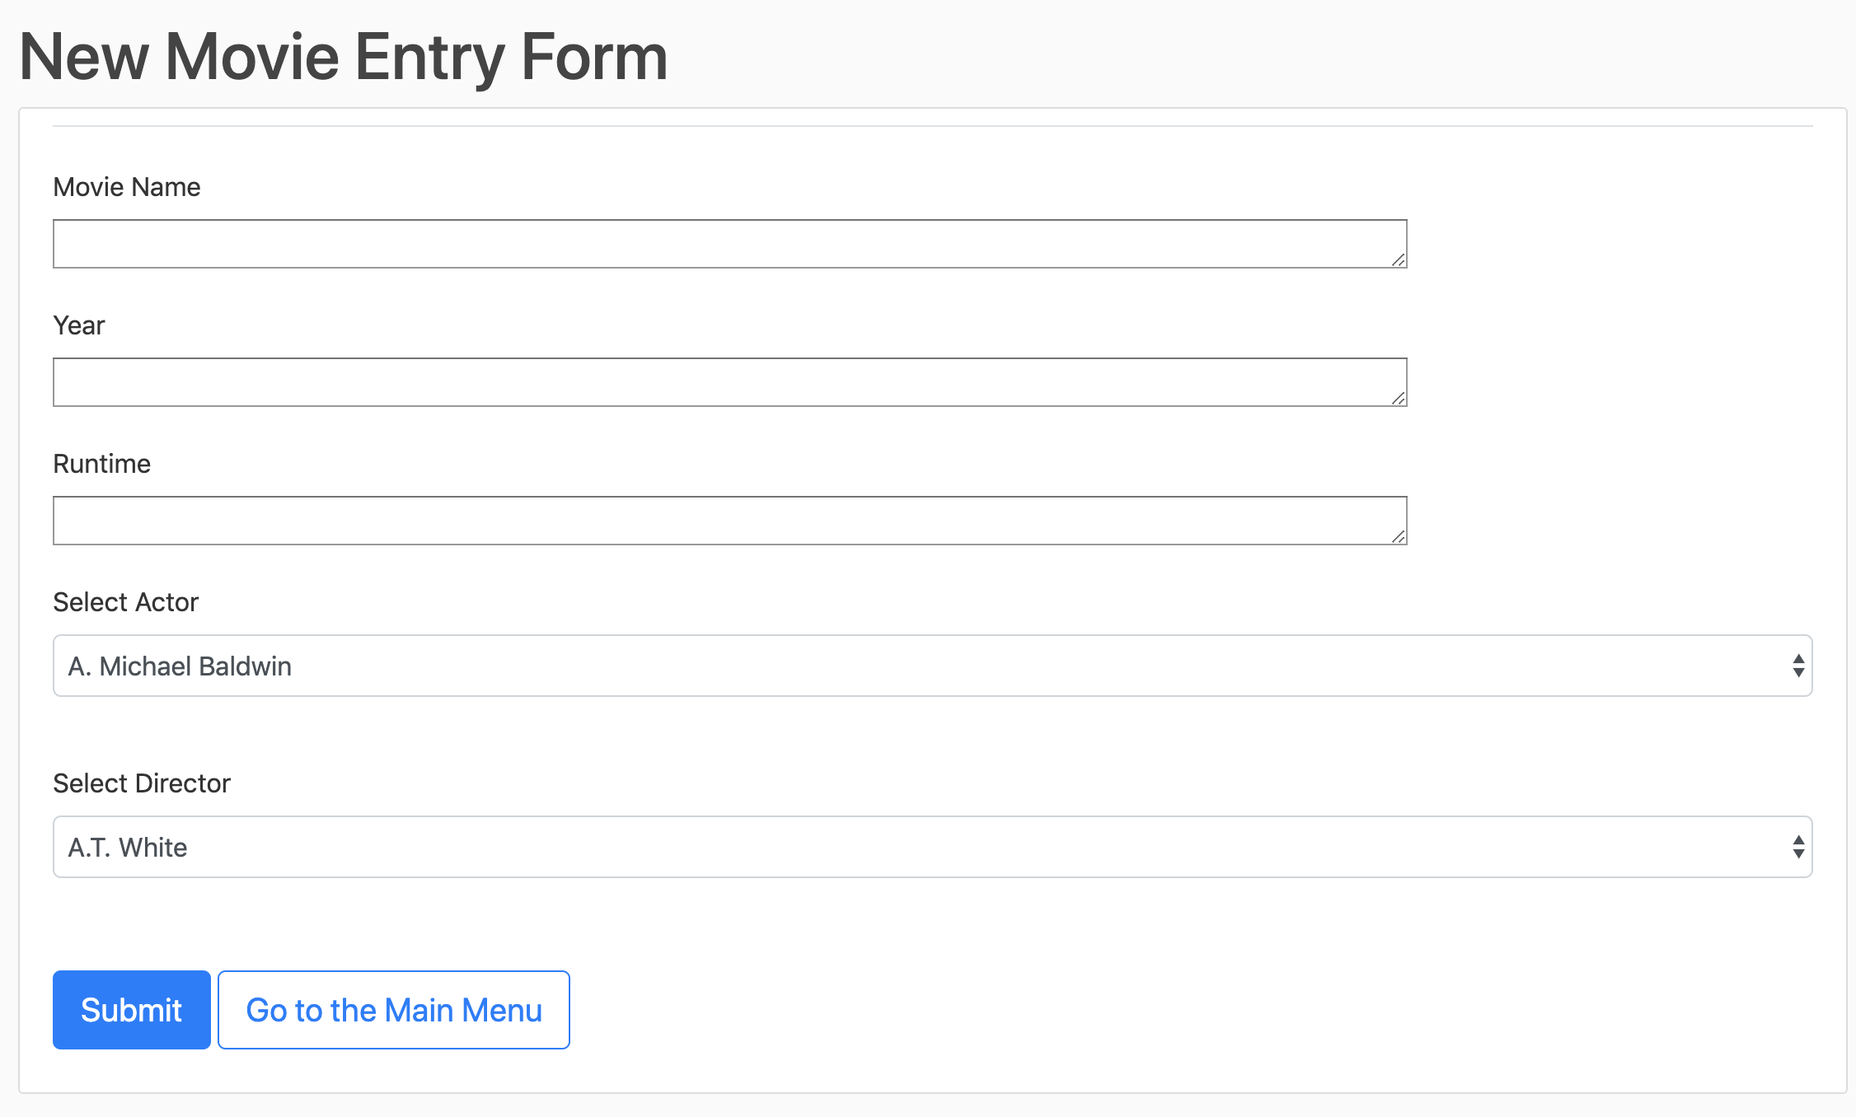
Insert Form

