Slide 1
Boxscore Bots

Slide 2
Members
Member 1: Eli Pappas
Email: pappaseh@mail.uc.edu
Member 2: Nikhil Gupta
Email: gupta2nh@mail.uc.edu
Advisor: Giovani Abuaitah

Slide 3
Project Abstract
Boxscore Bots is a Machine Learning powered sports line predictor. This project will utilize public statistics on player and team performances and will use these statistics to generate projections on how these players will perform in the future based on underlying trends in the data and upcoming matchup statistics. The front-end will be a website for the user interface which will allow ease of use and we plan on incorporating existing projections namely from sports-betting platforms to compare and advise on what we believe is a "good" bet.

Slide 4
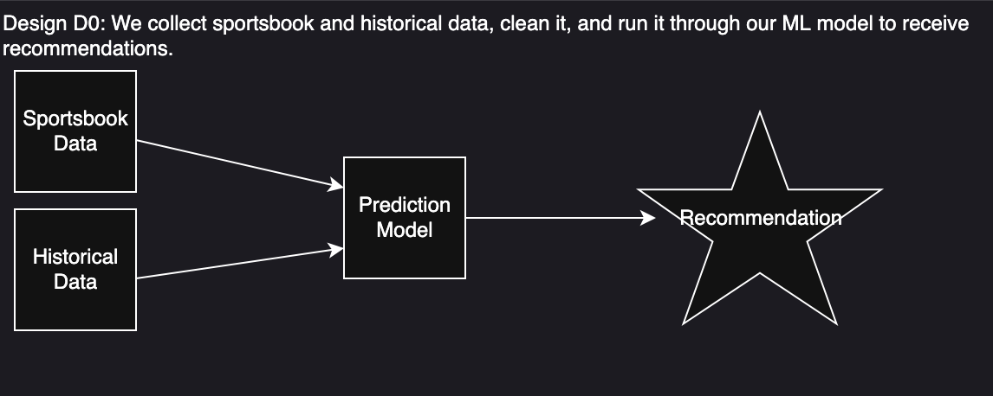
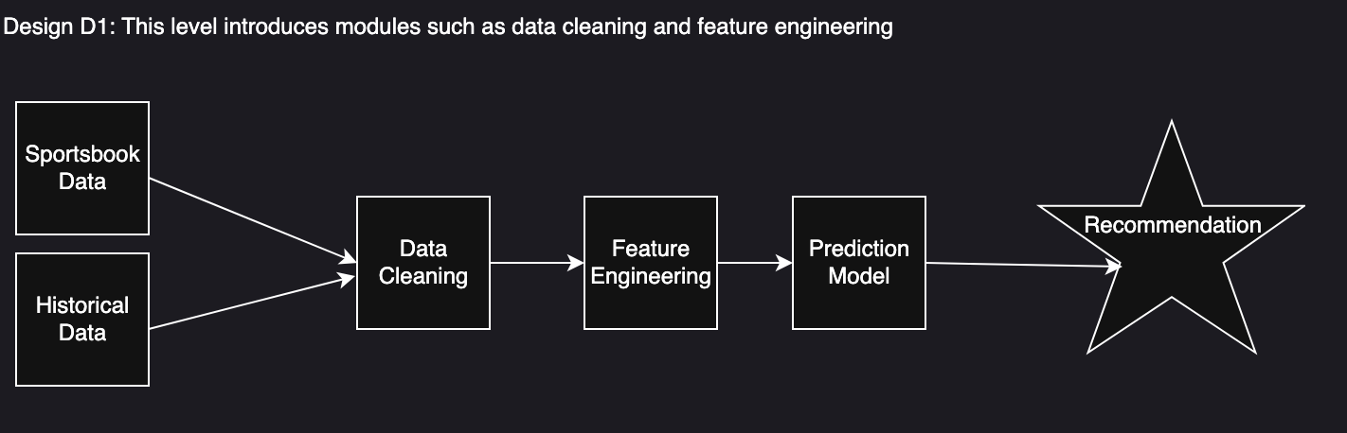
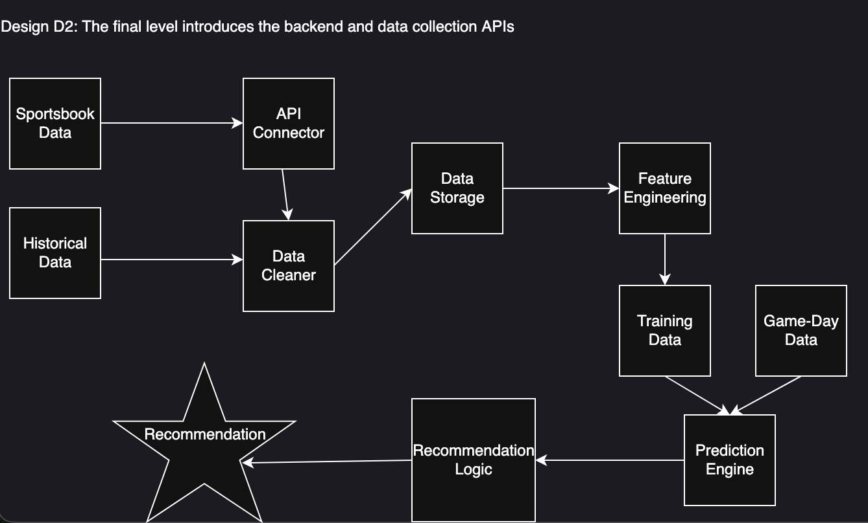
Design Diagrams

Slide 5
User Stories
Sports Analyst
As a sports analyst, I want to see the performance projections of players and teams' performances so that I can report accurate assessments of how they are doing or what they need to do to improve based on data-backed predictions.
Coach
As a coach, I want to see the performance projections of players on teams for certain games so that I can point out players has the weakest statistics in specific areas so that we can work to improve them, and know the weak points of players on opposing teams to
target them, in order to increase our chances of winning games in the future.
Average Sports-Betting Enthusiast
As a sports-betting enthusiast, I want to get performance projections of how teams will fare in games so that I can increase my odds of winning my bets by placing them on teams with a better chance of winning.
Scouts & Recruiters
As a sports scout, I want to seek potential talent to be promoted to better teams and positions, getting player projections on how each player fares against different teams and how they contribute to winning games by giving a wholistic view of their performance,
which will help me see what young talents are out there that would be worth pursuing to propose contracts and such to.

Slide 6
Major Project Constraints
Ethical:
Must avoid misleading users about prediction accuracy or promoting gambling.
Plans: add disclaimers, show historical accuracy transparently, and separate “Insights,” “Fantasy,” and “Betting” sections with age restrictions and warnings.
Legal:
Predictions may be used for gambling, requiring disclaimers that results are for entertainment only, not betting advice.
Player data may be protected by IP laws; unauthorized scraping could violate copyrights or terms of service.
Using public datasets minimizes licensing risks.
Social:
Benefits: supports community sports and objective player evaluation using data-driven insights.
Risks: overreliance on model predictions could bias perceptions or encourage gambling habits.
Mitigation: include clear disclaimers emphasizing predictions are not guarantees.
Professional:
Major learning opportunity in machine learning, data analysis, and UI design.
Builds collaboration, source control, and coding skills.
Provides strong portfolio experience for future careers in data science and analytics.

Slide 7
Project Progress
Implementation start date: Oct. 27th
Research on effective training models and data sources
Focus on data retrieval and training this term

Slide 8
Expected Accomplishments
Project work split into 3 phases:
  Data Retrieval
  Training
  UI Implementation
Goals for this term
  Training model complete
  Translate results into readable insights

Slide 9
Division of Work

Slide 10
Expected Expo Demo
Fully implemented UI with user-friendly navigation
Clear results for various match-ups
Model accuracy of at least 66%
Projection comparisons
Generate visualizations in performance trends

