Slide 1









Major Project Selection Phase Synopsis Presentation
August 2026
Dayananda Sagar College of Engineering, Bangalore, Karnataka Department of Electronics & Communication Engineering
Project Batch No. :06 Subject code : 22EC76
AgentEdge: Resource-Adaptive and Fault-Tolerant Agentic AI for Embedded Edge Systems
USN : 1DS23EC002 (Sec-A) Name : Aashika R
USN : 1DS23EC131 (Sec-C) Name : Nandini Kanni
USN : 1DS23EC140 (Sec-C) Name : Nikhil Singhvi
USN : 1DS23EC173 (Sec-C) Name : Rishika Banerjee
Prof. Vibha T. G.
Assistant Professor

Slide 2

Overview of the project selection phase presentation
1. 2. 3. 4. 5. 6. 7.
Introduction
Literature Survey
Problem Statement
Objectives
Advantages / Applications
References
Flow of the future works/Road Map (Aug’26 – Nov’26)

Slide 3
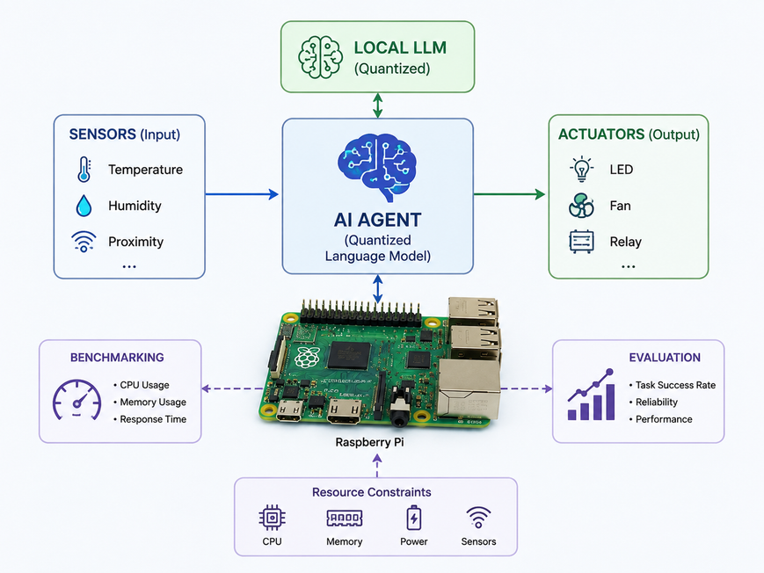
  INTRODUCTION
The Core Problem
  AI agent systems like ChatGPT, LangGraph, and AutoGen are powerful - but they run entirely on cloud servers. They need internet, powerful GPUs, and constant connectivity.
  Real-world embedded systems - factory sensors, medical monitors, agricultural nodes - need intelligence that works offline, on cheap hardware, in real-time.
  Existing work has explored edge LLMs, embedded AI agents, and physical tool interaction, but unified empirical evaluation of agentic task execution under resource constraints and hardware failures remains limited.
What AgentEdge Proposes
Small Language Model (SLM)
TinyLlama 1.1B / Phi-3-Mini 3.8B as candidate on-device reasoning models
Real Sensor Tool-Use
GPIO-connected temperature, ultrasonic, camera, BLE actuators
Agent Loop on RPi5
Perceive → Plan → Execute → Verify → Recover, fully offline
AgentEdge-Bench
AgentEdge-Bench: 20 tasks measuring success, RAM, energy, latency

Slide 4
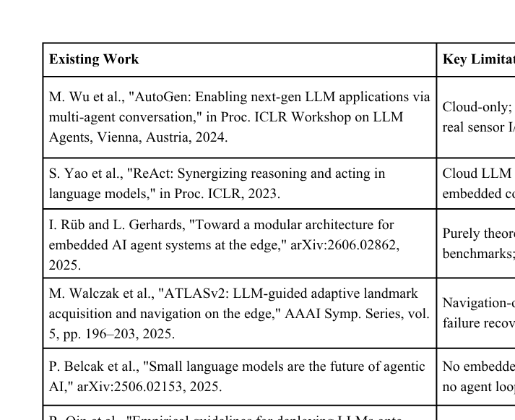
  LITERATURE SURVEY

Slide 5
  PROBLEM STATEMENT
  Current agentic AI systems are primarily designed for powerful cloud-based environments.
  Embedded devices introduce constraints such as limited memory, CPU capacity, and unreliable hardware tools.
  Under these conditions, an agent may experience slower execution, failed tool calls, incomplete plans, or incorrect responses.
  The impact of these constraints on agentic AI task execution and reliability remains insufficiently characterized.
Four Specific Sub-Problems
  P1 - RAM Overflow Mid-Task: When the agent plans a complex multi-step sequence, available RAM on RPi5 may be exhausted mid-execution. Existing embedded-agent approaches provide limited evaluation of mid-task resource exhaustion and recovery.
  P2 - Sensor Failure During Execution: Physical sensors can disconnect, timeout, or return invalid data during execution, requiring the agent to detect the failure and recover.
  P3 - No Embedded Agent Benchmark: Zero standardized benchmarks exist for agentic AI on embedded hardware. Researchers have no baseline to compare against.
  P4 - SLM Performance Unknown at Edge: The latency, memory, energy and task-success trade-offs of different SLMs for agentic tasks on RPi5 require further empirical characterization.

Slide 6
OBJECTIVE
  Deploy SLM on RPi5 Offline: Run TinyLlama 1.1B and Phi-3-Mini 3.8B (4-bit GGUF) via llama.cpp on Raspberry Pi 5 with zero cloud dependency
  Build Complete Agent Loop: Implement Perceive → Plan → Execute → Verify → Recover loop in Python with 5 real sensor/actuator tools (GPIO, camera, BLE).
  Resource-Adaptive Decomposition: Design and implement an algorithm that monitors live RAM/CPU usage and splits plan steps into sub-tasks when resources are constrained.
  Sensor Failure Recovery Protocol: Formally define and implement failure classification (timeout / bad reading / disconnect) with automated recovery actions.
  AgentEdge-Bench: 20-Task Suite: Create the first standardized benchmark for embedded agentic AI - 20 tasks with ground-truth success metrics, publishable as a research artifact.
  Measure Latency / RAM / Energy: Characterize all agent components: tokens/sec, RAM per planning step, mJ per decision using INA219 current sensor on real hardware.

Slide 7
Result & Literature Survey Analysis
Analysis Link

Slide 8

  ADVANTAGES AND APPLICATIONS
Key Advantages:
Applications:
  Smart Agriculture: Agent monitors soil moisture, temperature, light — autonomously controls irrigation and sends BLE alerts
  Industrial IoT: Factory floor agent monitors machine vibration, detects anomalies, triggers safety shutdown and alerts operator
  Disaster Response: Off-grid search & rescue agent processes sensor data, plans routes, coordinates team via BLE mesh — works without internet
  Research Platform: AgentEdge-Bench provides a reproducible evaluation platform for future embedded-agent research.
  Fully Offline Operation: No internet, no API keys, no data leakage. Works in air-gapped industrial and medical environments.
  Low-Cost Hardware: Low-Cost Embedded Platform: Runs on Raspberry Pi 5 with low-cost peripheral hardware.
  Energy Characterised: Energy Characterization: Measures energy consumption per agentic decision/task using INA219.
  Failure-Resilient: Formal sensor failure recovery - critical for industrial reliability where sensors routinely malfunction.
  Benchmarkable & Reproducible: AgentEdge-Bench lets future researchers directly compare improvements - follows open science principles.

Slide 9
REFERENCES
[1] Shen et al., “Large Language Models Empowered Autonomous Edge AI for Connected Intelligence,” IEEE Communications Magazine, vol. 62, no. 10, pp. 140–146, Oct. 2024.
[2] Yao et al., “ReAct: Synergizing Reasoning and Acting in Language Models,” International Conference on Learning Representations (ICLR), 2023.
[3] Navardi et al., “Metareasoning for Edge-Cloud Collaborative LLM Planning for Efficient Autonomous Navigation,” ACM Transactions on Embedded Computing Systems, 2025.
[4] Song et al., “LLM-Planner: Few-Shot Grounded Planning for Embodied Agents with Large Language Models,” IEEE/CVF International Conference on Computer Vision (ICCV), pp. 2986–2997, 2023.
[5] Qin et al., “Empirical Guidelines for Deploying LLMs onto Resource-Constrained Edge Devices,” ACM Transactions on Design Automation of Electronic Systems, 2024.
[6] Walczak et al., “ATLASv2: LLM-Guided Adaptive Landmark Acquisition and Navigation on the Edge,” AAAI Symposium Series, pp. 196–203, 2025.
[7] Rüb and Gerhards, “Toward a Modular Architecture for Embedded AI Agent Systems at the Edge,” arXiv preprint arXiv:2606.02862, 2026.
[8] Liu et al., “Adaptive and Resource-Efficient Agentic AI Systems for Mobile and Embedded Devices: A Survey,” arXiv preprint arXiv:2510.00078, 2025.

Slide 10
Flow of the future works/Road Map (Aug’26 – Nov’26)
PHASE | DURATION | Implementation
PROBLEM STUDY | AUGUST 2026 | Deep-read 11 core papers Download & setup public datasets Install llama.cpp + Ollama on RPi5 Run TinyLlama first inference Define 20 benchmark task specifications
DESIGN PHASE | SEPTEMBER | Build Perceive-Plan-Execute loop Integrate GPIO,BLE (bleak library) Run first 5 benchmark tasks end-to-end Measure baseline latency per step
ADAPTIVE AGENT DEVELOPMENT | OCTOBER | Build resource-adaptive decomposition algorithm Implement sensor failure classifier Build 3-action recovery protocol Run all 20 benchmark tasks
EXPERIMENTAL EVALUATION | NOVEMBER | NA219 energy measurement per decision RAM profiling per planning step TinyLlama vs Phi-3-Mini ablation study Complete 20-task benchmark results

Slide 11



