Slide 1
Mongo db

Slide 2
Mongo db
The most popular NoSQL database, is an open-source document-oriented database.
The term ‘NoSQL’ means ‘non-relational’.
It means that MongoDB isn’t based on the table-like relational database structure but provides an altogether different mechanism for storage and retrieval of data.
This format of storage is called BSON ( similar to JSON format).
BSON-Binary encoded JavaScript object notation

Slide 3
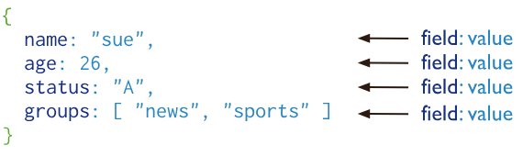
Mongo db
MongoDB is a document database. It stores data in a type of JSON format called BSON.
MongoDB stores documents in collections. Collections are analogous to tables in relational databases.

Slide 4
MongoDB
Windows:
Log in Admin
mongod(minimize)
Mongo(commands given here)
Linux:
mongo

Slide 5
Create databse
MongoDB use DATABASE_NAME is used to create database. The command will create a new database if it doesn't exist, otherwise it will return the existing database.
use DATABASE_NAME
Eg:
>use mydb
switched to db mydb

Slide 6
To check your currently selected database, use the command db
>db
Mydb
If you want to check your databases list, use the command show dbs.
>show dbs
local 0.78125GB
test 0.23012GB

Slide 7
CRUD operations:
Create Operations
CRUD operations create, read, update, and delete documents.
Create Operations
Create or insert operations add new documents to a collection.
If the collection does not currently exist, insert operations will create the collection.

Slide 8
Create Collection
MongoDB commands are case-sensitive
db.createCollection(name, options)
>db.createCollection(“mycollection”)
To check created collections
>show collections

Slide 9
Insert document in MongoDB collection
To insert data into MongoDB collection, you need to use MongoDB's insert() or save() method.
>db.COLLECTION_NAME.insert(document)
The insertOne() method
If you need to insert only one document into a collection you can use this method.
>db.COLLECTION_NAME.insertOne(document)

Slide 10
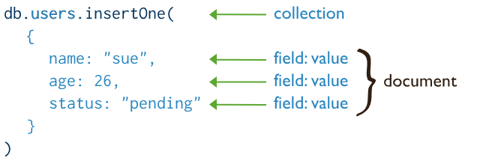
Create or insert operation
db .collection.insertOne() //Inserts a single document into a collection.

Slide 11
The insertMany() method
You can insert multiple documents using the insertMany() method. To this method you need to pass an array of documents.

Slide 12
Insert many documents
db.collection.insertMany(
[ <document 1> , <document 2>, ... ],
{
writeConcern: <document>,
ordered: <boolean>
}
)

Slide 13
Eg:
db.student.insertMany([{name:"Ajay",age:20},
{name:"Bina",age:24},
{name:"Ram",age:23}])

Slide 15
In MongoDB, each document stored in a collection requires a unique _id field that acts as a primary key.
If an inserted document omits the _id field, the MongoDB driver automatically generates an ObjectId for the _id field.
By default when inserting documents in the collection, if you don’t add a field name with the _id in the field name, then MongoDB will automatically add an Object id field as shown below

Slide 16
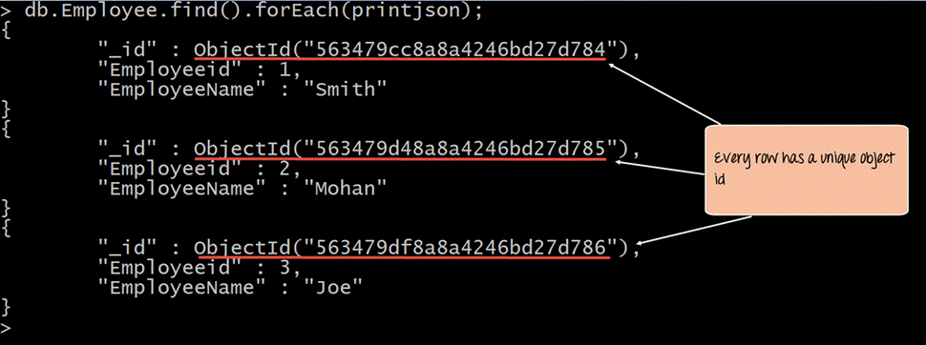

Slide 17
If you want to ensure that MongoDB does not create the _id Field when the collection is created and if you want to specify your own id as the _id of the collection, then you need to explicitly define this while creating the collection.
When explicitly creating an id field, it needs to be created with _id in its name.
db.Employee.insert({_id:10, "EmployeeName" : "Smith"})

Slide 18
Read Operations
Read operations retrieve documents from a collection; i.e. query a collection for documents.
MongoDB provides the following methods to read documents from a collection:
The find() method with no parameters returns all documents from a collection and returns all fields for the documents.
db.collection.find(query, projection, options)
db.collection.find(<query>).pretty()//display the documents in specific format.

Slide 19
Eg:
By default, db .collection.find() returns data in a dense format:
db.books.find()
{ "_id" : ObjectId("54f612b6029b47909a90ce8d"), "title" : "A Tale of Two Cities", "text" : "It was the best of times, it was the worst of times, it was the age of wisdom, it was the age of foolishness...", "authorship" : "Charles Dickens" }

Slide 20
Eg:
b.books.find().pretty()
{
"_id" : ObjectId("54f612b6029b47909a90ce8d"),
"title" : "A Tale of Two Cities",
"text" : "It was the best of times, it was the worst of times, it was the age of wisdom, it was the age of foolishness...",
"authorship" : "Charles Dickens"
}

Slide 21
The examples in this section use documents from the bios collection where the documents generally have the form: db.bios.find()
{
"_id" : <value>,
"name" : { "first" : <string>, "last" : <string> }, // embedded document
"birth" : <ISODate>,
"death" : <ISODate>,
"contribs" : [ <string>, ... ], // Array of Strings
"awards" : [
{ "award" : <string>, year: <number>, by: <string> } // Array of embedded documents
...
]
}

Slide 22
Query for selction of specific attribute
db.collection name.find( { _id: 5 } )
db. collection name.find( { "name.last": "Hopper" } )

Slide 23
Query for Equality eg:
The following operation returns documents in the bios collection where _id equals 5:
db.bios.find( { _id: 5 } )
The following operation returns documents in the bios collection where the field last in the name embedded document equals "Hopper":
db.bios.find( { "name.last": "Hopper" } )

Slide 24
Query Using Operators
The following operation uses the $in operator to return documents in the bios collection where _id equals either 5 or ObjectId("507c35dd8fada716c89d0013"):
db.bios.find(
{ _id: { $in: [ 5, ObjectId("507c35dd8fada716c89d0013") ] } }
)

Slide 25
The following operation uses the $gt operator returns all the documents from the bios collection where birth is greater than new Date('1950-01-01’):
db.bios.find( { birth: { $gt: new Date('1950-01-01') } } )
The following operation uses the $regex operator to return documents in the bios collection where name.last field starts with the letter N (or is "LIKE N%")
db.bios.find(
{ "name.last": { $regex: /^N/ } }
)

Slide 26
Query for Ranges
Combine comparison operators to specify ranges for a field. The following operation returns from the bios collection documents where birth is between new Date('1940-01-01') and new Date('1960-01-01') (exclusive):
Query for Multiple Conditions
The following operation returns all the documents from the bios collection where birth field is greater than new Date('1950-01-01') and death field does not exists:
db.bios.find( {
birth: { $gt: new Date('1920-01-01') },
death: { $exists: false }
} )
db.bios.find( { birth: { $gt: new Date('1940-01-01'), $lt: new Date('1960-01-01') } } )

Slide 28
Update
MongoDB Update() Method
The update() method updates the values in the existing document.
Syntax
The basic syntax of update() method is as follows −
>db.COLLECTION_NAME.update(SELECTION_CRITERIA, UPDATED_DATA)
>db.mycol.update({'title':'MongoDB Overview'},{$set:{'title':'New MongoDB Tutorial'}})

Slide 29
By default, MongoDB will update only a single document.
To update multiple documents, you need to set a parameter 'multi' to true.
>db.mycol.update({'title':'MongoDB Overview'}, {$set:{'title':'New MongoDB Tutorial'}},{multi:true})

Slide 30
MongoDB findOneAndUpdate() method
The findOneAndUpdate() method updates the values in the existing document.
The basic syntax of findOneAndUpdate() method is as follows −
>db.COLLECTION_NAME.findOneAndUpdate(SELECTIOIN_CRITERIA, UPDATED_DATA)

Slide 31
update the age and email values of the document with name 'Radhika'.
> db.empDetails.findOneAndUpdate(
{First_Name: 'Radhika'},
{ $set: { Age: '30',e_mail: 'radhika_newemail@gmail.com'}}

Slide 32
Deletion
To delete multiple documents, use
db.collection.deleteMany().
To delete a single document, use
db.collection.deleteOne().

Slide 33
db.movies.deleteMany( { title: "Titanic" } )
db.movies.deleteOne( { cast: "Brad Pitt" } )

Slide 34
References:
https://www.mongodb.com/docs/manual/reference/method/db.collection.find/#mongodb-method-db.collection.find
https://www.mongodb.com/docs/manual/introduction/
Video
https://www.youtube.com/watch?v=v6Xmydb7u4Y
https://www.youtube.com/watch?v=eOJeZ4CllNI

