Slide 1
Thyroid Detection Using Machine Learning
Nikhila Baby
S3 MCA
MAC23MCA-2044

Slide 2
Contents
1. INTRODUCTION
2. LITERATURE REVIEW 1
3. LITERATURE REVIEW 2
4. LITERATURE REVIEW 3
5. SUMMARY
6. PROJECT PROPOSAL
7. CONCLUSION

Slide 3
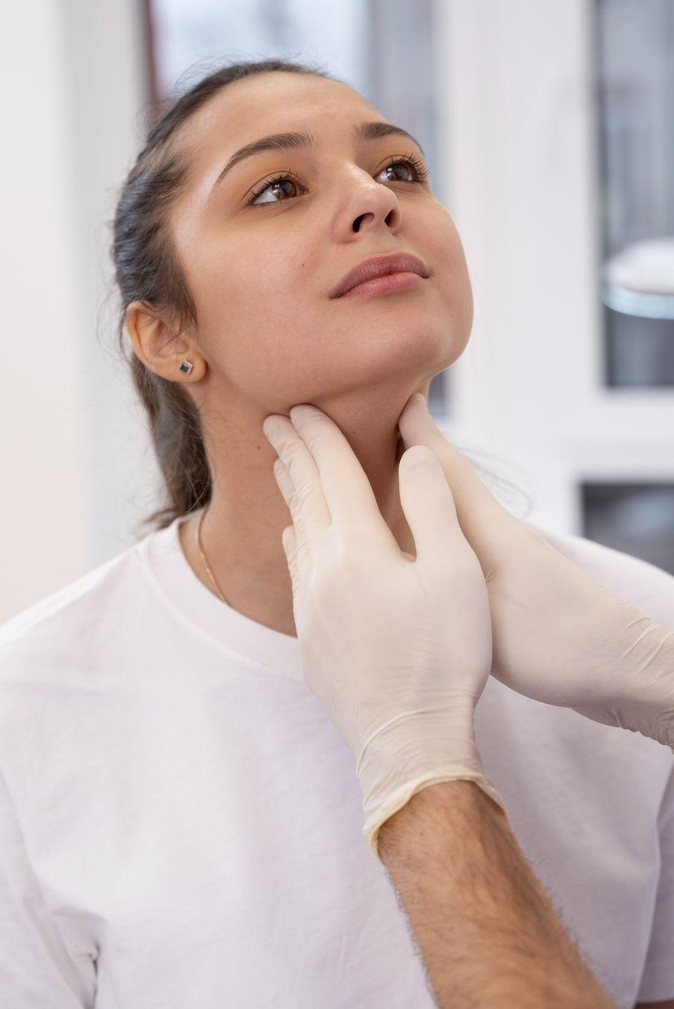
Introduction
The thyroid gland has one of the most important functions in regulating metabolism.
Detection and accurate diagnosis of hypothyroidism and hyperthyroidism.
Aims to utilize machine learning techniques to improve the detection and diagnosis of thyroid diseases.
Develop and train machine learning models using relevant medical data.

Slide 4

Literature Review

Slide 5
Thyroid disease prediction using selective features and machine learning techniques
1
Focuses on enhancing feature engineering techniques for machine learning.
Machine learning models with enhanced feature engineering are more accurate and computationally efficient for detecting thyroid diseases.
Accuracy of all proposed algorithm is arrived to show the best model.

Slide 6
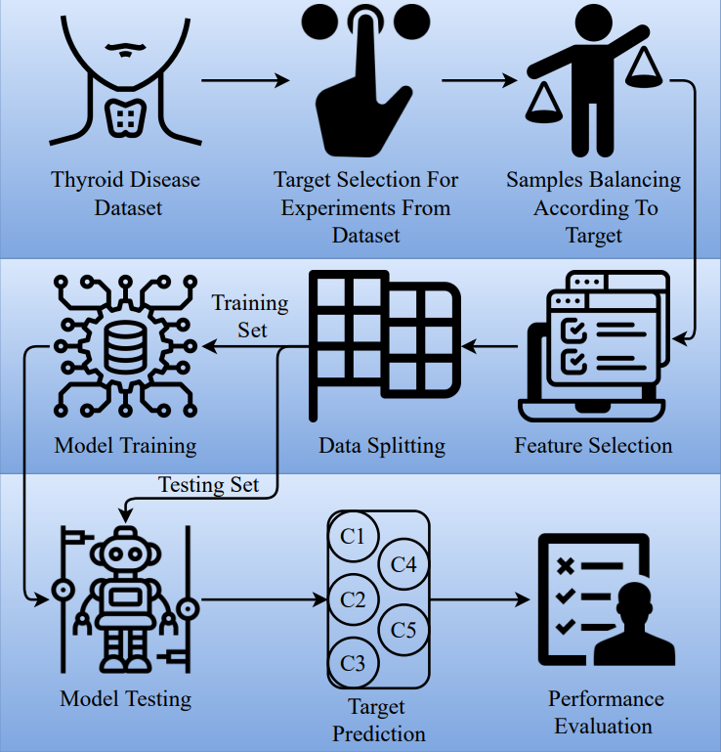
Work Flow
1

Slide 7
Dataset
1
Dataset is collected from UCI repository. The dataset contains 9172 sample observations and each sample is represented by 31 features.
Data sample attribute Types
age | pregnant | goiter | T3_measured | FTI_measured | patient_id
sex | thyroid_surgery | tumor | T3 | FTI
on_thyroxine | I131_treatment | hypopituitary | TT4-measured | TBG_measured
query_on_thyroxine | query_hypothyroid | psych | TT4 | TBG
on_antithyroidmeds | query_hyperthyroid | TSH_measured | T4U_measured | referral_source
sick | lithium | TSH | T4U | Target

Slide 8
Accuracy
1
99%
98%
97%
RF
GBM
ADA
87%
92%
LR
SVM

Slide 9
Detecting thyroid disease using optimized machine learning model based on differential evolution
2
Conditional Generative Adversarial Networks (CGANs) are employed for data augmentation to handle class imbalance effectively.
Hyperparameter optimization is performed using Differential Evolution (DE) algorithm. This algorithm helps to find the best hyperparameter settings for the machine learning models.
Machine learning models are trained on the augmented data.

Slide 10
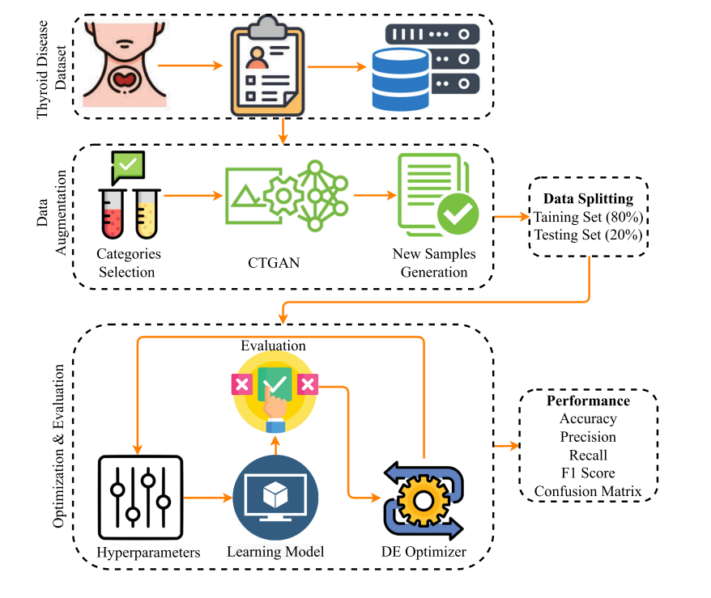
Work Flow
2

Slide 11
Dataset
2
Dataset is collected from Kaggle. The dataset contains 9172 sample observations and each sample is represented by 31 features.
Data sample attribute Types
age | pregnant | goiter | T3_measured | FTI_measured | patient_id
sex | thyroid_surgery | tumor | T3 | FTI
on_thyroxine | I131_treatment | hypopituitary | TT4-measured | TBG_measured
query_on_thyroxine | query_hypothyroid | psych | TT4 | TBG
on_antithyroidmeds | query_hyperthyroid | TSH_measured | T4U_measured | referral_source
sick | lithium | TSH | T4U | Target

Slide 12
Accuracy
2
99.5%
99.6%
99.8%
RF
GBM
ADA
64.3%
96.6%
LR
SVM

Slide 13
An explainable artificial intelligence framework for the predictive analysis of hypo and hyper thyroidism using machine learning algorithms
3
Use machine learning algorithms to predict hypothyroidism and hyperthyroidism based on medical data.
Identifying significant features that enhance the accuracy of disease detection.
Various classification models are tested to predict thyroid diseases.

Slide 14
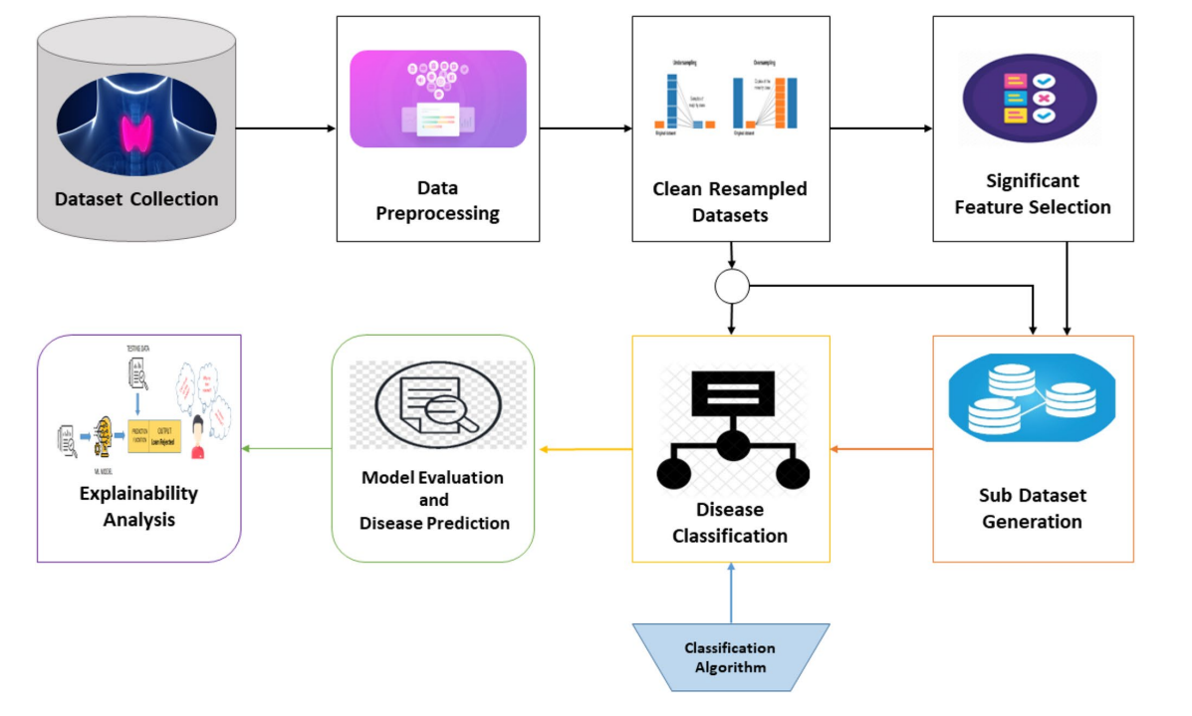
Work Flow
3

Slide 15
Dataset
3
Dataset is collected from UCI repository. The dataset contains 3221 instances with a total of 30 features.
Data sample attribute Types
age | pregnant | goiter | T3_measured | FTI_measured
sex | thyroid_surgery | tumor | T3 | FTI
on_thyroxine | I131_treatment | hypopituitary | TT4-measured | TBG_measured
query_on_thyroxine | query_hypothyroid | psych | TT4 | TBG
on_antithyroidmeds | query_hyperthyroid | TSH_measured | T4U_measured | referral_source
sick | lithium | TSH | T4U | category

Slide 16
Accuracy
3
DT
RF
GBM
90.43%
91.42%
90.5%
NB
KNN
LR
67.86%
86.22%
73.15%
SVM
73.7%

Slide 17
Summary
 | Title | Year | Journal Name | Summary
Paper 1 | Thyroid disease prediction using selective features and machine learning techniques | 2022 | Cancers(MDPI) | RF – 0.99 GBM – 0.98 ADA – 0.97 LR – 0.87 SVM – 0.92
Paper 2 | Detecting thyroid disease using optimized machine learning model based on differential evolution | 2024 | International Journal of Computational Intelligence Systems(Springer) | RF – 0.995 GBM – 0.996 ADA – 0.998 LR – 0.643 SVM – 0.966
Paper 3 | An explainable artificial intelligence framework for the predictive analysis of hypo and hyper thyroidism using machine learning algorithms | 2023 | Human-Centric Intelligent Systems(Springer) | DT – 90.43 RF – 91.42 GBM – 90.5 NB – 67.86 KNN – 86.22 LR – 73.15 SVM – 73.7

Slide 18
Project Proposal
Comparative study of three algorithms.
RF
LR
SVM
Classify thyroid disease under three classes.
assist medical experts
Patients can diagnose their condition without the assistance of a medical expert.
Hypothyroid
Hyperthyroid
No Thyroid

Slide 19
Conclusion
Dataset
Dataset is taken from Kaggle Repository.
9172 samples and every sample has 31 features.
Contains numeric values and Boolean values.
Class labels include letters from A to T which indicates different thyroid conditions.
https://www.kaggle.com/datasets/emmanuelfwerr/thyroid-disease-data

