Slide 1
Thyroid Detection Using Machine Learning
Nikhila Baby
S3 MCA
MAC23MCA-2044

Slide 2
Contents
1. INTRODUCTION
2. LITERATURE REVIEW 1
3. LITERATURE REVIEW 2
4. LITERATURE REVIEW 3
5. SUMMARY
6. PROJECT PROPOSAL
7. CONCLUSION

Slide 3
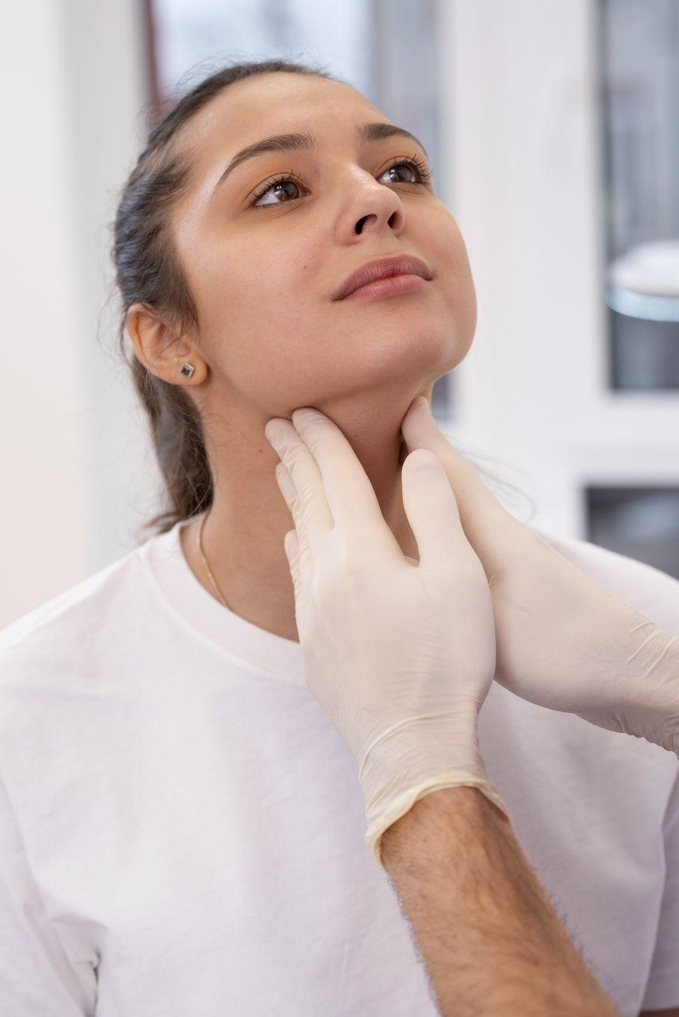
Introduction
The thyroid gland has one of the most important functions in regulating metabolism.
Detection and accurate diagnosis of hypothyroidism and hyperthyroidism.
Aims to utilize machine learning techniques to improve the detection and diagnosis of thyroid diseases.
Develop and train machine learning models using relevant medical data.

Slide 4

Literature Review

Slide 5
Thyroid disease prediction using selective features and machine learning techniques
1
Focuses on enhancing feature engineering techniques for machine learning.
Machine learning models with enhanced feature engineering are more accurate and computationally efficient for detecting thyroid diseases.
Accuracy of all proposed algorithm is arrived to show the best model.

Slide 6
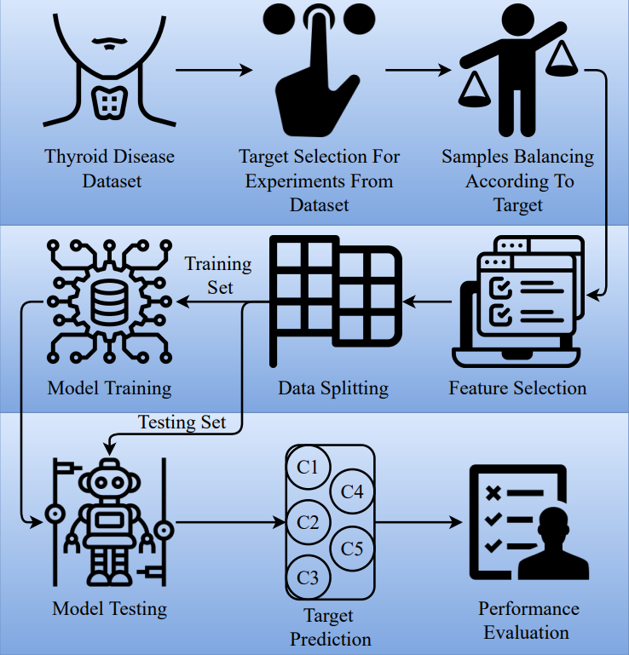
Work Flow
1

Slide 7
Dataset
1
Dataset is collected from UCI repository. The dataset contains 9172 sample observations and each sample is represented by 31 features.
Data sample attribute Types
age | pregnant | goiter | T3_measured | FTI_measured | patient_id
sex | thyroid_surgery | tumor | T3 | FTI
on_thyroxine | I131_treatment | hypopituitary | TT4-measured | TBG_measured
query_on_thyroxine | query_hypothyroid | psych | TT4 | TBG
on_antithyroidmeds | query_hyperthyroid | TSH_measured | T4U_measured | referral_source
sick | lithium | TSH | T4U | Target

Slide 8
Accuracy
1
99%
98%
97%
RF
GBM
ADA
87%
92%
LR
SVM

Slide 9
Detecting thyroid disease using optimized machine learning model based on differential evolution
2
Conditional Generative Adversarial Networks (CGANs) are employed for data augmentation to handle class imbalance effectively.
Hyperparameter optimization is performed using Differential Evolution (DE) algorithm. This algorithm helps to find the best hyperparameter settings for the machine learning models.
Machine learning models are trained on the augmented data.

Slide 10
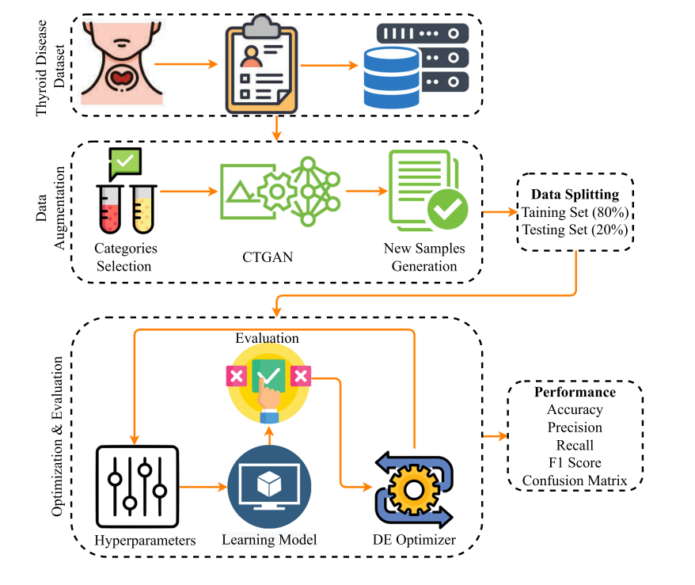
Work Flow
2

Slide 11
Dataset
2
Dataset is collected from Kaggle. The dataset contains 9172 sample observations and each sample is represented by 31 features.
Data sample attribute Types
age | pregnant | goiter | T3_measured | FTI_measured | patient_id
sex | thyroid_surgery | tumor | T3 | FTI
on_thyroxine | I131_treatment | hypopituitary | TT4-measured | TBG_measured
query_on_thyroxine | query_hypothyroid | psych | TT4 | TBG
on_antithyroidmeds | query_hyperthyroid | TSH_measured | T4U_measured | referral_source
sick | lithium | TSH | T4U | Target

Slide 12
Accuracy
2
99.5%
99.6%
99.8%
RF
GBM
ADA
64.3%
96.6%
LR
SVM

Slide 13
An explainable artificial intelligence framework for the predictive analysis of hypo and hyper thyroidism using machine learning algorithms
3
Use machine learning algorithms to predict hypothyroidism and hyperthyroidism based on medical data.
Identifying significant features that enhance the accuracy of disease detection.
Various classification models are tested to classify thyroid diseases.

Slide 14
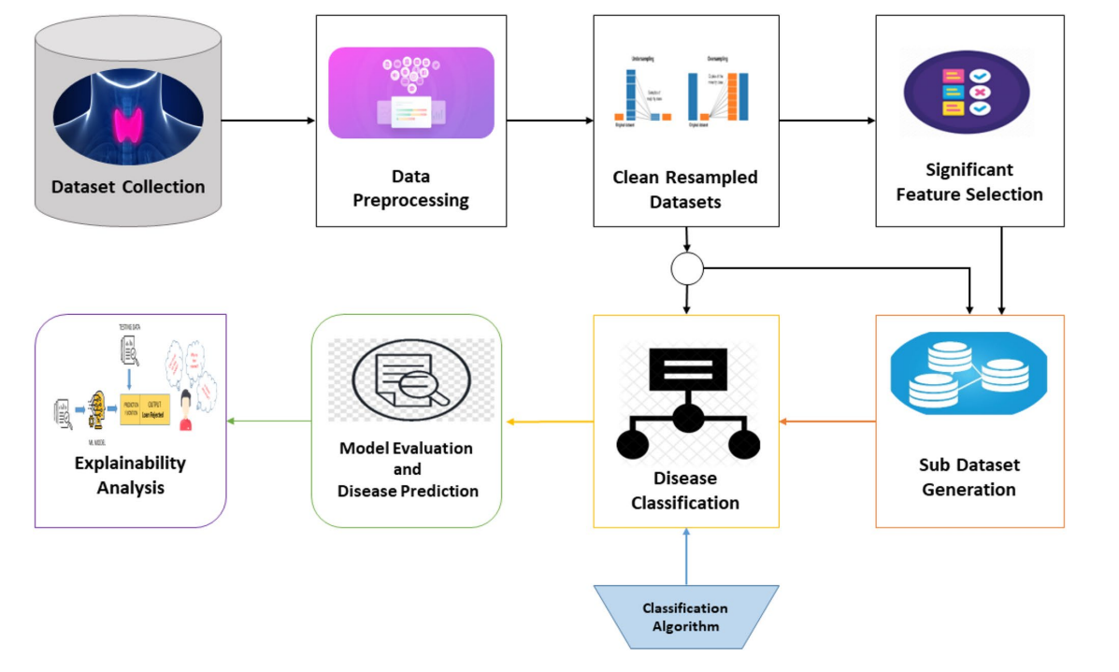
Work Flow
3

Slide 15
Dataset
3
Dataset is collected from UCI repository. The dataset contains 3221 instances with a total of 30 features.
Data sample attribute Types
age | pregnant | goiter | T3_measured | FTI_measured
sex | thyroid_surgery | tumor | T3 | FTI
on_thyroxine | I131_treatment | hypopituitary | TT4-measured | TBG_measured
query_on_thyroxine | query_hypothyroid | psych | TT4 | TBG
on_antithyroidmeds | query_hyperthyroid | TSH_measured | T4U_measured | referral_source
sick | lithium | TSH | T4U | category

Slide 16
Accuracy
3
DT
RF
GBM
90.43%
91.42%
90.5%
NB
KNN
LR
67.86%
86.22%
73.15%
SVM
73.7%

Slide 17
Summary
 | Title | Year | Journal Name | Summary
Paper 1 | Thyroid disease prediction using selective features and machine learning techniques | 2022 | Cancers(MDPI) | RF – 0.99 GBM – 0.98 ADA – 0.97 LR – 0.87 SVM – 0.92
Paper 2 | Detecting thyroid disease using optimized machine learning model based on differential evolution | 2024 | International Journal of Computational Intelligence Systems(Springer) | RF – 0.995 GBM – 0.996 ADA – 0.998 LR – 0.643 SVM – 0.966
Paper 3 | An explainable artificial intelligence framework for the predictive analysis of hypo and hyper thyroidism using machine learning algorithms | 2023 | Human-Centric Intelligent Systems(Springer) | DT – 90.43 RF – 91.42 GBM – 90.5 NB – 67.86 KNN – 86.22 LR – 73.15 SVM – 73.7

Slide 18
Project Proposal
Comparative study of three algorithms.
RF
LR
SVM
Why Random Forest ?
Accuracy
Figure out which features
are most important.
Why Logistic Regression ?
Gives probabilities for each class, helping to understand how confident the model is in its predictions
Why Support vector machine?
Consistently delivers good results especially with high-dimensional data
avoiding overfitting

Slide 19
Project Proposal
Classification of thyroid disease under three classes.
Hypothyroid
Hyperthyroid
No Thyroid
Helpful to medical experts to make disease predictions without any human mistakes.
Patients can diagnose their condition without the assistance of a medical expert.

Slide 20
Dataset
Dataset is taken from Kaggle Repository.
9172 samples and every sample has 31 features.
Contains numeric values and Boolean values.
Class labels include letters from A to T which indicates different thyroid conditions.
Dataset has missing values.
https://www.kaggle.com/datasets/emmanuelfwerr/thyroid-disease-data

Slide 21
Dataset Attributes
age | age of the patient | I131_treatment | whether patient is undergoing I131 treatment
sex | gender of the patient | query_hypothyroid | whether the patient believes they have hypothyroid
on_thyroxine | whether patient is on thyroxine medication | query_hyperthyroid | whether the patient believes they have hyperthyroid
query_on_thyroxine | Whether the patient is queried for thyroxine medication | lithium | whether patient is on lithium
on_antithyroidmeds | whether the patient is on antithyroid medication | goiter | whether patient has goitre
sick | whether patient is sick | tumor | whether patient has tumor
pregnant | whether patient is pregnant | hypopituitary | whether patient has hyperpituitary gland
thyroid_surgery | whether patient has undergone thyroid surgery | psych | whether patient has psychological conditions

Slide 22
TSH_measured | whether TSH was measured in the blood | FTI_measured | whether FTI was measured in the blood
TSH | TSH level in blood from lab work | FTI | FTI level in blood from lab work
T3_measured | whether T3 was measured in the blood | TBG_measured | whether TBG was measured in the blood
T3 | T3 level in blood from lab work | TBG | TBG level in blood from lab work
TT4-measured | whether TT4 was measured in the blood | referral_source | The source of referral
TT4 | TT4 level in blood from lab work | Target | target classification for the patient's thyroid condition.
T4U_measured | whether T4U was measured in the blood | patient_id | unique id of the patient
T4U | T4U level in blood from lab work

Slide 23
Class Labels
Class labels include letters from A to T which indicates different thyroid conditions
Hyperthyroid
Hypothyroid
No Thyroid
A Hyperthyroid
B T3 toxic
C Toxic goitre
D Secondary toxic
E Hypothyroid
F Primary hypothyroid
G Compensated
hypothyroid
H Secondary
hypothyroid
I Increased binding
protein
J Decreased binding
protein
K Concurrent
non-thyroidal illness
L Consistent with
replacement therapy
M Underreplaced
N Overreplaced
O Antithyroid drugs
P I131 treatment
Q Surgery
R Discordant array
results
S Elevated TBG
T Elevated thyroid
hormones

Slide 24
THANK YOU

