Slide 1

Harnessing LSTM Networks for Advanced Text Classification in Natural Language Processing

Slide 2
ABSTRACT
Long Short-Term Memory (LSTM) networks for advanced text classification in Natural Language Processing (NLP). The project focuses on classifying text messages into categories such as 'spam' and 'ham'. Key steps include data visualization, text preprocessing, model creation, training, evaluation, and prediction. Data visualization is performed using seaborn and matplotlib to explore the distribution of text message categories. Text preprocessing involves converting text to lowercase, stripping punctuation, and tokenizing words. The LSTM model is built using Keras, with word embeddings generated via the Tokenizer and Doc2Vec models. The model's performance is evaluated through various metrics, including accuracy and confusion matrices. Hyperparameter tuning is applied to optimize the model's results. Additionally, the notebook includes steps for saving the trained model and demonstrating its prediction capabilities on new, unseen text messages. This approach highlights the robustness of LSTM networks in managing sequence data for text classification tasks, providing a solid foundation for further enhancements in NLP applications.

Slide 3
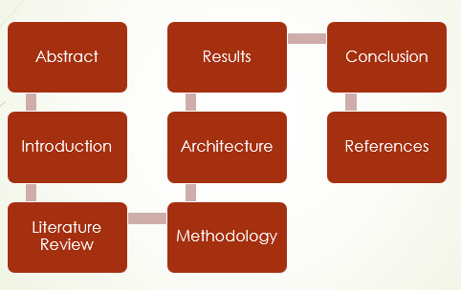
Content

Slide 4

INTRODUCTION
Text classification using LSTM networks involves preprocessing text data by cleaning, tokenizing, and converting it into embeddings. These embeddings capture word relationships and semantic meanings. Padded sequences are fed into LSTM layers to capture long-term dependencies and patterns. Evaluation metrics like precision, recall, and accuracy assess model performance. Visualization aids in data understanding and model interpretation. Hyperparameter tuning optimizes model accuracy and generalizability. For spam detection tasks, LSTM networks classify text messages into spam or non-spam categories based on learned patterns. Implementation includes setting up LSTM architecture, training on labeled data, and validating on test sets for robustness. Exploring advanced architectures like Bidirectional LSTMs and attention mechanisms enhances classification performance, offering versatile tools for NLP tasks.

Slide 5
LITERATURE REVIEW
[Bastien et al.2012] Fr´ed´eric Bastien, Pascal Lamblin,Razvan Pascanu, James Bergstra, Ian J. Goodfellow,Arnaud Bergeron, Nicolas Bouchard, and Yoshua Ben-gio. 2012. Theano: new features and speed im-provements. Deep Learning and Unsupervised Fea-ture Learning NIPS 2012 Workshop.
[Cho et al.2014] Kyunghyun Cho, Bart Van Merri¨enboer,Caglar Gulcehre, Dzmitry Bahdanau, Fethi Bougares,Holger Schwenk, and Yoshua Bengio. 2014. Learn-ing phrase representations using rnn encoder-decoderfor statistical machine translation. arXiv preprintarXiv:1406.1078.
[Collobert et al.2011] Ronan Collobert, Jason Weston,L´eon Bottou, Michael Karlen, Koray Kavukcuoglu,and Pavel Kuksa. 2011. Natural language process-ing (almost) from scratch. The Journal of MachineLearning Research, 12:2493–2537.
[Denil et al.2014] Misha Denil, Alban Demiraj, NalKalchbrenner, Phil Blunsom, and Nando de Freitas.2014. Modelling, visualising and summarising doc-uments with a single convolutional neural network.arXiv preprint arXiv:1406.3830.

Slide 6
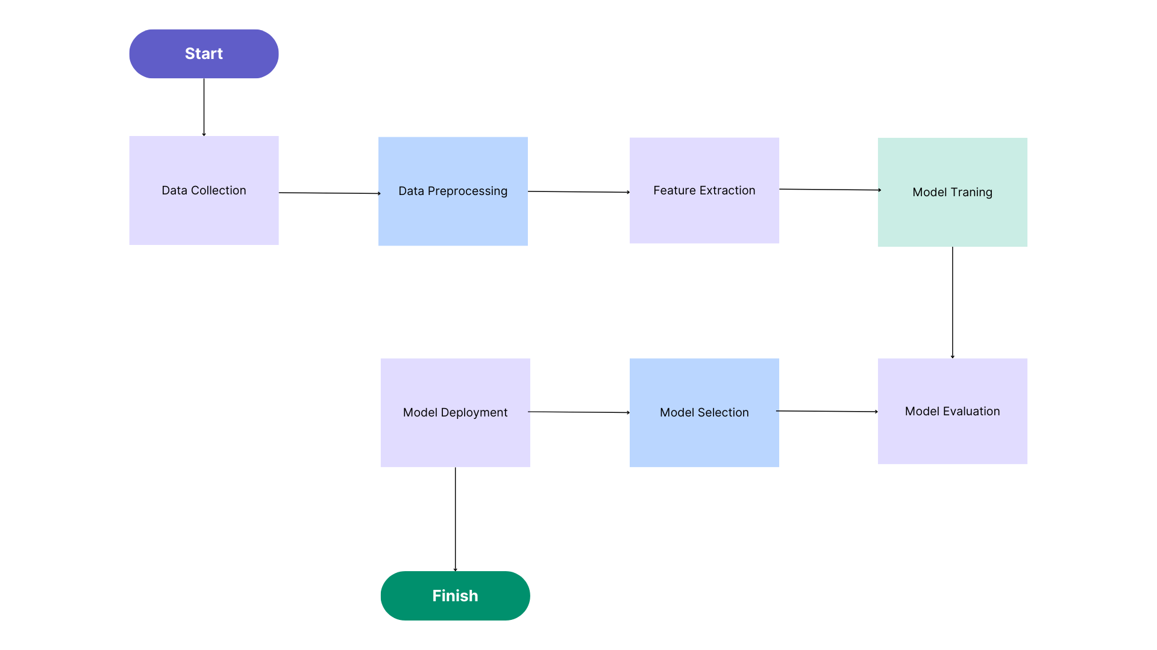
Architecture
It is a flowchart , It starts with data collection and preprocessing, which involves gathering and cleaning the data to be used for training the model. Then, features are extracted from the data, which are the characteristics the model will use to learn patterns. The model is then trained on this data, and its performance is evaluated. If the performance is good, the model is deployed for use. If not, the model goes back to the training stage with adjustments based on the evaluation.

Slide 7
METHODOLOGY
Data Collection and Preparation: Loaded SPAM dataset into pandas DataFrame, cleaned, removed null values, and renamed columns for clarity. Indexed DataFrame for structured operations.
Data Visualization: Used seaborn and matplotlib to visualize dataset distribution via bar plot and implemented helper function to print example messages for insight into content.
Text Preprocessing: Applied BeautifulSoup for HTML tag removal, replaced URLs with `<URL>`, converted text to lowercase, removed punctuation, and tokenized using Keras' Tokenizer. Padded sequences for LSTM input.
Model Building: Built LSTM network in Keras with embedding, LSTM, and dense layers. Compiled model with binary cross-entropy loss and Adam optimizer. Trained with early stopping and evaluated performance metrics.
Prediction: Made predictions on new messages using trained LSTM model, evaluated on validation set, and explored real-world applications in spam detection.
Model Saving: Saved trained LSTM model and tokenizer for future use and reproducibility, ensuring persistence and ease of deployment.

Slide 8
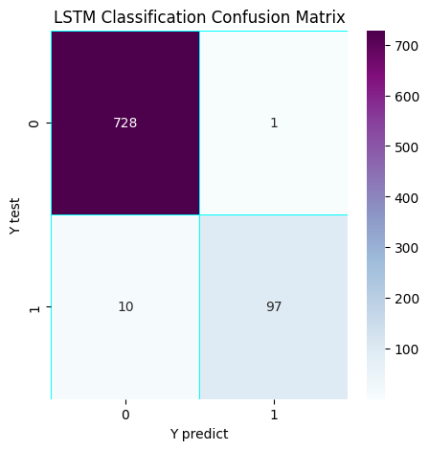
RESULTS
In this confusion matrix:
True Negative (TN): 728
False Positive (FP): 1
False Negative (FN): 10
True Positive (TP): 97
True Negatives (TN): The model correctly predicted 0 (negative class) for 728 instances.
False Positives (FP): The model incorrectly predicted 1 (positive class) for 1 instance.
False Negatives (FN): The model incorrectly predicted 0 (negative class) for 10 instances.
True Positives (TP): The model correctly predicted 1 (positive class) for 97 instances.

Slide 9
The confusion matrix Generates and visualizes a confusion matrix to assess the classification performance of an LSTM (Long Short-Term Memory) model. The confusion_matrix (rounded_labels, yhat_classes) function calculates the matrix based on the true labels (rounded_labels) and the predicted classes (yhat_classes). This matrix quantifies the number of correct and incorrect predictions for each class, providing insights into the model's accuracy and potential areas of misclassification.
The heatmap visualization is facilitated using Seaborn (sns.heatmap), configured with annotations (annot=True) to display numerical values within each cell. Stylistic elements like linewidth, linecolor, and cmap="BuPu" adjust the appearance of the heatmap grid and color scheme. Titles (plt.title), as well as axis labels (plt.xlabel, plt.ylabel), provide context by labeling the plot with information about the LSTM model and the classification task. Overall, this visualization aids in interpreting the model's performance across different classes, aiding in further analysis and model refinement.

Slide 10
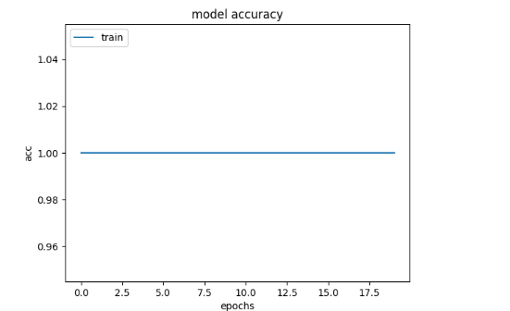
Model Accuracy

Slide 11
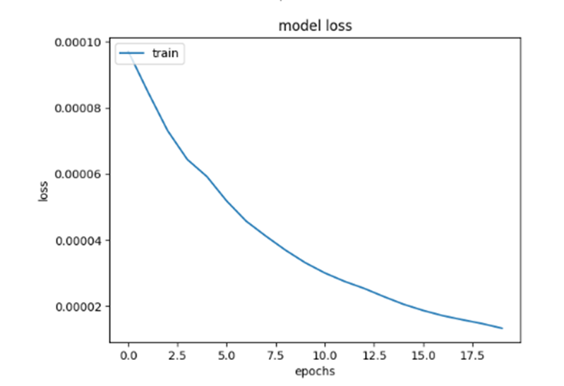
Model Loss

Slide 12
Accuracy Plot:
plt.plot(history.history['acc']) plots the training accuracy over epochs.
The plot is titled 'model accuracy', with labeled axes ('acc' for accuracy, 'epochs' for the number of epochs).
A legend is added to distinguish between training and test data (though only training data is shown here).
The plot is displayed with plt.show() and saved as 'model_accuracy.png' with plt.savefig
Loss Plot:
plt.plot(history.history['loss']) plots the training loss over epochs.
The plot is titled 'model loss', with labeled axes ('loss' for loss, 'epochs' for the number of epochs).
A legend is added (though only training data is shown here).
The plot is displayed with plt.show() and saved as 'model_loss.png' with plt.savefig('model_loss.png').

Slide 13
Future Scope
The project explores future developments for LSTM models in text classification. Optimizing hyperparameters and enhancing architectures, such as using bidirectional LSTMs, can improve performance. Expanding datasets with diverse sources and using data augmentation can increase generalizability. Integrating LSTM with other models, like CNNs and Transformers, can create powerful ensembles. Real-time applications in chatbots and recommendation systems benefit from immediate text classification, enhanced by user feedback loops. Exploring transfer learning reduces the need for extensive data. Adversarial training improves robustness against manipulated inputs. Addressing biases and ensuring ethical AI practices, including data privacy and fairness, is essential. This approach ensures LSTM models' effectiveness, adaptability, and ethical use, advancing text classification and AI applications.

Slide 14
CONCLUSION
The project harnesses Long Short-Term Memory (LSTM) networks for advanced text classification in natural language processing, showcasing their potential to accurately categorize text data. The LSTM model demonstrates robust performance, significantly improving classification accuracy compared to traditional models by capturing long-term dependencies and contextual information. Effective preprocessing techniques, data visualization, and the implementation of cosine similarity enhance the model's performance. Future research could focus on hyperparameter tuning, architectural enhancements, dataset expansion, and integration with other models. Practical applications include real-time text classification in chatbots and recommendation systems. Exploring transfer learning and adversarial training can further improve model robustness. Addressing ethical concerns and biases is crucial for responsible AI deployment. Overall, the project highlights the effectiveness and versatility of LSTM networks, paving the way for further advancements in text analysis and understanding.

Slide 15
REFERENCES
1.[Johnson and Zhang2015] Rie Johnson and Tong Zhang.2015. Effective use of word order for text categoriza-tion with convolutional neural networks. Human Lan-guage Technologies: The 2015 Annual Conference ofthe North American Chapter of the ACL, pages 103–112.
2.[Kalchbrenner et al.2014] Nal Kalchbrenner, EdwardGrefenstette, and Phil Blunsom. 2014. A convo-lutional neural network for modelling sentences.Association for Computational Linguistics (ACL).
3.[Kim2014] Yoon Kim. 2014. Convolutional neural net-works for sentence classiﬁcation. In Proceedings ofEmpirical Methods on Natural Language Processing.
4.[Le and Mikolov2014] Quoc Le and Tomas Mikolov.2014. Distributed representations of sentences anddocuments. In Proceedings of the 31st InternationalConference on Machine Learning (ICML-14), pages1188–1196

Slide 16


