Slide 1

Music Album Management System
Dnyaneshwari Dalvi - 23204007
Parth Talele - 22104134
Atharva Shibe - 22104193
Nikhil Patil - 23204001
Project Guide
Ms. Shweta Mahajan

Slide 2
Contents
Introduction
Objectives
Scope
Literature Survey
Proposed System
Project Outcomes
Block Diagram
E-R/DFD
Technology Stack
Suggestions in Review-1
Result and Discussion
Conclusion and Future Scope
References

Slide 3
1. Introduction
Problem Identified :
Insufficent Organization
Mood based personalization absent
Absence of Data Visualization
Solution Proposed :
Mood based playlists option and recommendation.
Implementation of Data Visualization based on user preference.
.

Slide 4
2. Objectives
To Organize Music Collections
To User-Friendly Interface
To User Authentication and Security
To Playlist Creation and Management
To Artist and Album Details
To integrate Data Visualization

Slide 5
3. Scope
The system allows users to listen to music according to their own preference.
It can be customized to meet the specific needs of different music genres based on moods like, happy, sad, romantic etc.
It can be useful for users to look at what type of music, artist and mood based music they listen to by plotting it in the form of statistics.

Slide 6
4. Proposed System
1. Artist Details :
Manage information about artists, providing a link between albums and the musicians who created them.
2. User Experience Enhancements:
Manage information about artists, providing a link between albums and the musicians who created them.

Slide 7
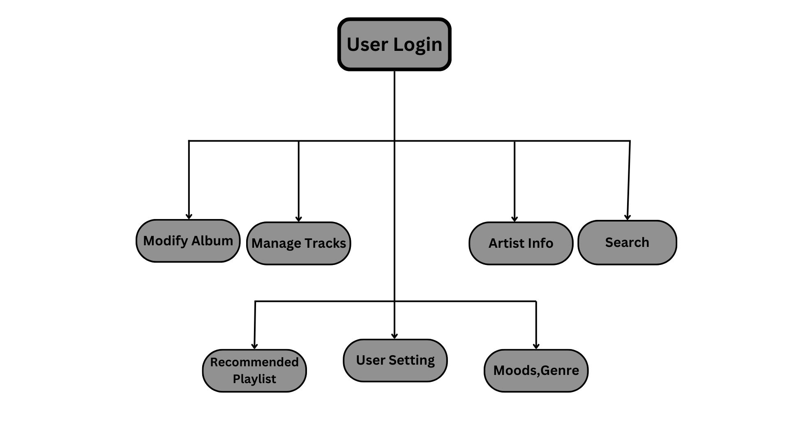
5. Block Diagram

Slide 8
6. Outcome of Project
User Can Login.
User Can Create And Manage Playlists On Their Own.
User Can Also Access Artist Details.
User Can See Album Information:
Music Title
Music Artists
Genre

Slide 9
7. Technology Stack
1.Front End :
HTML, CSS, for building the user interface.
JavaScript for interactive features, especially for asynchronous communication with the backend.
2.Back End :
Python for the backend logic.
A web framework like Django to handle HTTP requests and responses.
3.Data Base :
A MySQL Database to store and retrive data like album, artist and track information.

Slide 10
8. References
https://www.makeuseof.com/tag/manage-music-library
https://youtu.be/JRta1R8lt8o?si=hZZqsptn3D2bUbve

Slide 11
Suggestions Please...
Thank You...!!

