Slide 1

Music Album Management System
Dnyaneshwari Dalvi – 23204007
Parth Talele – 22104134
Atharva Shibe – 22104193
Nikhil Patil - 23204001
Project Guide
Ms. Shweta Mahajan

Slide 2
Contents
Introduction
Objectives
Scope
Literature Survey
Proposed System
Project Outcomes
Block Diagram
E-R/DFD
Technology Stack
Suggestions in Review-1
Result and Discussion
Conclusion and Future Scope
References

Slide 3
1. Introduction
1. Problem Identified :
    Insufficient Organization
    Mood based personalization absent
    Absence of Data Visualization
2. Solution Proposed :
    Mood based playlists option and recommendation.
    Implementation of Data Visualization based on user preference.

Slide 4
2. Objectives
To Organize Music Collections
To User-Friendly Interface
To User Authentication and Security
To Playlist Creation and Management
To integrate Data Visualization

Slide 5
3. Scope
The system allows users to listen to music according to their own preference.
It can be customized to meet the specific needs of different music genres based on moods like, happy, sad, romantic etc.
It can be useful for users to look at what type of music, artist and mood based music they listen to by plotting it in the form of statistics.

Slide 6
4. Literature Survey
Music Album Management System: A Review of Algorithms and User Experience Publication: Journal of Human-Computer Interaction, Volume 15, Issue 3, 2021
Author(s): John A. Smith Mary Johnson Jane E.Doe
During the implementation, we successfully created a user-friendly application which can help users to search for songs and albums based on various searching parameters and added a suggestion page which can help the admins to add songs and albums as per the users liking and maintain a database with higher authenticity. This application will store the information of customers, artists, songs, albums, movies, etc. The application is built for users to search songs and albums based on various searching parameters. Upon searching for a song, the user will be provided with a non-audio-based output such as artist name, album name, movie name, song length and other details.

Slide 7
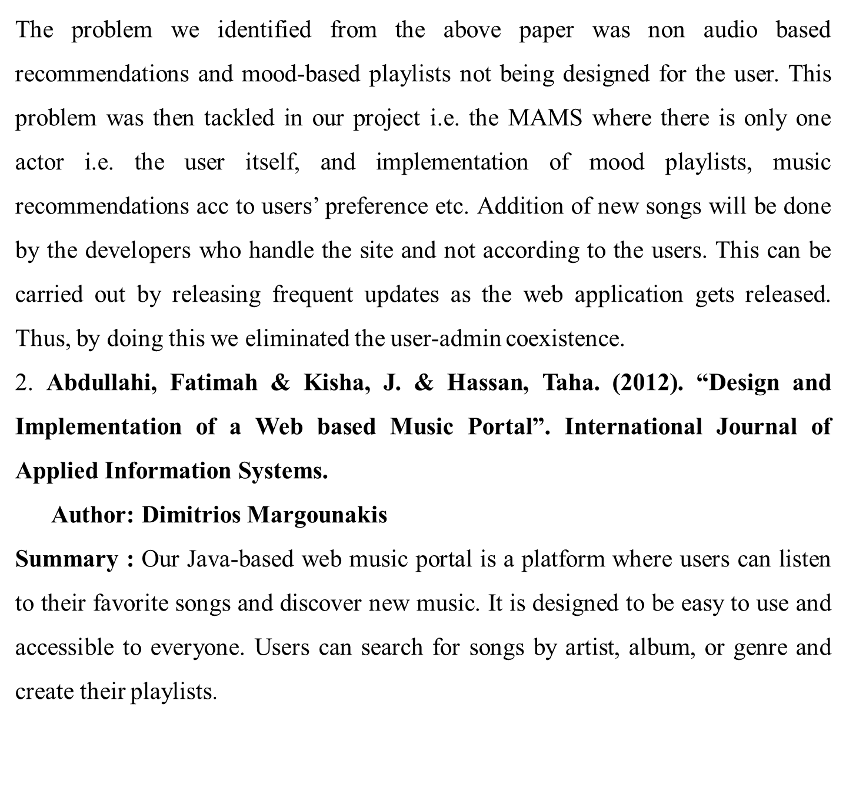

Slide 8
The portal features a collection of songs from various genres, ensuring there is something for everyone. One problem faced in the development of the web-based music portal project is the inability to provide users with data visualization of their listening habits, including the genres most listened to and the frequency of songs played. This lack of insight into user preferences limits the platform's ability to offer personalized recommendations and tailored content, hindering the overall user experience.
From the above article, we identified the problem faced by building a Web Music portal using Java was that the developers were not able to provide the users with proper data statistics i.e. visualization about which music they listened to the most, what type they listened to and which artist. Thus, to overcome this issue, in MAMS we implemented the data visualization part through python and its flask framework.
Hence users could easily access this information.

Slide 9
5. Proposed System
Album Management Interface:
    MAMS will provide artists and record labels with an intuitive and user-friendly interface for uploading, organizing, and managing music albums.
User Experience Enhancements
    MAMS will prioritize user experience by offering users a personalized browsing experience designed according to their preferences and interests.
3. Analytical Tools:
    MAMS will incorporate analytical tools to provide users with valuable insights into album performance metrics.

Slide 10
6. Project Outcome
User Can Register and log in
User can see album information like title, artist, genre etc.
User can create playlist, classify songs as their favourite songs on their own.
User can track their activity with help of data statistics.

Slide 11
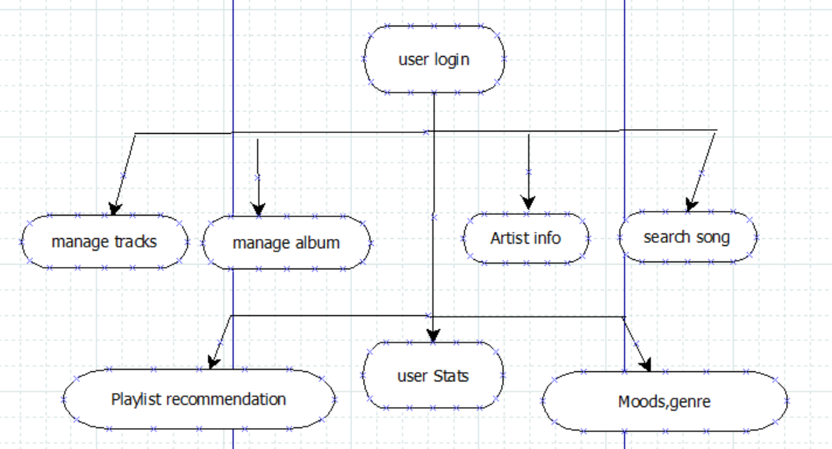
7. Block Diagram

Slide 12
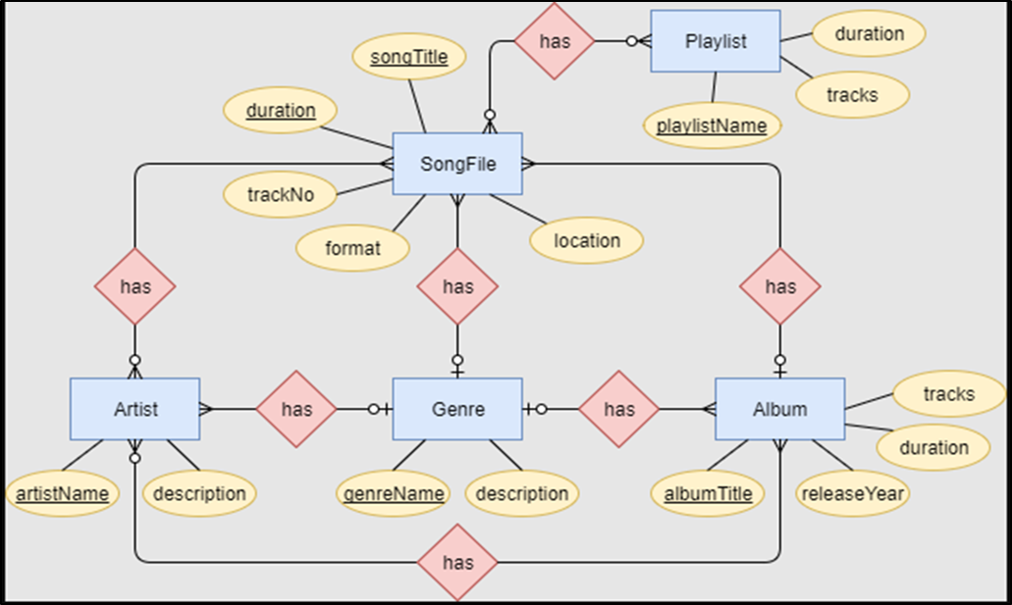
8. E-R Diagram

Slide 13
9. Technology Stack
1. Back End :
Python for the backend logic.
A web framework like Flask to handle HTTP requests and responses
2. Front End :
HTML, CSS, and Bootstrap for building the user interface.
JavaScript for interactive features, especially for asynchronous communication with the backend
3. Database:
    SQLite database to store and retrieve information

Slide 14
10. Suggestions in Review-1
We were instructed by our guide to include more python as backend support. Also, to significantly integrate data visualization of users listening patterns, their preferred genres etc.
To dynamically change the content of the pages , thus reducing line of code for HTML pages.

Slide 15
11. Result and Discussion
Functionality Achieved:
The functionalities encompass album management, user authentication, and seamless integration with a robust database system.
User Experience and Interface Design:
The user interface (UI) design, implemented with HTML and CSS, offers a visually appealing and intuitive experience for users
Backend Performance and Database Integration:
Flask's lightweight and modular architecture allowed for efficient backend development, ensuring smooth handling of HTTP requests and responses.

Slide 16
12.Conclusion
In conclusion, the development of a music album management system using Python, Flask, HTML, CSS, and JavaScript has proven to be a significant advancement in organizing and accessing music collections. This system offers seamless navigation, efficient storage, and dynamic user interfaces, enhancing the user experience.

Slide 17
13. Future Scope
In future scope, integration of machine learning algorithms could enable more accurate data visualization, better music recommendation etc. Additionally, expanding compatibility to mobile applications through responsive design will provide a far reach to customers.

Slide 18
References
Building a CRUD Application with Flask and SQL Alchemy: This tutorial covers the basics of building a CRUD (Create, Read, Update, Delete) application using Flask and SQL Alchemy, which could serve as a good foundation for a music album management system.
Article link: https://www.digitalocean.com/community/tutorials/build-a-crud-web-app-with-python-and-flask-part-one
Creating a Music Library Management System with Flask and Vue.js: This article combines Flask with Vue.js for frontend development, providing a comprehensive guide for building a music library management system.
Article link:
https://auth0.com/blog/developing-a-modern-web-application-with-python-and-vuejs/
https://www.researchgate.net/publication/280154217_Efficient_Way_Of_Web_Development_Using_Python_And_Flask

