Slide 1


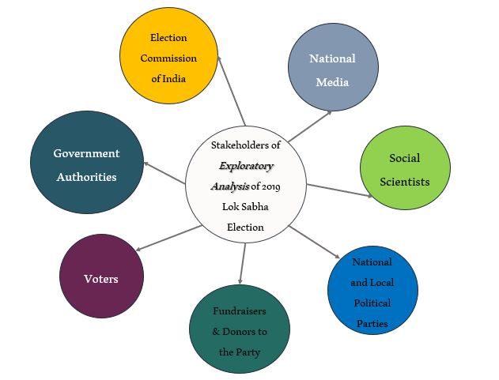
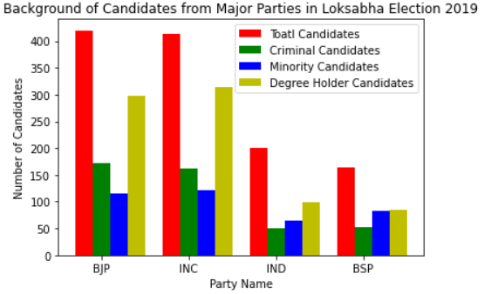
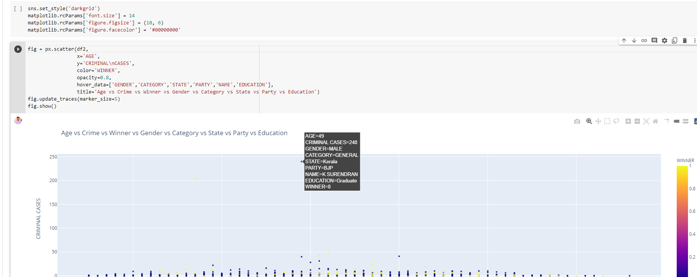

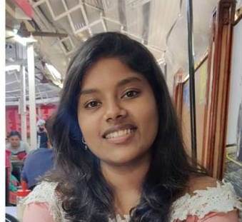

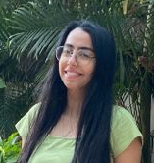

Analyzing profiles of 2019 general election candidates ​
Problem Statement-
1. What are the attributes in analyzing the profile of a candidate?​ 2. What is the distribution of number of election candidates across states and the gender ratio?​ 3. What is the distribution of criminal cases across the states and correlation with their candidate profile?​ 4. What is the age ratio between election candidate across each party and category wise distribution of voters?
Stakeholder Map
Track Name- Track B
(Analytics with Python)
Team Name- Team Phoenix
Team Members-
Namrta Mali ​
Raveeraj Dhage ​
Nikhil Bose ​
Vidhisha Anchan ​
Darshika Kapadia​
Secondary Research
Graphs
Referred the PIB election report for analysis of the dataset we have.
Also reference of news articles for gaining better insights for candidate profiles
Insights
Solution
Based on research and analysis of data the candidate profile that is more likely to win was derived.
Correlation between various aspects bright a holistic view of candidate profile
Provides election candidates a view on the voting behavior of the people.
Team Group Pic –
Prototype
Way Ahead ?
This model has built for 2019 elections, but this model and its functionality are dynamic in nature. So, we can use this model for the analysis of further elections also.
Using the findings to understand if voters are influenced by criminal records of the candidates and deciding to contest for elections accordingly.

Slide 2
Note -
Please make the Poster in the above template – answering the questions
The Placement can be arranged as per the content of your answers
Please use Arial Font.. With Heading Font Size 112, Sub – Heading 60 and Text as 30
The size of Poster is A1. which 59.4cm Width x 89.1 height
Please find the sample Poster and Make it in that manner
You can either use this ppt format or can use indesign/ photoshop/ illustrator or any software.

