Slide 1


Analyzing profiles of 2019 general election candidates
Team Phoenix-
Namrta Mali
Raveeraj Dhage
Nikhil Bose
Vidhisha Anchan
Darshika Kapadia

Slide 2
Problem statement
What factors should be considered while examining a candidate's profile?
How are the number of election candidates distributed between states, as well as the gender ratio?
What is the distribution of criminal cases between states and how does it relate to their candidate profile?
What is the age distribution of election candidates across each party, as well as the distribution of voters by category?

Slide 3
Solution overview
We analyzed the profile of general election candidates based on their state, gender, age, education and criminal history.
We correlated the parameters of gender and age of the election candidates to understand the highest and lowest variables.
After correlating all the parameters, we derived conclusions based on the resulting graphs. Also, with the help of multi-dimensional graphs we got insightful solutions.

Slide 4
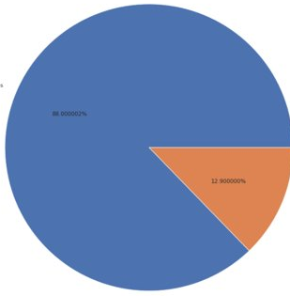
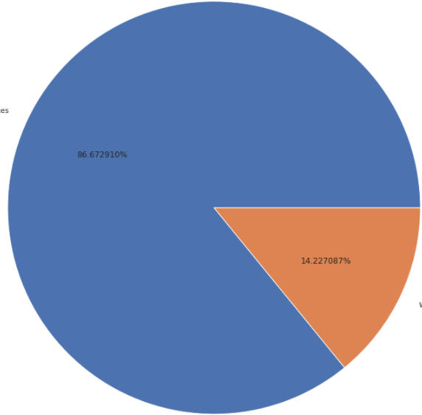
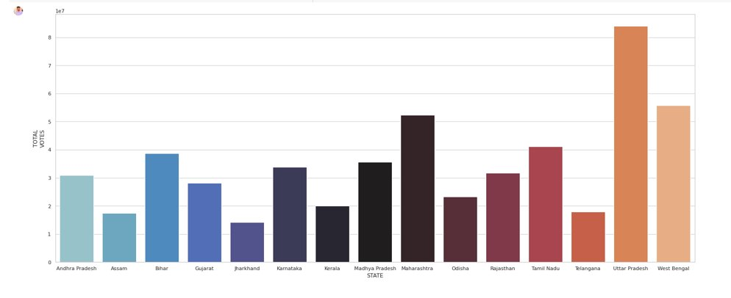
Detailed working
Male
candidates
Winning Male
candidates
Male election candidates outnumbered female candidates by wide margin. While the proportion of female candidates winning elections is higher.
88.00%
86.67%
12.90%
Female
candidates
14.23%
Winning Female
candidates
Uttar Pradesh has the most candidates who have received the most votes, followed by West Bengal and Maharashtra. As a result, penetration is greater in these states. While Jharkhand has the lowest number.

Slide 5
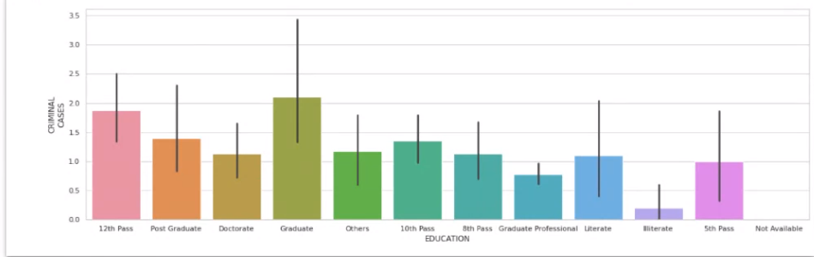
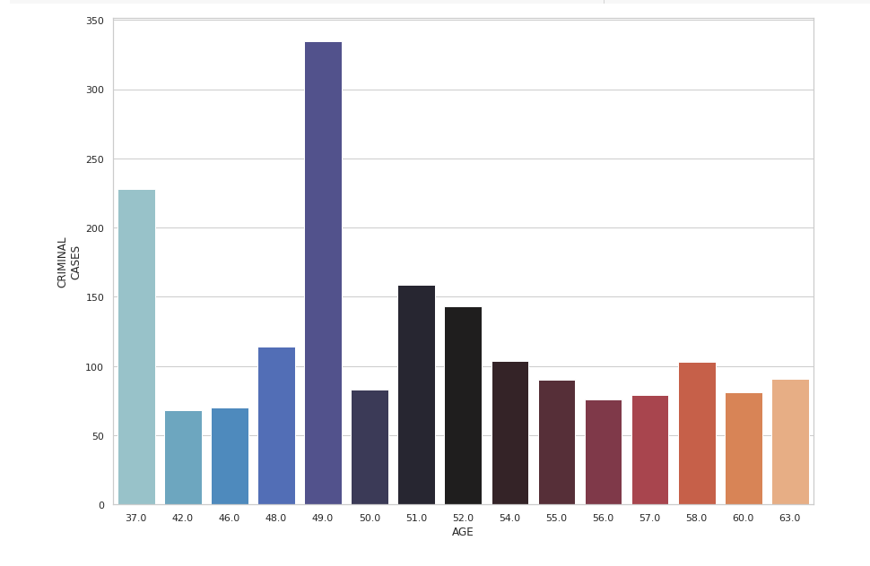
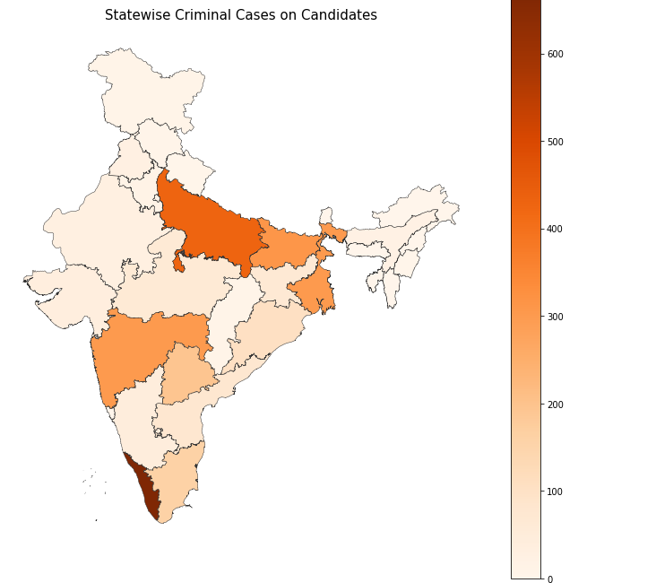
The inference from correlation between criminal cases and education shows that criminal cases are highest among graduates.
The Number of Criminal cases are highest in Kerala followed by U.P. The candidates under 55 years have a lower criminal record than the candidates under 54 years.

Slide 6
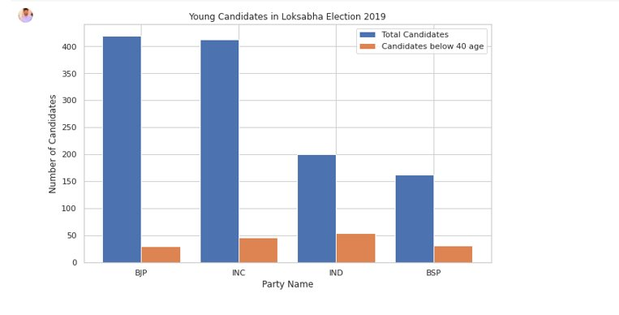
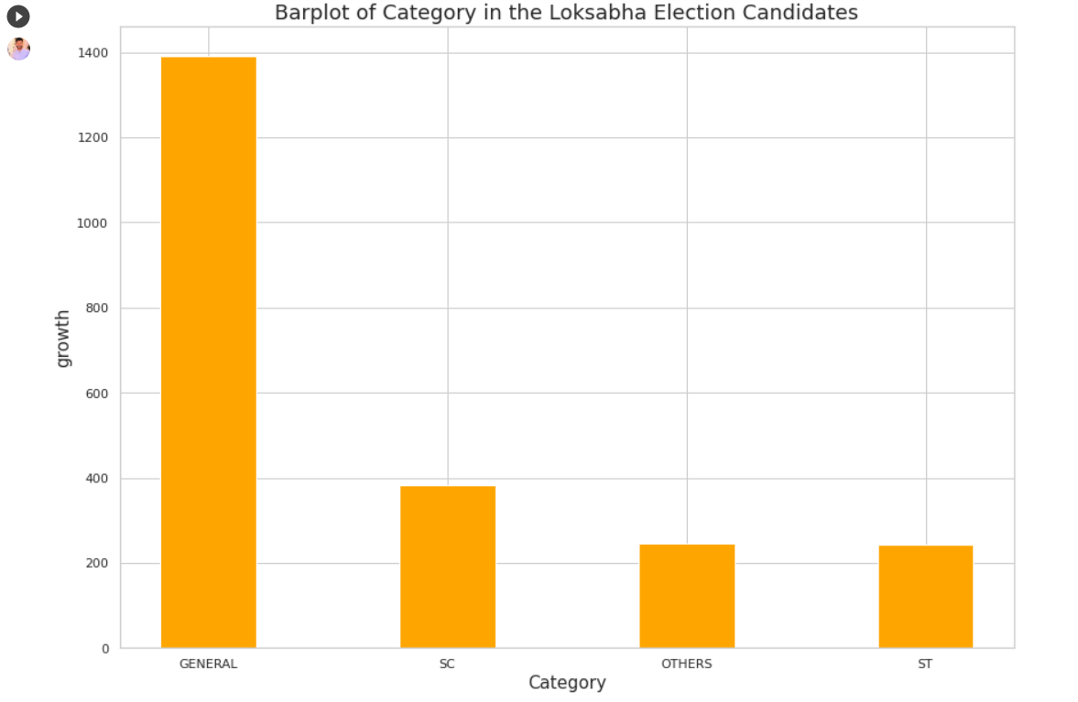
There is a substantially higher number of candidates under 40 years in IND party, while in BJP the number of candidates under 40 years is the lowest.
Dadra and Nagar Haveli and Sikkim has youngest candidates while Chandigarh has eldest candidates.
Of all the candidates the highest category comprises of the general candidates.
The percentage of victorious candidates under 40 years old is 18.3 percent, while it is 28.7 percent for those over 40 years old. This implies that the winning rate of younger candidates is low

Slide 7
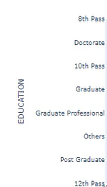
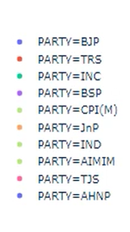
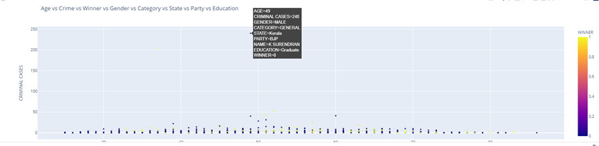
UNIQUENESS OF SOLUTION
Analysis of data through this dynamic chart. Various parameters can be analyzed altogether through this chart. Hovering over the dots would give detailed info for each aspect separately as well.

Slide 8
THANK YOU

