Slide 1
Control System Design
MPC
Fuel Reference
PI
GT
Speed_FuelRef
Min
Temperature_FuelRef

Slide 2
Gas Turbine Schematic
3
Θ
12
20

Slide 3
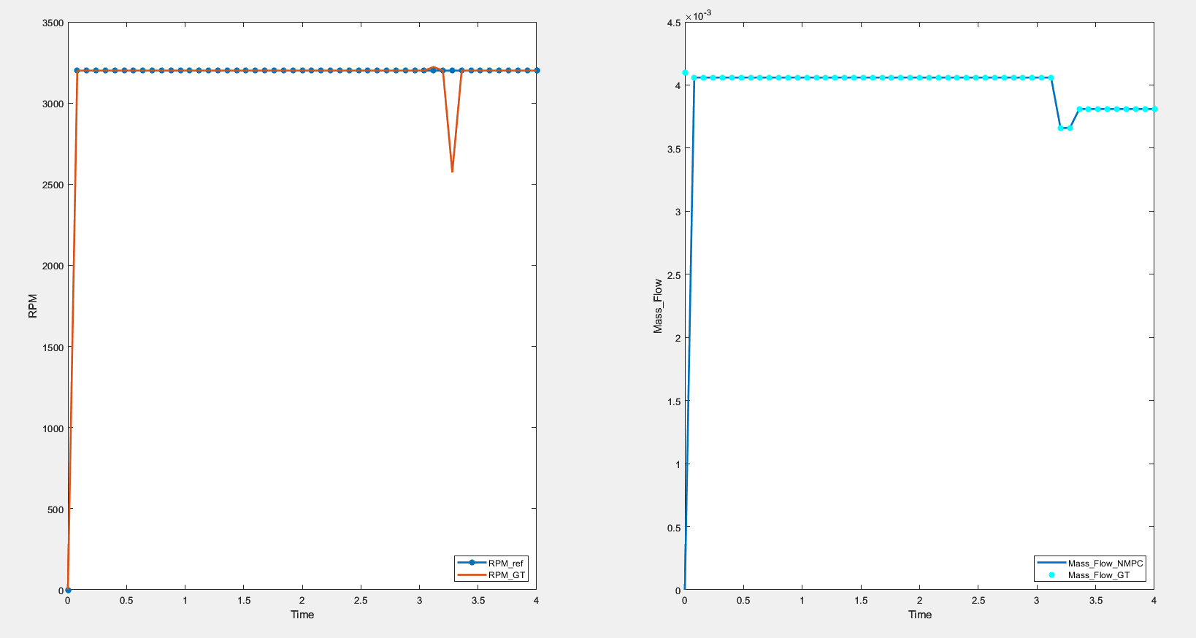
Results

