Slide 1


Taskify: A CLI To-Do List
Cut Distractions, Complete the task!
Presented by
Nikhil Goyal
GitHub
github.com/nikhil-405
edX
edx.com/nikhil_405
Location
Surat, India
Date
May 14, 2024

Slide 2
Add Tasks
Quick Entry
Easily add new tasks with a simple interface

Slide 3
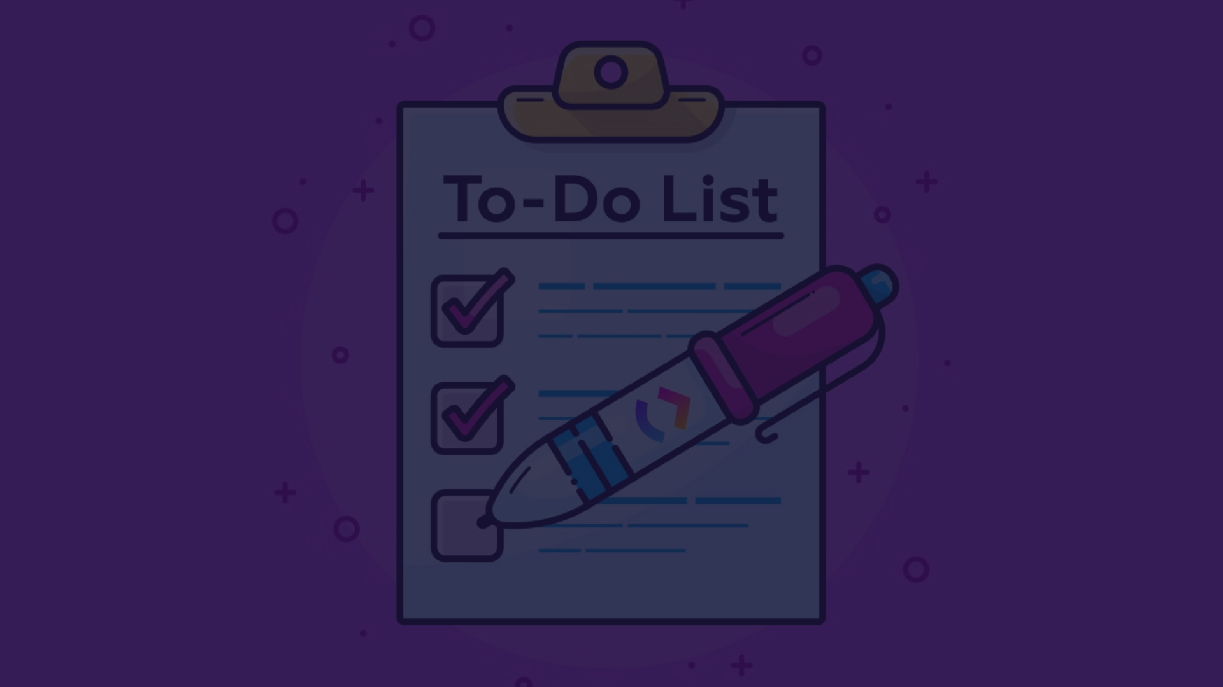
Update Tasks
Edit
Mark Complete
Modify task details like title, notes, and due date
Check off tasks as you finish them
1
2
3
Prioritize
Quickly change the priority of a task

Slide 4
Track Task Status
Dashboard
Filters
Progress Tracking
Get an overview of all your tasks, their status, and due dates
View tasks by category, priority, or completion status
Monitor your productivity and see how many tasks you've completed

Slide 5



Export To-Do as CSV
Export
File Format
Share
Download your to-do list as a CSV file
View your tasks in a spreadsheet application
Easily share your to-do list with others

Slide 6

Conclusion
1
Streamlined Productivity
2
Customizable Features
Taskify helps you stay organized and on top of your tasks
Tailor the app to your specific needs and preferences
3
Cross-Platform Accessibility
Use Taskify on your smartphone, tablet, or computer

