Slide 1

Chaukas AI
Shikayat se Samaadhan tak
A complaint-handling tool for city departments: verify, prioritise, route, and prove the fix.
Team Shivay | National Hackathon 6.0 | COER University, Roorkee | AI & Intelligent Systems
Notes:
PRESENTER: Nikhil (opening, 20 sec).
Hello judges, we are Team Shivay from SD College of Engineering and Technology, Muzaffarnagar. Our product is Chaukas AI. Today we will show you how a citizen photo becomes a prioritised, routed and verified case for the department that must fix it. Everything you will see is running software, and the AI results are real runs recorded on our machine.

Slide 2
THE PROBLEM, FROM THE DEPARTMENT SIDE
Presents: Nikhil
The department inbox is the bottleneck, not the repair crew
Many channels, no single queue
One problem, many tickets
Phone calls, WhatsApp, written applications and helpline tickets all land in different places.
The same pothole is reported by ten neighbours; staff cannot tell one big issue from ten small ones.
No exact spot, no photo
Closed on paper, not on the road
"Near the chowk" means a field visit just to find the location.
Without proof of repair, citizens complain again and trust drops.
Chaukas AI | Team Shivay
2
Notes:
PRESENTER: Nikhil (40 sec).
Most pitches in round one talked about the government in general. Our target is narrower: the department officer who receives the complaints. PWD, Jal Sansthan, Nagar Nigam and the electricity department each have repair crews. What they lack is a clean, prioritised queue with proof. These four problems are what we remove.
If asked for statistics: we do not quote a national number we cannot source. Our claim is about workflow, which you can see in the demo.

Slide 3
OUR CUSTOMER IS THE DEPARTMENT
Presents: Nikhil
Who we build for: the four departments that receive most street complaints
Department | Complaint types | What the department gets from Chaukas AI
PWD | Road damage, potholes | Queue sorted by severity; school-zone potholes first
Jal Sansthan / Jal Nigam | Pipe bursts, water leakage | Leaks with GPS pin, reach the spot before the road collapses
Nagar Nigam / Nagar Palika | Garbage, drainage | Repeat reports merged into one task per spot
Electricity / street lighting | Dark streets, broken lamps, live wires | Live-wire reports always Critical, top of the queue
The citizen is the sensor. The department is the customer. The city office keeps the overview through the dashboard.
Chaukas AI | Team Shivay
3
Notes:
PRESENTER: Nikhil (40 sec).
This is the key change from round one. We are not asking the government to adopt a big platform. We offer each department a tool that makes its own work easier and its results provable. Routing in the prototype is configured for Roorkee and Muzaffarnagar, because that is where we know the department structure. Adding a city means adding one row of department names, not new code.

Slide 4
THE SOLUTION
Presents: Nikhil
From photo to verified closure in five steps
1
2
3
4
5
Capture
Understand
Prioritise
Route
Verify
Photo, GPS, voice or text note in Hindi or English
Vision AI confirms a real civic issue, names category, rates damage
School/hospital nearby, main road, repeat reports, safety words
Right department for that city, with a formal letter (EN + HI)
After-photo checked by AI at the same GPS spot before closing
Complaint creation takes about 12 seconds on our laptop. Closure verification takes 3 to 4 seconds.
Chaukas AI | Team Shivay
4
Notes:
PRESENTER: Nikhil (45 sec), then hand over to Madhav for the live product.
One sentence per step. Stress step five: most civic apps stop at submission. We close the loop, and the department cannot close a case with a fake photo. Timings are from our own recorded runs, not marketing numbers.

Slide 5
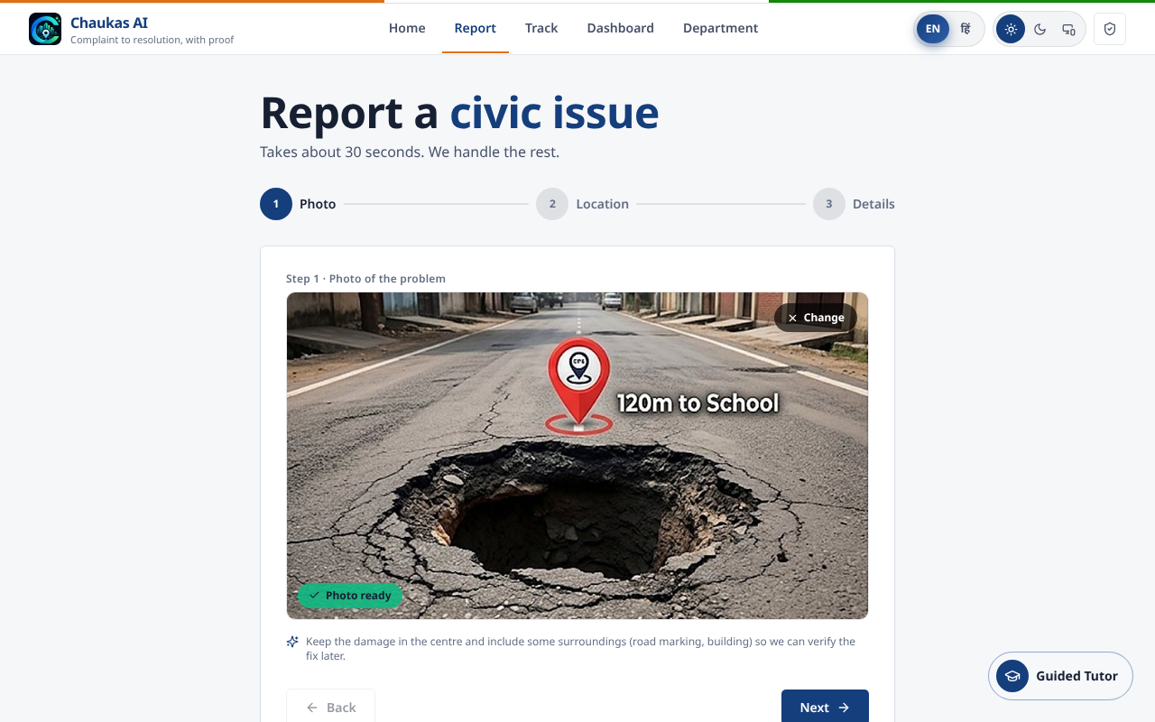
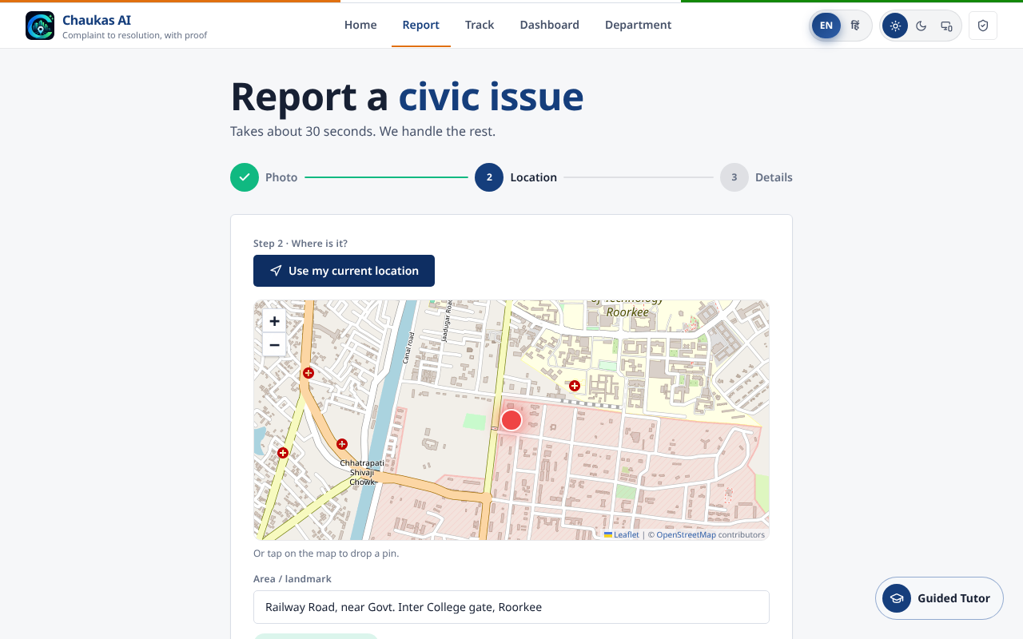
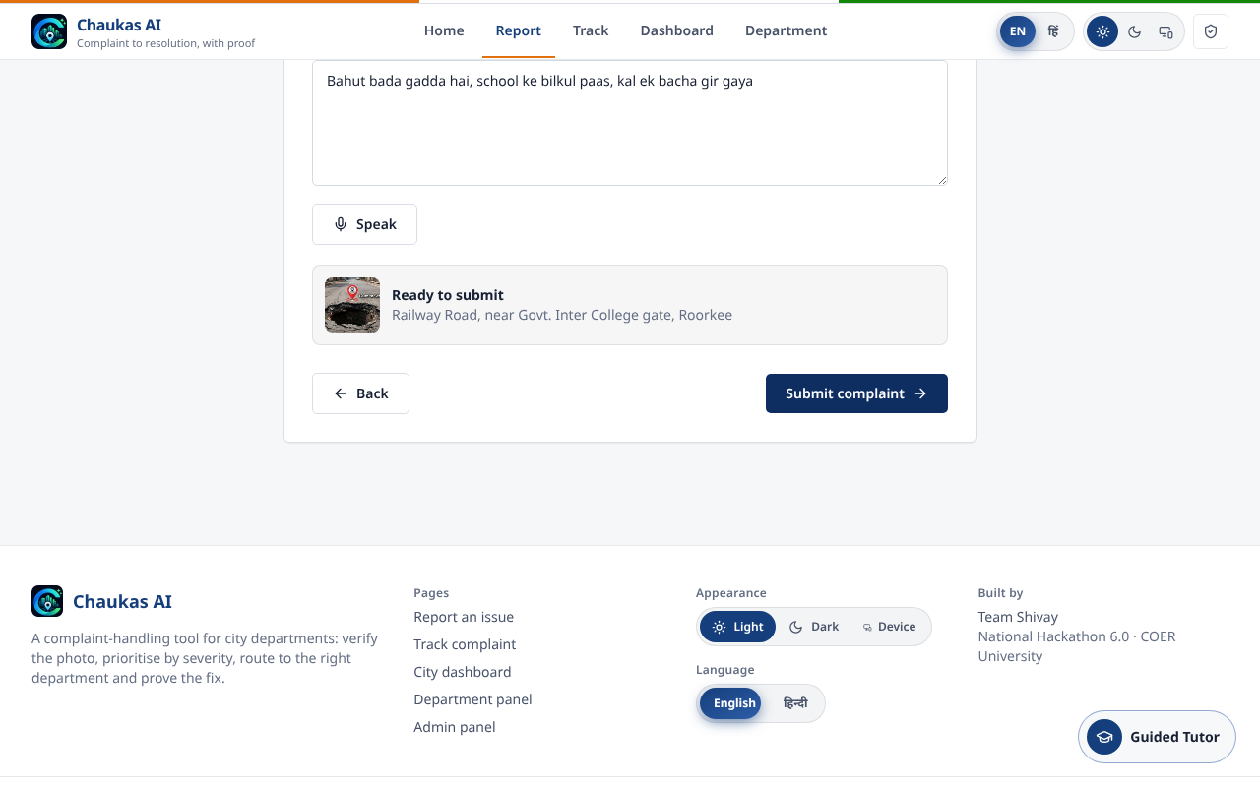
LIVE PRODUCT - REAL SCREENSHOTS
Presents: Madhav
Citizen side: three steps, about thirty seconds
1. Photo
2. Location (GPS or map pin)
3. Note by voice or text
Works on a phone browser and installs as an app; Hindi and English across the whole interface
Voice note in Hindi or Hinglish; guided tutor with spoken instructions for first-time users
Chaukas AI | Team Shivay
5
Notes:
PRESENTER: Madhav (45 sec). Madhav drives the live demo or the video here.
Show the three steps. Mention the Guided Tutor: it speaks Hindi or English, which matters for citizens who are not comfortable with apps.
If the live AI is slow or the laptop hangs, play the recorded video (chaukas_demo.mp4); do not wait. It is the same software.

Slide 6
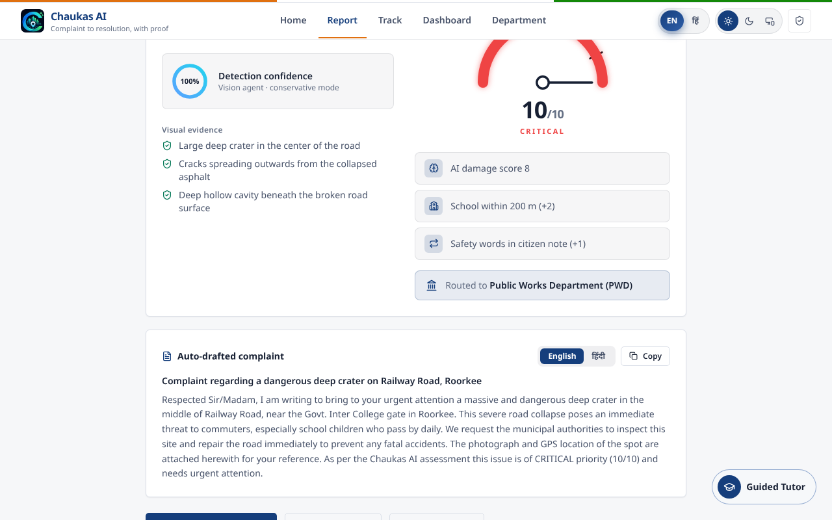
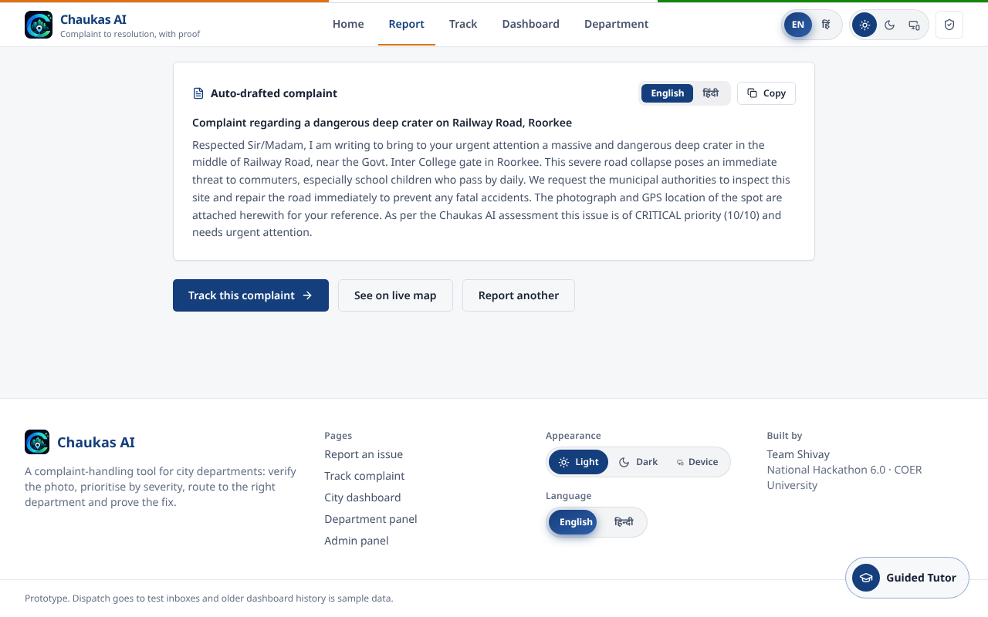
REAL GEMINI RUN, RECORDED - CASE CS-1047
Presents: Madhav
What the AI returns: category, evidence, score, department, letter
Auto-drafted letter; Hindi on one tap
Evidence in the model's own words: "large deep crater", "cracks spreading from collapsed asphalt"
AI score 8 + school within 200 m (+2) + safety words (+1) = 10, Critical; routed to PWD
Result: confidence, visual evidence, severity gauge, routing
Chaukas AI | Team Shivay
6
Notes:
PRESENTER: Madhav (50 sec).
This is a real run of Gemini through our backend, recorded earlier because running a heavy model live on a laptop is risky. The evidence lines are the model's own words, so an officer can see why. The letter is ready to forward.
If asked "is the score hard-coded?": no. Three different photos in the next slides give different scores, from Medium to Critical.

Slide 7
PRIORITY ENGINE
Presents: Abhishek
Severity is explainable: the photo is only the starting point
Signal | Effect | Source
AI damage score from photo | 0 to 10 (extent and safety risk) | Gemini vision
School or hospital within 200 m | +2 | OpenStreetMap, fallback to citizen note
Repeat reports within 50 m | +1 for 2-3, +2 for 4+ | Our database
Main road | +1 | OpenStreetMap
Safety words in note | +1 | Hindi/English keyword match
Open manhole or live wire | Always 10 | AI hazard flag or note
Bands
Critical
9-10
High
7-8
Medium
4-6
Low
0-3
Every point is shown to the officer as a reason line. No black box.
Chaukas AI | Team Shivay
7
Notes:
PRESENTER: Abhishek (50 sec).
The model gives a base score from the image, using a rubric: how big is the damage and how dangerous is it. Our code then adds context the photo cannot show, such as a school nearby. All rules are plain code, so a department can change them.
If asked about OpenStreetMap failing: we time out in 3.5 seconds and fall back to words in the citizen note, so the demo never hangs.
If asked "why not train your own model": for a prototype a vision-language model with a clear rubric is faster, and the rules layer is where local knowledge lives.

Slide 8
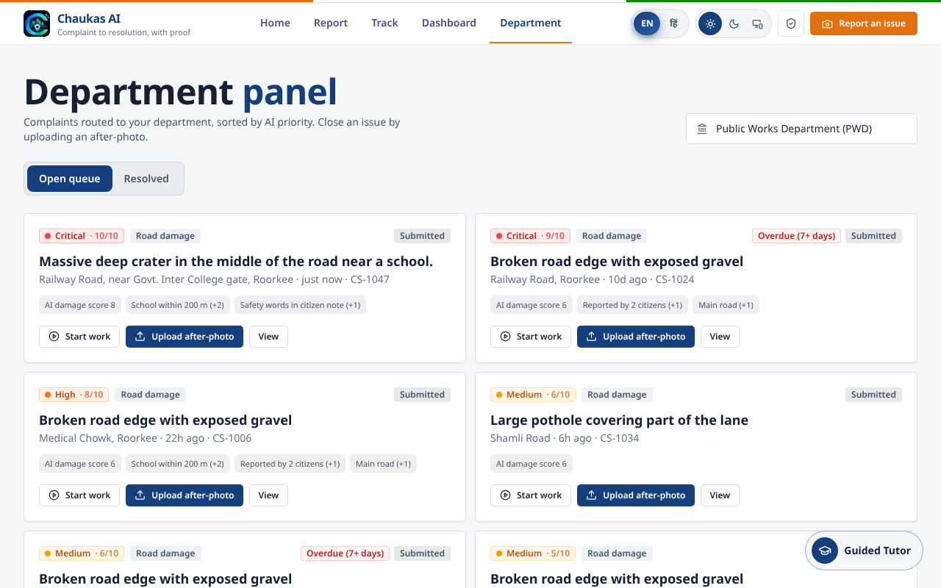
DEPARTMENT VIEW
Presents: Madhav
Department panel: one queue, sorted by priority, with overdue flags
Officer sees only complaints routed to their department
Highest severity first; every card shows why
Cases open 7+ days are flagged Overdue
Start work, then close with an after-photo; no photo, no closure
PWD queue: severity, reasons, start work, upload after-photo
Chaukas AI | Team Shivay
8
Notes:
PRESENTER: Madhav (40 sec).
This is the screen that makes the department a customer. Note the Overdue chip: it gives the supervisor a simple accountability signal.
Honest limit: the panel currently lets you pick the department from a list. In a pilot each department gets its own login; the admin login already exists and uses a server-verified token.

Slide 9
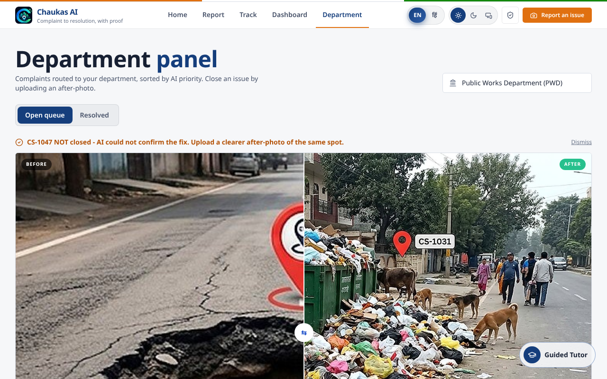
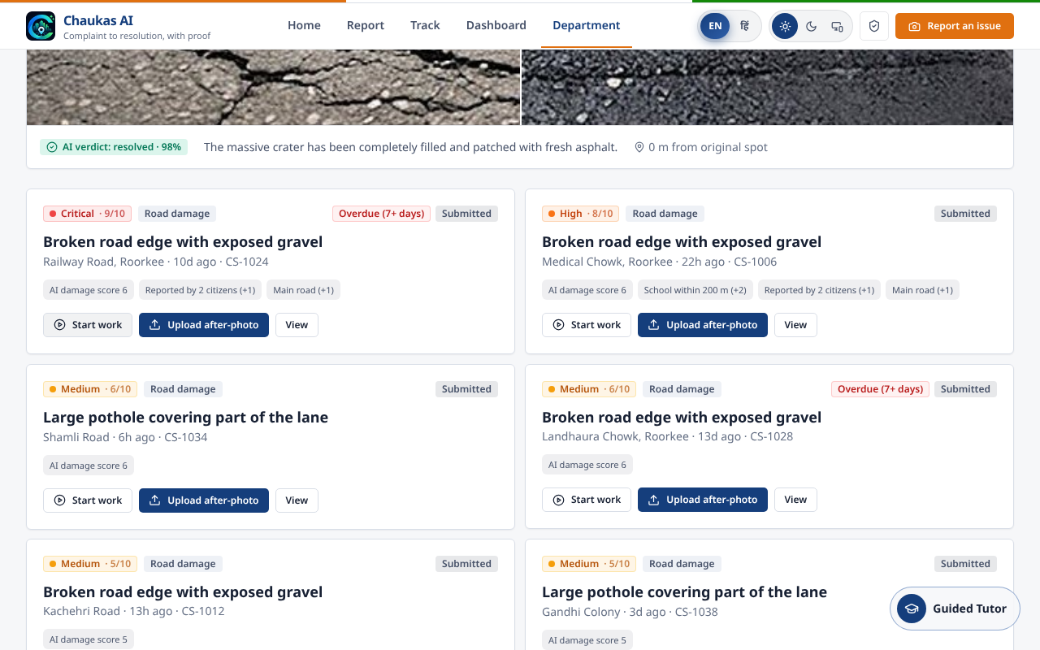
PROOF OF CLOSURE
Presents: Abhishek
Fake fixes are rejected: the AI checks the after-photo
A garbage photo uploaded for a pothole: NOT closed
Correct after-photo: "crater completely filled", 98%, 0 m from spot
Checks: same issue, same place (GPS within 300 m), actually repaired
Wrong or unrelated photo keeps the case open and records the reason
Chaukas AI | Team Shivay
9
Notes:
PRESENTER: Abhishek (50 sec).
This is our strongest differentiator. In our recorded run we first uploaded an unrelated garbage photo as the "after" image. The AI said: unrelated garbage issue at a different location, not resolved, and the case stayed open. Then the right photo was accepted with 98 percent confidence.
Be honest if asked: a determined person could stage a photo of a different repaired road at the same GPS point; the GPS check and the model reduce this but do not make it impossible. A second layer (citizen confirmation) is on the roadmap.

Slide 10
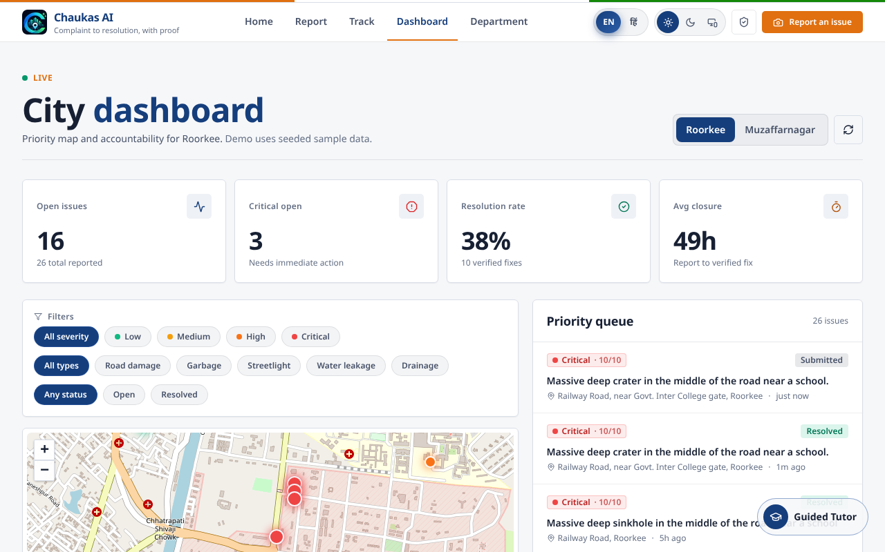
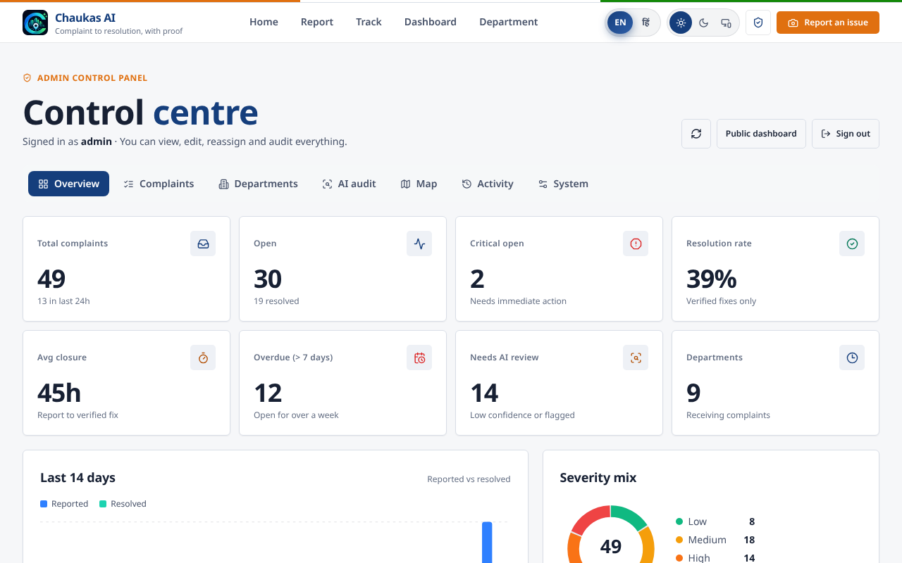
MONITORING
Presents: Avni
City dashboard and admin panel: accountability for the whole city
Priority map and queue (Roorkee)
Admin overview with audit log
Open, critical, resolution rate and average closure time per city
Map pins coloured by severity; filters by type and status
Admin: edit status, add notes, delete, full audit trail
Chaukas AI | Team Shivay
10
Notes:
PRESENTER: Avni (40 sec).
Show the map and the filters. Mention that older history in the demo is sample data that we seeded to make the dashboard readable; new complaints you saw are live. We label this in the product footer so we do not mislead anyone.

Slide 11
REAL AI RESULTS FROM OUR RECORDED SESSION
Presents: Abhishek
Different photos, different scores: real runs, not canned output
Case | Category | AI score | Final score | Level | Routed to
CS-1047 | Road damage | 8 | 10 | Critical | PWD
CS-1048 | Garbage | 7 | 8 | High | Municipal Corp - Sanitation
CS-1049 | Water leakage | 6 | 7 | High | Jal Sansthan
CS-1050 | Streetlight | 5 | 6 | Medium | Municipal Corp / UPCL
Model: Gemini 3.5 Flash. Test set: our four sample photos, one per category. This is a demonstration, not an accuracy study.
Chaukas AI | Team Shivay
11
Notes:
PRESENTER: Abhishek (40 sec).
These four rows are exactly what our backend returned in the recorded session. The difference between the AI score and the final score is the context rules. We are not claiming an accuracy percentage; four photos cannot support one. For a pilot we would measure agreement between officers and the AI on a few hundred real complaints.

Slide 12
TECHNOLOGY
Presents: Smriti
Architecture: simple, deployable on one small server
Citizen app / website
API
Vision agent
React + Vite + Tailwind, PWA, Hindi and English
>
FastAPI (Python), rate limits, JWT admin
>
Gemini 3.5 Flash through KodeKey, one structured call
MongoDB Atlas
OpenStreetMap (Overpass)
Dispatch hook
Complaints, audit log, images; local-file fallback keeps the demo alive
School, hospital, road class near the spot; 3.5 s timeout
n8n / webhook for email or WhatsApp to the department
Why Gemini is not run on our laptop: it is a hosted model called through an API. The laptop only runs the web app and a light Python server.
Chaukas AI | Team Shivay
12
Notes:
PRESENTER: Smriti (40 sec).
Smriti explains the database: MongoDB stores complaints, audit entries and the photos. If the database cannot be reached the system falls back to a local file, so nothing crashes during a demo.
For judges: AI runs in the cloud through an API, the laptop does not need a GPU. Our backend is stateless apart from the database, so it can be deployed on a small server. Admin passwords and the JWT secret are environment variables and must be changed before any real deployment.

Slide 13
PATH TO ADOPTION (PROPOSAL, NOT YET VALIDATED)
Presents: Nikhil
Pilot plan and how this can sustain itself
Phase 1: Pilot (90 days)
Phase 2: Department licence
Phase 3: City rollout
One city, one or two departments, free. Success measures: time from report to assignment, repeat-complaint rate, share of cases closed with verified proof.
Per-department yearly subscription, priced by ward count, covering hosting, AI usage and support. Price to be set after the pilot.
Add departments and wards; municipal dashboard for the commissioner; integration with existing helplines.
We have not signed any department yet. The plan above is what we would propose; the numbers will come from the pilot.
Chaukas AI | Team Shivay
13
Notes:
PRESENTER: Nikhil (50 sec).
Be direct: no department has signed. We would approach through the municipal commissioner, PWD executive engineer and Jal Sansthan office with a free pilot. The business model is a department licence because the department gets the benefit. Cost side is small: hosting plus AI calls per complaint. Do not quote revenue numbers you cannot defend.
Likely judge question: "why will a department use this?" Answer: it reduces duplicate tickets and field visits, and the closure proof protects them from repeat complaints.

Slide 14
HONEST LIMITATIONS AND ROADMAP
Presents: Member 6
What is not done yet, and what we do next
Current limits
Next 90 days
Routing is configured for Roorkee and Muzaffarnagar only
Department panel needs per-department logins
Older dashboard history is seeded sample data
AI needs internet; photos are not yet compressed on device
Department logins and SLA timers
WhatsApp intake and status messages
Citizen confirmation after closure
Measure AI against officer judgement on real complaints
Pilot with one department
Chaukas AI | Team Shivay
14
Notes:
PRESENTER: Member 6 (30 sec).
Saying our limits openly builds trust with judges. Read the left side quickly, spend more time on the right side, then hand back to Nikhil for the team slide.

Slide 15
THE TEAM
Presents: Nikhil introduces all six
Team Shivay
N
Nikhil Tomar
M
Madhav Katyayan
A
Abhishek Pundir
Team lead. Backend, analytics, business plan, main pitch
Frontend and integrations; co-presenter, leads judges' questions
AI vision agent, severity and verification logic
S
Smriti Gupta
A
Avni Rajput
?
[Member 6 name]
MongoDB database, data and testing support
Maps, dashboard and remaining support work
[Role: e.g. demo operator, testing, documentation]
B.Tech CSE final year, SD College of Engineering and Technology, Muzaffarnagar
Chaukas AI | Team Shivay
15
Notes:
PRESENTER: Nikhil (20 sec). Each member stands or raises a hand when named. EDIT THIS SLIDE: replace "[Member 6 name]" and the role before the final round.

Slide 16
We make the department's queue clear, and its work provable.
Ask: a pilot with one department in Roorkee or Muzaffarnagar.
Live demo and recorded 45-second video available now.
Thank you. Questions?
Chaukas AI | Shikayat se Samaadhan tak | Team Shivay
Notes:
PRESENTER: Nikhil closes (20 sec), then Madhav leads Q&A.
Close with the ask. Do not add new claims.

