Slide 1
Information Systems
UNIT I
Basic of Management
Theory & Practices

Slide 2
Outline
Definitions
Types of Information Systems
Information Systems Vs Information Technology
Expanding Roles of IS
Classification of IS
Enterprise Resource Planning
Information Systems Development
IS as Discipline
Information systems: Opportunities and Challenges
Conclusion

Slide 3
Definitions
Data
Raw facts such as an employee’s name and number of hours worked in a week, inventory part numbers or sales orders.
Information
A collection of facts organized in such a way that they have additional value beyond the value of the facts themselves.
Information
Data
$35,000 12 Units $12,000 J. Jones Western Region $100,000 100 Units 35 Units
Salesperson: J. Jones Sales Territory: Western Region Current Sales: 147 Units = $147,000
Data Processing

Slide 4
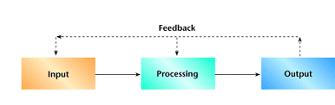
Definitions
Information Systems
An information system(IS) is typically considered to be a set of interrelated elements or components that collect(input), manipulate(processes), and disseminate (output) data and information and provide a feedback mechanism to meet an objective.
Open System
Close System

Slide 5
Types of Information Systems
Informal Information System - Based on organization represented chart
Formal Information System – Based on employee based system design to meet personal needs and help in the solutions of work related problems

Slide 6
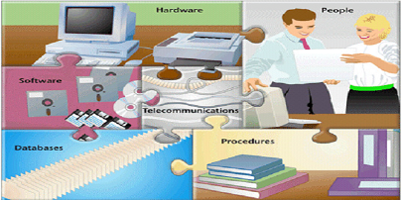
Computer-based Information System
An Information System is an organized combination of people, hardware, software, communication networks and the data resources that collects, transforms and disseminates information in a organization.

Slide 7
IS Vs IT
Payroll System
INFORMATION TECHNOLOGY
Hardware
Software
Databases
Networks
Other related components
Inventory System
are used to build
INFORMATION SYSTEMS
Marketing System
Customer Service System

Slide 8
Payroll system
A payroll system is software designed to organize all the tasks of employee payment and the filing of employee taxes.
These tasks can include keeping track of hours, calculating wages, withholding taxes and deductions, printing and delivering checks and paying employment taxes to the government.

Slide 9
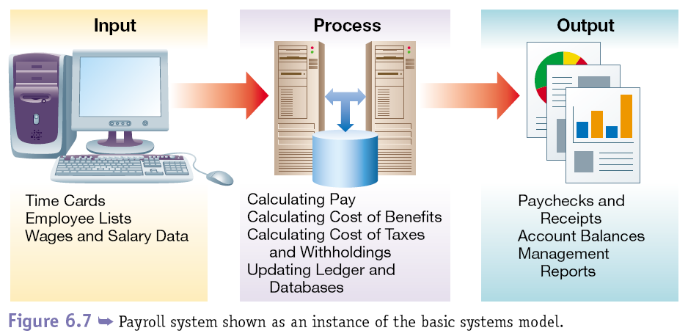
TPS payroll system
9

Slide 10
Inventory System
Inventory management is a discipline primarily about specifying the shape and placement of stocked goods.
It is required at different locations within a facility or within many locations of a supply network to precede the regular and planned course of production and stock of materials.
The concept of inventory, stock or work-in-process has been extended from manufacturing systems to service businesses and projects
By generalizing the definition to be "all work within the process of production- all work that is or has occurred prior to the completion of production." .

Slide 11
Marketing System
A market system is a place (virtual or physical) that facilitates the matching of buyers and sellers.
Many markets exist, and each can be defined based on a number of characteristics, such as what is being exchanged in the market, the regulations, who is allowed to participate, and how transactions occur.

Slide 12
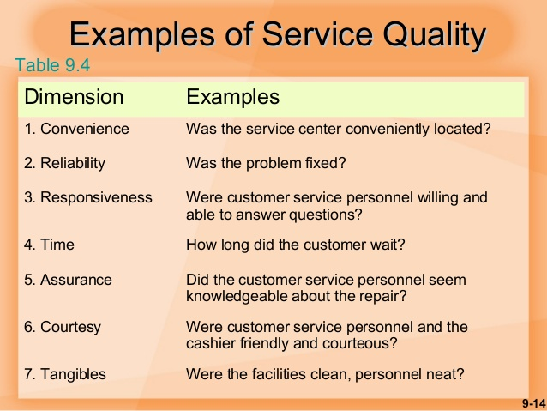

Slide 13
Customer service system
A service system (or customer service system, CSS) is a configuration of technology and organizational networks designed to deliver services that satisfy the needs, wants, or aspirations of customers.

Slide 14
Expanding Roles of IS
Data Processing: 1950s-1960s
Management Reporting: 1960s-1970s
Decision support: 1970s-1980s
Strategic and End User Support: 1980s-1990s
Global Internetworking: 1990s-2000s

Slide 15
Classification of IS
Information Systems
Operations Support System
Management Support System
Transaction processing systems
Office automation systems
Management information systems
Decision support systems
Executive information systems
Process control systems

Slide 16
1. Operations support systems process data generated by business operations
Major categories are:
i) Transaction processing systems
ii) Process control systems
iii) Office automation systems
2. Management Support Systems provide information and support needed for effective decision making by managers
Major categories are
Management Information System
Decision Support Systems
Executive Information System

Slide 17
Transaction processing System
Transaction processing is a style of computing that divides work into individual, indivisible operations, called transactions.
A transaction processing system (TPS) or transaction server is a software system, or software/hardware combination, that supports transaction processing

Slide 18
Batch processing
Batch processing is execution of a series of programs (jobs) on a computer without manual intervention. Several transactions, called a batch are collected and processed at the same time. The results of each transaction are not immediately available when the transaction is being entered; there is a time delay.

Slide 19
Real-time processing
Real time systems attempt to guarantee an appropriate response to a stimulus or request quickly enough to affect the conditions that caused the stimulus."[9] Each transaction in real-time processing is unique; it is not part of a group of transactions.

Slide 20
Transaction processing
A Transaction Processing System (TPS) is a type of information system that collects, stores, modifies and retrieves the data transactions of an enterprise.
Transaction processing systems also attempt to provide predictable response times to requests, although this is not as critical as for real-time systems.

Slide 21
Examples of transaction processing systems
Include payroll, order processing, reservations, employee records, accounts payable and accounts receivable.
These systems collect and store data about transactions, which are activities that change stored data. For example, using a credit card, reserving a flight and ordering products from a catalog are transactions.

Slide 22
Operations Support System
i) Transaction processing systems
Process business exchanges
Maintain records about the exchanges
Handle routine, yet critical, tasks
Perform simple calculations
ii) Process control systems monitor and control industrial processes.
iii) Office automation systems automate office procedures and enhance office communications and productivity.

Slide 23
2. Management support systems provide information and support needed for effective decision making by managers
Major categories are:
Management information systems
Routine information for routine decisions
Operational efficiency
Use transaction data as main input
Databases integrate MIS in different functional areas

Slide 24
ii) Decision Support System
Interactive support for non-routine decisions or problems
End-users are more involved in creating a DSS than an MIS
iii) Executive information systems
provide critical information tailored to the information needs of executives

Slide 25
Other categories
Expert systems
End user computing systems
Business information systems
d) Strategic information systems
a) Expert Systems are knowledge-based systems that provides expert advice and act as expert consultants to the users
b) End user computing systems support the direct, hands on use of computers by end users for operational and managerial applications
c) Business information systems support the operational and managerial applications of the basic business functions of a firm
d) Strategic information systems provide a firm which strategic products, services, and capabilities for competitive advantage

Slide 26
Enterprise Resource Planning (ERP)
Integrated programs that can manage a company’s entire set of business operations
Often coordinate planning, inventory control, production and ordering

Slide 27
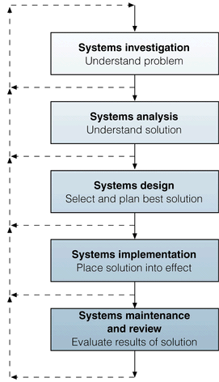
Information Systems Development

Slide 28
IS as Discipline
IS is an interdisciplinary field influenced by Computer Science, Political Science, Psychology, Operations Research, Linguistics, Sociology, and Organizational Theory.

Slide 29
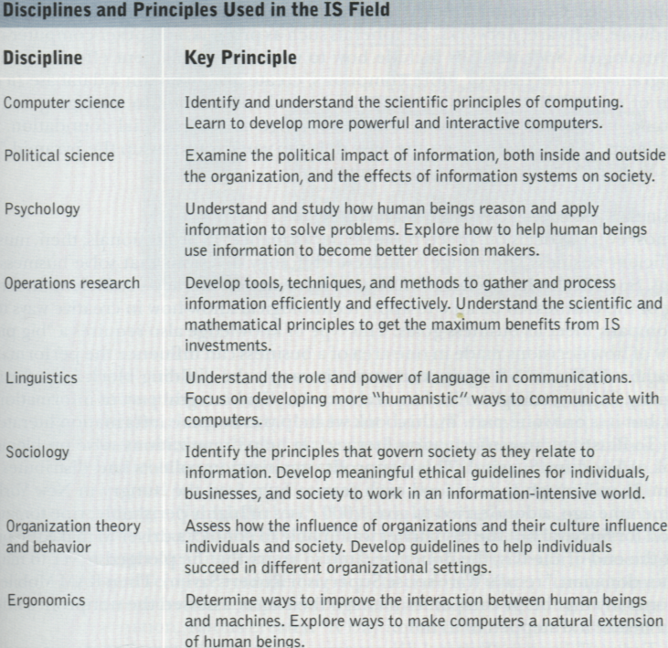

Slide 30
Challenges
Workforce downsizing
Information overload
Employee mistrust
Difficult to built
Security breaches

Slide 31
Opportunities
Enhanced global competitiveness
Capture market opportunities
Support corporate strategy
Enhance worker productivity
Improve quality of goods and services

Slide 32
Conclusion
Information Systems are indispensable to the business, industry, academia and any organization to meet the future challenges

