Slide 1

Introduction to AngularJS

Slide 2
Agenda
The current system and what’s wrong
What is AngularJS?
Why AngularJS?
How it is what it is?
The Architecture - MVVC
Services and dependency injection
Routing and multiple views
Filters
Directives
Form Validation
Using Grails as backend for REST API

Slide 3
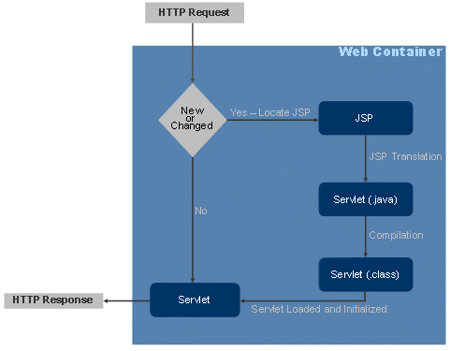
The current system
Current web container life cycle

Slide 4
OK! But what’s wrong with it?
More page load time as every page request is a completely new request
A new request involves all the overheads such as connection time, DNS lookup time, page generation, network latency etc.
Pages are similar in most respects especially header and footer; only minor portions of the page change

Slide 5
OK! But what’s wrong with it?
The response of every request is heavy and contributes to page load time and sloppy user experience
The view generation is also a concern of the backend which is somewhat unethical.
It should be responsible only for the business logic

Slide 6
What is AngularJS?
Open source JS framework developed by Google
Aimed at developing single page apps with minimum effort
Adapts and extends traditional HTML to better serve dynamic content through two-way data-binding
Lets you use good old HTML and lets you extend HTML’s syntax to express your application’s components clearly

Slide 7
What is AngularJS?
Helps with server-side communication, taming async callbacks with promises and deferred’s
Angular teaches the browser new syntax through a construct we call directives
Handles all of the DOM - AJAX glue code and puts it in a well-defined structure

Slide 8
Why AngularJS?
Complete framework with everything: binding, template binding, test framework, seed application
Decouple DOM manipulation from application logic. This improves the testability of the code.
Decouple the client side of an application from the server side. Allows development work in parallel; allows for reuse of both sides

Slide 9
Why AngularJS?
Follows the MVC pattern and encourages loose coupling between presentation, data, and logic components
Much of the burden on the backend is reduced, leading to much lighter web applications
The best of all: it makes development fun!

Slide 10
Barebones application
<!doctype html>
<html xmlns:ng="">
<head><script src="angular.js"></script></head>
<body ng-app>
<input type=“text” ng-model=“name” />
<span> Hello {{name}}! </span>
</body>
</html>

Slide 11
Whoa! How did that happen?
Angular automatically initializes on DOMContentLoaded event
Angular looks for the ng-app declaration in the DOM to designate application root and then…
loads the module associated with the directive
  create the application injector
  compile the DOM treating the ng-app directive as the root of the compilation
HTML compiler kicks in and starts its two-way binding to allow for live updates on the view
  The {{name}} interpolates the expression toHello World!

Slide 12
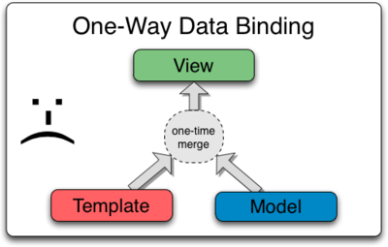

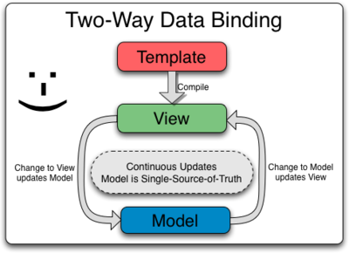
Two-way vs One way

Slide 13
Important Parts and Concepts
Scope – the glue that binds together data and the view
Controller – the part of an angular application that should contain the application behavior
Model – the application data that is bound to the view using {{}}
View – the user screens that keep changing when the user browses our site
Root Scope – the parent glue that is shared among all controllers in an application
Services – used to exchange data between controllers and write business logic
Directives – used to extend how angular parses the HTML

Slide 14
MVC Architecture in AngularJS
MVC pattern implies:
  Separating application into distinct presentation, data and logical components
  Enable loose coupling between these components
Makes application better structured, easier to maintain and more testable
AngularJS provides services and dependency injection to allow loose coupling in an application
Provides the scope to store the data that should be displayed in a view and provides two way binding

Slide 15
Controllers

Slide 16
Controller
A controller is a JavaScript function(type/class) that is used to augment instances of angular scope
Used to set up initial state of scope and add behaviour to the scope object
Creating a controller
function GreetingCtrl($scope) {
$scope.greeting = 'Hola!';
}
<h1 ng-controller=”GreetingCtrl”>{{greeting}}</h1>
Creates a new controller with the scope having a key called ‘greeting’ with its value set to “Hola!”

Slide 17
Controller (contd.)
Ideally controllers should be kept as slim as possible
Should contain business logic only for a single view
Creating services that encapsulate behavior common to many controllers can also help in creating lightweight controllers
Some important services/variables that can be injected in controllers
  $scope
  $http
  $rootScope
  $location
  $stateParams

Slide 18
Model

Slide 19
Model
The term ‘model’ can refer to a single object representing a single entity or the entire data model for the application
Any data that is available in the scope and can be used by the controller constitutes model
Created by explicit assignment in the controller definition, or by using in an angular expression or using the ng-init directive

Slide 20
Directives

Slide 21
Directives
Directives are markers on a DOM element (such as an attribute, element name, comment or CSS class
attach a specified behavior to that DOM element or even transform the DOM element and its children.
Whenever the DOM is being parsed, the directives are read and executed
Lot of built-in directives already available; being used for a variety of things ranging from identifying the root of an app to repeating DOM elements

Slide 22
Directives
Compilation happens in three phases
1. Compile the DOM - traverse the DOM and collect all of the directives
2. Link - combine the directives with a scope and produce a live view. Any changes in the scope model are reflected in the view, and any user interactions with the view are reflected in the scope model.

Slide 23
Directives
angular.module(‘myApp', []).
directive(‘randomColor', function() {
return {
link: function(scope, element) {
var colors = [‘red’, ‘green’, ‘blue’];
element.css(‘background-color’,
colors[Math.floor((Math.random()*3)+1)]); }
}
});

Slide 24
Services & Dependency Injection
Dependency injection is a S/W pattern of how code gets hold of dependencies
In Angular, dependencies are provided to controllers and they are injected by name just like in Grails

Slide 25
Filters

Slide 26
Filters
Filters are functions that are used to alter the data presentation
They are used to format the data displayed to the user
They can be part of any scope and are usually used to format expressions in bindings in your templates
{{ expression | filter }}
They can be chained together as well to form a new data type, formatting the data in the process
We can also pass arguments to filters using the colon-separator
{{123 | number:2 }}
Creating a new filter is very easy – just register a filter in your module

Slide 27
Filters
angular.module(‘myApp', []).
filter('reverse', function() {
return function(input, uppercase) {
var out = "";
for (var i = 0; i < input.length; i++) {
out = input.charAt(i) + out;
}
// conditional based on optional argument
if (uppercase) {
out = out.toUpperCase();
}
return out;
}
});

Slide 28
Form Validation

Slide 29
Form Validation
Form validation is one of the most commonly performed tasks
AngularJS has built-in functionality that can be used to validate forms
It has some very advanced options as well such as matching the value of a text field against a regex expression
It also allows the user to extend this functionality by providing the ability for the developer to add their own custom validations
The validation can happen in two places:
Model to View update - Whenever the bound model changes. This triggers the formatters which can change the validity state of a control
View to Model update - Whenever a user interacts with a control and changes its value, it triggers the parsers which can convert the value and change the validity state of the control

Slide 30
Form Validation
Classes are used to identify the validity state of a form control
  ng-valid – The form control is in a valid state
  ng-invalid – The form control is in an invalid state
  ng-pristine – The value of the form control has not changed
  ng-dirty – The value of the form control has changed from its original value than what was processed by AngularJS
The validity state of a particular control is in variable named $error.
<span>
{{formName.fieldName.$error.required}}
</span>

Slide 31
Routing and Views
UI Router

Slide 32
What is UI router?
1. a 3rd-party module and is very powerful. It supports everything the normal ngRoute can do as well as many extra functions.
2. It is a contributed module which is overcome the problems of ngRoute. Mainly Nested/Complex views.
3. allows for you to have strong-type linking between states based on state names.
4. Doesn't come with angular, needs to be loaded separately

Slide 33
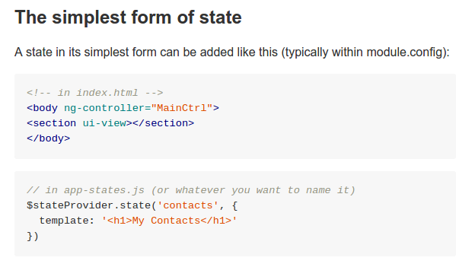

Slide 34
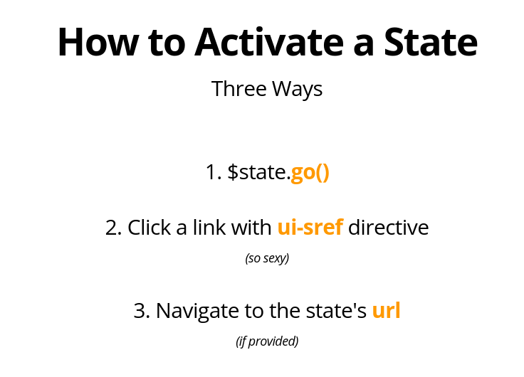

Slide 35
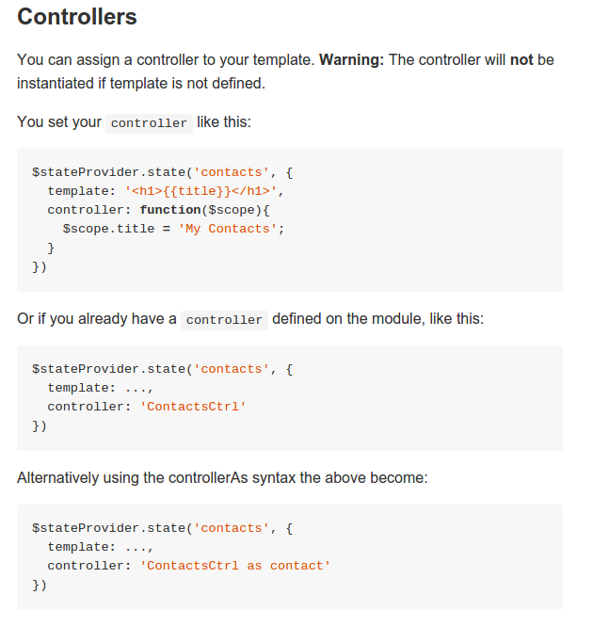

Slide 36
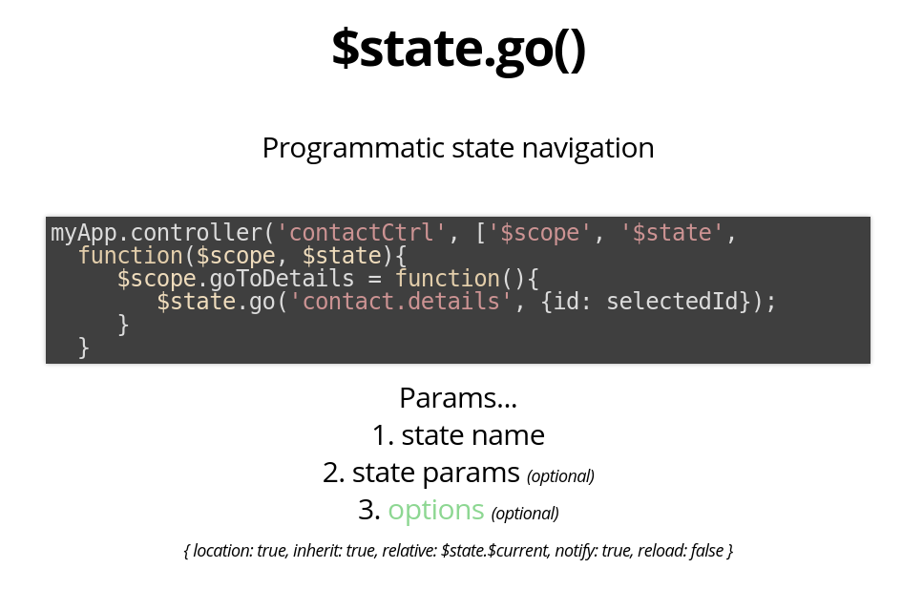

Slide 37
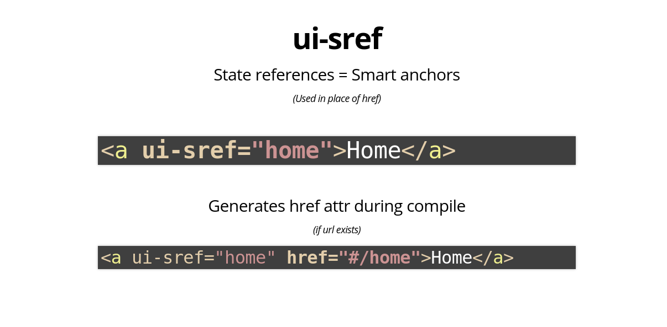

Slide 38
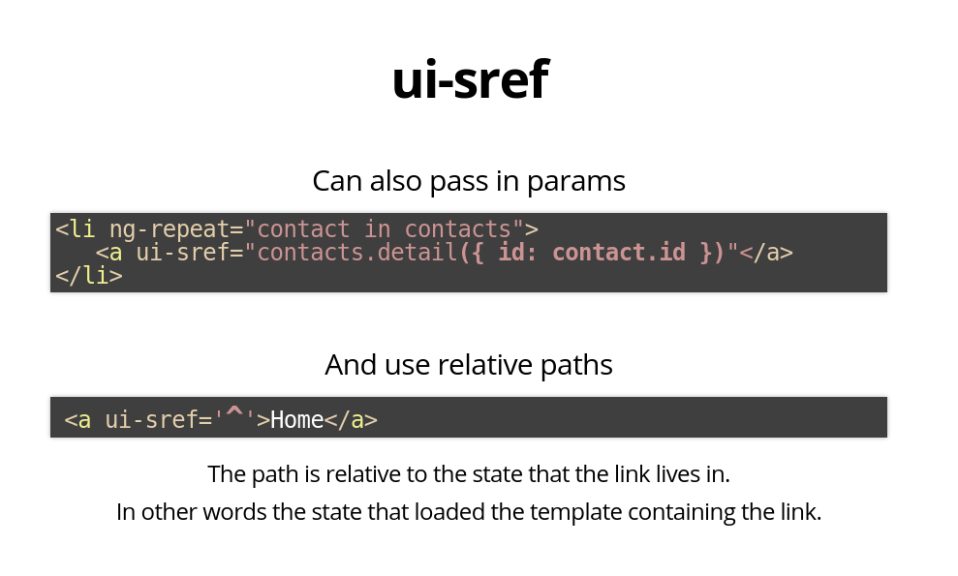

Slide 39
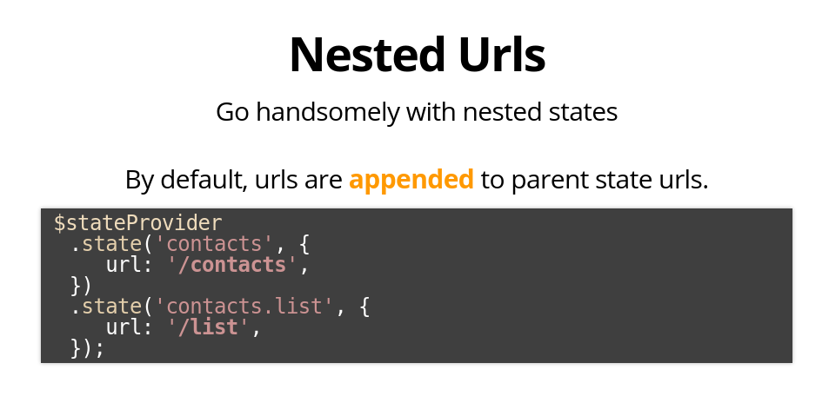

Slide 40
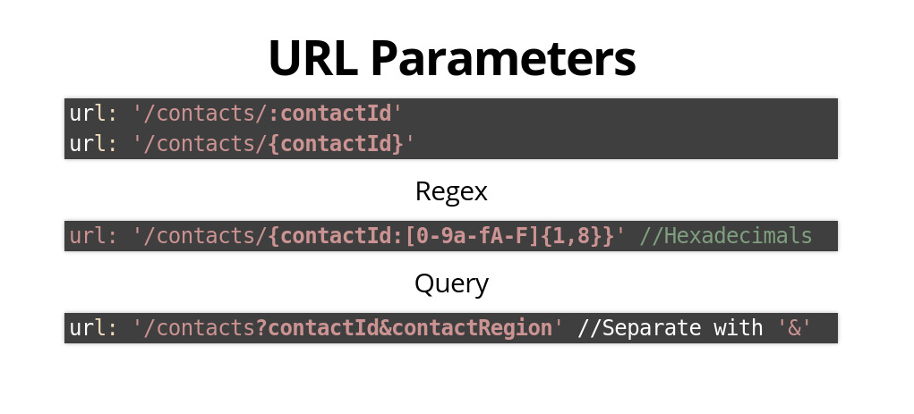

Slide 41
Limitations of Using
AngularJS

Slide 42
Disadvantages or Limitations
Single page apps have not been widely received by many people and there are still speculations over its feasibility. For eg. Social plugins
SEO headache – Single Page Applications (SPA) are not indexed by web bots or spiders since they do not execute the javascript on the page which is needed by angular
Ad counts and page views are of no importance in a single page app since it essentially is a single page!!
You need to take care of the age-old problem faced by developers – JavaScript browser compatibility

