Slide 1
Class Board App
Using parse api to build a customizable messaging app geared towards educational institutes..

Slide 2
Android Development Basics...
Grab the latest copy of the Android sdk+eclipse archive
Read up documentation about basic UI
Read up documentation about parse.com

Slide 3
Creating an Account on parse.com
On parse.com creation / using github open-auth login
Go to Dasboard and click on create an app
Get your api keys and keep them handy

Slide 4
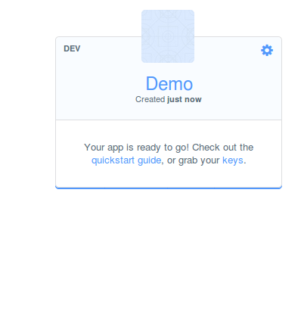
App keys

Slide 5
Parse Cloud Api
If you want some of your code to run in the cloud use parse cloud api which currently support javascript/php
To write cloud functions.
The documentation provides scenarios in which it will be useful

Slide 6
Going through the android code
Before I begin .
Lets understand Parseobjects which is the way we deal with data.
It is a rather glorified way of referring to data which is stored in a json like format , or key value pair format
You can create Parseojects or even extend them
Saving them is as eay as calling a save function on them

Slide 7
ParseQueries
Parsequeries are run on client side to retrieve data
From the cloud.
Go through the api to see the available functions which provide multiple ways through which you can query data

Slide 8
ParseAdapter/ParseImageAdapters
Parse has provided an implementation for display data.
Which takes care of everthing network problems caching pagination
You can create your own custom adapter on top of them by extending them and the associated xml files in a fashion similar to that with android arrayadapter and so on..

Slide 9
Login /Logout/Users
Users can be anonymous or authenticated through a login system
They have provided an easy guide for implementiong login/logput activity and authenticated view of data.

Slide 10
Saving posts..
Extend parseobject for storing info about usermade post
newpost.setMessage(text);
newpost.setTitle(title);
newpost.setReciever(reciever);
newpost.setAuthor(ParseUser.getCurrentUser());
newpost.saveInBackground(new SaveCallback()
And new post get saved in the background..

Slide 11
Retreving posts..
ParseQueryAdapter.QueryFactory<Post> factory =
new ParseQueryAdapter.QueryFactory<Post>() {
public ParseQuery<Post> create() {
ParseQuery<Post> query = Post.getQuery();
query.include("author"); query.orderByDescending("createdAt");
query.whereEqualTo("reciever",ParseUser.getCurrentUser().getUsername());
query.setLimit(10);
return query;
}
}; // get latest posts and get a reference to them

Slide 12
Displaying posts....
mainAdapter = new ParseQueryAdapter<Post>(this, factory) {
@Override
public View getItemView(Post post, View view, ViewGroup parent) {
if (view == null) {
view = View.inflate(getContext(), R.layout.post_item, null);// See the layout file
}
TextView contentView = (TextView) view.findViewById(R.id.contentView); // binding data to the ui elements
TextView usernameView = (TextView) view.findViewById(R.id.usernameView);
contentView.setText(post.getMessage());
usernameView.setText(post.getAuthor().getUsername());
return view;
}
};
ListView postsView = (ListView) this.findViewById(R.id.listy);
postsView.setAdapter(mainAdapter);

Slide 13
Group Management
Create a group add members
And then run a cloud function to update installation parameter Subcribed to : of the added member //flag variable
And then update its post list activity to include these files too.

Slide 14
Acknowledgement of messages
Again add a parsecloud scripts to run when user reads a message and give a notification to sender...

