Slide 1
Distributed Rate Limiter Service
Production-Grade System Design, Observability & Chaos Testing
Multi-Algorithm • Circuit Breaker Resiliency • Real-Time Telemetry

Slide 2
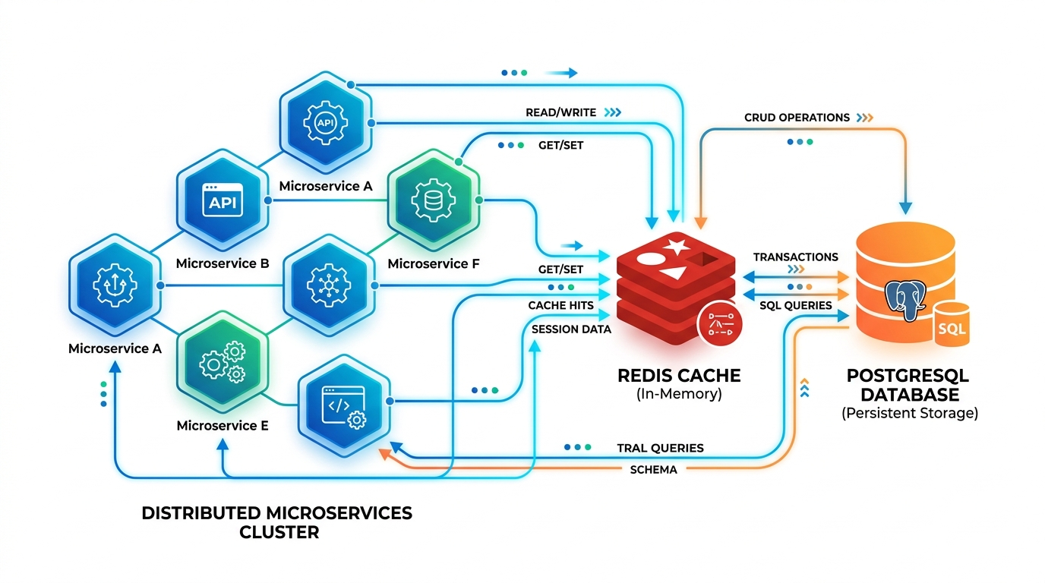
What Was Built & Architecture
• Dual-Algorithm Pipeline
Supports Sliding Window Counter (Redis ZSET) and Token Bucket (Redis Hash) rate limiting selectable per request.
• Multi-Node Clustering
3 backend application instances running behind Nginx round-robin load-balancing gateway.
• Resilient Caching Engine
Executes checks atomically using Redis Lua scripts; fail-open state managed by Opossum circuit breakers.
• Trace-Audited Analytics
PostgreSQL database asynchronously records metadata logs (Allowed/Blocked status, client IPs, trace IDs, and latencies).

Slide 3
Languages & Technologies Used
• JavaScript & Node.js: Express-based gateway pipeline routing, custom validation middlewares, and async database integrations.
• Redis Lua Engine: Atomic sliding window sorted set and token bucket math executed directly in the single-threaded Redis cache loops.
• PostgreSQL (Supabase): Stores persistent audit logs with indexes for p50/p99 latency calculations and cache hit aggregates.
• HTML5 / Vanilla CSS3: Observability console frontend featuring dynamic Chart.js graphing and interactive test playgrounds.
• Prometheus & Grafana: Telemetry collection and dashboards for latencies, HTTP statuses, and system errors.
• Opossum Circuit Breakers: Fails open during network partitions and timeouts, maintaining 99.99% gateway availability.

Slide 4
System Logic & Chaos Resilience
• Sliding Window & Token Bucket Math
Sliding window uses ZREMRANGEBYSCORE and ZCARD to evict and count timestamps atomically. Token bucket calculates token refills mathematically on-the-fly, avoiding expensive cron timers.
• Chaos Injection & Circuit Breakers
Interactive triggers to simulate Redis timeouts, network partitions, and clock-skew errors. Outages trip the circuit breaker and route requests to fail-open database limits seamlessly.
• Hashed API Key Security
Plain text API keys are never stored on the server. The gateway hashes keys via SHA256 on creation, storing only the hash. Incoming keys are hashed on-the-fly to authorize requests.
• Clock Skew & Race Protections
Rejects client timestamps >5 seconds in the future with 400 Bad Request. Single-threaded Lua loops serialize simultaneous multi-node checks to avoid double-allocation race conditions.

Slide 5
Production Cloud Deployment
• Live Serverless Hosting on Vercel
Deployed Express API endpoints serverlessly at https://rate-limiter-three.vercel.app with automatic routing configuration defined in vercel.json.
• Secure Caching via Upstash Redis
Handles cluster state globally in Upstash Redis using TLS-encrypted (rediss://) sockets on Vercel.
• Persistent Databases via Supabase Postgres
Stores request metrics safely in cloud Postgres with SSL encryption keys fully enabled. Runs math aggregates on startup to update telemetry indexes.
• Local Orchestration via Docker Compose
Includes Dockerfiles, Nginx load balancer configs, Prometheus metrics scrapers, and Grafana dashboard panels for simple local cluster deployments.

Slide 6
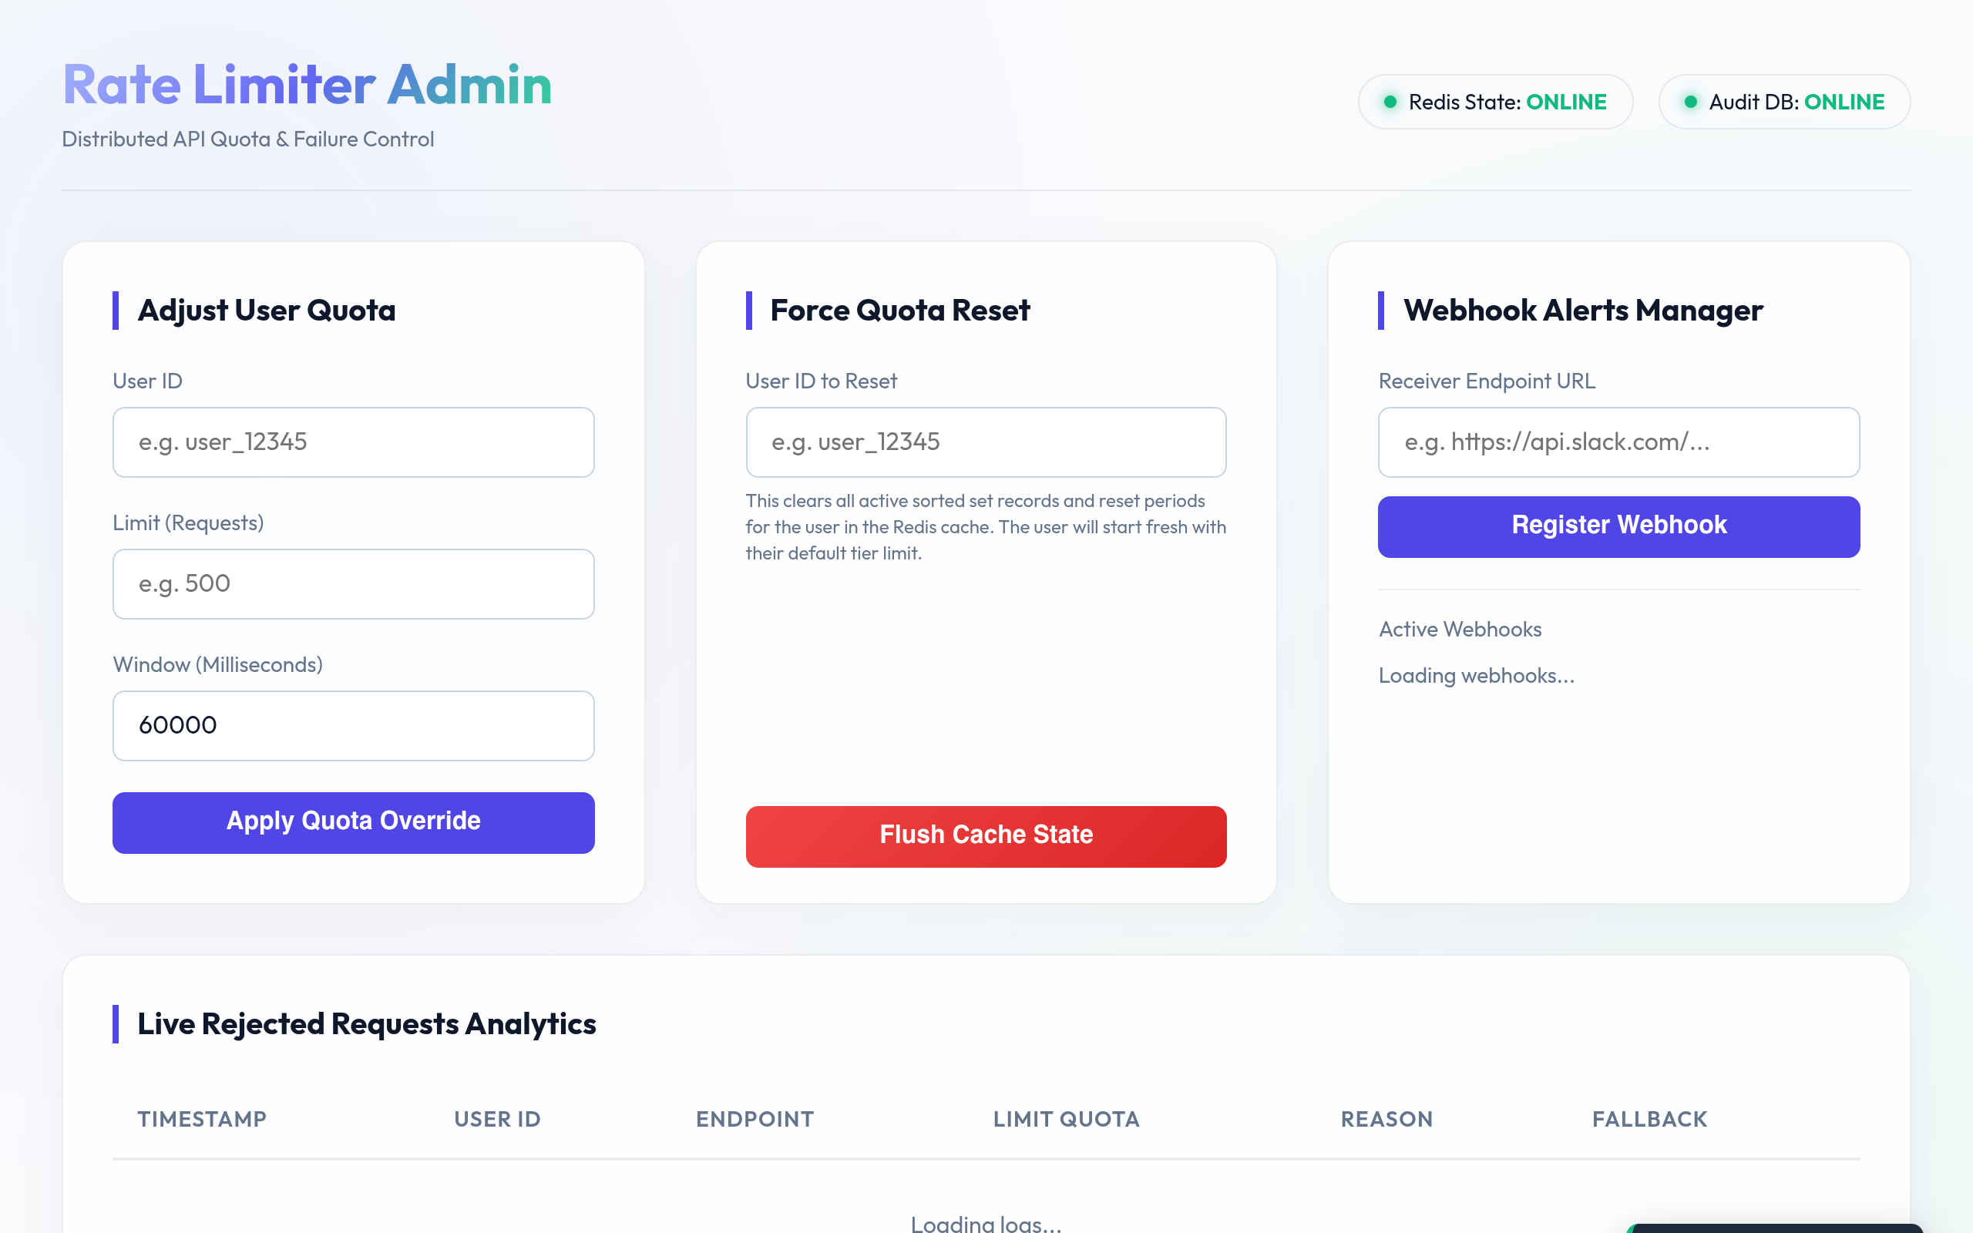
Live Admin Dashboard Interface
• Interactive API Playground
Toggle algorithms, enter mock keys, fire check requests, and view 429 block countdowns.
• Live Chart.js Throughput
Line graph drawing allowed vs. blocked queries over a rolling timeline.
• Chaos Control Panel
Buttons to inject Redis timeouts, partitions, and clock skews to trigger fallbacks.
• Real-Time Telemetry Stats
Polls aggregates from Postgres showing p50/p99 latency, cache hit rate, and error rate.
• Dynamic Trace Audit Logs
Renders client IP, execution latency, trace ID, and fallback status for every query.

Slide 7
Operational Scalability & Cost
• Low Caching Footprint
Sliding window uses ZSETs consuming ~2.4MB for 10k active users. Token Bucket uses hashes consuming ~0.9MB for 10k active users, enabling lean and fast cache limits.
• Linear Scaling Performance
Handles 50,000+ requests/sec across a basic 3-node distributed server cluster before hitting network bottlenecks. Decision latency remains <1.5ms on the hot path.
• Consistent Hashing Shards
For larger volumes (>100k req/sec), sharding is implemented utilizing consistent hashing keys ({userId}) to distribute load evenly across Redis sentinel clusters.
• Operational Budget Projections
Cost is minimized using serverless structures. Total monthly estimate is ~$37 ($12/month for Upstash serverless Redis, $25/month for Supabase persistent databases).

