Slide 1


Help your friends with their moods

Slide 2
Problem
A person’s emotions and moods have direct bearings on his/her daily activities.
Negative emotions that our family or friends might be experiencing, gets unnoticed.
No easy way exists to understand the emotions of a friend or your followers or your company employees.

Slide 3
Solution
A web platform where users can find their followers emotions and suggest them their own choice of playlists from spotify to
Eliminate Negative emotions of friends and family
Understand you followers emotions better and build strong social relationships
Build a community that wants to help others to improve their emotions

Slide 4
Target
Tens of millions of people each year suffer from depression and only a fraction receives adequate treatment.
Mental illness is a leading cause of disability worldwide. It is estimated that nearly 300 million people suffer from depression (World Health Organization, 2018).
Target size:
As of the second quarter of 2018, the micro-blogging service twitter averaged at 335 million monthly active users.

Slide 5
Customer Value Propositions:
Detects your twitter followers mood(happy/angry/sad/disgust/fear) with the help of IBM Watson Tone Analyzer.
User can suggest their followers a playlist by searching for it in our app and also be able to share a playlist that the user thinks the follower would like and make his/her mood happy using the Spotify Api.
Also the user can send him/her a message that will be posted on his/her mood dashboard.
And surprising features are also included for premium users, which we will see in the demo
Our web app has user-friendly UI that can run on desktops, mobiles and tablets.

Slide 6
Customer Acquisition Strategy:
Social media is a huge platform of different type of users and all of them have emotional breakdowns at some point of time. By getting feedback from existing users we can tailor our app to be more precise for helping the moods of social media users.
The app can find followers mood irrespective of whether they have joined the app or not. A user can share a playlist to his twitter account with our app, with a link to out app.
The app is free to use by anybody, and most of the high quality contents in our app are free, we do have a pricing when the tweets or mood analysis or spotify playlists exceed the free limits.
Advertising our app on social media and other platforms.

Slide 7

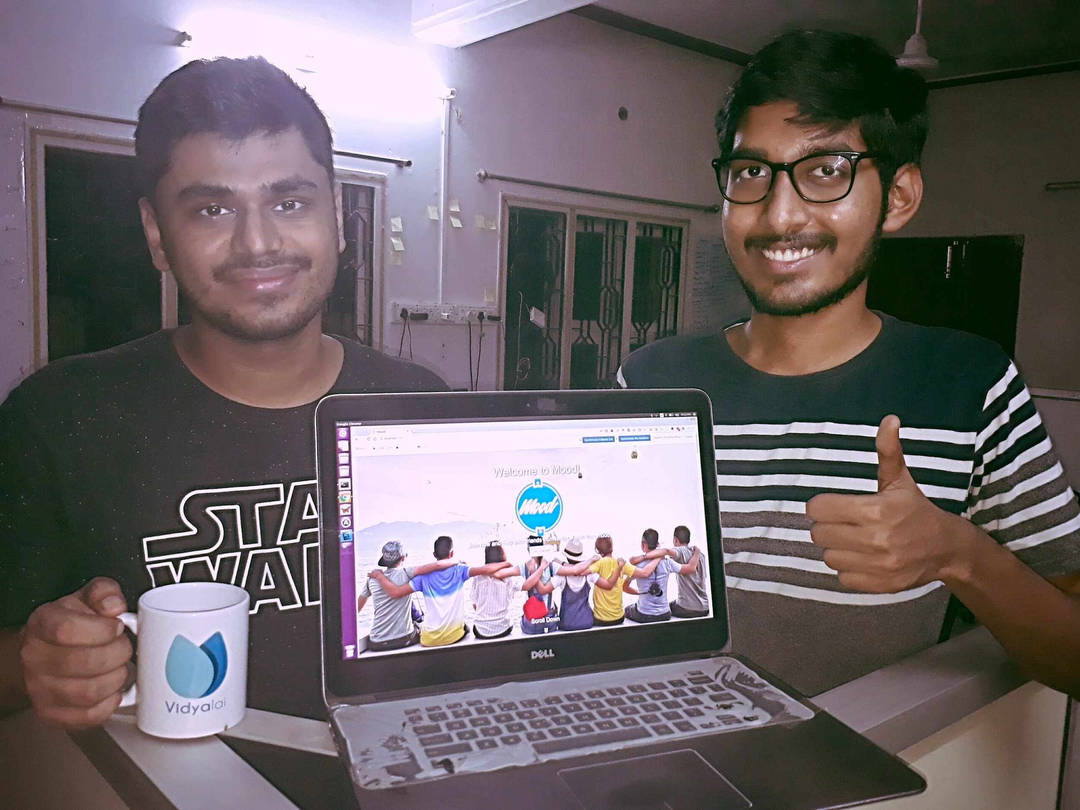
User Validation
Manu John
Co-Founder, Vidyalai
- Your personal teacher
“Nikhil's product was very interesting. Getting a real time snapshot of how our twitter followers would be feeling at a any instant could help us in tailor making our social media interactions more personalised. ”
User Validation with a Startup Entrepreneur

Slide 8
Demo

Slide 9
Business Model
Loyalty program through Points System
Tokens(every user gets 3 tokens (1$ = 100 tokens)) to share between users,
Gratitude(every user starts with 0, and increases when he sends tokens to other users)
Tokens - When the user gets happy after receiving a playlist, he gives tokens to the sender of the playlist and the user gets a Gratitude token.
Gratitude & feedback of the shared playlist - Lucky users can get bonus points for collecting some significant amount of gratitude tokens.

Slide 10
Revenue Model
We charge users for premium features to access a more detailed dashboard.
Premium feature for a complete dashboard that has details of historical analysis of mood and also be able to have a doctor that can view the complete dashboard.
Charge viewers for accessing premium content of their followers in the dashboard.
Act as marketing strategy for promotional companies/celebrities that want to know their followers emotions.

Slide 11
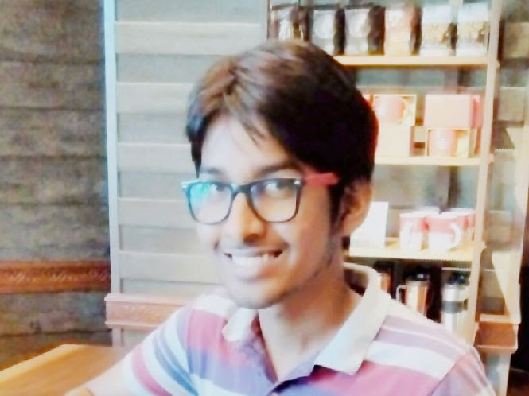

Team
Nikhil Isaac Manohar
Research Intern @ Ericsson
Final year, Dual Degree CSE,
IIITDM Kancheepuram
Prateek Verma
Research Intern @ Ericsson
Final year, Dual Degree CSE,
IIITDM Kancheepuram

Slide 12
Thank you

