Slide 1
SELLER WORKFLOW
0. Home Page
1. Registration
2. Login
3. Dashboard (Home Page)
4. Products (Add product)
5. Post the product
6. Go to Dashboard (Updated)

Slide 2
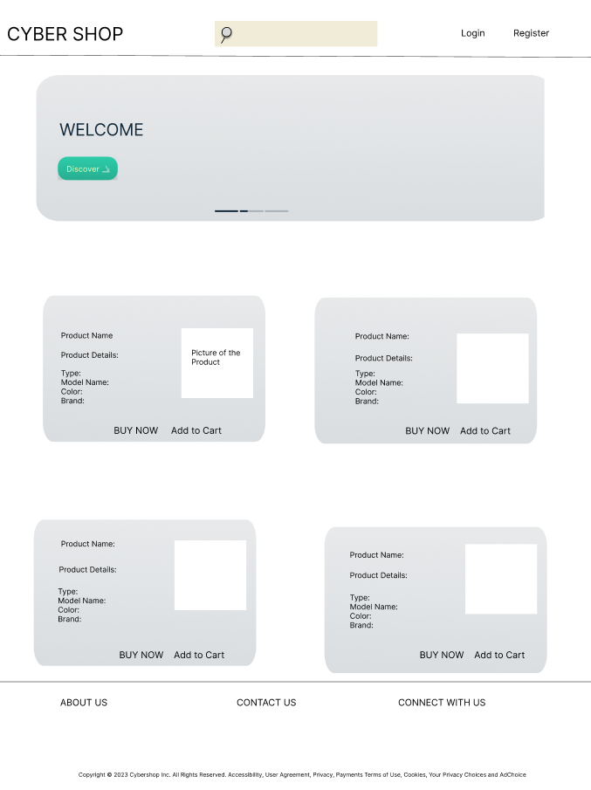
HOME PAGE:

Slide 3
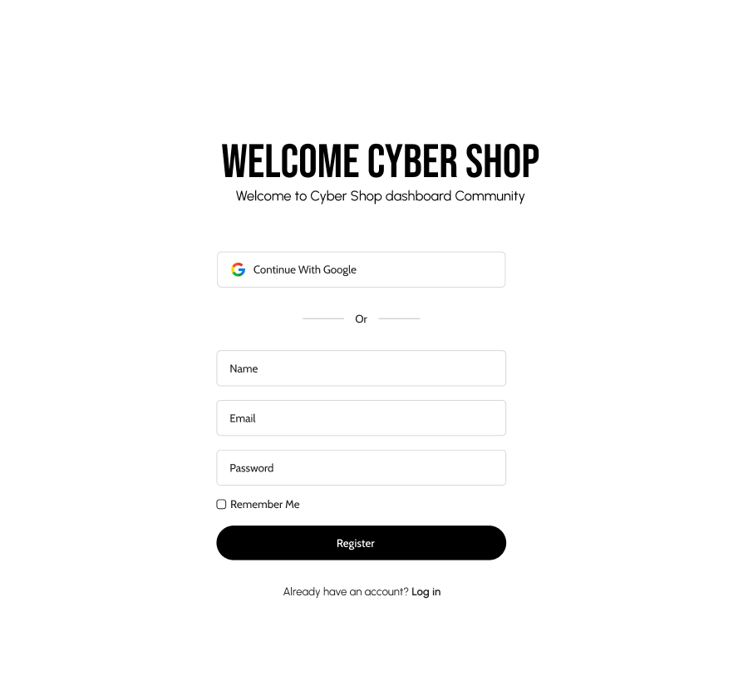
REGISTRATION PAGE:

Slide 4
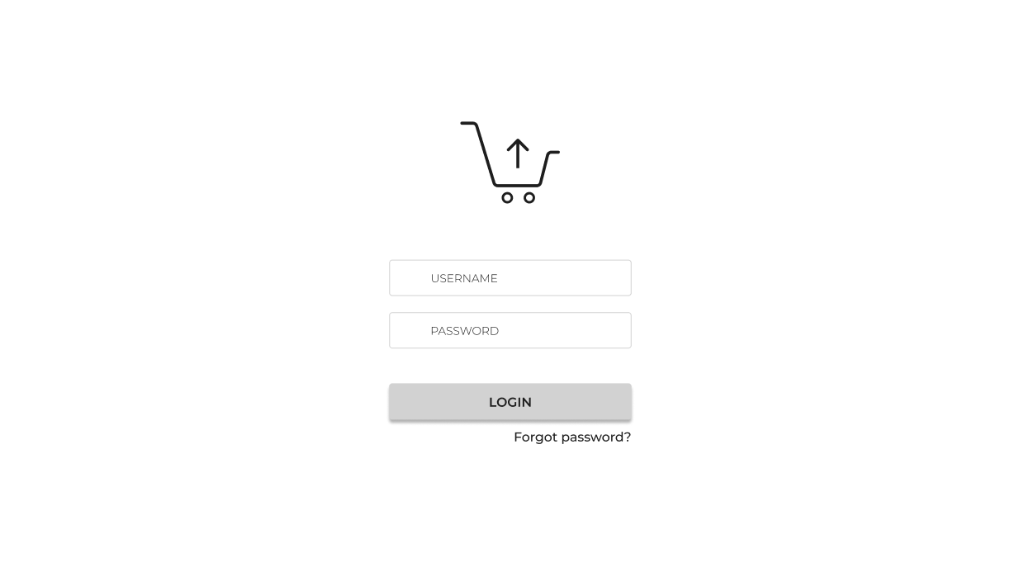
LOGIN PAGE:

Slide 5
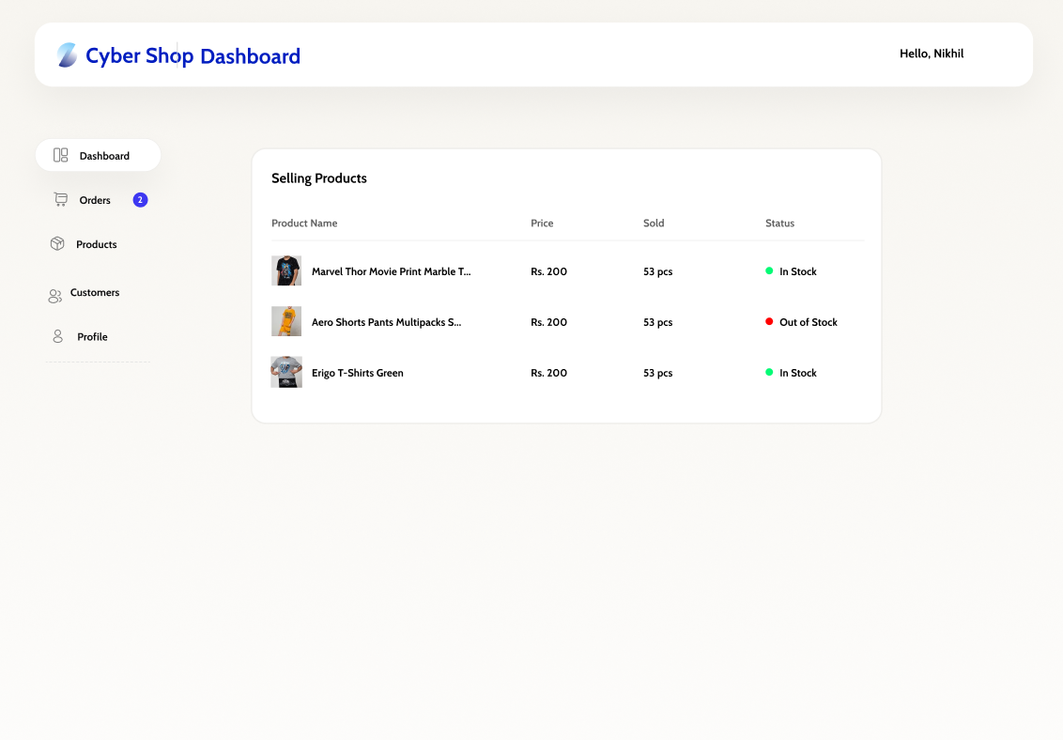
DASHBOARD:

Slide 6
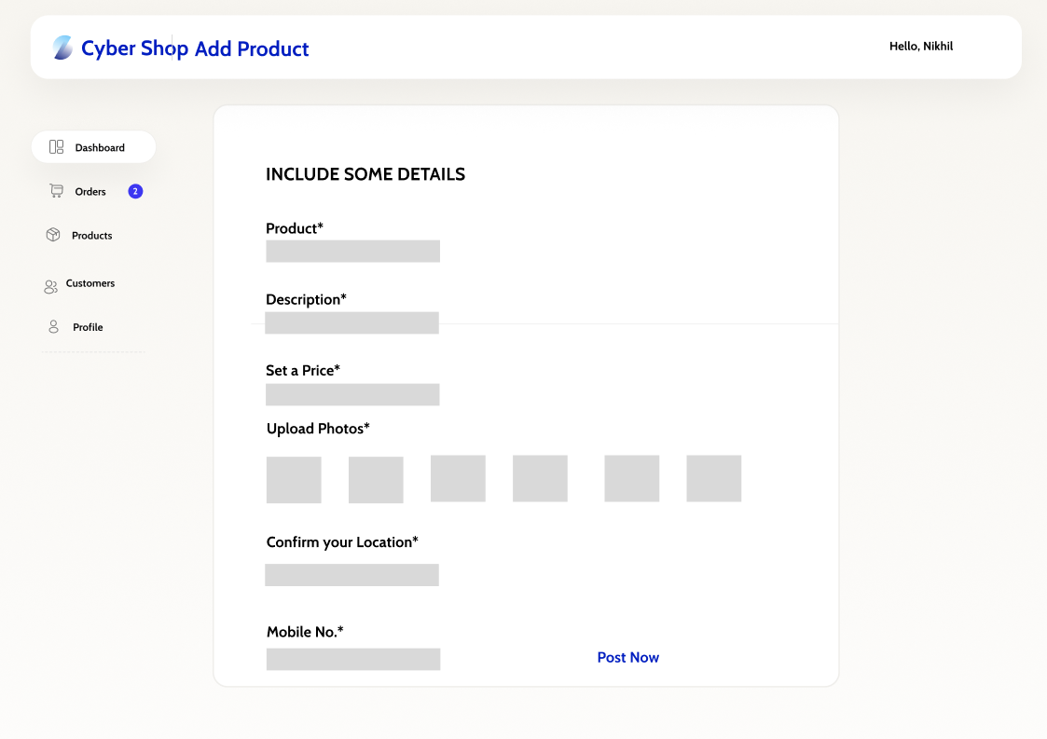
ADD PRODUCT:

Slide 7
BUYER WORKFLOW
1. Registration
2. Login
3. Home Page
4. Shows all Products and can search the products through search bar
5. Buy Now and Add to Cart
Next sem work:
6. If Buy now -> Billing Details (Info of buyer, Payment)
7. If Add to Cart -> Add to Cart page -> Billing Details (Info of buyer, Payment)
8. Confirmation Page

Slide 8
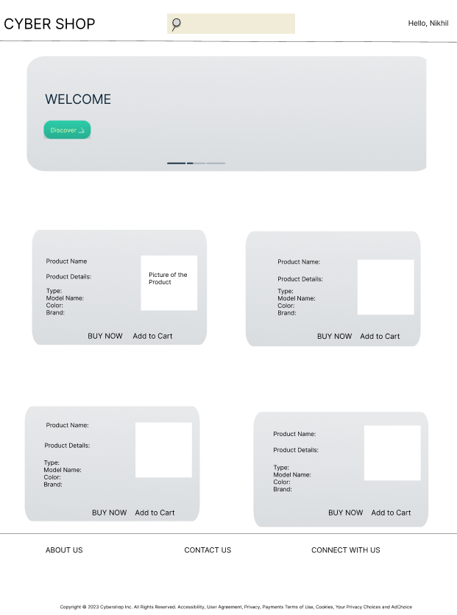
HOME PAGE:

Slide 9
REGISTRATION PAGE:

Slide 10
LOGIN PAGE:

Slide 11
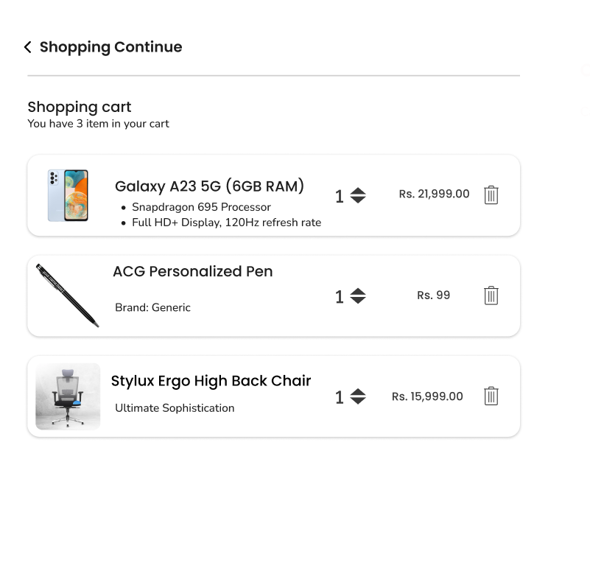
ADD TO CART:

Slide 12
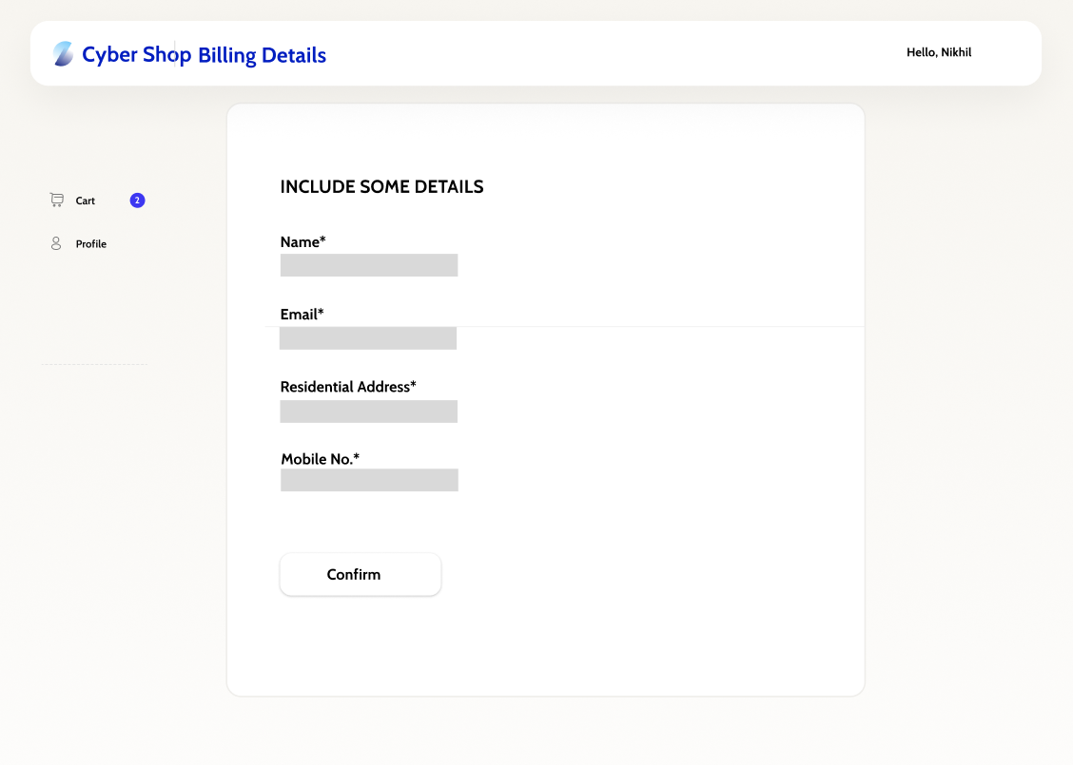
BILLING DETAILS:

Slide 13
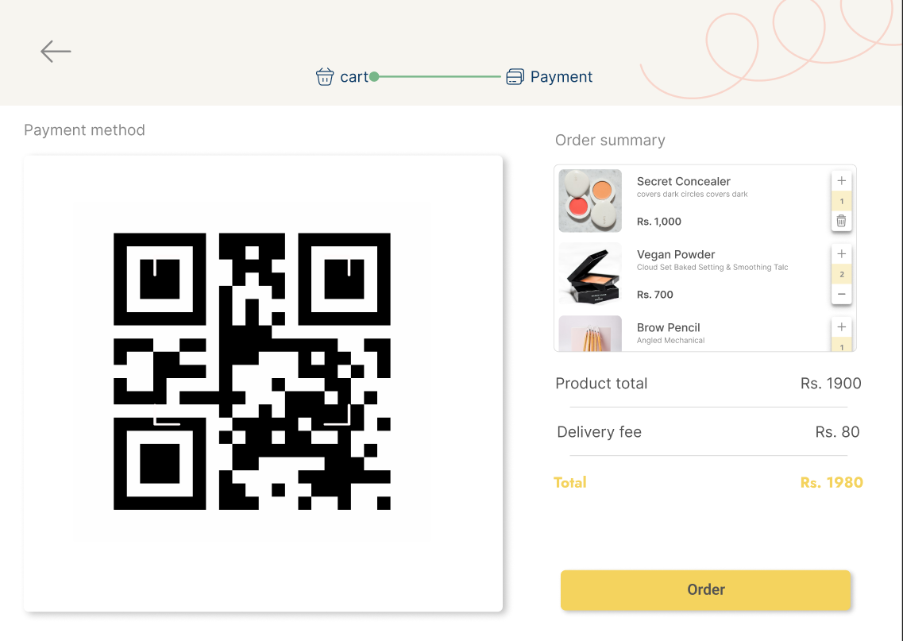
PREVIEW:

Slide 14
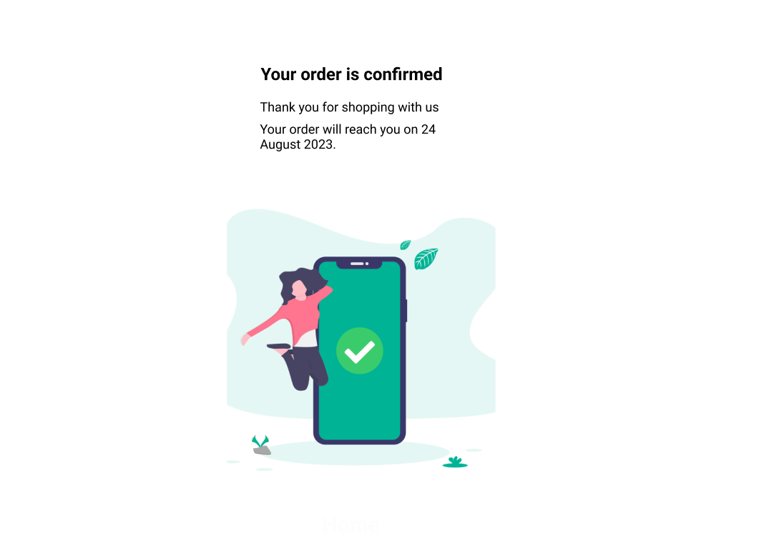
ORDER CONFIRMATION:

