Slide 1
Project 2
Deniable File System
Presented by:
Abhishek Ramchandran
Nikhil Reddy
Thomas Alexander Sellie-Lund

Slide 2
Possible attacks
Data Eavesdropping: Data when it is stored on the file system, a third party/malicious user can view it if they have access to the machine.
Data modification: An adversary can try to tamper with or modify the data which is at rest in the file system. The regular userwill not have any knowledge that the attack took place.
Lack of Deniability: An adversary can try to guess the password or decryption mechanism in the case of a cryptographic file system.

Slide 3
Deniable File System Goals
Confidentiality
Integrity
Availability
Deniability

Slide 4


HOW A DENIABLE FILE SYSTEM WORKS..
Just Like An Onion..

Slide 5
Security Measures
Hybrid encryption cryptosystem
Data encapsulation scheme – AES-128-CTR
Integrity checks with Keyed Message Hashing – SHA-256
Encrypt then Hashing: Reduces Leakage of any information about the message blocks.
For encryption, file blocks are encrypted and then the hash of the encrypted blocks are stored on the header-block along with the random garbage look-alike blocks that are encrypted and the hash stored in the header-blocks.
For decryption, user enters a password, keyed hashes are compared with and returns the decrypted block for which the keyed hash computed matches the one in the header block. A garbage block can be returned if the hash matches with the stored hash thus causing Deniability.
If no hash matches, an error message is returned.

Slide 6
encryptedFile call
Header
Hashes
Cipher Text
Header Version
Block Size
Block 1, Block 2… Block “n”
Num of Blocks
Block 1 Hash, Block 2 Hash… Block “n” Hash

Slide 7
Functionality(Encryption process)
Encryption
AES CTR 128
Hashing
Keyed HMAC SHA 256
Encryted.txt
(Contains the original file at random location)
“File.extension” + Password
Deniability
+PASSWORD
LOOPED TO NUMBER OF FILES, “DEFINED BY USER”
For number of blocks of original file
For number of blocks of original file

Slide 8
Functionality(Decryption process)
Match New Hash with Header Hashes
If “match”… Decrypt
“Desiredfilename.extension”
Password + Encrypted Text
Hash the cipher text with password
For user defined password and total number of blocks

Slide 9
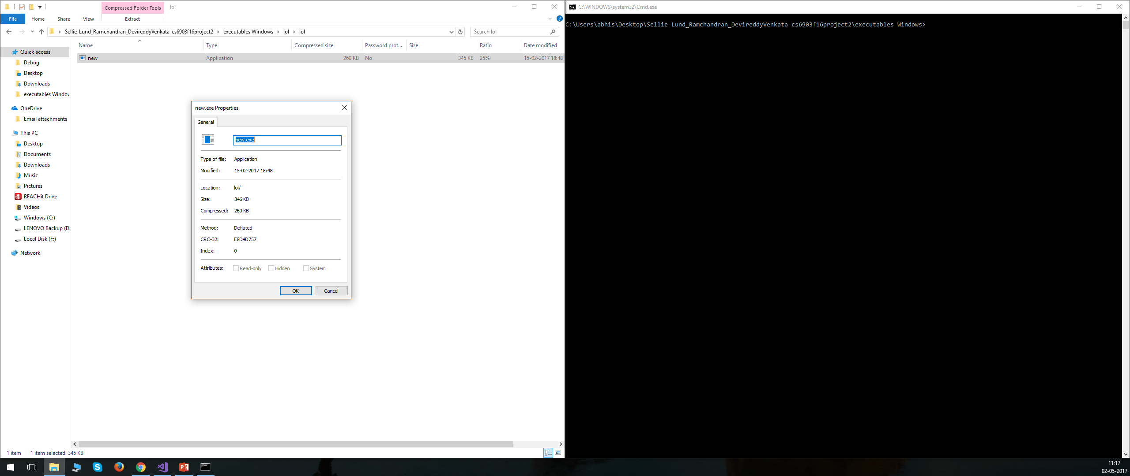
Functionality contd.
Zip Folder Contents…

Slide 10
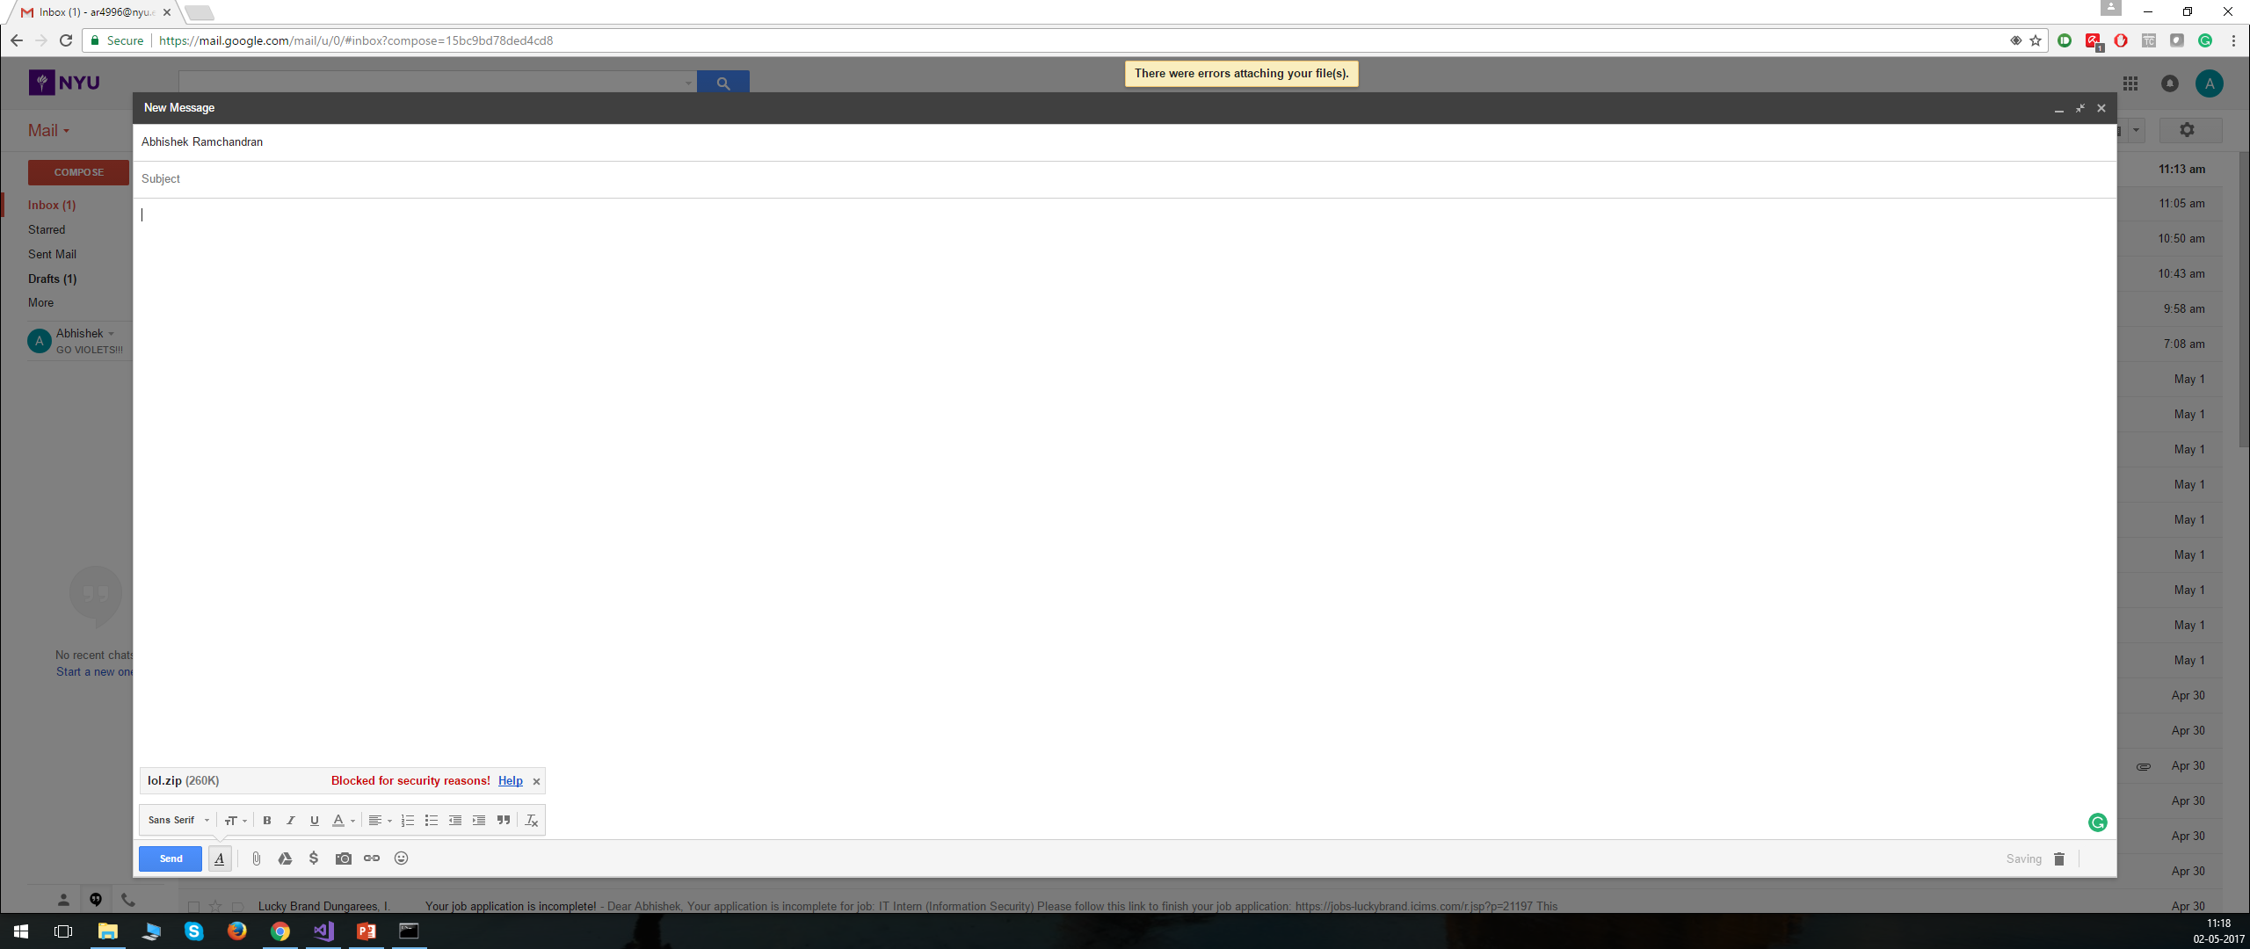
Functionality contd.
Try Uploading the .zip to GMAIL… ☹

Slide 11
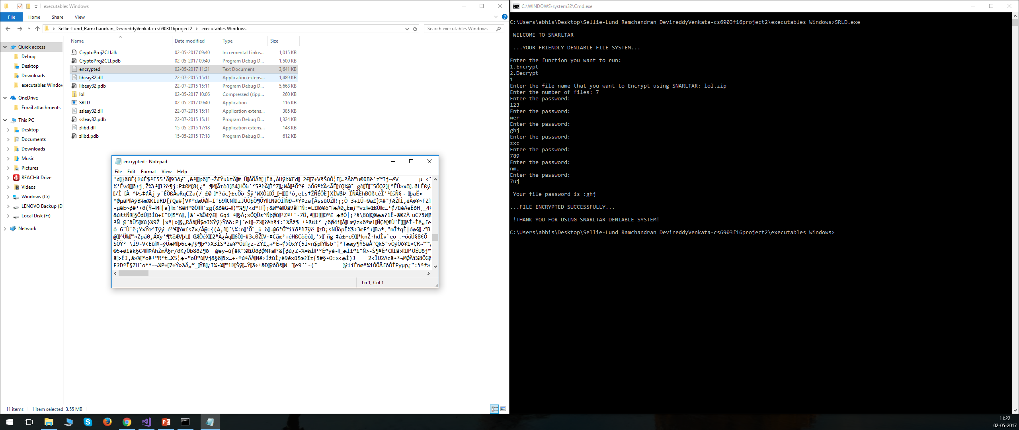
Functionality contd.
SOLUTION: Encrypt it using SNARLTAR!

Slide 12
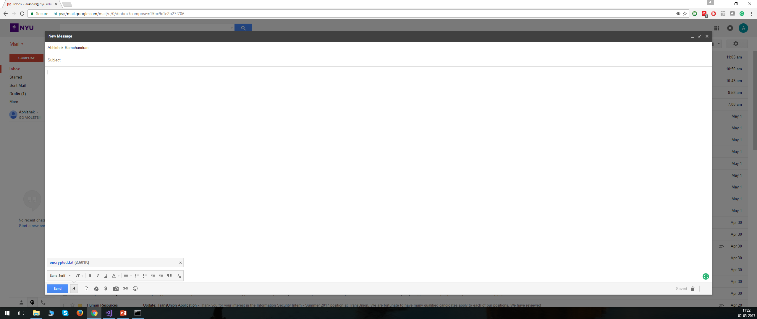
Functionality contd.
SUCCESS!

Slide 13
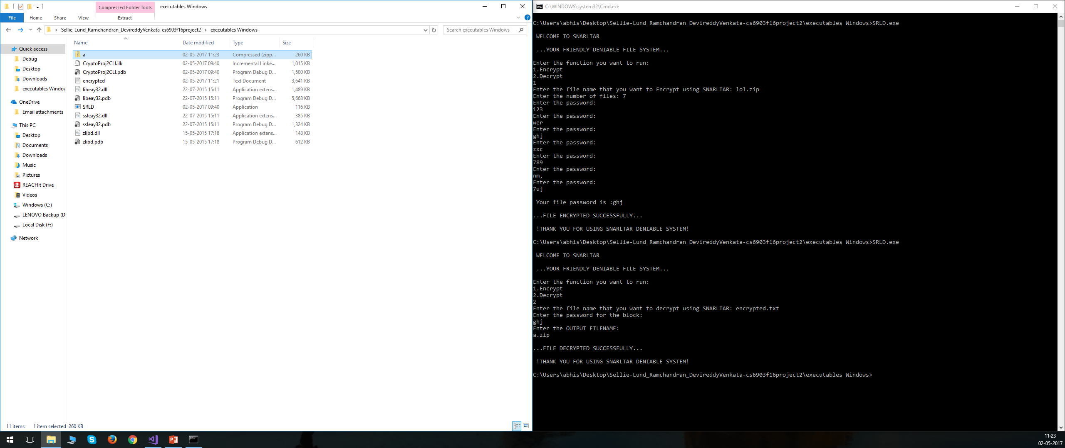
Functionality contd.
AND YES! It is retrievable!

Slide 14
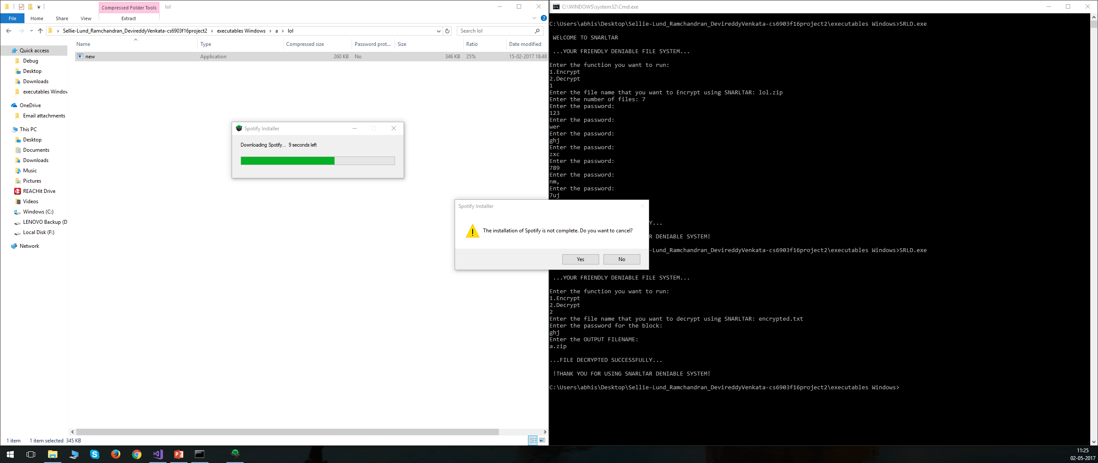
Functionality contd.
And it is Executable!

Slide 15
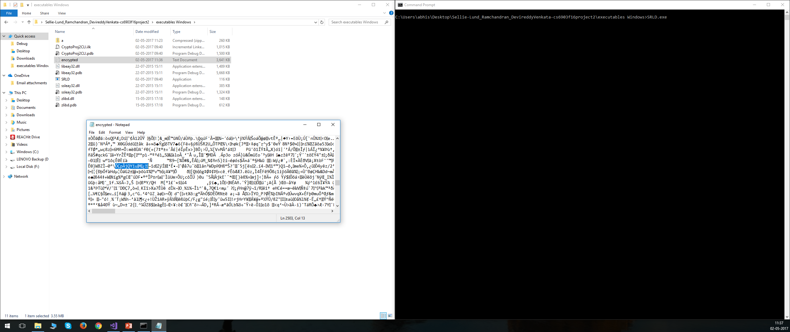
Functionality contd.
Try editing the file…

Slide 16
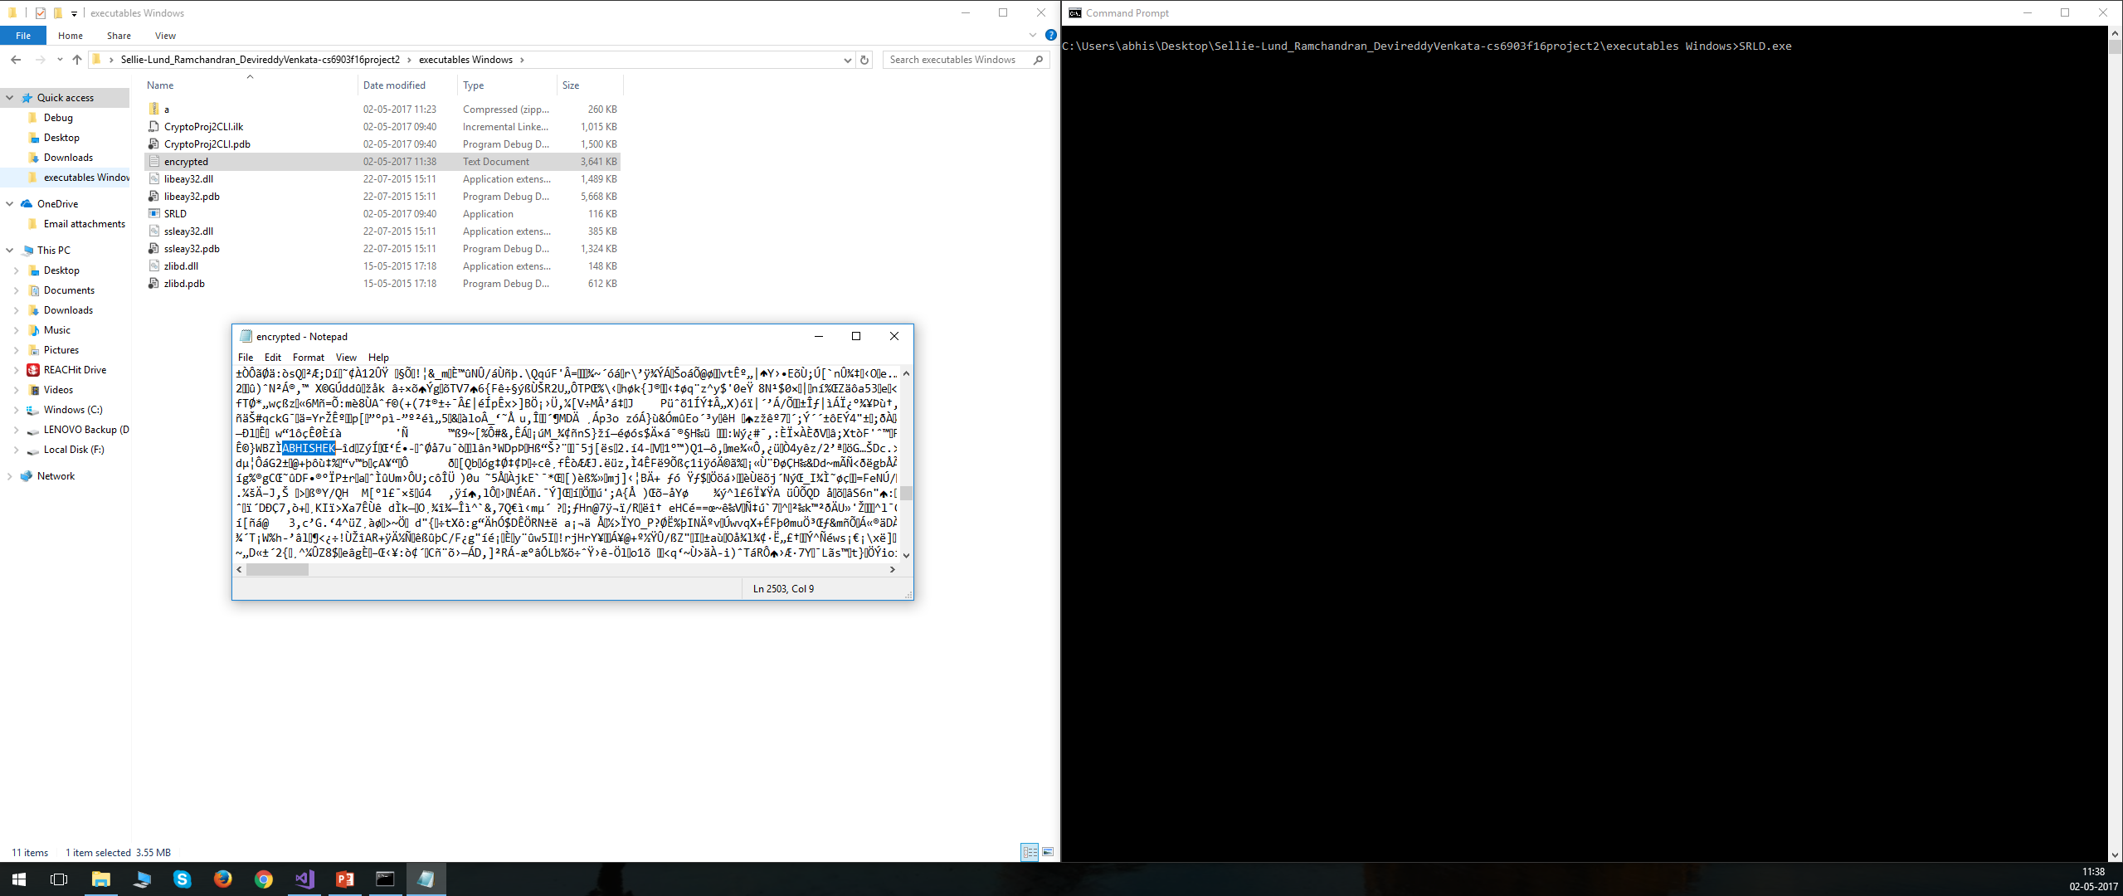
Functionality contd.
Something more deliberate…

Slide 17
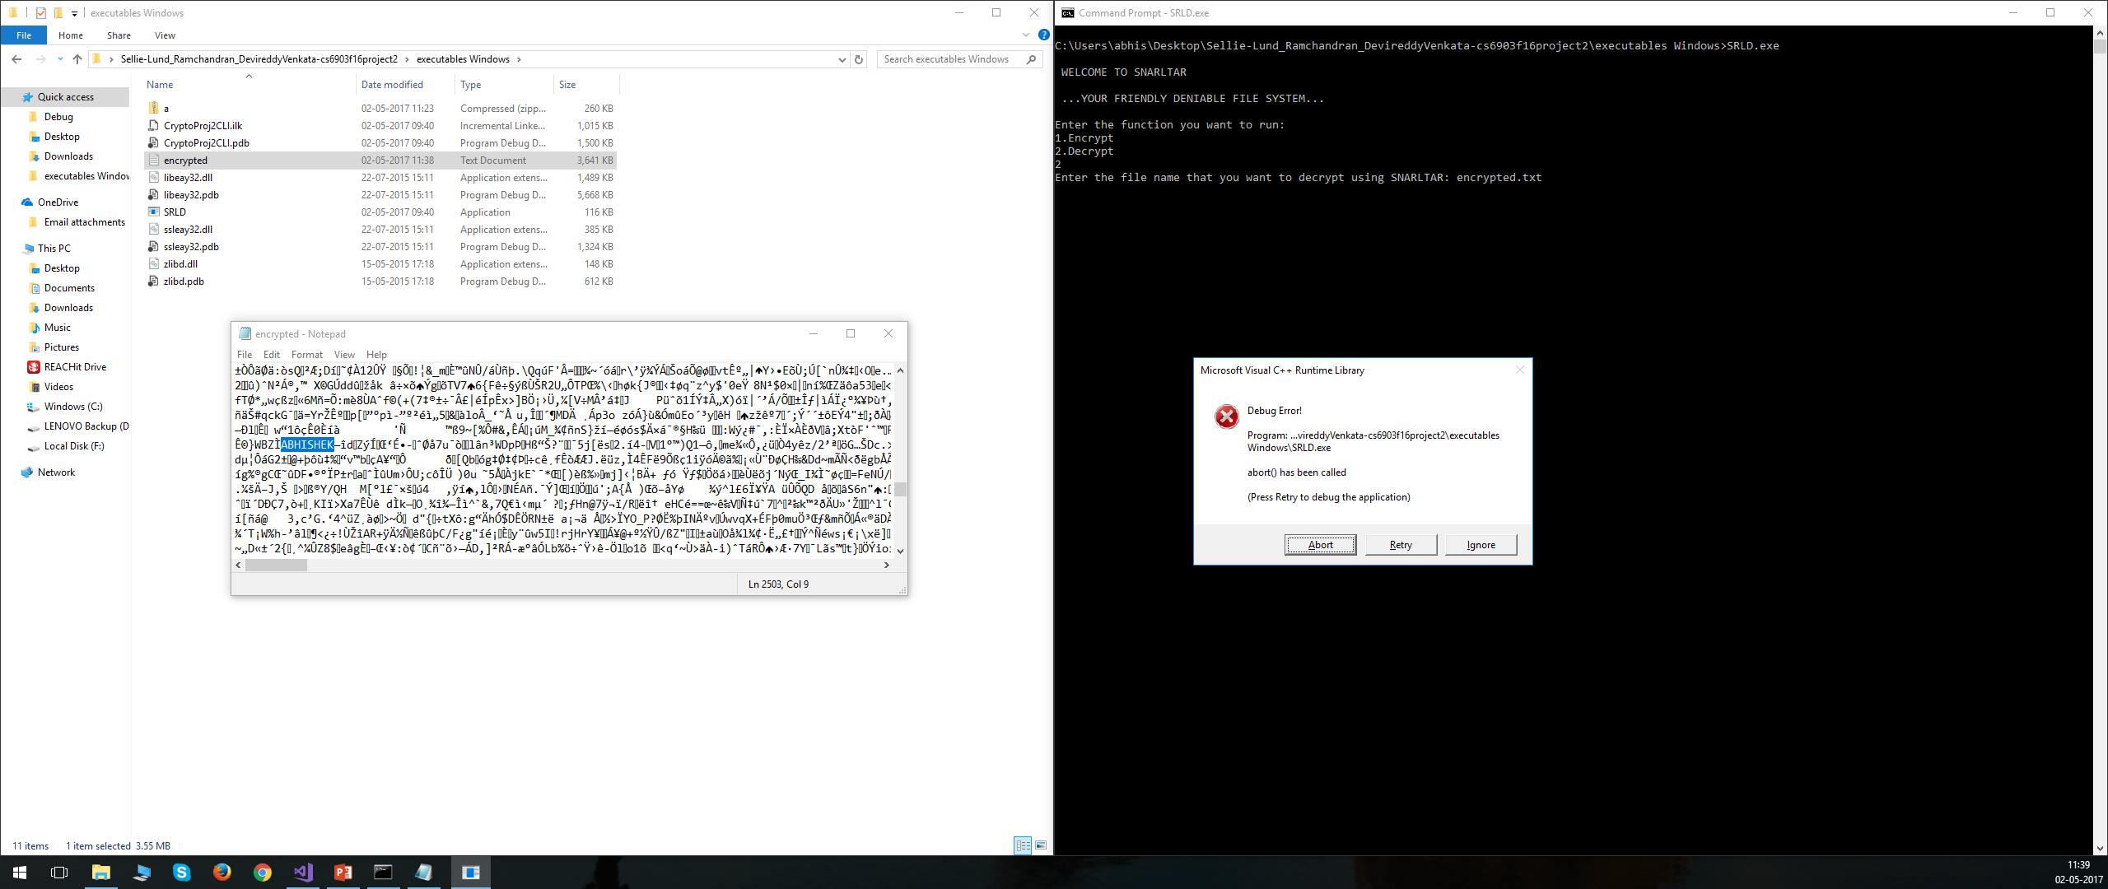
Functionality contd.
Ouch, SNARLTAR doesn’t like the new settings…

Slide 18
Conclusion
Security of all algorithms can be compromised by brute force attacks but given the use of the proposed Cryptographic schemes, we can assure that this would cost the attacker considerable time and money.
Cryptography is only one element of comprehensive computer security.

Slide 19
??ANY QUESTIONS??

