Slide 1

Multi Modal Image Deblurring and Super Resolution
^{1st} review
Mathematics for computing iV
Group – 8
S NIKHIL – CB.SC.U4AIE24351
DHYAN B krishnan – CB.SC.U4AIE24314

Slide 2
Introduction
What is image restoration?
Image restoration is the process of recovering a clean, high-quality image from a degraded version
Common Degradations:
Blur: Camera shake
Low Resolution: Small sized photo
Noise: Grainy texture
This project aims to create a unified a deep learning model that handle both image deblurring and super-resolution.

Slide 3
problem statement
limitations in image restoration:
Lack of flexibility
Users need multiple models for different tasks
Mysterious Nature
Cannot understand how the model makes decisions
Poor Generalization
Models trained for one blur type fail on others

Slide 4
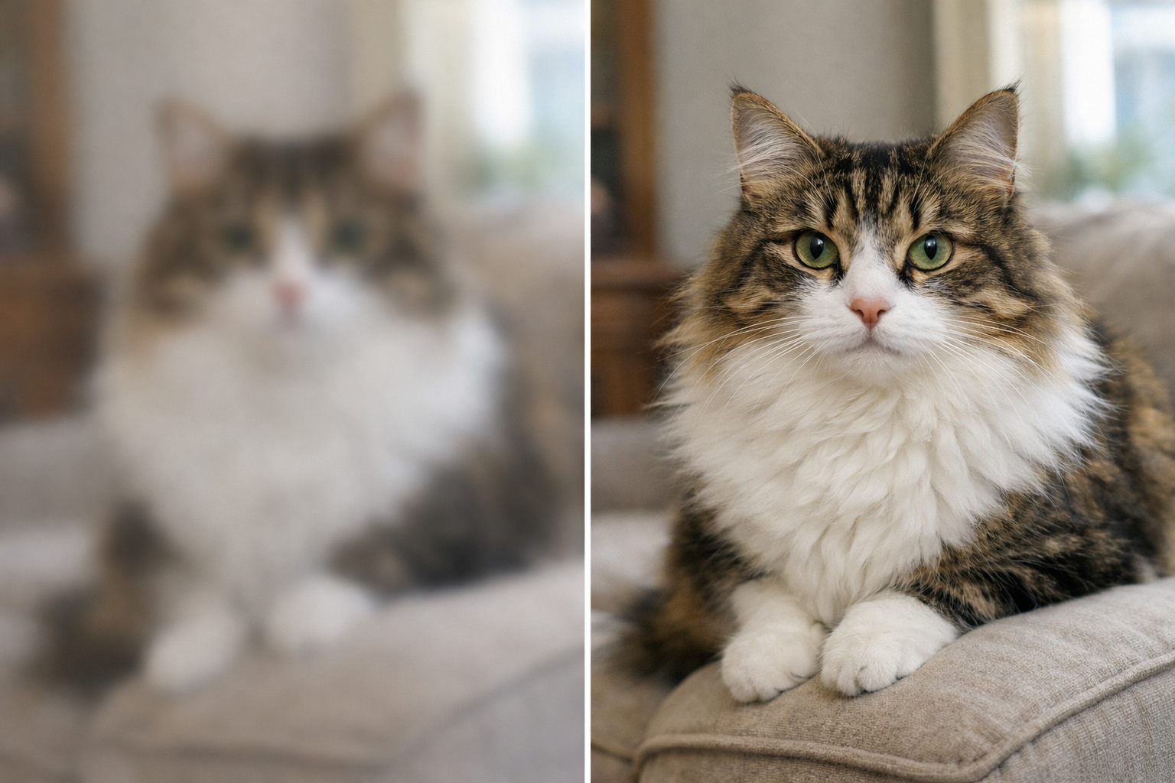
Objective
Develop a unified deep learning framework that combines:
Optimization (using ADMM)
Deep neural networks (using CNNs)
To perform multi-modal image restoration tasks within a single model
BLURRED
IMAGE
DEBLURRED + SR
IMAGE

Slide 5
Literature review
Paper: Deep Unfolding Network for Image Super-Resolution
Published: 2020 IEEE/CVF Conference on Computer Vision and Pattern Recognition (CVPR)
This paper proposes a unified deep learning framework that combines ADMM optimization with neural networks to perform both image deblurring and multi-scale super-resolution (2×, 3×, 4×) using a single end-to-end trainable model. By unfolding the optimization algorithm into an interpretable network architecture, this approach achieves the flexibility of traditional mathematical methods and the performance of modern deep learning.

Slide 6
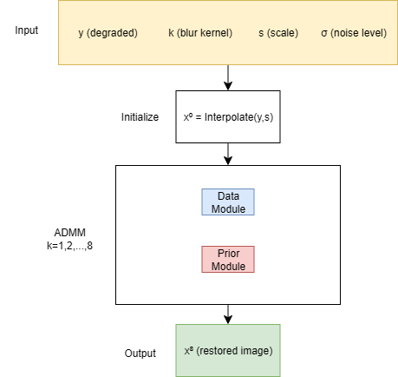
WORKFLOW (Network architecture)
Figure-1: Workflow Diagram For Proposed Model

Slide 7
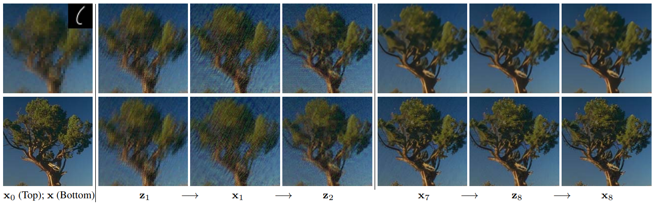
WORKFLOW (Network architecture)
Figure-2: HR estimation in different iterations of USRNet (top row) and USRGAN (bottom row).

Slide 8

Methodology
Image degradation model formulation:
Where :-
$$y={\left(x⊗k\right)\text{↓}}_{s}+n$$
Symbol | Name | What it is | Example
x | HR image | The perfect photo we want | 512x512 sharp cat photo
y | LR image | The bad photo we have | 128x128 blurry cat photo
k | Blur kernel | Pattern of how it blurred | 25x25 motion blur
⊗ | Convolution | Applying the blur | Like smudging
↓ₛ | Downsampling | Making it smaller | Keep 1 out of every sxs pixels
n | Noise | Random grain/dots | Camera sensor noise
s | Scale factor | How much smaller | S=4 means 4x smaller

Slide 9
Methodology (Energy function)
The main problem:
Direct Inversion Doesn’t Work.
We have:
y = (x ⊗ k)↓s + n
We want:
x = ???
What if we reverse it:
x = [(y - n)↑s] ⊗ k⁻¹
Problems:
We don’t know n (noise is random)
k⁻¹ doesn’t exist (deconvolution is ill-posed)
↑s loses information (which pixels to fill)
Multiple x can give same y (infinite solutions)

Slide 10

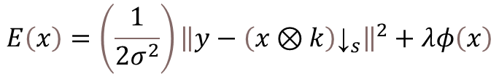
Methodology (Energy function)
Therefore instead of direct inversion, we define what “good” image means
Data Term (clearer estimate)
Enforces the degradation model.
Ensures consistency with the observed data y.
Uses known blur k and scale s.
Prior Term (cleaner estimate)
Enforces natural image characteristics.
Removes noise and artifacts.
Adds realistic details.
$$E\left(x\right)=Data+Prior$$
$$E\left(x\right)=\left(\frac{1}{2σ^{2}}\right){\left\|y−{\left(x⊗k\right)\text{↓}}_{s}\right\|}^{2}+λφ\left(x\right)$$

Slide 11
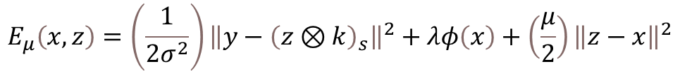
Methodology (Modified energy function)
To minimize E(x), we need to minimize both terms simultaneously (Data term & Prior term) but they are coupled (both depend on x), cant solve one term without affecting the other.
Introduce auxiliary variable z to decouple the problem:
Where :-
z: Auxiliary variable
μ: Penalty parameter
$$E_{μ}\left(x,z\right)=\left(\frac{1}{2σ^{2}}\right){\left\|y−{\left(z⊗k\right)}_{s}\right\|}^{2}+λφ\left(x\right)+\left(\frac{μ}{2}\right){\left\|z−x\right\|}^{2}$$

Slide 12

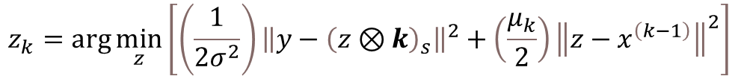
Methodology (ADMM Steps)
subproblem 1: Data term (z update) solved using FFT
Where :-
F, F⁻¹: Fast Fourier Transform and inverse
F̄(k): Complex conjugate
⊙ₛ: Distinct block processing (element-wise on s×s blocks)
αₖ = μₖσ²: Controls data module
d = F(k)F(y↑ₛ) + αₖF(x^(k-1)): Intermediate variable
$$z_{k}=\text{arg}\min_{z}\left[\left(\frac{1}{2σ^{2}}\right){\left\|y−{\left(z⊗k\right)}_{s}\right\|}^{2}+\left(\frac{μ_{k}}{2}\right){\left\|z−x^{\left(k−1\right)}\right\|}^{2}\right]$$
$$z_{k}=ℱ^{−1}\left(\frac{1}{α_{k}}\left(d−\overline{ℱ\left(k\right)}⊙_{s}\frac{\left(ℱ\left(k\right)d\right)⇓_{s}}{\left(\overline{ℱ\left(k\right)}ℱ\left(k\right)\right)⇓_{s}+α_{k}}\right)\right)$$

Slide 13


Methodology (ADMM Steps)
subproblem 2: Prior term (x update), solved using CNN
Where :-
βₖ = λ/μₖ: Controls prior module
Denoiser: solved by CNN
$$x_{k}=\arg{\min_{x}\left[\left(\frac{μ_{k}}{2}\right){\left\|z^{k}−x\right\|}^{2}+λφ\left(x\right)\right]}$$
$$x_{k}=Denoiser\left(z^{k},β_{k}\right)$$

Slide 14
REFERENCES
[1] Deep Unfolding Network for Image Super-Resolution Kai Zhang, Luc Van Gool, Radu Timofte IEEE/CVF Conference on Computer Vision and Pattern Recognition (CVPR), 2020 Foundation for our ADMM-based architecture
[2] Plug-and-Play ADMM for Image Restoration: Fixed-Point Convergence and Applications Stanley H. Chan, Xiran Wang, Omar A. Elgendy IEEE Transactions on Computational Imaging, 2017 Theoretical basis for ADMM in image restoration
[3] Image Super-Resolution Using Very Deep Residual Channel Attention Networks Yulun Zhang, Kunpeng Li, Kai Li, et al. European Conference on Computer Vision (ECCV), 2018 RCAN - Baseline for comparison
[4] ADMM-Net: A Deep Learning Approach for Compressive Sensing MRI Yan Yang, Jian Sun, Huibin Li, Zongben Xu Advances in Neural Information Processing Systems (NeurIPS), 2016 Early deep unfolding network using ADMM
[5] Learning Deep CNN Denoiser Prior for Image Restoration Kai Zhang, Wangmeng Zuo, Shuhang Gu, Lei Zhang IEEE/CVF Conference on Computer Vision and Pattern Recognition (CVPR), 2017 IRCNN - Plug-and-play denoising prior

Slide 15
Thank you

