Slide 1
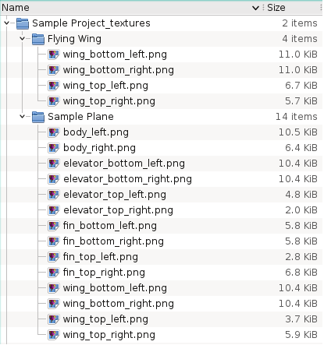
The directory name should be “ProjectName_textures” and be placed next to the ProjectName.xfl file
The texture files should be placed in the following directory arborescence. Directory and file names must not be modified.
.png and .jpg type files are recognized.
If an image file cannot be found, a default image shall be used
It is not necessary to define textures for all surfaces,
The images width and height should preferably be square powers of 2 such as 1024 x 256 pixels. Other dimensions such as 988 x 451 should be avoided.
Plane Name

Slide 2
The textures use only the part of the image file corresponding to the wing’s outline. This is to limit distortion. Minimal distortion is unavoidable however since the wing surfaces are not developable on a flat surface
The image does not need to be in the same height to width ratio as the wing. The texture will be stretched to match the surface’s dimensions. This will induce distortion.
Image width is a power of 2, e.g. 512 pixels
Unused region
Height is a power of 2, e.g. 128 pixels
Root chord
Part of the image which will be pasted on the wing’s surface
Tip chord
Half span
Unused region
Right wing outline
For the body, the whole texture image is projected on the surface. This will induce distortion

