Slide 1
Project Title - Healthcare Analytics for Doctor Visits _TIRTC​
Name - Nikhil vamsi Bandaaru
ID - STU6655f9316508b1716910385

Slide 2


PROBLEM STATEMENT
Healthcare organizations generate large amounts of patient-related data, but identifying meaningful patterns from this data can be challenging.
This project focuses on analyzing healthcare data to understand:
Patterns in doctor visits
Relationship between illness and doctor visits
Differences in healthcare utilization across gender
Association between health conditions and visits
Impact of reduced activity on healthcare visits
Healthcare coverage and chronic-condition patterns
The goal is to use Python-based data analysis and visualization to transform healthcare data into clear and meaningful insights that can support better understanding of healthcare utilization.

Slide 3
Project Description
This project performs exploratory healthcare data analysis to identify patterns related to doctor visits and healthcare conditions.
Key Activities
Load and clean the healthcare dataset
Analyze patient-related variables such as gender, age, income, and illness
Study doctor visit patterns
Analyze health and reduced-activity variables
Examine healthcare coverage and chronic conditions
Compare doctor visits across different groups
Use statistical summaries and visualizations to identify patterns
Present the findings through clear and meaningful charts
Tools Used
Python • Pandas • NumPy • Matplotlib • Seaborn

Slide 4

WHO ARE THE END USERS?
Hospitals and Clinics – to understand patient visit patterns.
Healthcare Analysts – to analyze healthcare data and trends.
Doctors and Healthcare Professionals – to understand patient health patterns.
Healthcare Administrators – to support resource and service planning.
Researchers – to study factors related to healthcare utilization.
Insurance Organizations – to analyze insurance and healthcare-related patterns.

Slide 5

Technology Used
Python – Programming language
Pandas – Data loading, cleaning, and analysis
NumPy – Numerical operations
Matplotlib – Data visualization
Seaborn – Statistical graphs and heatmaps
Google Colab – Development and execution platform
CSV Dataset – Healthcare patient data source

Slide 6
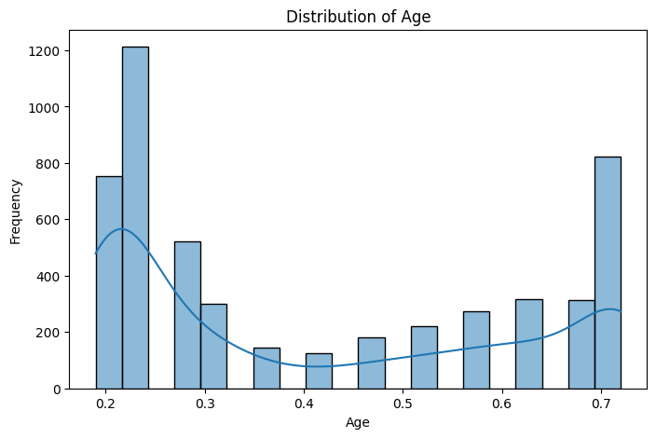
RESULTS

Slide 7
RESULTS
GitHub Repository

Slide 8
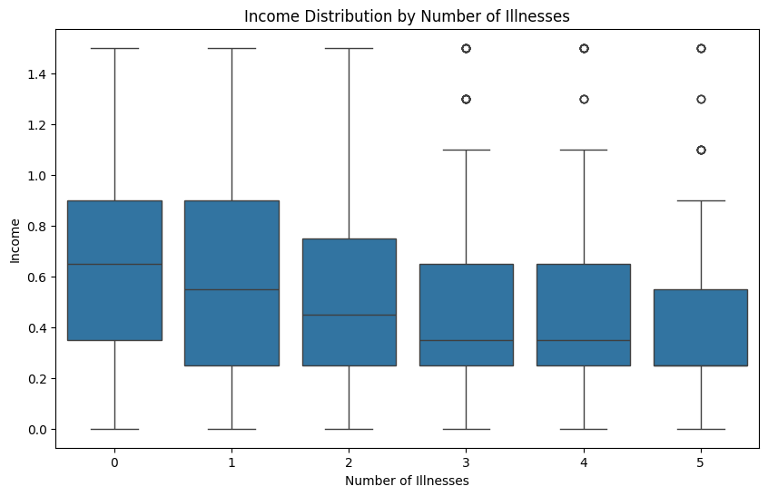

Slide 9
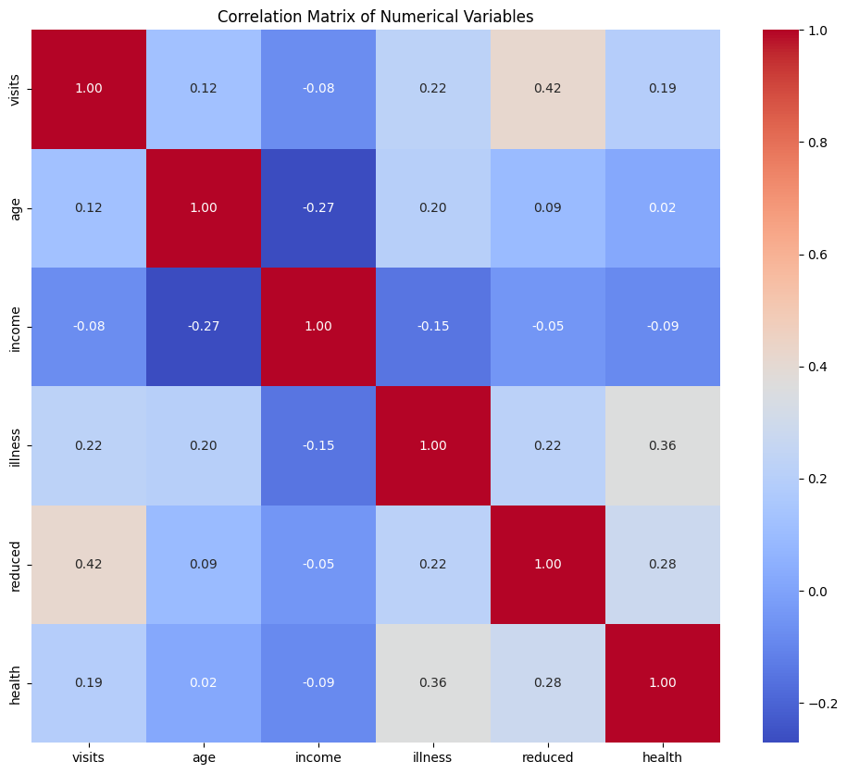

Slide 10
Thank you
.
.

