Slide 1

Project Title - Seasonal Agriculture Performance Analysis
Student Name – NIKHIL VAMSI BANDAARU
College Name - Velagapudi Ramakrishna Siddhartha Engineering College
AICTE STU ID : STU6655f9316508b1716910385

Slide 2

PROBLEM STATEMENT
Agricultural performance is influenced by seasonal variations, environmental conditions, farming practices, resource availability, and market conditions. As a result, agricultural outcomes may vary across different seasons.
However, raw agricultural data does not clearly reveal these seasonal patterns, trends, relationships, and variations.
The objective of this project is to analyze the agricultural dataset and identify meaningful seasonal differences in agricultural performance using data analytics and visualization techniques.

Slide 3
Project Description
This project analyzes agricultural data to identify seasonal patterns, crop-wise performance, profitability, and relationships among key agricultural variables. Using Python, Pandas, NumPy, Matplotlib, and Seaborn, the project performs data cleaning, exploratory analysis, statistical analysis, correlation analysis, seasonal comparisons, and outlier detection. The insights support data-driven agricultural planning, crop selection, and resource allocation.

Slide 4

WHO ARE THE END USERS?
Farmers – To identify profitable crops and suitable seasons for cultivation.
Agricultural Planners – To support seasonal planning and resource allocation.
Government & Policymakers – To understand agricultural trends and support data-driven decisions.
Agribusinesses – To evaluate crop profitability and production patterns.
Agricultural Researchers – To study seasonal variations, crop performance, and agricultural trends.

Slide 5

Technology Used
Python – Programming and data analysis
Pandas – Data cleaning, manipulation, and analysis
NumPy – Numerical computations
Matplotlib – Data visualization
Seaborn – Statistical visualization and charts
Google Colab – Cloud-based development and execution environment
Jupyter Notebook – Interactive analysis and documentation

Slide 6
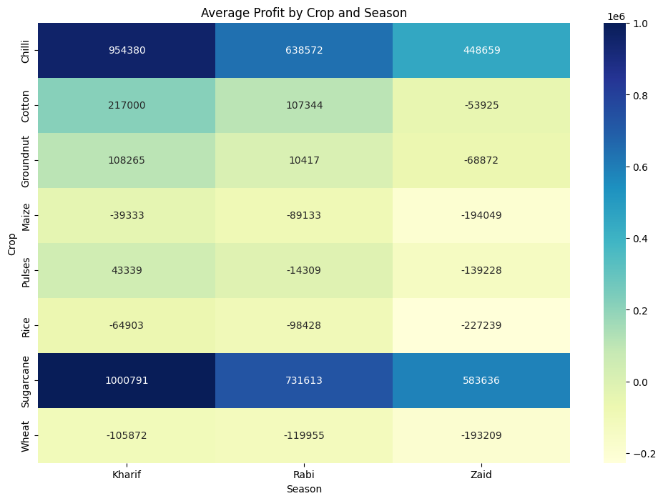
RESULTS
1. Seasonal Profit Performance
Kharif achieved the highest average profit: ₹178,914.65
Rabi: ₹87,689.47
Zaid: -₹24,804.82

Slide 7
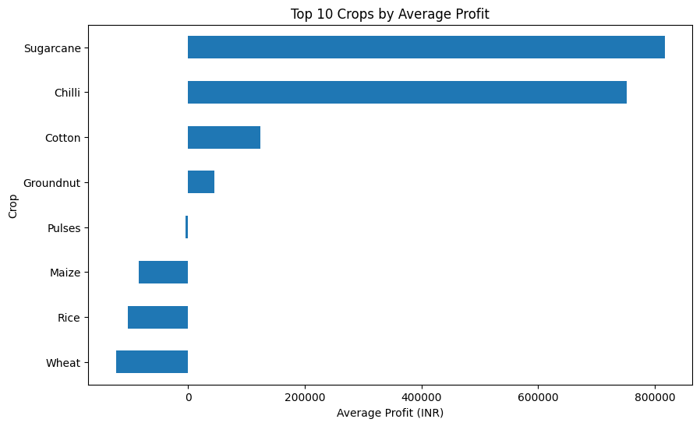
RESULTS
2. Crop Profitability
Sugarcane: ₹817,187.99 average profit
Chilli: ₹750,878.34
Cotton: ₹124,546.92
Wheat, Rice and Maize showed negative average profits.

Slide 8
RESULTS
3. Crop × Season Analysis
The analysis shows that profitability varies depending on both crop and season, helping identify more suitable crop-season combinations.

Slide 9
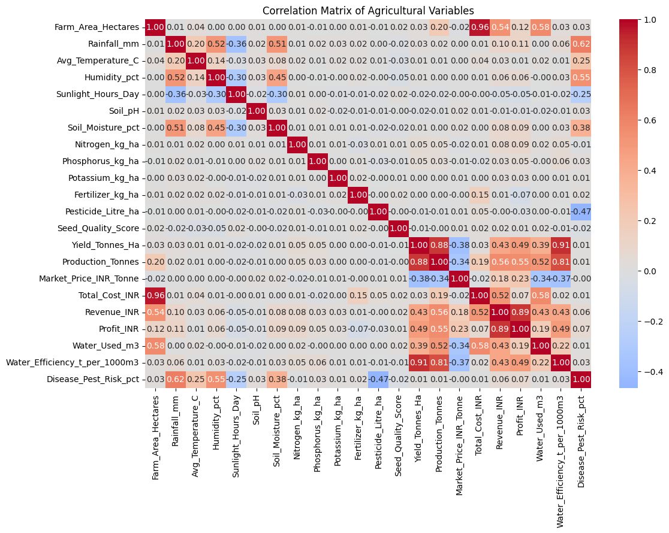
RESULTS
4. Correlation Analysis
Farm Area and Total Cost: correlation = 0.962
This indicates a very strong positive relationship between farm size and total agricultural cost.

Slide 10
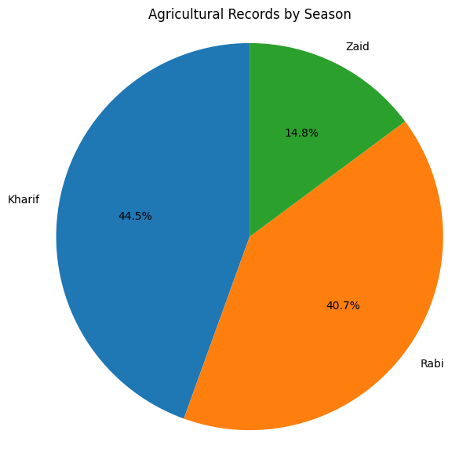
RESULTS
5. Profit & Production Variability
Profit shows the highest number of outliers (10.10%), followed by production (8.33%) and yield (7.55%). This indicates considerable variation in farm-level agricultural performance and highlights the need to investigate unusually high or low-performing observations.

Slide 11
Future Scope
Crop Yield Prediction using Machine Learning
Profitability Prediction for different crops and seasons
Smart Crop Recommendation based on soil and weather conditions
Real-time Weather & Rainfall Integration
IoT-based Soil & Irrigation Monitoring
Market Price Forecasting
Interactive Power BI Dashboard
Farmer-focused Web/Mobile Application

Slide 12
GitHub Link
View Project on GitHub

Slide 13

VOIS Course completion certificate - Course name- Data Visualization

Slide 14
Presented by: Nikhil Vamsi
Seasonal Agriculture Performance Analysis
Project: Data Analytics & Visualization
Thank You Questions & Discussion
.

