Slide 1
Plant Disease Detection
Using Deep Learning and Transfer Learning
Nikhil Jaswaraj Karkera
Student ID: 111369531
University of Colorado Boulder

Slide 2
Why Plant Disease Detection Matters
20-40%
Slow Diagnosis
Traditional methods require experts to physically inspect crops
of global crop production lost
to diseases annually
Limited Access
Rural farmers lack access to trained plant pathologists
Smartphone Solution
Deep learning model on a phone enables instant diagnosis

Slide 3
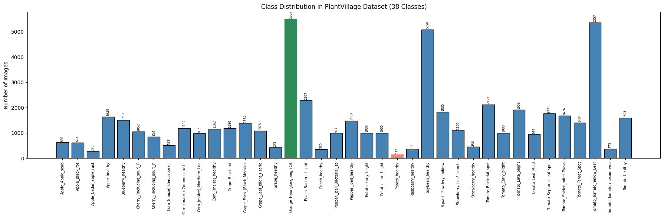
PlantVillage Dataset
54,306
38
14
80/20
Total Images
Disease Classes
Crop Species
Train/Val Split

Slide 4
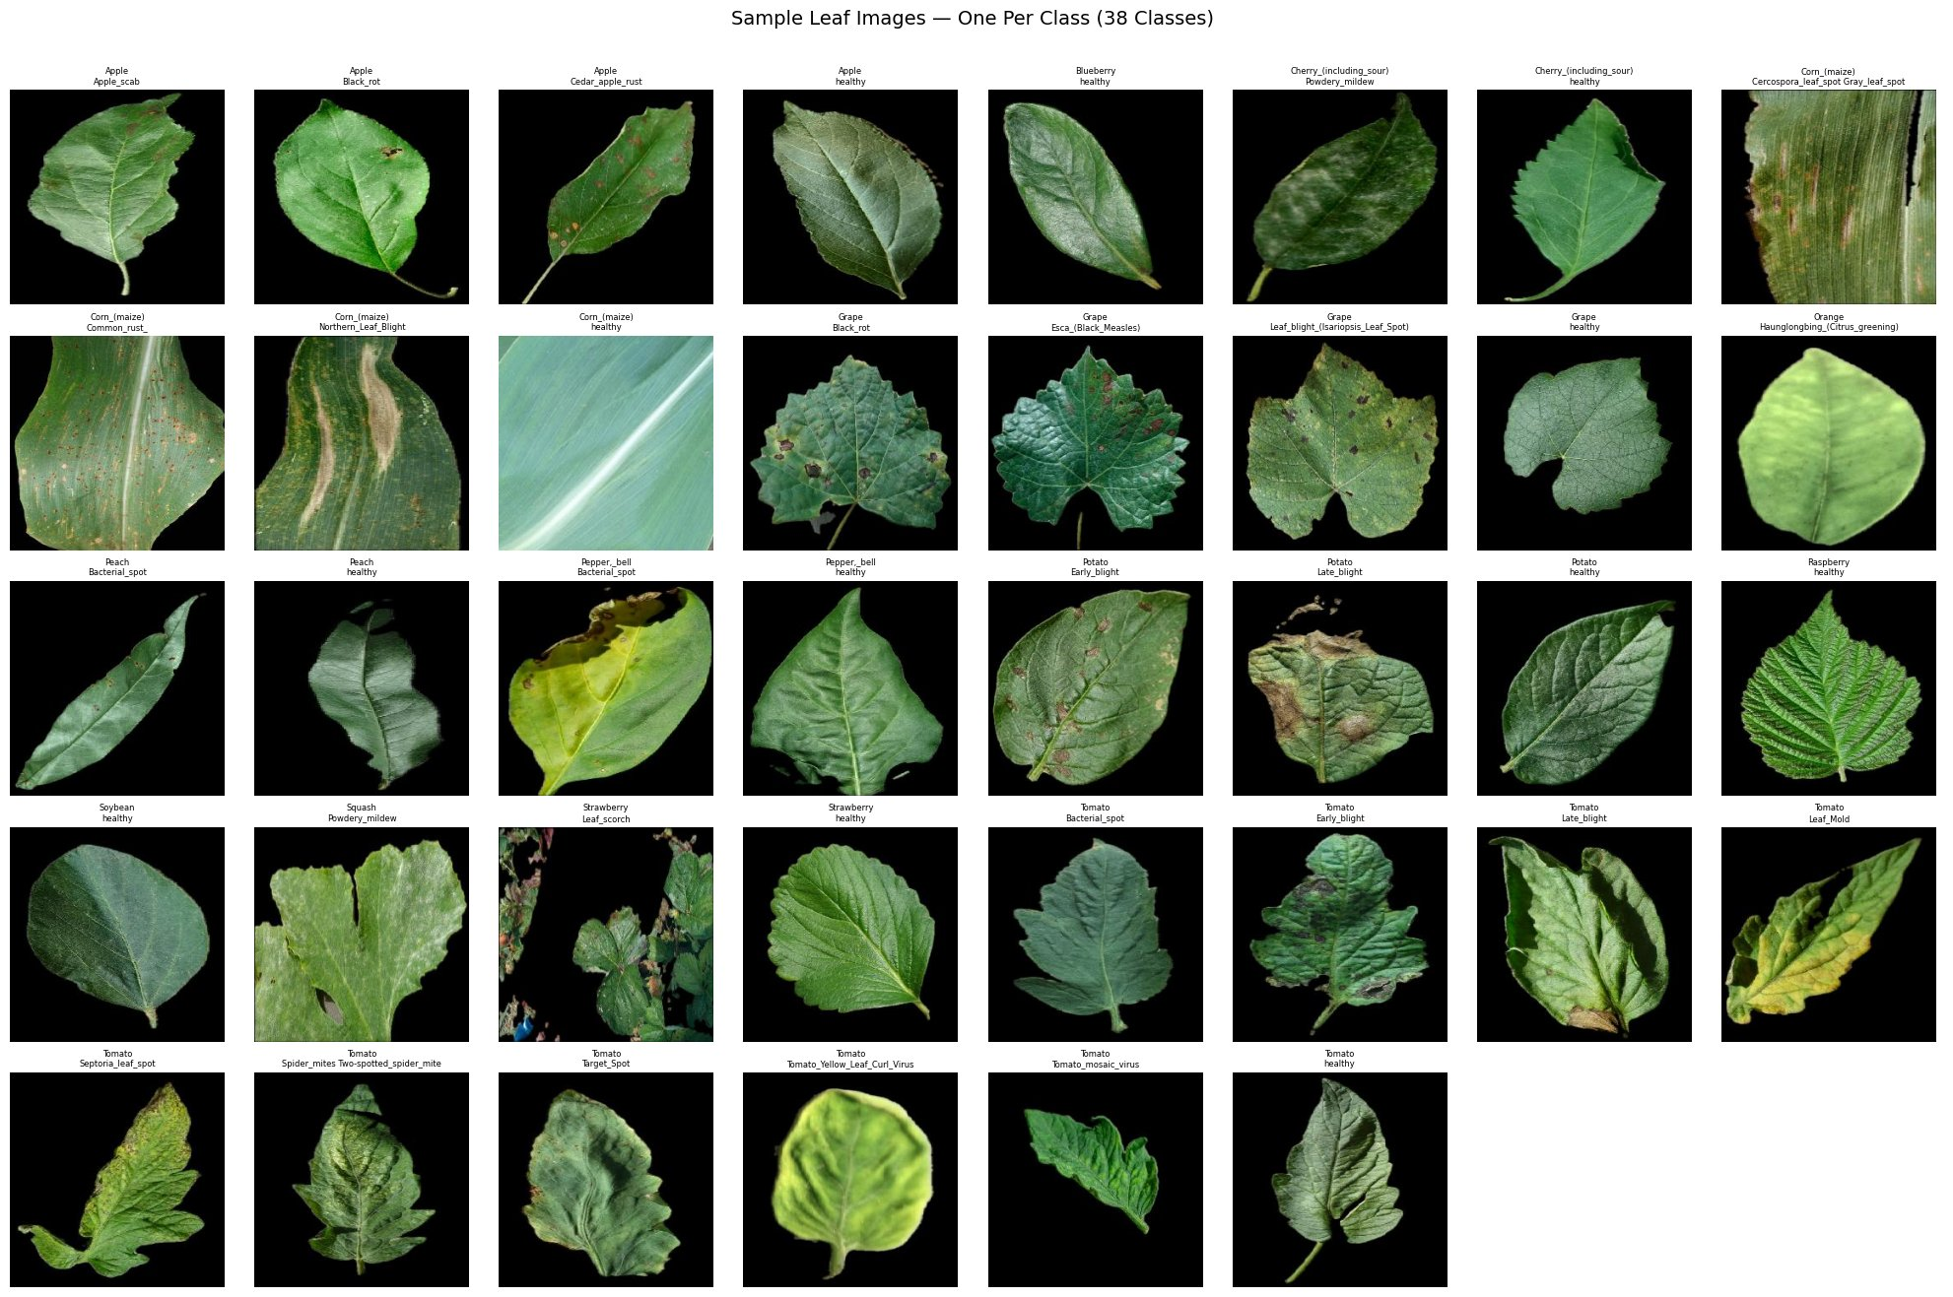
Sample Images — One Per Class

Slide 5
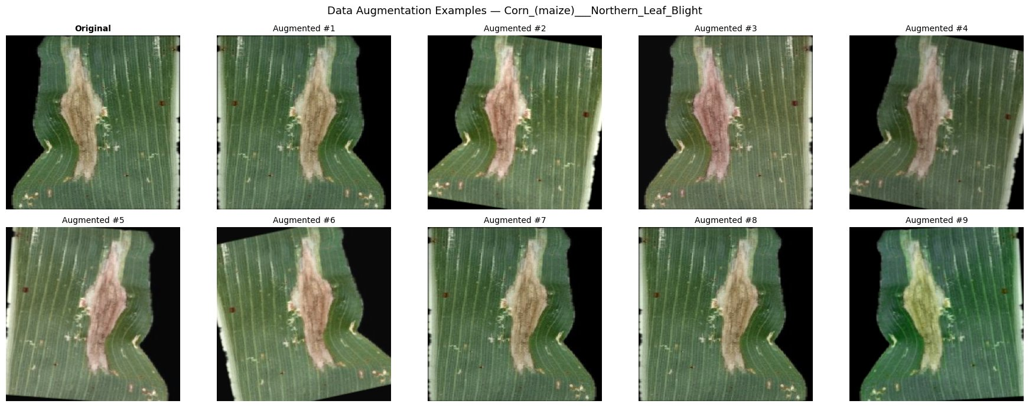
Method: EfficientNet-B0 + Transfer Learning
Input
224×224
→
Pretrained
EfficientNet-B0
→
New Head
38 Classes
→
Prediction
Training Configuration
Data Augmentation
Optimizer:
AdamW (lr=0.001)
LR Schedule:
Cosine Annealing
Loss:
CrossEntropyLoss
Epochs:
10
Batch Size:
32
Parameters:
4.05M (all trainable)

Slide 6
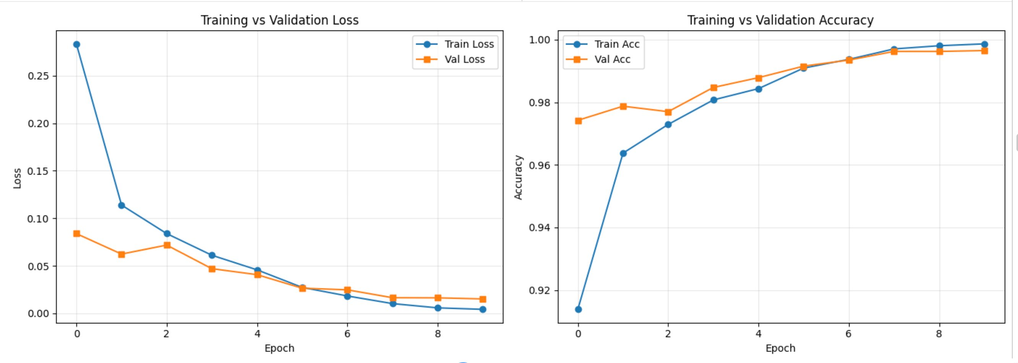
Results: Training Performance
99.65%
38/10,862
0.9965
22/38
Best Validation Accuracy
Misclassified
Weighted F1
Perfect Classes

Slide 7
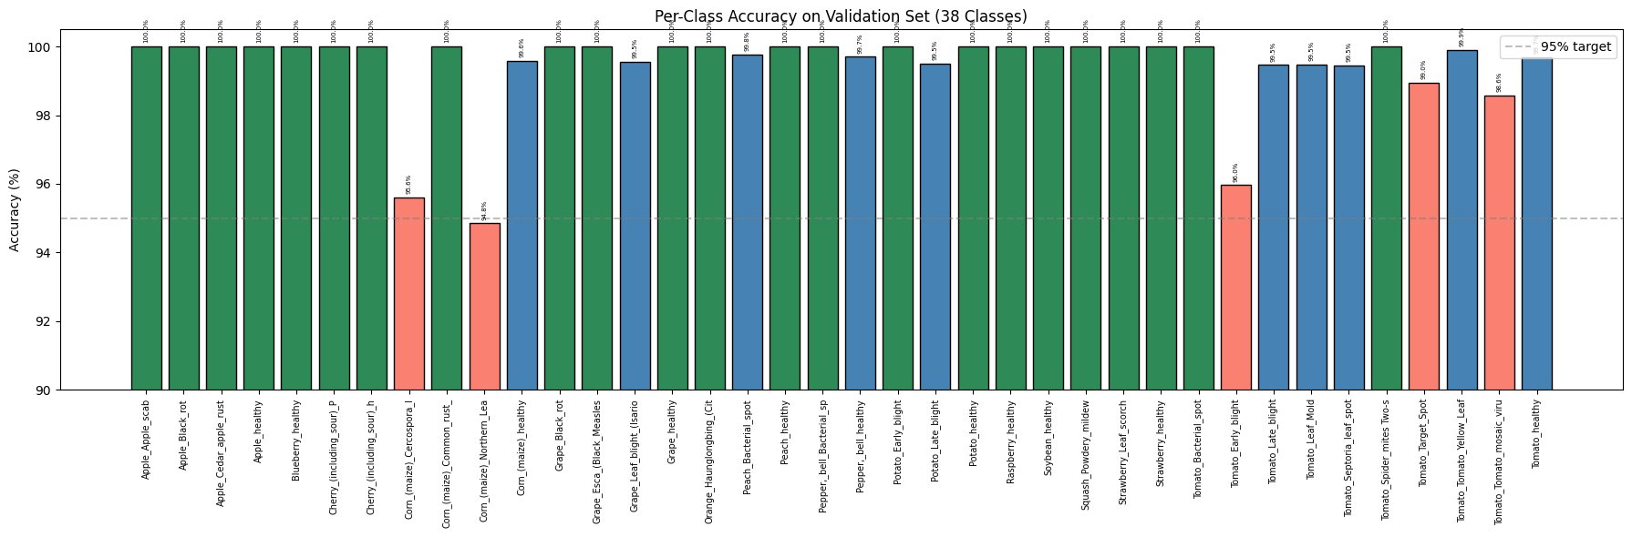
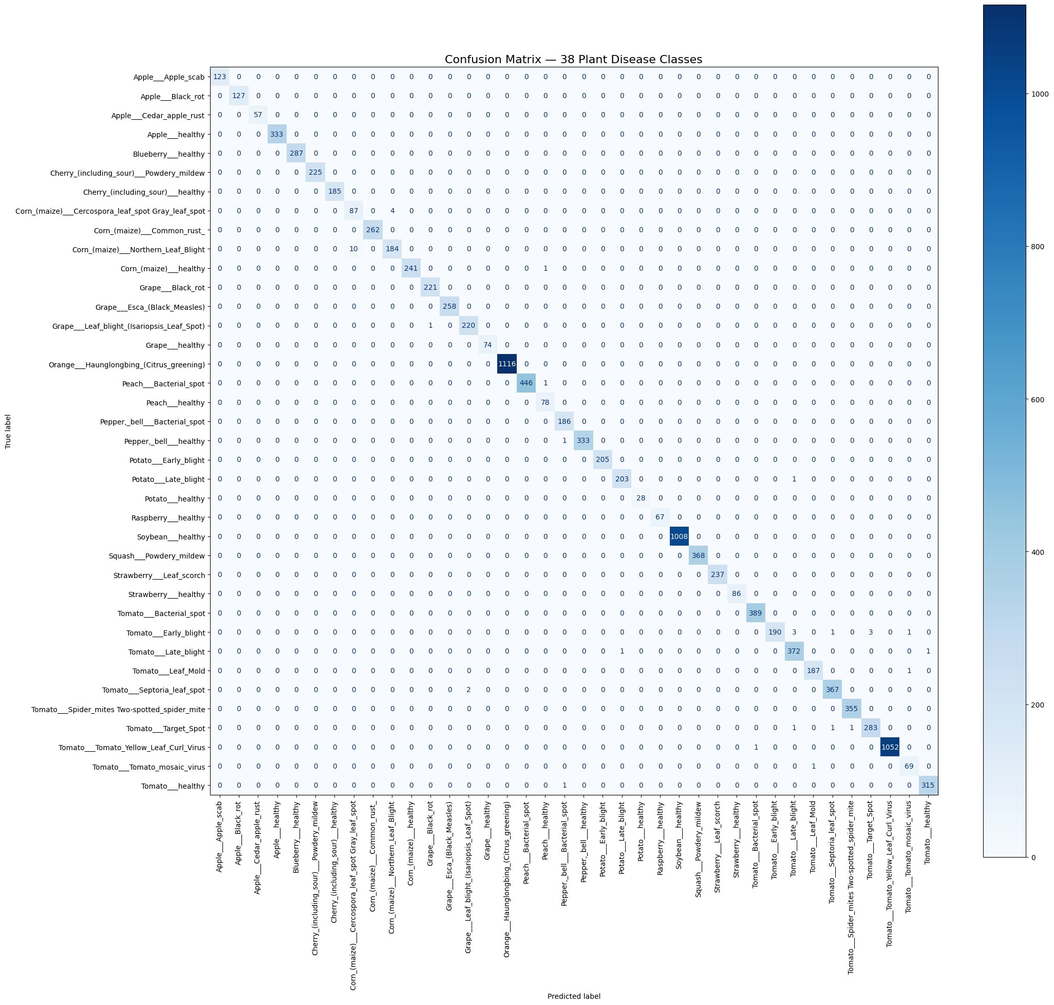
Results: Classification Performance
Top Misclassified Pairs
Corn N. Leaf Blight → Cercospora (10)
Corn Cercospora → N. Leaf Blight (4)
Tomato Early Blight → Late Blight (3)
Tomato Early Blight → Target Spot (3)
Potato Late Blight ↔ Tomato Late Blight (2)

Slide 8
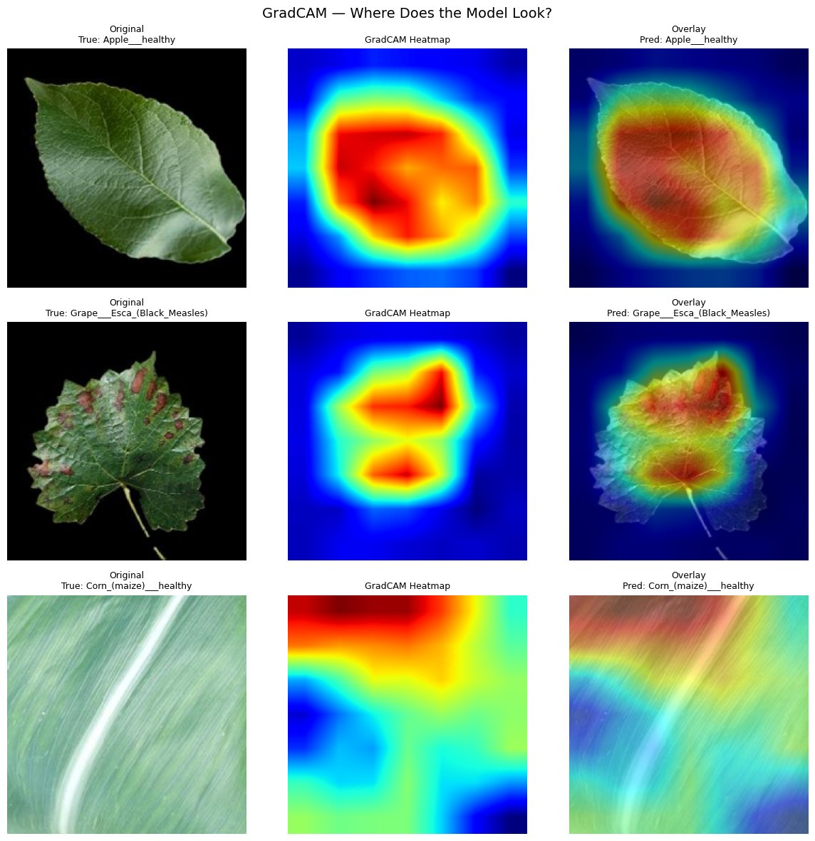
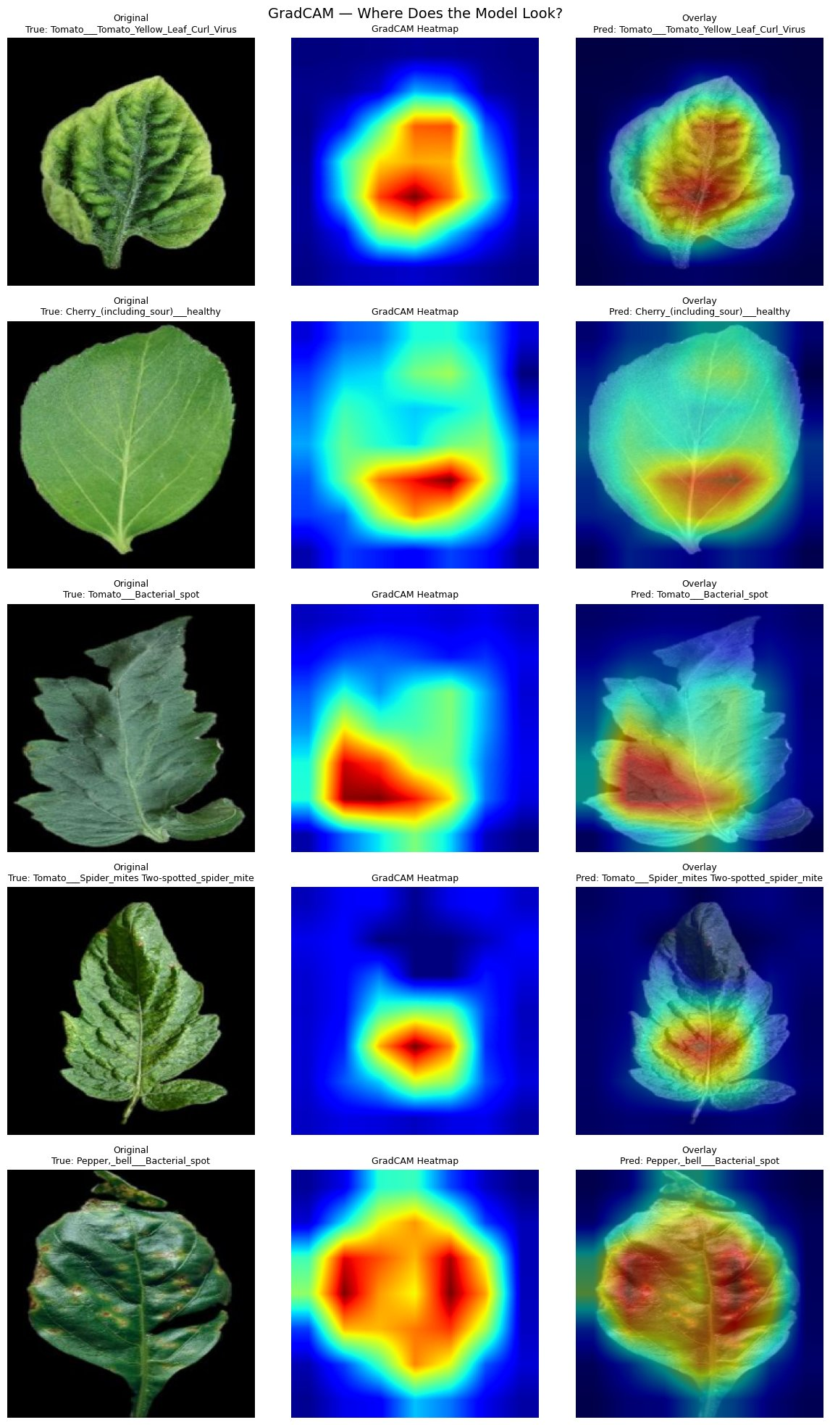
GradCAM: Where Does the Model Look?
The model consistently highlights disease-relevant regions — lesions, spots, and discolored tissue — rather than background artifacts.

Slide 9
Comparison with Published Baselines
Study | Model | Params | Accuracy
Mohanty et al. (2016) | AlexNet | 60M | 95.65%
Mohanty et al. (2016) | GoogleNet | 6.8M | 99.35%
Too et al. (2019) | VGG16 | 138M | 99.27%
Too et al. (2019) | ResNet50 | 25.6M | 99.75%
Ferentinos (2018) | VGG | 138M | 99.53%
Ours | EfficientNet-B0 | 4.05M | 99.65%
EfficientNet-B0 achieves near state-of-the-art accuracy with only 4.05M parameters — 34× fewer than VGG16 and 6× fewer than ResNet50 — making it practical for mobile deployment.

Slide 10
Conclusion & Future Work
99.65% Accuracy
Future Work
Achieved across 38 classes with only 38 misclassifications out of 10,862 images
Test on real field-captured images
Add class-weighted loss for imbalance
Model compression for mobile deployment
Expand to more crop species
Explore Vision Transformers
Interpretable
GradCAM confirms the model focuses on disease lesions, not background artifacts
Efficient
4.05M parameters — small enough for smartphone deployment
Thank You!
Questions?

