Slide 1
Developer wiki using WSO2
Peraiah Karnam
Wednesday, November 29, 2017

Slide 2
Agenda
WSO2 API Manager Overview
How to design REST API using wso2
How to Publish REST API using wso2
API Specification & Governance
Roles and Privileges
WSO2 Console view
References

Slide 3
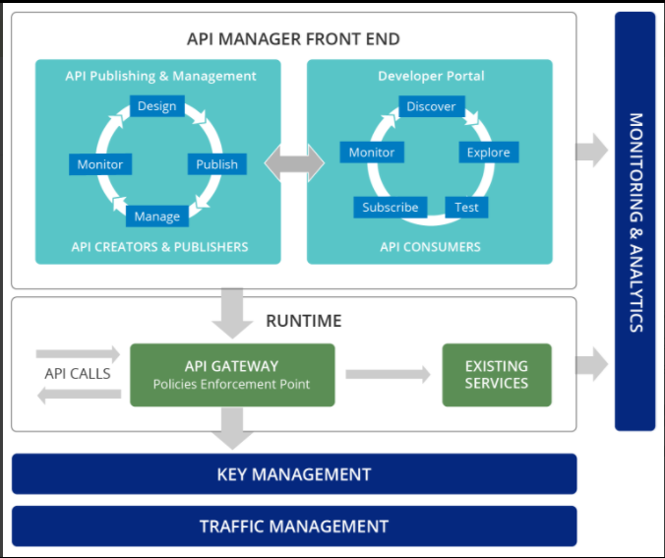
WSO2 API Manager Overview
WSO2 is a fully Open Source, complete solution for designing, creating, publishing and managing all aspects of an API and its lifecycle. The WS02 Product is deployed in SpRX POC environment. The focus of this session is to demonstrate, API publishing & Management and Developer Portal components.
Note that the API GATEWAY and Monitoring & Analytics components are not enabled in the installed configurations. The focus at this point is use WSO2 for API Design, publish and API Governance using Developer Portal (Wiki)
Notes:
Direct access to Elasticsearch, where the data is stored, can be and should be strictly restricted. Only Kabana and Logstash have direct access to Elasticsearch and this access is authenticated and via Transport Layer Security.

Slide 4
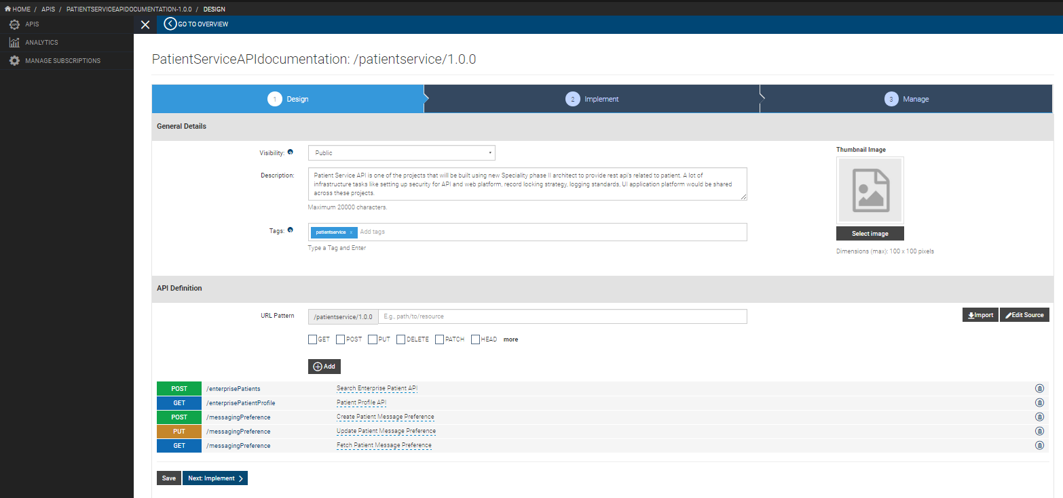
Log in to the API Publisher ( http://10.228.129.72:9443/publisher ) as a user who is assigned the ”creator” role. And then click on Add New API , then Design a New REST API , provide the required information, then add the required end points ( swagger editor option available) and then we can see the below sample API design for one of the patient service.
How to design Rest API

Slide 5
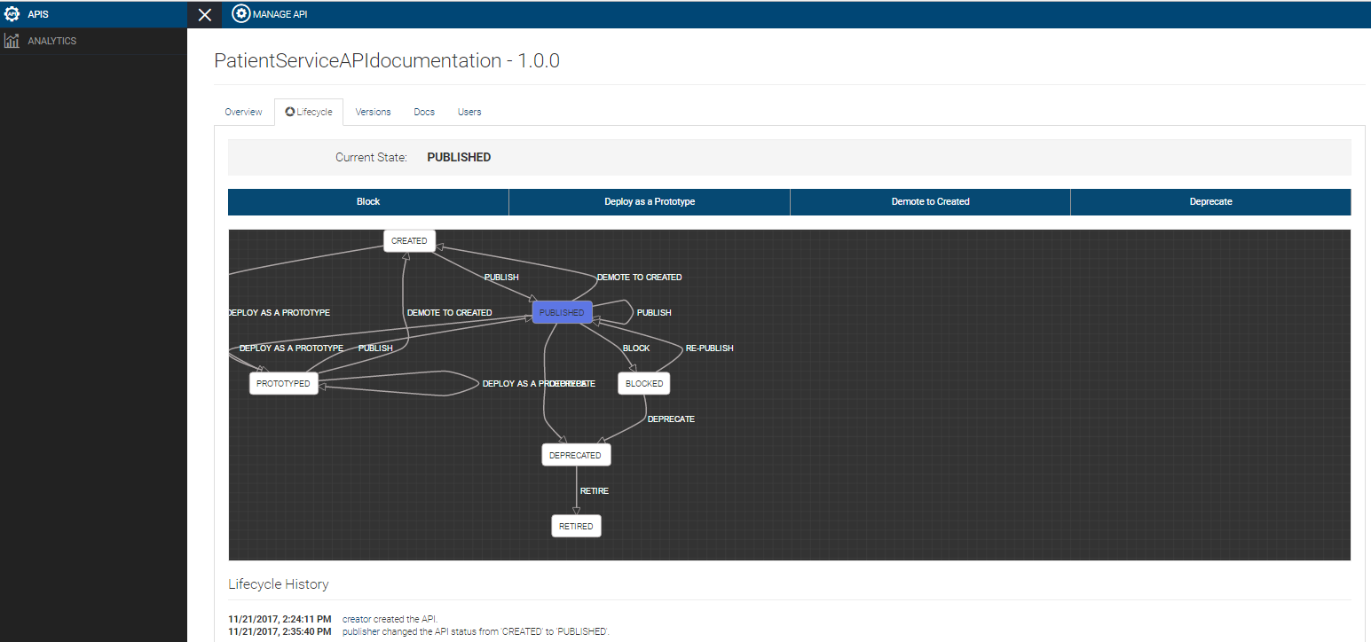
How to publish REST API
Once developer has created Rest API and it should published for availability to the consumers so publisher has to publish the Rest API. Log in to the API Publisher ( http://10.228.129.72:9443/publisher ) as a user who is assigned the ”publisher” role. We can see application status is created and then click on publish(options available), then current status of the application will be published and see the below sample API publish for one of the patient service.

Slide 6
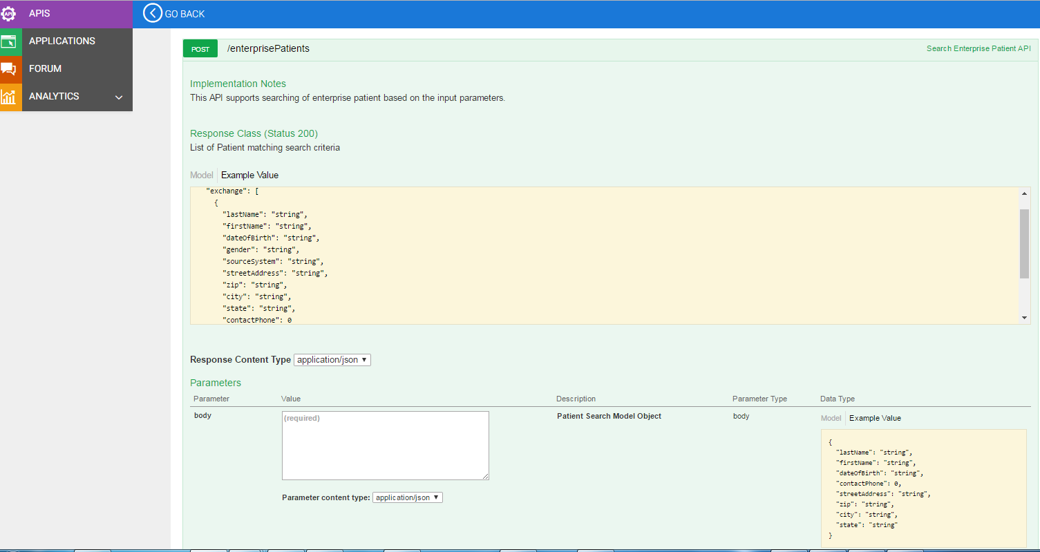
API specification & governance
An important part of API development best practices is planning the API spec. An API spec consists of a plan of how your API should look structurally - like a blueprint of a house. It's a key part of API development because it can help you isolate design flaws or problems before you write a line of code.
Log in to the API Publisher ( http://10.228.129.72:9443/store ) as a user who is assigned the ”consumer” role. And then click on any one of the available services, then click on Api Console tab and then we can see all the Rest end points available in selected service and select one of the end point , then we can see below screen. See the below sample API design for one of the patient service.

Slide 7
Roles and Privileges
Built-in Roles
admin
Custom Roles
creator/developer
publisher/manager
consumer/subscriber

Slide 8
WSO2 Console view
CarbonUIServiceComponent Mgt Console URL : https://10.228.129.72:9443/carbon/
CarbonUIServiceComponent API Publisher Default Context : https://10.228.129.72:9443/publisher
CarbonUIServiceComponent API Store Default Context : https://10.228.129.72:9443/store

Slide 9
References
WSO2 Api Manager- https://wso2.com/api-management/
Design Rest API - https://docs.wso2.com/display/AM200/Create+and+Publish+an+API
Publish Rest API- https://docs.wso2.com/display/AM200/Quick+Start+Guide#QuickStartGuide-PublishingtheAPI
Subscribing to the API- https://docs.wso2.com/display/AM200/Quick+Start+Guide#QuickStartGuide-SubscribingtotheAPI
POC URL - https://10.228.129.72:9443/publisher (creator/creator , publisher/publisher & consumer/consumer)

Slide 10
Thank You

