Slide 2


















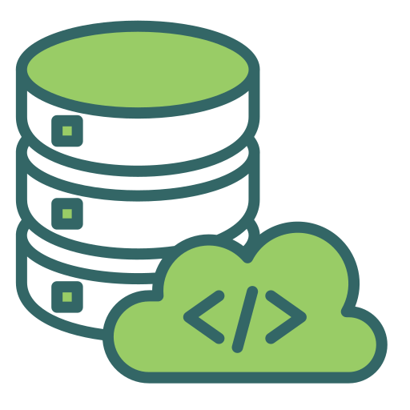

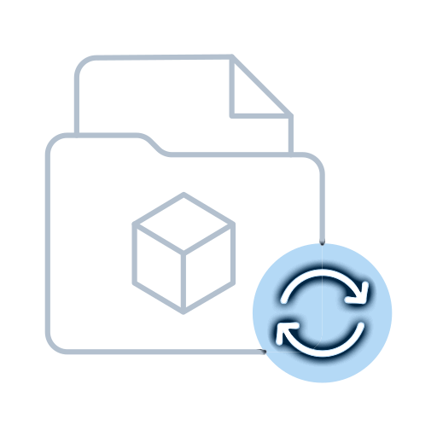


CASPIAN DATALAKE
AWS Cloud
VPC
Caspian Airflow
DST
CDM
AIRFLOW
Kafka lambda Sync connector
Read
Notification
Read File
from Caspian
Caspian data
to Ingress
Ingress
Bucket
Databrick
Job Tigger
File Selector
S3 Sensor
Sales
Connect
Landing
-> Raw
Raw
-> Standard
Broadridge
Standard
Tag Files
Dataset
Producer
MFT
RPO
Replication
Notification
IPS
Landing
Standard
DORIS
Out
Post
Raw
Curated

