Slide 1



SOURCE SYSTEM
Landing Zone
Pre-Processing
MDM
Consumers
Advisor Data
1
1
1
Batch
CDM
Batch
Sales Connect
2
2
Mastering Process
3
2
Batch Consumers
(SLA – 8am EST)
SFDC
Data
Extraction
Data Source Aligned
UX | API
5:00 pm to
8:00 am
CPTS
Cleansing
4
Client Experience
DORIS
9:30 pm
to
2:00 am
IDQ CDM Instance
Standardization
Advisor
Investor
Multiple
Flat Files
Data
Normalization
IPS
Data Enrichment
Advisor
Full Extract
1
3
Match and Merge
Advisor / Intermediaries
Associate Experience
Investor Data
Data
Validation
Golden Records
Data
Enrichment
Trust / Survivorship
Plan Sponsor
SS&C - TA2000
Address
Doctor
Enabling Platforms
SS&C - TRAC
Multiple
Flat Files
Golden Record
(Party ID)
Plan
1
Empower
2:00 pm to
5:00 am
ETL
Rules
DQ Rules
Investor
2
Plan | Retirement Data
Investors
Bright Scope | MMD |
Newport
Denormalized Data Files
ETL
Exceptions
Other Customer DQ Libraries
CDM
Exception Management
Multiple
Flat Files
MDM Repository
(SQL Server)
CDM API
Intermediary Data
Non
Daily
2
DMI|Financial Clarity
API
Framework
File System
Informatica Power Center
Informatica IDQ
Informatica MDM 10.4.1
IDQ Enterprise
Advisor Data
Direct API – Real Time
Metrics Reporting
Digital
Data Governance
4
1
External Data Feeds
Internal Feeds

Slide 2







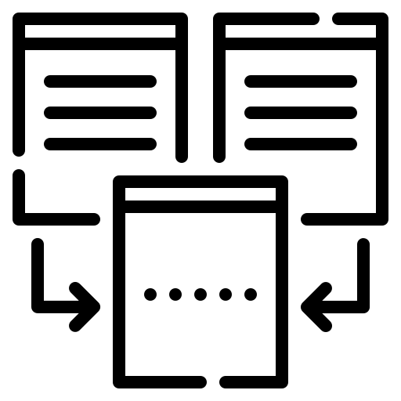



DATA INTEGRATION STORAGE
CDC DATA INTEGRATION
SOURCE SYSTEM
DATA LANDING
DATA INGESTION
MDM PUBLISH
MDM HUB
DATA CONSUMPTION
Denormalized Data Files
Advisor Data
1
Batch
Multiple
Files
Sales Connect
2
SFDC
Change detection or delta processing
data analytics and reporting
CPTS
From landing table process or transform the raw data into structure data.
DORIS
9:30 pm
to
2:00 am
Data quality and validation
IPS
Multiple
CSV Files
Investor Data
2:00 pm
to
5:00 am
internal stakeholders accessing data and reporting
SS&C - TA2000
Landing source File Processing load the data into landing tables
based on prelanding and data integration layer identify delta data and store
based on delta data table records timely entities files generated for MDM ingestion
SS&C - TRAC
Empower
Non
Daily
Plan | Retirement Data
Data governance and integrity
wide distribution to multiple consumers
&
delivery or transmission of data.
Multiple
Flat Files
structured tabular data
Bright Scope | MMD |
Newport
Staging Databases
Intermediary Data
DMI|Financial Clarity
Advisor Data
Data Governance
Digital

Slide 3












Apache Airflow
Workflow automation & scheduling for following data pipeline
Sales Connect
Newport
Amazon s3
Aws Glue
Aws RDS
Amazon s3
MDM
Out Post-Zone:
Data from MDM flows into this Data Lake for further processing, ensuring high availability
Regional Data Processing
Backup & Recovery
MDM Data Ingestion
Efficient Querying
DORIS
Landing-Zone:
Store ingested data before transformation, ensure data availability
Landing Zone data transfers from Pre-Landing Zone using Apache Airflow or an S3 Sensor, ensuring ingestion, validation, and availability for transformation.
MDM (Master Data Management) ensures data accuracy, consistency, and integrity across systems.
Data Cleansing.
Golden Record Creation
Match & Merge
Reference Data Management
Deduplication
Integration with Systems
MMD
Transform-Zone:
processes and enriches data before storage, ensuring quality, consistency, and usability for downstream systems.
Reference Data Enrichment
Business Rules Application
Schema Enforcement
Format Conversion
Delta Processing
Sensitive Data Masking
Staging-Zone:
Stores fully transformed data with the target data model, ensuring consistency and efficient querying.
Bright Scope
OR
Amazon s3
Pre-Landing-Zone:
Multiple source raw data files
Amazon Redshift: Best for large-scale and reporting
CloudWatch
Monitor data transformation logs, errors, and performance metrics in AWS CloudWatch

Slide 4



SOURCE SYSTEMS
ENTERPRISE DATA PLATFORM
INTERNAL SOURCES
C
INFORMATICA XML EXPORTS
DATA INGESTION
Investor
v
C
Demograics
AUTOGEN JOB DATA
C
…
INTERNAL BATCH FILES
Identity
3rd Party Data
….

