Slide 1


AWS Glue & AutoSys ETL Job Orchestration - Cost Overview
Migration of 800 Informatica Jobs to PySpark/AWS Glue
©LTIMindtree | Privileged and Confidential 2022

Slide 2


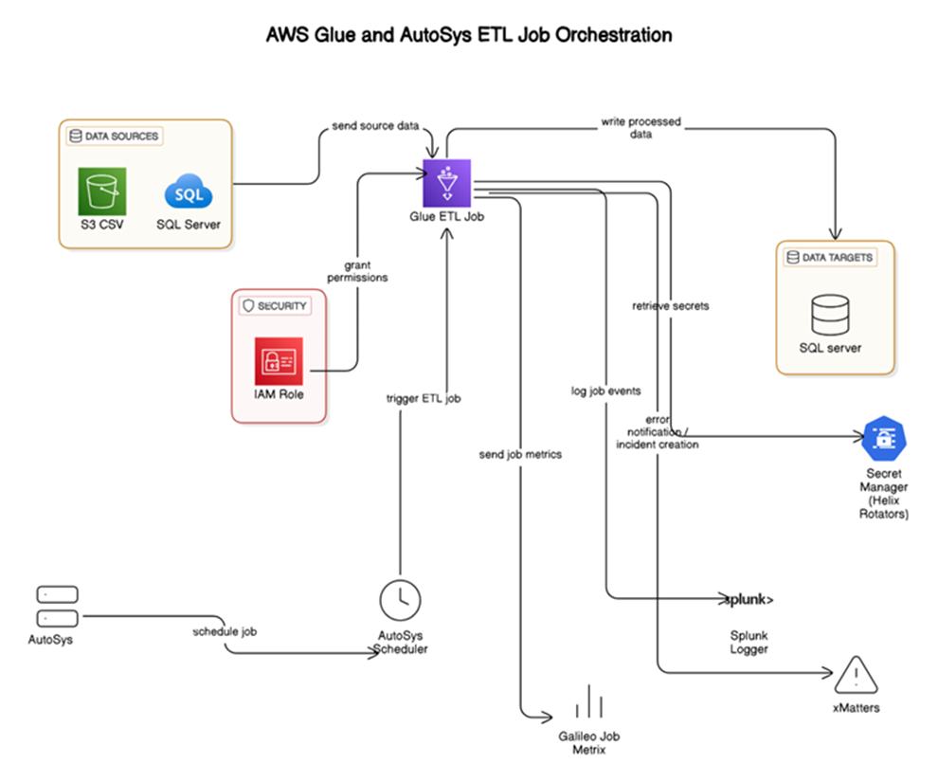
©LTIMindtree | Privileged and Confidential 2025

Slide 3
Costing Assumptions
800 Glue/PySpark jobs migrated from Informatica
Daily: 300 jobs run transferring 1K to 1M records
ETL execution time: ~10 minutes avg/job Data volume/day: ~50M
100M records -AWS Glue Standard worker type used
AutoSys used only for scheduling (license cost assumed external)
©LTIMindtree | Privileged and Confidential 2025

Slide 4
AWS Glue Job Pricing (Estimate)
AWS Glue (v3.0): $0.44 per DPU-Hour (Standard worker)
1 job ~ 2 DPUs for 10 minutes = ~$0.15/job
300 jobs/day × $0.15 = $45/day
Monthly Cost (30 days): ~$1,350
Annual Cost: ~$16,200
©LTIMindtree | Privileged and Confidential 2025

Slide 5
Other AWS Services Pricing
S3 Storage: $0.023/GB/month (~500 GB assumed = $11.50/month)
AWS Secret Manager: $0.40/secret/month (~100 secrets = $40/month)
CloudWatch Logs: ~$0.50/GB ingested (~$30/month estimated)
xMatters & Splunk: External pricing (not AWS-managed)
IAM roles, AutoSys Scheduler: No direct cost if pre-existing
©LTIMindtree | Privileged and Confidential 2025

Slide 6
Total Estimated Monthly Cost
AWS Glue ETL Jobs: $1,350
S3 Storage: $11.50
Secrets Manager: $40
CloudWatch Logs: $30
-------------------------------------------
Total: ~$1,431.50/month
Annual Estimate: ~$17,178
©LTIMindtree | Privileged and Confidential 2025

Slide 7
Comparison: AWS Glue vs Informatica PowerCenter (Cost Perspective)
1. AWS Glue Based Architecture
Component | Monthly Cost | Annual Cost
AWS Glue ETL Jobs (300/day) | ~$1,350 | ~$16,200
S3 Storage (~500 GB) | ~$11.50 | ~$138
Secrets Manager (100 secrets) | ~$40 | ~$480
CloudWatch Logs | ~$30 | ~$360
Total | ~$1,431.50 | ~$17,178
©LTIMindtree | Privileged and Confidential 2025

Slide 8
2. Informatica PowerCenter Licensing
Licensing cost depends on:
Core count
Environment (Dev, QA, Prod)
Throughput/data volume
CPU-based or user-based license
Component | Approx Cost (Annual)
License for 8-core Prod Server | $100,000 – $150,000+
Dev + QA Environment | $40,000 – $60,000
Annual Support (20–25%) | $30,000+
Infra/Server (on-prem) | $10,000+
Total Annual | $180,000 – $250,000+
Note:
These are enterprise-level estimates; actual quotes vary.
This doesn't include hardware, admin, upgrade costs.
©LTIMindtree | Privileged and Confidential 2025

Slide 9
Summary Comparison
Criteria | AWS Glue (Cloud-native) | Informatica PowerCenter (Traditional)
Initial Cost | Pay-per-use, $0 upfront | High upfront license + infra
Monthly Cost | ~$1,431 | ~$15,000+ equivalent
Flexibility | High (scale up/down) | Rigid (fixed infra/license)
Infrastructure | Serverless | On-prem or costly VMs
Maintenance | Managed by AWS | Requires dedicated admin team
Upgrade path | Automatic | Manual, costly
Cost Transparency | Fully transparent | Opaque / Negotiated
©LTIMindtree | Privileged and Confidential 2025

Slide 10

THANK YOU
©LTIMindtree | Privileged and Confidential 2022
LTIMindtree Limited is a subsidiary of Larsen & Toubro Limited

