Slide 1
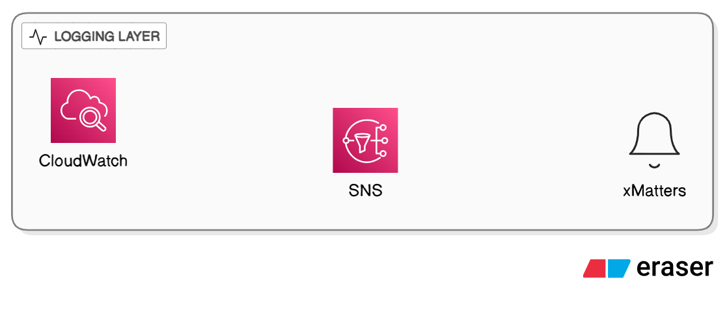
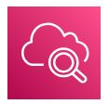
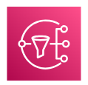

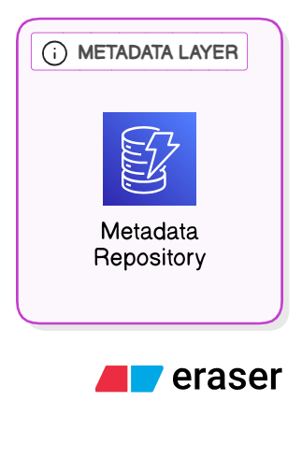
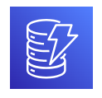
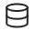
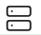

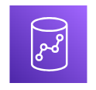

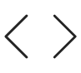
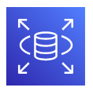
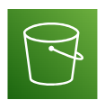
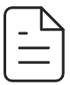
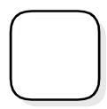
log archival actions
LOGGING LAYER
log job status
log job status
trigger alerts
send notifications
Cloud watch
SNS
xMatters
read/write configs
METADATA LAYER
read table info
Metadata Repository
TARGET LAYER
LOGGING LAYER
Airflow
submit ETL job
write cleansed data
EMR Serverless (Pyspark)
Redshift
Airflow Python Task
PROCESSING LAYER
S3(Raw/Source Data)
read CSV files
SQL Database
scan for files >30d
CSV files
Transition to glacier flexible retrieval
move files to archive
S3(Archive/Source- Data/)
S3 Glacier

Slide 2
