Slide 1

IILM UNIVERSITY
Greater Noida, Uttar Pradesh
Internship Report Presentation
Community Teaching & Social Outreach Programme
STUDENT NAME
Nikhil Mani Tripathi
ENROLLMENT NUMBER
25SCS1003000720
PROGRAM & SEMESTER
B.Tech CSE — 3rd Semester
ORGANIZATION
Mahila SewaShakti Foundation

Slide 2
01
Acknowledgement
I am using this opportunity to express my gratitude to everyone who supported me throughout this internship — for their guidance, encouragement and constant support during this journey.
I extend my heartfelt thanks to Ms. Sarita, our mentor at the NGO, for her constant guidance, patience and encouragement. Her supervision made this experience truly meaningful.
I am also thankful to Mahila SewaShakti Foundation for the opportunity to be part of this social internship, and to my institute, IILM University, Greater Noida, and the faculty of the School of Computer Science and Engineering, for their continuous support.
Finally, I express my gratitude to my parents for their blessings, and to my fellow group members for their teamwork and cooperation throughout the internship.
Nikhil Mani Tripathi | 25SCS1003000720
2

Slide 3
02
Internship Completion Certificate
✓
Certificate to be inserted here
Place the scanned copy of the Internship Completion Certificate issued by Mahila SewaShakti Foundation on this slide.
Tip: Insert → Picture, then resize the certificate image to fit within this dashed frame.
Nikhil Mani Tripathi | 25SCS1003000720
3

Slide 4
04
Introduction
2 hrs
per weekly session
This report presents a detailed account of the social internship undertaken with Mahila SewaShakti Foundation, as part of the B.Tech (CSE) programme at IILM University, Greater Noida.
Unlike a conventional technical internship, this was a group social internship in which our team taught students of Classes 1st, 3rd and 5th at the foundation's centre — strengthening their academic foundation and developing our own communication, patience, teamwork and social responsibility.
4
sessions over 1 month
3
classes taught (I, III, V)
Nikhil Mani Tripathi | 25SCS1003000720
4

Slide 5
05
Organization Profile
Mahila SewaShakti Foundation
Non-Governmental Organization (NGO)
Mahila SewaShakti Foundation works towards the welfare, empowerment and education of underprivileged communities, with a special focus on women and children.
Learning Centre
Focus Area
Volunteer-Driven
Runs a learning centre for students from nearby areas who lack access to consistent quality schooling.
Education support, welfare and empowerment of women and children in underprivileged communities.
Depends on student volunteers and interns to conduct remedial classes and mentor children.
Nikhil Mani Tripathi | 25SCS1003000720
5

Slide 6
06
Problem Statement
A large number of children studying at the foundation's centre come from economically weaker backgrounds and do not always have access to consistent schooling, guidance, or academic support at home.
As a result, many students lag behind the learning level expected for their class.
The internship was designed to address this gap by providing focused, small-group remedial teaching to students of Classes 1st, 3rd and 5th, and to help identify and support students who were struggling the most.
Core Gap Identified
Inconsistent schooling
Lack of home academic support
Students below expected class level
Need for individualized, small-group teaching
Nikhil Mani Tripathi | 25SCS1003000720
6

Slide 7
07
Objectives of the Internship
Conduct engaging and effective teaching sessions for students of Classes 1st, 3rd and 5th.
Assess the existing academic level of each student and identify learning gaps.
1
2
Help students improve their basic reading, writing, and mathematical skills.
Build confidence among students and encourage active participation in class.
3
4
Work collaboratively as a group of interns under the guidance of the NGO mentor.
Develop soft skills — patience, communication, empathy and responsibility.
5
6
Nikhil Mani Tripathi | 25SCS1003000720
7

Slide 8
08
Scope of the Internship
The scope of this internship was limited to conducting in-person teaching sessions at the Mahila SewaShakti Foundation centre — once every week on Mondays, for two hours per session, spread across one month.
WHERE
WHEN
DURATION
SUBJECTS
Mahila SewaShakti Foundation centre — in-person sessions
Every Monday, one session per week, across one month
Two hours per teaching session
Mathematics (counting, tables, multiplication, division) & language skills
Nikhil Mani Tripathi | 25SCS1003000720
8

Slide 9
09
Teaching Methodology & Activities
Our group followed a hands-on, student-centric teaching approach. Each session began with a quick assessment of what students remembered from the previous week, followed by focused teaching, one-on-one doubt-clearing, and group activities. As students belonged to different classes and learning levels, we divided ourselves within the group so each intern could focus on a smaller group or individual student, ensuring no child was left behind.
1
2
3
4
Quick recap assessment
Whiteboard-based teaching
One-on-one doubt clearing
Group activities & board practice
Topics covered: number counting, multiplication tables, basic division and multiplication word problems, and language & reading practice.
Nikhil Mani Tripathi | 25SCS1003000720
9

Slide 10
10
Observations
Wide Variation in Levels
Key Takeaways
Even within the same class, some students were exceptionally smart and quick to grasp new concepts — already ahead of their grade level. Others in Class 5th were not yet familiar with basic Class 1st level counting and reading.
Highlighted real, on-ground challenges faced by underprivileged students lacking consistent quality education.
Reinforced the importance of individualized attention over a one-size-fits-all method.
Shy students gradually became more comfortable and participative as sessions progressed.
Patience and consistent encouragement visibly improve a student's willingness to learn.
Nikhil Mani Tripathi | 25SCS1003000720
10

Slide 11
11
Session-wise Schedule
Session | Class Group | Focus Area / Activity
Session 1 (Week 1) | Class III – Remedial | Introduction: assessment of reading, writing & number skills; basic counting and place value (1000–1500 range).
Session 2 (Week 2) | Class III & V – Combined | Mental maths practice (multiplication & division problems), Hindi reading.
Session 3 (Week 3) | Class I, III & V – Group | Table learning (14–19), basic division and multiplication word problems, handwriting practice.
Session 4 (Week 4) | Class I, III & V – Review | Recap of topics, one-on-one doubt clearing, encouraging weaker students, oral tests to track improvement.
Nikhil Mani Tripathi | 25SCS1003000720
11

Slide 12
12
Learning Outcomes
Gained practical, hands-on experience in teaching and mentoring children from underprivileged backgrounds.
Learned to identify and adapt to different learning levels within the same group of students.
Developed patience, empathy, and effective communication through direct interaction with children.
Understood the value of teamwork by coordinating with fellow interns to manage a diverse group.
Experienced a strong sense of satisfaction and personal fulfilment through teaching and contributing.
“
Beyond academic objectives, watching these children slowly improve, gain confidence, and enjoy learning was an extremely satisfying and joyful experience — giving us a deep sense of purpose over just one month.
Nikhil Mani Tripathi | 25SCS1003000720
12

Slide 13
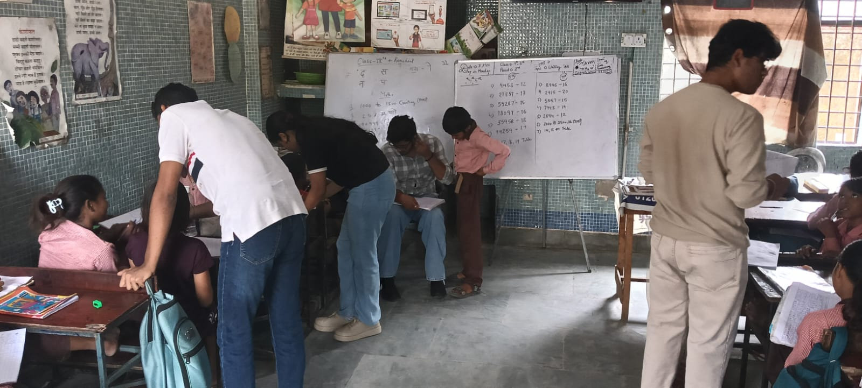
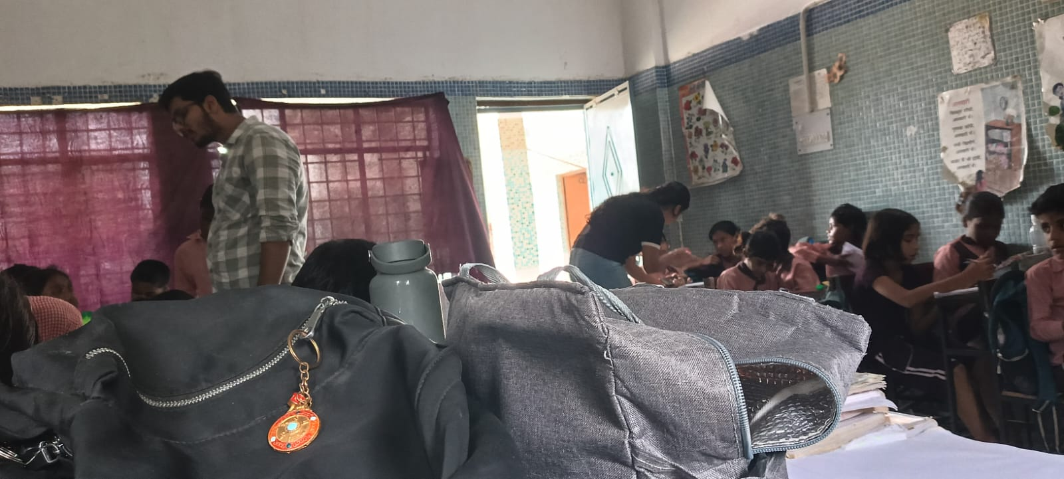
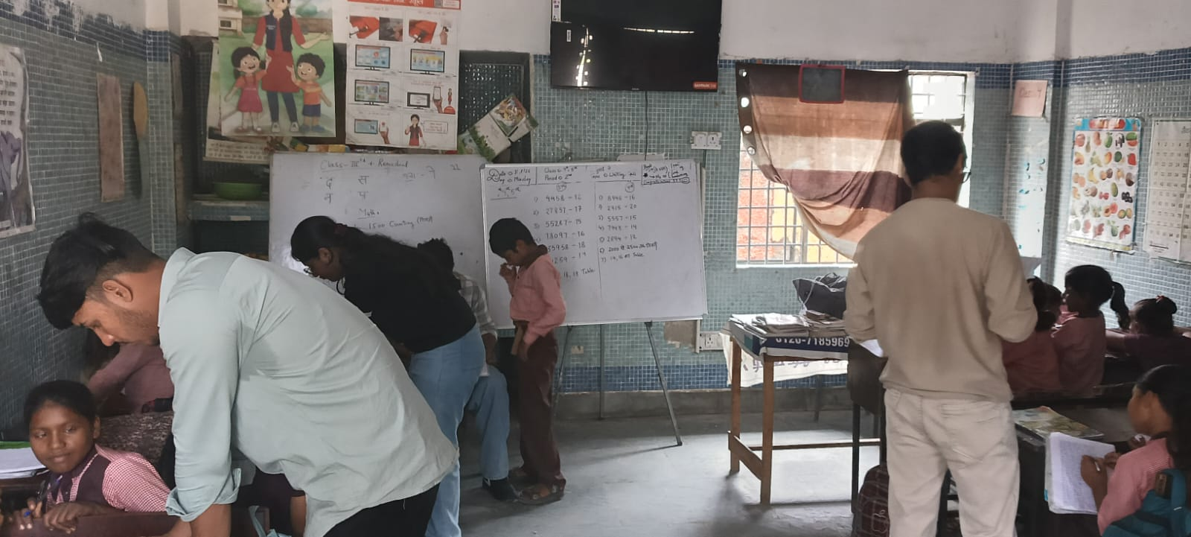
13
Photographs of the Internship Activity
Group members teaching students at the Mahila SewaShakti Foundation centre.
An intern helping students with their classwork during a Monday session.
Whiteboard teaching session for Class III and V remedial batch.
Nikhil Mani Tripathi | 25SCS1003000720
13

Slide 14
Conclusion
This social internship with Mahila SewaShakti Foundation was a truly enriching and eye-opening experience. Working as a group to teach students of Classes 1st, 3rd and 5th allowed us to step outside the conventional technical scope of our degree and contribute meaningfully to society.
It taught us that education is not just about delivering a fixed curriculum, but about understanding each student's individual needs and helping them grow at their own pace.
I am extremely thankful to Ms. Sarita, our mentor at the NGO, for her constant guidance and support. This internship has left me with valuable memories, a deeper sense of social responsibility, and a genuine appreciation for the effort that goes into shaping young minds.

Slide 15
Thank You
Nikhil Mani Tripathi • 25SCS1003000720
B.Tech CSE, 3rd Semester • IILM University, Greater Noida

