Slide 1
Transfer PA
Verify + Upload PA
Credentials
Download (existing) PA
User
Login
Download Logs
Request Public Key
RFM info

Slide 2
Application layer
Necessary because application layer must have access to core libraries
GUI
Services
Middleware
Base reuse

Slide 3






Login Button
Login
Enter username password
Wrong
username
Connection request to server
Enter username
and password
Display the success/error
Change the circle colour (red/green)
Wrong
password
Credentials correct?
No
Disconnected from RFM server
Connected to RFM server
Yes
Enter server IP and port
Send Conn Req
Login
success?
No
Yes
Change login
text to logout

Slide 4

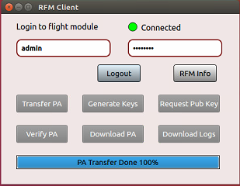
Transfer PA Button
Transfer PA
Open window
to select the file
No file selected
Check for valid credentials and connection to RFM server
Open window and select the PA
file from location
Send the PA length to server
sendPacket(_TRANSFER_PA)
sendPAdata() upon +ve acknowledgement
Packet recd
by server?
Timeout (1.5 sec)
Display results/errors in progress bar
Yes
Send the PA
data in bytes
Send all data
All data
recd ack by
server?
No
Yes
Show result on progress bar

Slide 5
Verify PA Button
Check for valid credentials and connection to RFM server
sendPacket(_VERIFY_PA)
Show progress bar for verification
Show progress bar for upload PA to FC
Display results/errors

Slide 6

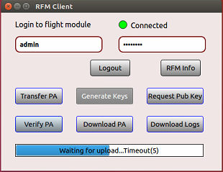


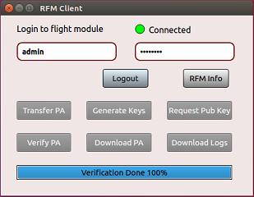



Waiting for upload
Verify PA
No
Upload resp ok?
Yes
Send the request packet to server
No
PA verify resp ok?
Upload complete
Yes
Yes
PA Signature ok?
Yes
Drone ID match ok?
Yes
Server has drone ID?
No
No
No

Slide 7



Download PA Button
Download PA
Check for valid credentials and connection to RFM server
Send request packet to server
sendPacket(_DOWNLOAD_PA)
Resp for
length ok?
No
Receive num bytes length in PA
Receive all the data bytes from server
Yes
Open window, select file and write
Receive all data bytes from server
Open window
to select the file
File saving
ok?
No
Yes

Slide 8



Request Pub Key Button
Request Pub Key
Check for valid credentials and connection to RFM server
Send request packet to server
sendPacket(_REQ_PUB_KEY)
Resp for
length ok?
No
Receive num bytes length in key
Receive all the data bytes from server
Yes
Open window, select file and write
Receive all data bytes from server
Open window
to select the file
File saving
ok?
No
Yes

