Slide 1


DEEP FAKE
DETECTION

Slide 2


Introduction
1. Rise of Digital Media: Advances in mobile camera technology and social media platforms have made video creation and sharing more accessible than ever.
2. Deepfake Technology: Deep generative models like GANs and Autoencoders enable the creation of hyper-realistic fake videos, posing new challenges for society.
3. Potential Threats: Deepfakes can spread misinformation, cause social unrest, and harm reputations, making their detection critically important.
4. Need for Detection: The availability of open-source deepfake tools has increased the realism and prevalence of fake videos, necessitating reliable detection methods.
5. Project Aim: Our project focuses on leveraging deep learning techniques to effectively detect and classify deepfake videos, ensuring the safety and integrity of digital media.

Slide 3
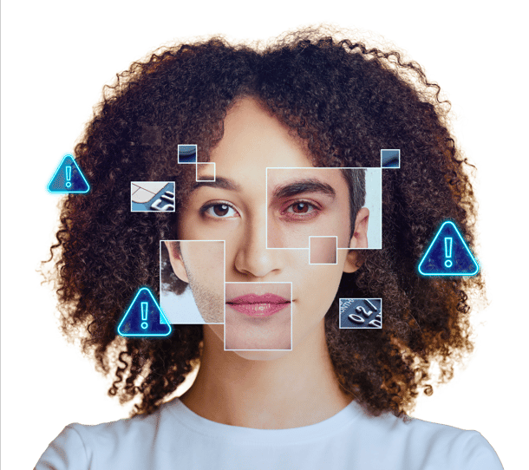
Objectives
1. Deepfake Detection: Develop a robust deep learning model combining ResNeXt CNN and LSTM to accurately identify deepfake videos by analyzing frame-level features and temporal changes.
2. Real-Time Application: Create a user-friendly interface for real-time video upload and classification, providing results with high confidence to combat deepfake threats effectively.

Slide 4


Project Overview
Deepfakes are generated using tools like GANs and Autoencoders, can manipulate video authenticity with alarming realism. Our solution integrates ResNeXt CNN for extracting frame-level features and LSTM-based RNN for analyzing temporal sequences, enabling effective classification of videos as real or fake.
To ensure robustness, the model was trained on diverse datasets, including FaceForensics++, Deepfake Detection Challenge, and Celeb-DF.
We also developed a user-friendly application to enhance accessibility. Users can upload videos, which are processed through the model to deliver real-time classification results with confidence scores.

Slide 5
Literature Survey
1. Face Warping Artifacts : Detects artifacts by comparing generated face areas with surroundings using CNN. Limited resolution of deepfake images; lacks temporal frame analysis.
2. Detection by Eye Blinking : Uses eye blinking patterns for classification with LRCN. Eye blinking alone insufficient due to advanced deepfake algorithms; suggests adding parameters like facial wrinkles and eyebrow placement.
3. Capsule Networks : Detects forged images/videos using capsule networks. Random noise during training affects real-time data performance; lacks robustness.
4. Recurrent Neural Network : Combines RNN for sequential frame analysis with ImageNet pre-trained models. Dataset (HOHO) limited to 600 similar videos, unsuitable for real-time application.
5. Synthetic Portrait Videos : Extracts biological signals from facial regions to classify videos using PPG maps and CNN. High accuracy but struggles with formulating a differentiable loss function to preserve biological signals.

Slide 6
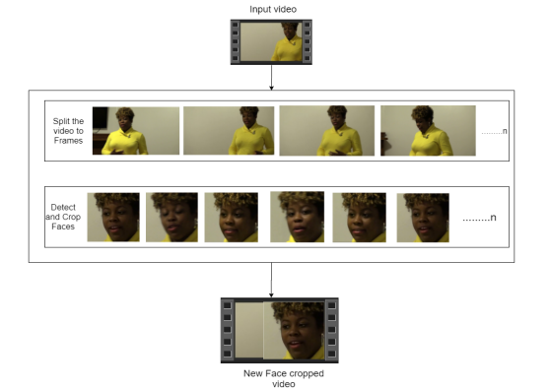
Process
1
Data-set Gathering: We created a balanced dataset of 6000 videos (50% real, 50% fake) by combining FaceForensics++, DFDC, and Celeb-DF. Audio-altered videos from DFDC were removed during preprocessing.
2
Pre-processing: Videos are split into frames, faces are cropped, and frames without faces are removed. Only the first 150 frames are kept to manage computation. Processed videos are saved at 112x112 resolution and 30 fps in sequential order for LSTM.

Slide 7
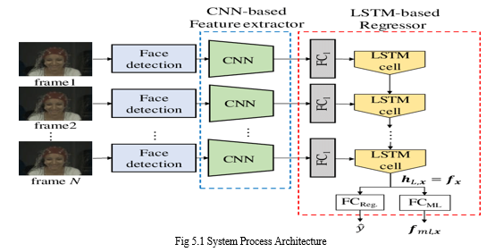
Process
3
Data-set split : The dataset is split into train and test dataset with a ratio of 70% train videos (4,200) and 30% (1,800) test videos. The train and test split is a balanced split i.e 50% of the real and 50% of fake videos in each split.
4
Model Architecture: Our model combines ResNeXt CNN for frame-level feature extraction and LSTM for video classification. Labels are loaded with a Data Loader and used to train the model.

Slide 8
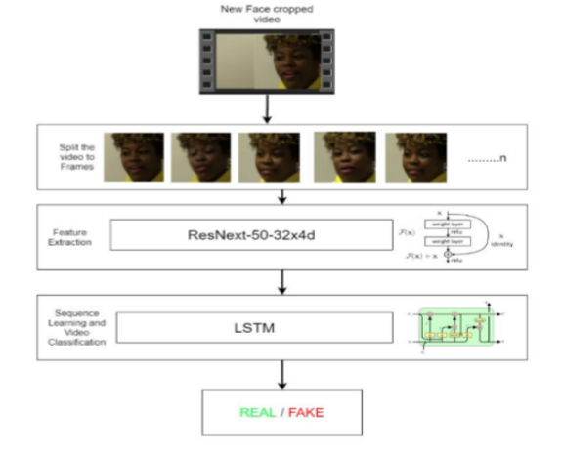
Process
5
Hyper-parameter tuning: Hyper-parameter tuning was performed to optimize accuracy, using the Adam optimizer with a learning rate of 1e-5 (0.00001) and a weight decay of 1e-3. Cross-entropy loss was used for classification, with a batch size of 4 for efficient training. The user interface, built with Django, allows video upload and processing. The model predicts if a video is real or fake with confidence scores, displaying results on the video playback page.

Slide 9
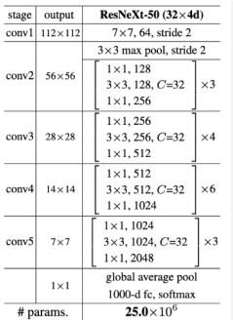
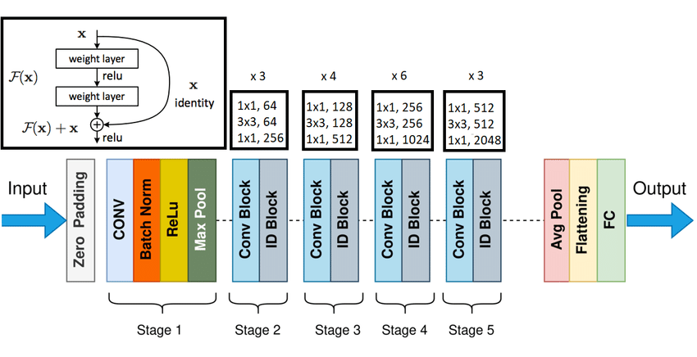
Model Details
ResNext CNN : The pre-trained model of Residual Convolution Neural Network is used. The model name is resnext50_32x4d()[22]. This model consists of 50 layers and 32 x 4 dimensions. Figure shows the detailed implementation of model.

Slide 10
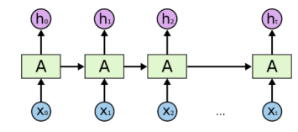
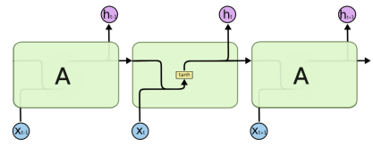
Model Details
Sequential Layer: Acts as a container to organize feature vectors from ResNeXt in order, enabling sequential input to the LSTM.
LSTM Layer: Processes 2048-dimensional feature vectors with 2048 hidden layers and 0.4 dropout. It analyzes frames sequentially, comparing the current frame with earlier ones to detect temporal changes across the video.

Slide 11
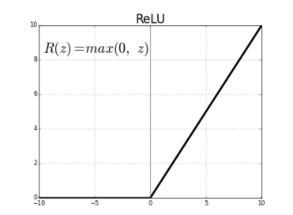
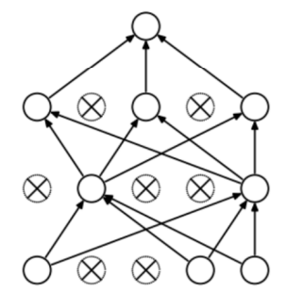
Model Details
ReLU: A non-linear activation function that outputs 0 for negative inputs and the input itself for positive inputs, mimicking neuron behavior and speeding up training in large networks.
Dropout Layer: With a 0.4 rate, it prevents overfitting by randomly setting neurons' outputs to 0, helping the model generalize better.
Adaptive Average Pooling Layer: Reduces variance, computation complexity, and extracts low-level features using a 2D pooling layer.

Slide 12
Model Training Details
Train Test Split : The dataset is split into train and test dataset with a ratio of 70% train videos (4,200) and 30% (1,800) test videos. The train and test split is a balanced split i.e 50% of the real and 50% of fake videos in each split.
Data Loader : It is used to load the videos and their labels with a batch size of 4.
Training: The training is done for 20 epochs with a learning rate of 1e-5 (0.00001),weight decay of 1e-3 (0.001) using the Adam optimizer.
Adam optimizer : To enable the adaptive learning rate Adam optimizer with the model parameters is used.

Slide 13
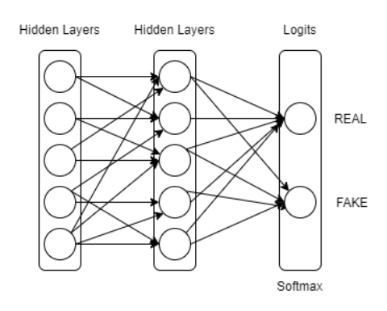
Model Training Details
Cross Entropy: To calculate the loss function Cross Entropy approach is used because we are training a classification problem.
Softmax Layer: The Softmax function is a squashing function that converts outputs into probabilities, with values ranging from 0 to 1. It is used in multi-class classification problems to determine the probability of each class, and its outputs sum to 1. This makes it ideal for the final layer in neural networks, where the predicted class corresponds to the highest probability.

Slide 14
Model Training Details
Confusion Matrix: A confusion matrix summarizes a model's classification performance by showing the count of correct and incorrect predictions for each class. It helps identify the types of errors made by the model, providing valuable insights into how the model performs. It is used to evaluate the model and calculate accuracy, revealing where the model may be confused in its predictions.
Export Model: After the model is trained, we have exported the model. So that it can be used for prediction on real time data.

Slide 15
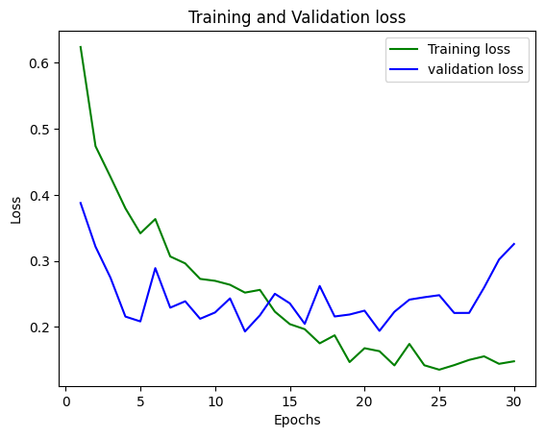
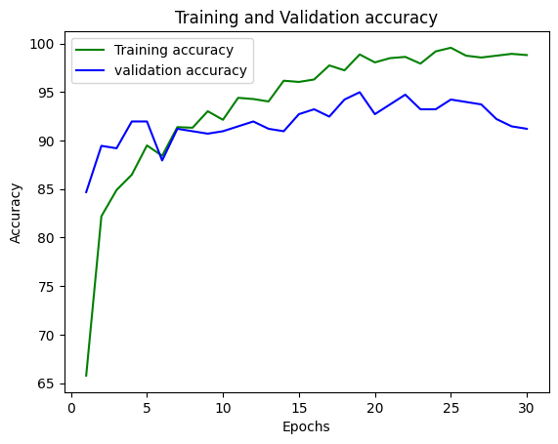
Result
Our model achieved an overall accuracy of 91.2%, demonstrating its effectiveness in detecting deepfake videos across diverse datasets and varying sequence lengths.

Slide 16
Conclusion
This study presents a robust deepfake detection model combining CNN for feature extraction and LSTM for temporal analysis, achieving 91.2% accuracy on real-time data. By training on a balanced, diverse dataset, our approach minimizes biases and ensures reliable performance. The model's scalability and precision make it a practical solution for addressing deepfake challenges.

Slide 17

Thank
You

