Slide 1
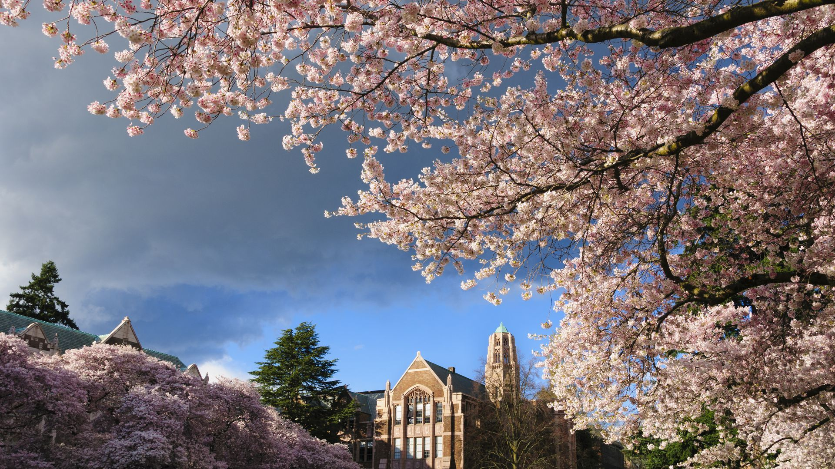

Automated Presentation Creating Process

Slide 2
How to Add a Chart

Slide 3
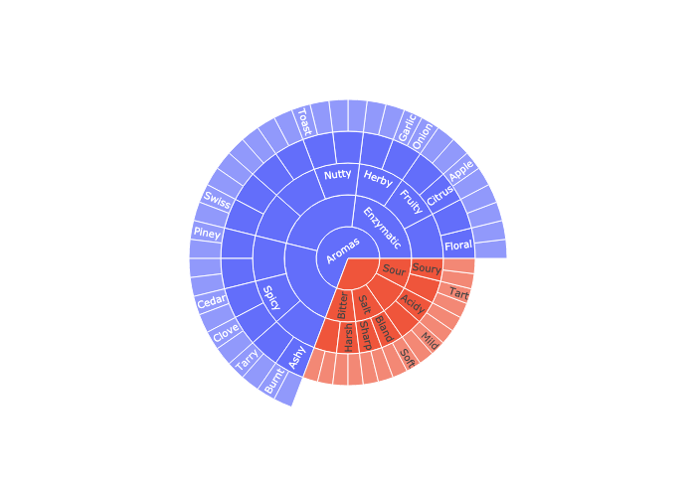
Add an image damnit !

Slide 4
Wassup Beaches !
Akkad bakkad Bambe Bo, Assi Nabbe poore Sau, Sau me nikla dhaaga,dum daba ke bhaaga
They will find the Ring, and kill the one who carries it.

Slide 5
Thank You

