Slide 1



USED CAR PRICE PREDICTION

Slide 2
GUIDED BY
Anay Tamhankar
Trupti Joshi
Prasad Deshmukh
GROUP MEMBERS
Abhishek Patel (230943025001)
Ajinkya Gaiki (230943025003)
Nikhil Gaikwad (230943025017)
Vaibhav Gurav (230943025021)

Slide 3
INTRODUCTION
Analyzing market trends
Need for Price Prediction model that effectively determines the worthiness
of the car using a variety of dependent features.
Apache PySpark for data preprocessing and ML ,
Tableau for Data Visualization

Slide 4
PROBLEM STATEMENT
Lack of reliable methods to determine fair prices for cars.
50% of people prefer to buy used cars
To predict the car price using PySpark ML model

Slide 5






ARCHITECTURE
Data collection
Data pre-processing
Exploratory data
analysis
Predictions &
Deployment
Data Visualization
Model Training
Clean Data

Slide 6
DATA PRE-PROCESSING
1. Dropping Independent Columns:
2. Removing Duplicate Records:
3. Handling Missing Values:
4. Handling Categorical Columns:
5. Converting Data Types:
6. Handling Outliers:
7. Adding New Column

Slide 7
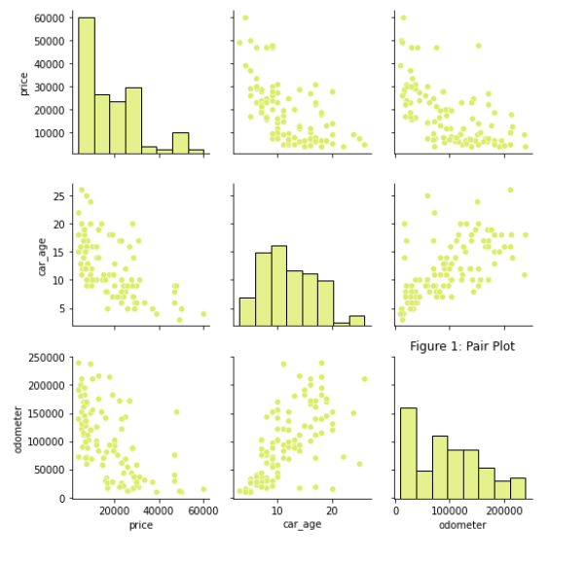
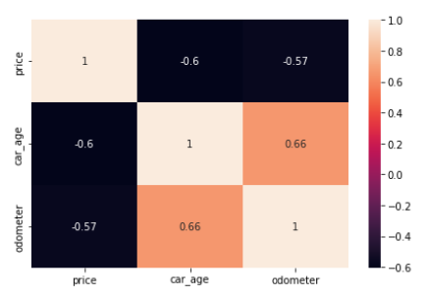
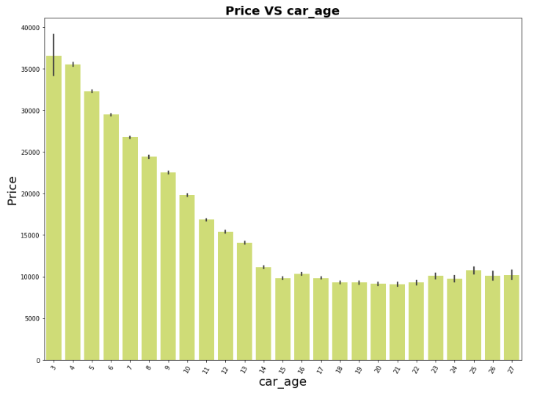
EDA

Slide 8
ML MODELS
Model
R2 Score
1.Linear Regression
0.74
2. Random Forest Regression
0.68
3. Decision Tree
0.65
4. Ridge
0.74
5. Lasso
0.74
6. Gradient Boosting
0.76
7.Gradient Boosting(T)
0.84

Slide 9
CONCLUSION
Use of multiple Machine-learning Algorithms to build up automobile price forecasting model.
Gradient Boosting is the best model demonstrates the highest prediction performance with R2 score of 0.84.
Provides valuable insights for both sellers and buyers .

Slide 10
PROBLEM FACED
Pre-processing of Data
Tuning of Model
User Interface using gradio

Slide 11
FUTURE SCOPE
Can provide this model to bind with different website
We can build an android app for interacting with user.
For better performance, we plan to design deep learning network structures,
use adaptive learning rates

Slide 12
THANK
YOU

