Slide 1



The Data Incubator Capstone Project
Nikhil Ajgaonkar
Department of Physics & Astronomy
University of Kentucky

Slide 2
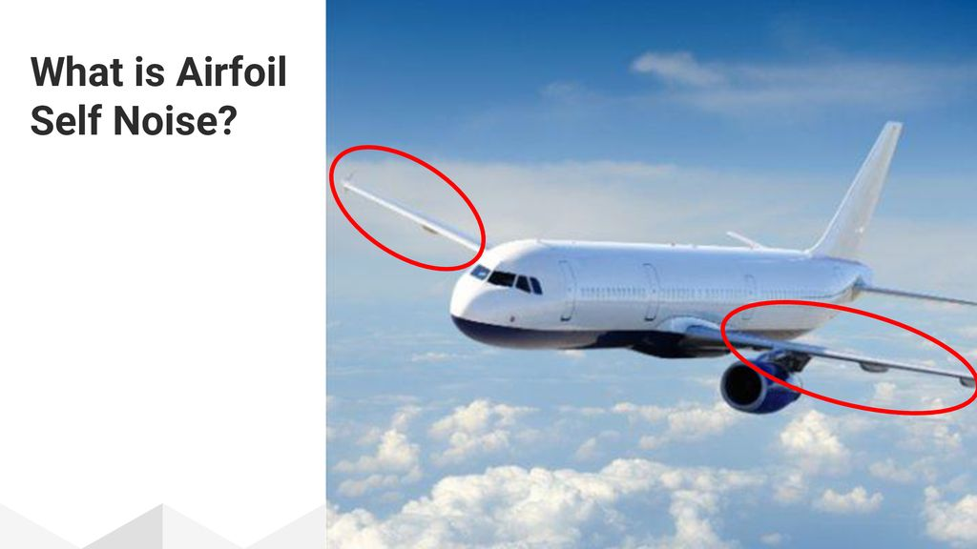
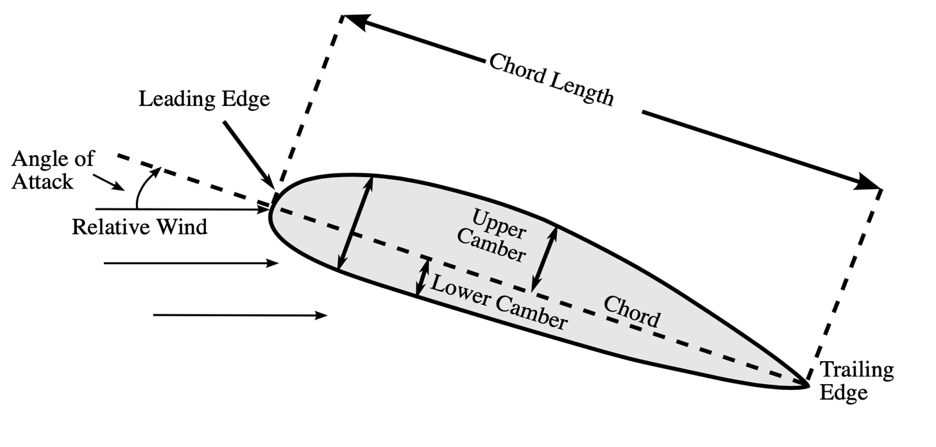
Introduction
1. Airfoil self noise is caused due to interaction of smooth non-turbulent flow with airfoil edges near wake.
2. At high speeds, noise can increase vibrations on the airplane wing and can cause the wing to break.
3. Reducing airfoil self-noise is an important problem in the aerospace industry.
How to predict airfoil self noise?
Cross section

Slide 3
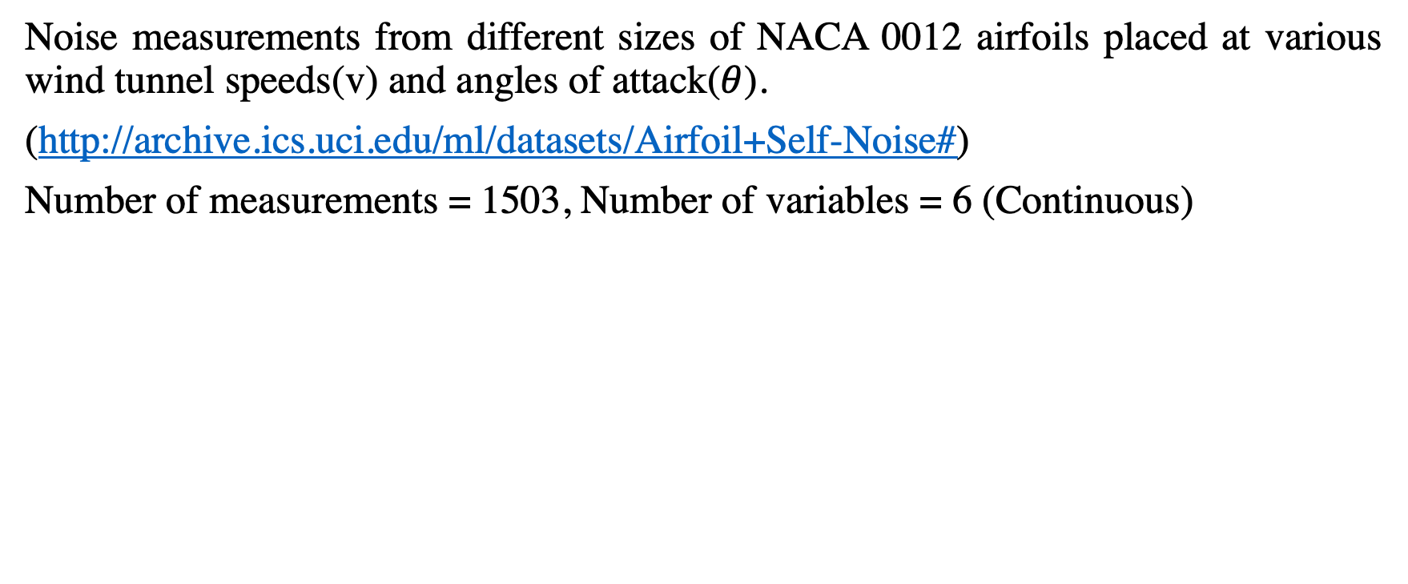
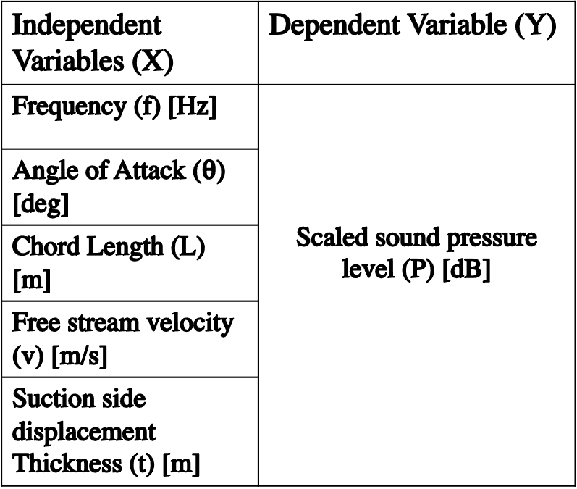
The Data Set
Noise measurements from different sizes of NACA 0012 airfoils placed at various wind tunnel speeds(v) and angles of attack($θ$).
(http://archive.ics.uci.edu/ml/datasets/Airfoil+Self-Noise#)
Number of measurements = 1503, Number of variables = 6 (Continuous)
Independent Variables (X) | Dependent Variable (Y)
Frequency (f) [Hz] | Scaled sound pressure level (P) [dB]
Angle of Attack ($θ$) [deg]
Chord Length (L) [m]
Free stream velocity (v) [m/s]
Suction side displacement Thickness (t) [m]
Aim: Predict P

Slide 4
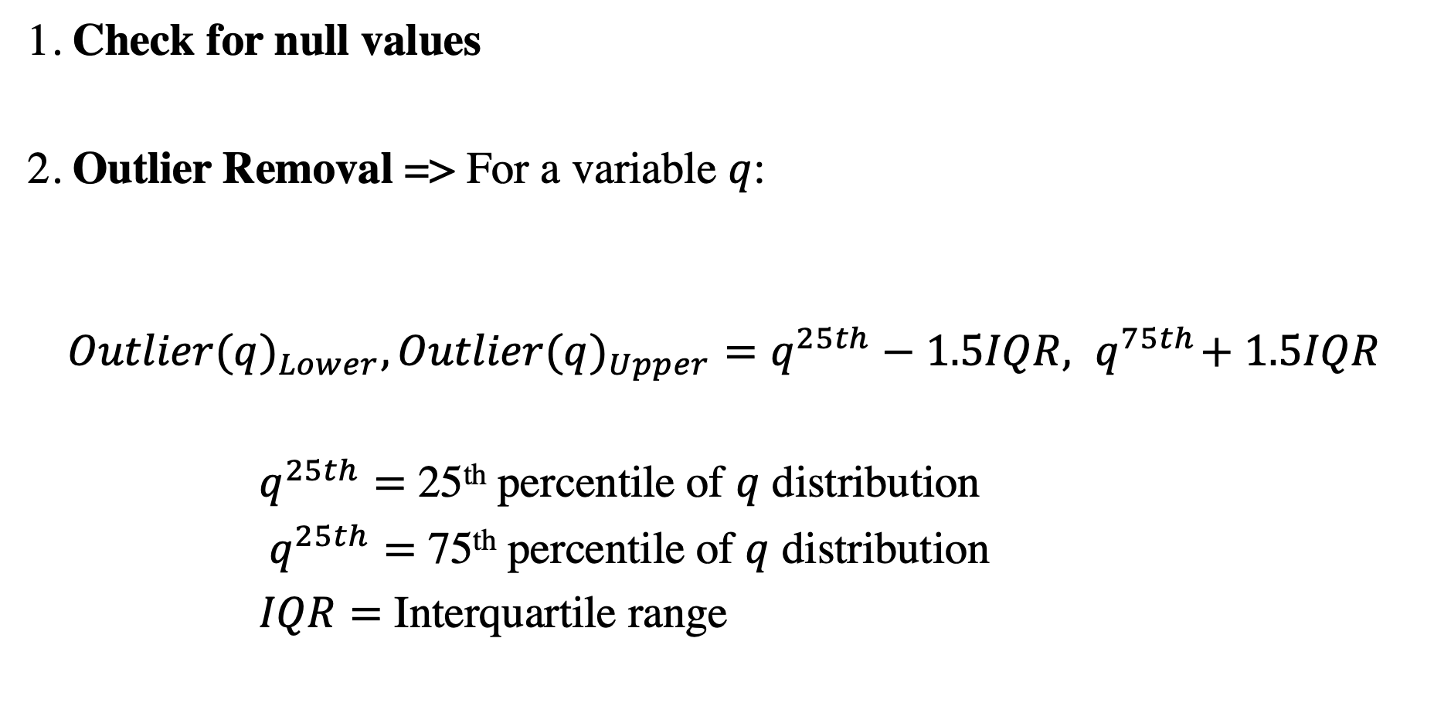
Exploratory Data Analysis
1. Check for null values
2. Outlier Removal => For a variable $q$:
$${Outlier(q)}_{Lower},{Outlier(q)}_{Upper}=q^{25th}−1.5IQR,{ q}^{75th}+ 1.5IQR$$
$q^{25th}=$ 25th percentile of $q$ distribution
$q^{25th}=$ 75th percentile of $q$ distribution
$IQR=$ Interquartile range

Slide 5
Exploratory Data Analysis

Slide 6
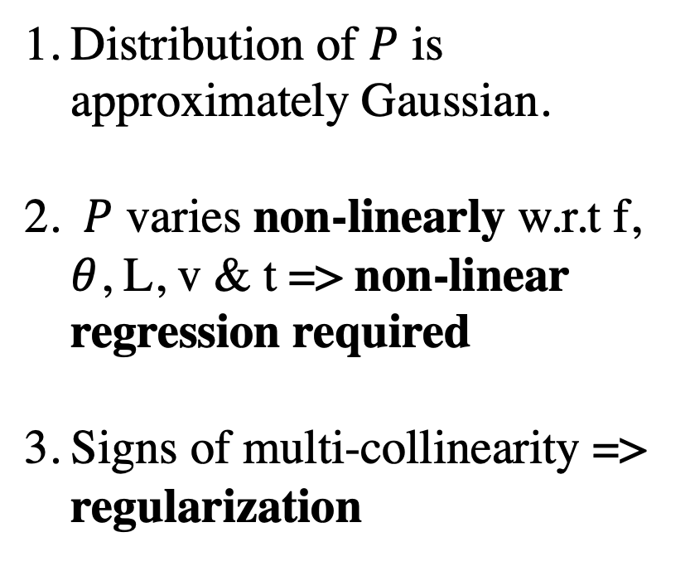
Exploratory Data Analysis
Distribution of $P$ is approximately Gaussian.
$P$ varies non-linearly w.r.t f, $θ$, L, v & t => non-linear regression required
Signs of multi-collinearity => regularization
3
2
2
2
2
2
1

Slide 7

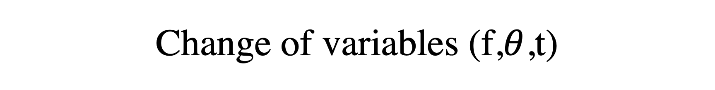
Change of variables (f,$θ$,t)
f => log₁₀(f)
$θ$ =>log₁₀($θ$)
t => log₁₀(t)

Slide 8
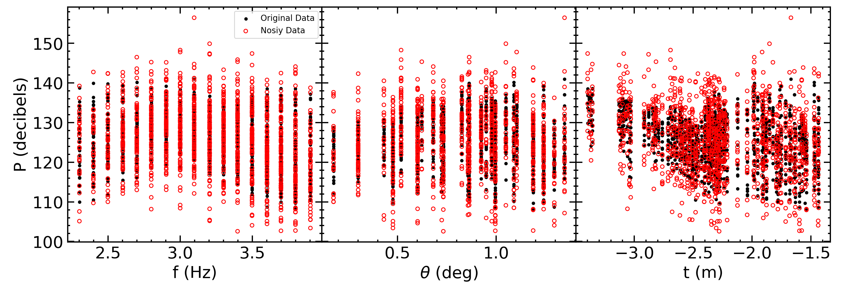
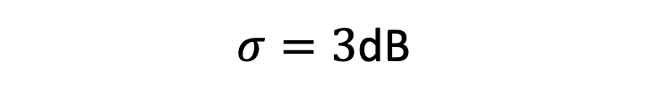
Adding Gaussian Noise to dependent variable, P
P_{noisy}= P + $N\left(0,σ\right); σ=Noise in pressure in$ dB
$σ=3$dB

Slide 9
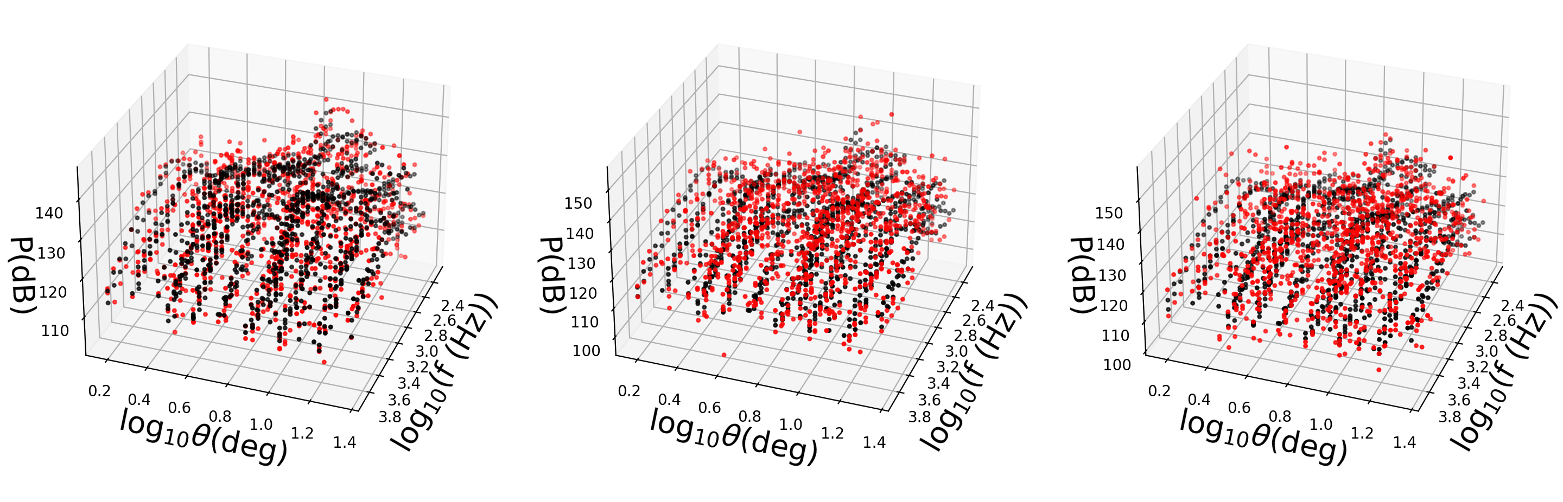
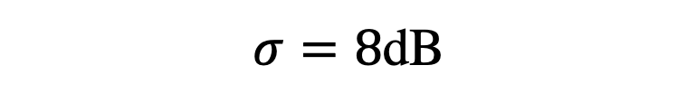
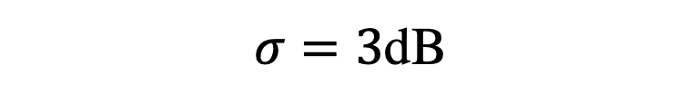
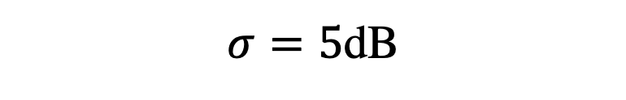
3D view of added noise
$σ=3$dB
$σ=5$dB
$σ=8$dB

Slide 10
Future work
Predict P using different techniques like non-linear regression (OLS, SVR, Neural Networks etc) and compare the accuracies.
Use regularization techniques (Lasso/Ridge) to constrain the parameters of correlated independent variables
Perform the above two for different levels of added noise to P. Relate the accuracy of the selected model.

Slide 11
Thank you….
Questions?

