Slide 1
Advanced Indoor Pathloss Prediction Using Deep Learning
Sajid Javid (PHD24002)
Nikhil Suri (2021268)
Siddhant Gautam (2021100)

Slide 2
Introduction
Indoor pathloss prediction is a critical task in wireless communication, especially for designing and optimizing indoor networks.
Challenges: Complex indoor environments with obstacles like walls and furniture.
Limitations of Traditional Methods
Empirical models struggle to capture real-world complexities.
Limited generalization across diverse indoor scenarios.
Deep Learning as a Solution
Utilizes large datasets to learn intricate patterns.
Improves prediction accuracy and generalization to new environments.
Objective of the Work
Leverage deep learning to enhance indoor pathloss prediction.
Evaluate performance on unseen indoor geometries.

Slide 3
3 Tasks
Task-1
Simulation Parameters: Isotropic antenna pattern (Ant1) at 868 MHz (f1).
Buildings: Data for buildings B1 to B25.
Sample Generation:
50 radio maps generated for each building.
Valid sample names: ‘B(1-25)_Ant1_f1_S(0-49)’.
Objective:
Assess model generalization to new geometries.
Test the model with samples from 5 new geometries not included in the dataset.
Task-2
Simulation Parameters: Isotropic antenna pattern (Ant1) at frequencies 0.868, 2, and 3.5 GHz (f1, f2, f3).
Buildings: Data for buildings B1 to B25 (includes data from Task 1).
Sample Generation:
50 radio maps generated for each building and frequency.
Valid sample names: ‘B(1-25)_Ant1_f(1-3)_S(0-49)’.
Objective:
Assess model generalization to new geometries and frequencies.
Test the model with samples from 5 new geometries and a frequency band not included in the dataset.
Task-3
Simulation Parameters: 5 different antenna radiation patterns (Ant1 to Ant5) at frequencies 0.868, 2, and 3.5 GHz (f1, f2, f3).
Buildings: Data for buildings B1 to B25 (includes data from Task 2).
Sample Generation:
For Ant1: 50 radio maps for each building and frequency (valid names: ‘B(1-25)_Ant1_f(1-3)_S(0-49)’).
For Ant2 to Ant5: 80 radio maps for each building and frequency, with random steering angles (valid names: ‘B(1-25)_Ant(1-5)_f(1-3)_S(0-79)’).
Objective:
Assess model generalization to new geometries, frequencies, and antenna radiation patterns.

Slide 4
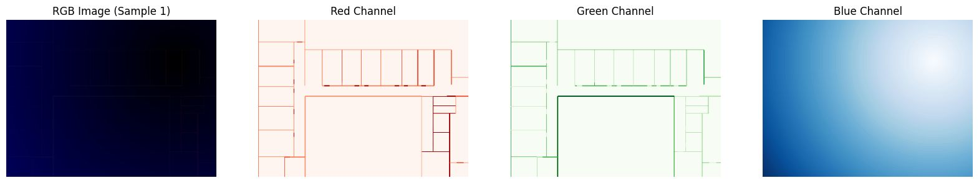
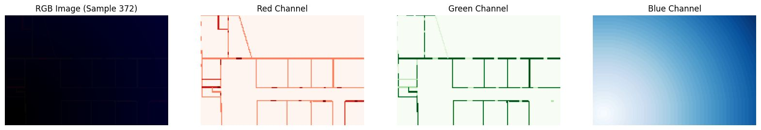
Dataset
Red, Green & Blue channels representing Transmittance, Reflectance and Tx Location

Slide 5
Overview: Our Progressive Approach
Our comprehensive project has delivered several key outcomes across all three tasks:
Model Development: UNET, WNET, and DeepLab architectures have demonstrated high accuracy in pathloss prediction, successfully handling multiple building maps, multiple frequencies, and antenna pattern variations.
Novel Feature Integration: We have incorporated ASSP and several channels including Line of Sight (LOS), wavelength-dependent characteristics (lambda scaling), and antenna radiation patterns, significantly enhancing prediction accuracy.

Slide 6
Work Overview: A Progressive Approach
Our project demonstrates progressive advancement in indoor pathloss prediction through three distinct phases:
Task 1 established foundational models operating at f1 868 MHz, and 1 antenna radiation pattern successfully implementing UNet, WNet, and DeepLabV3 architectures with Line-of-Sight considerations. There are 25 buildings with this. Generalize for different Building Maps.
Task 2 extends our capabilities to multiple frequencies (0.868 GHz, 2 GHz, 3.5 GHz) incorporating wavelength-dependent characteristics (lambda scaling of LoS). Our results were better with lambda scaling. Generalize for different Building Maps and Frequencies.
Task 3 advances the implementation by integrating multiple antenna radiation patterns (5 ant1-ant 5). Results were better with extra channel.So 3 different frequencies,25 different buildings & 5 different antennas. Generalize for different Building Maps, Frequencies and Antenna Radiation Patterns.

Slide 7
LOS Channel and Antenna Radiation Pattern
Fourth LoS Channel = (R+G)/(B+ε)λ = (R+G)/(B+ε)c/f
where:
R represents the reflectance values from input
G captures transmittance characteristics
B indicates distance from transmitter
ε is a small constant preventing division by zero
c speed of light
f frequency
Antenna Radiation Pattern:
The fifth channel computation follows a systematic sequence of geometric and electromagnetic transformations:
We calculate the distance between transmitter and prediction points using:
distance = √((xv-txx)² + (yv-txy)²)
base_angle = (degrees(arctan2(yv-txy,xv-txx)) + 360) mod 360
adjusted_angle = (base_angle + azimuth + 360) mod 360
gain_linear = 10^(gain_pattern[adjusted_angle]/10)
intensity = exp(-distance²/(2·std_dev²))·gain_linear

Slide 8

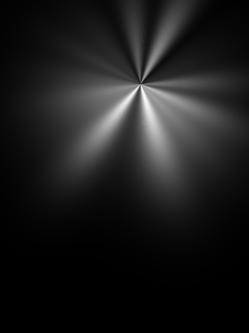
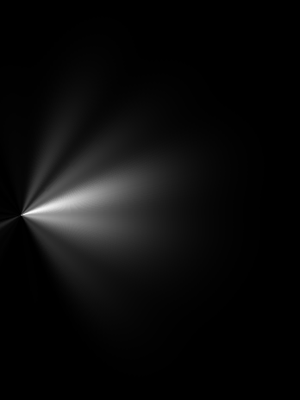
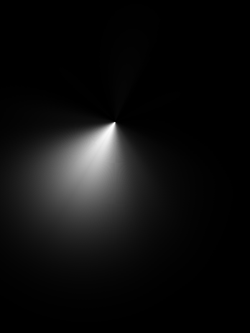

Antenna Radiation Pattern

Slide 9
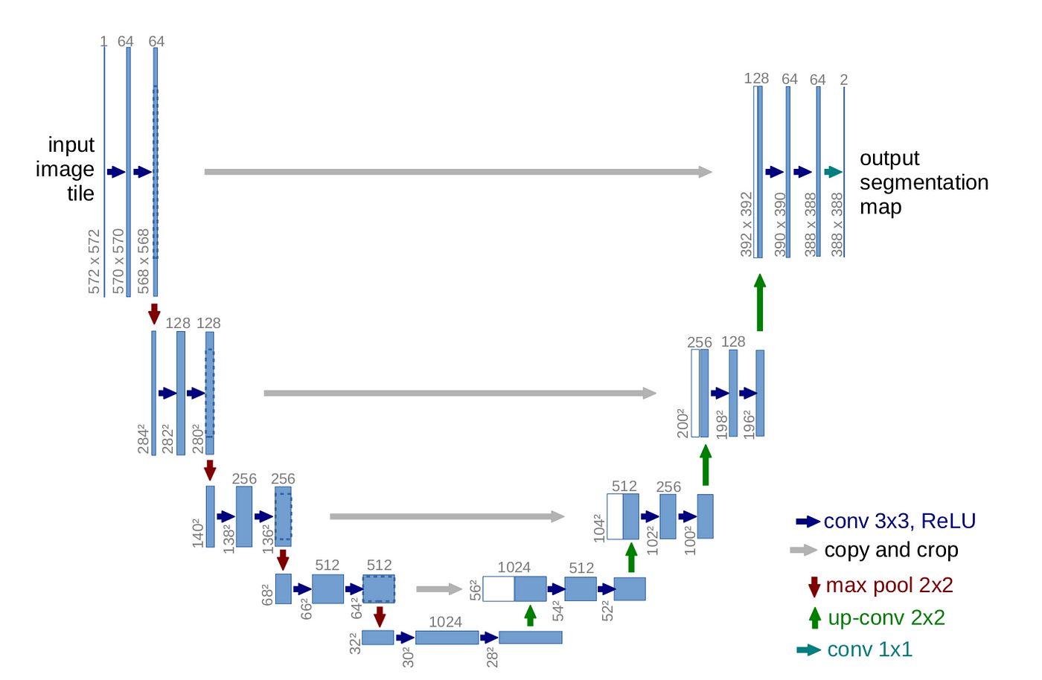
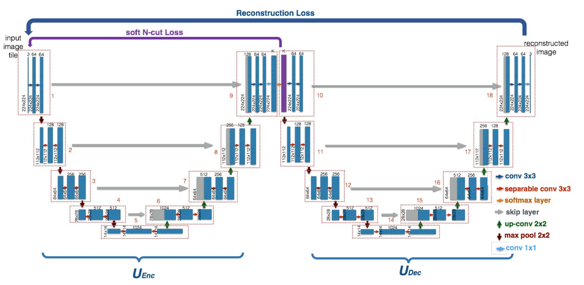
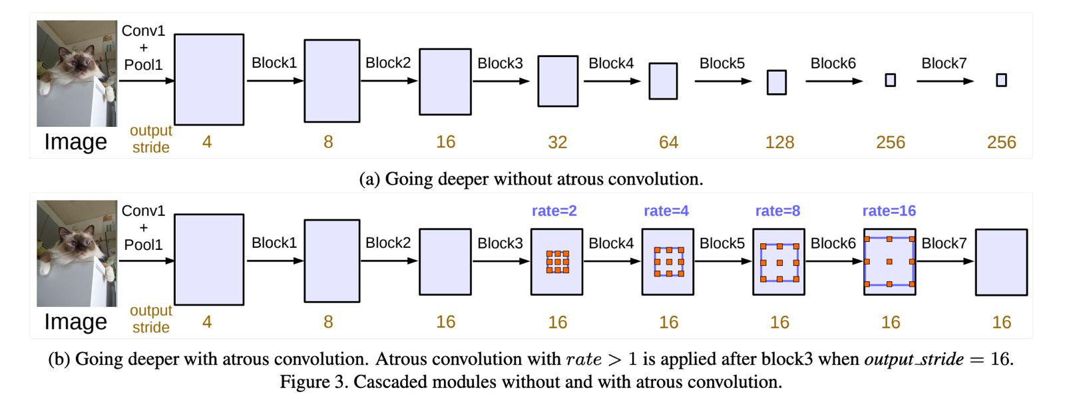
Methodology: Model Architectures
Baseline UNet : The UNet is a convolutional neural network specifically designed for image-to-image translation tasks. It features an encoder (downsampling path) to capture context and a decoder (upsampling path) for precise localization, connected by skip connections. This architecture effectively balances spatial and semantic information for accurate predictions.
WNet : WNet builds on the UNet by incorporating dual encoder paths, allowing it to process different aspects of the input data simultaneously. By combining two units of data during processing, it captures more complex features and structural nuances, making it highly effective for tasks requiring detailed feature extraction.
DeepLabV3 with Group Normalization : DeepLabV3 leverages atrous convolutions to capture multi-scale contextual information, making it ideal for semantic segmentation. It replaces Batch Normalization with Group Normalization, which enhances performance with smaller batch sizes, ensuring robustness in diverse training conditions. This advanced architecture is well-suited for complex segmentation tasks.

Slide 10
Data Preprocessing and Augmentation
Preprocessing Steps
Resizing: Standardized all images to 256x256 pixels for consistent input dimensions.
Normalization: Scaled pixel values to the range [0, 1] for both input and output images to facilitate stable training.
Data Augmentation Techniques
Flipping: Applied vertical and horizontal flipping (Left-to-Right and Top-to-Bottom) to simulate varied orientations.
Rotations: Introduced random rotations (0°, 90°, 180°, 270°) to enhance model robustness.
Synchronized Transformations: Ensured identical transformations for input and output images to preserve spatial correspondence.
Building-wise Randomization (BR): Randomized building selections for training, validation, and testing to evaluate model generalizability across different indoor environments.
Training Configuration
Loss Function: Used Mean Squared Error (MSE) Loss to minimize the difference between predicted and actual path loss values.
Optimizer: Adopted the Adam optimizer with learning rates fine-tuned for each model (e.g., 0.0001 or 0.001).
Number of Epochs: Trained models for 200 epochs with early stopping (patience) to ensure convergence.
Batch Size: Set to 16 samples per batch for optimal computational efficiency and accurate gradient estimation.

Slide 11
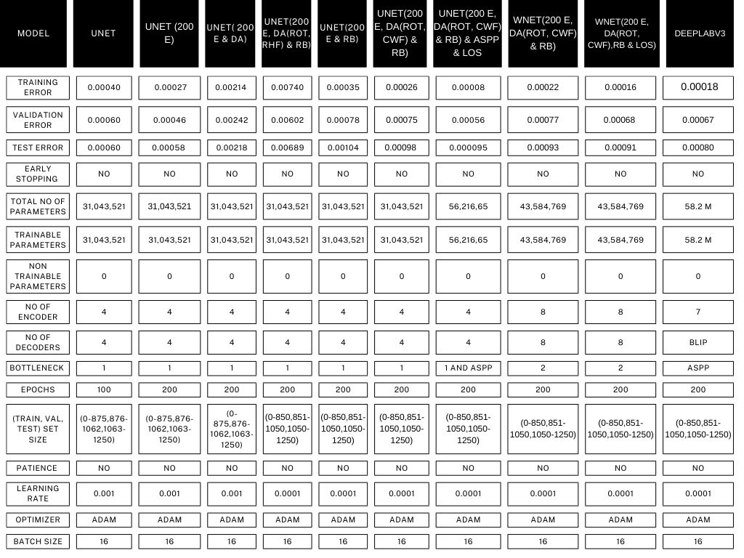
Experiments and Results
RB = Random Building
DA = Data Augmentation
RHF = Right Horizontal Flip
ROT = Rotation
CWF = Complete Width Flip*
LOS = Line of Sight
*flip in all directions

Slide 12
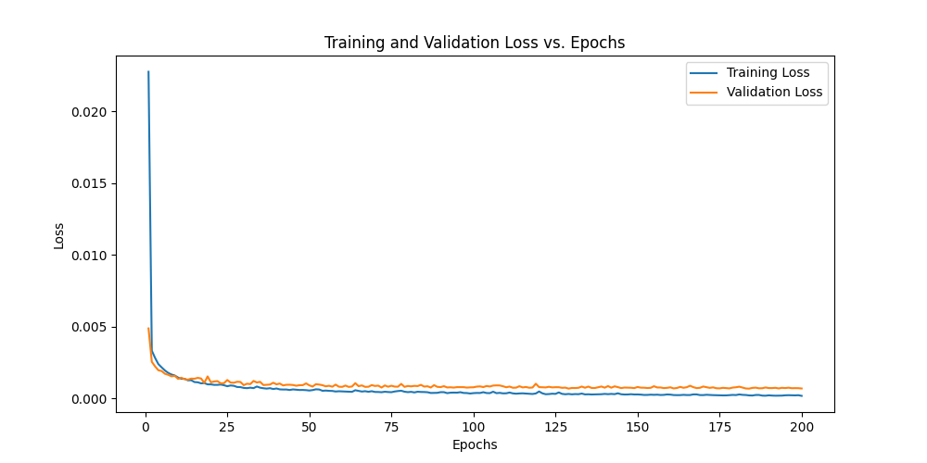
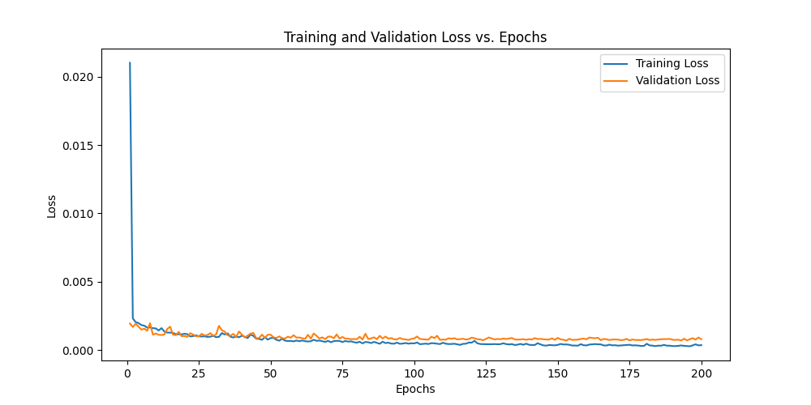
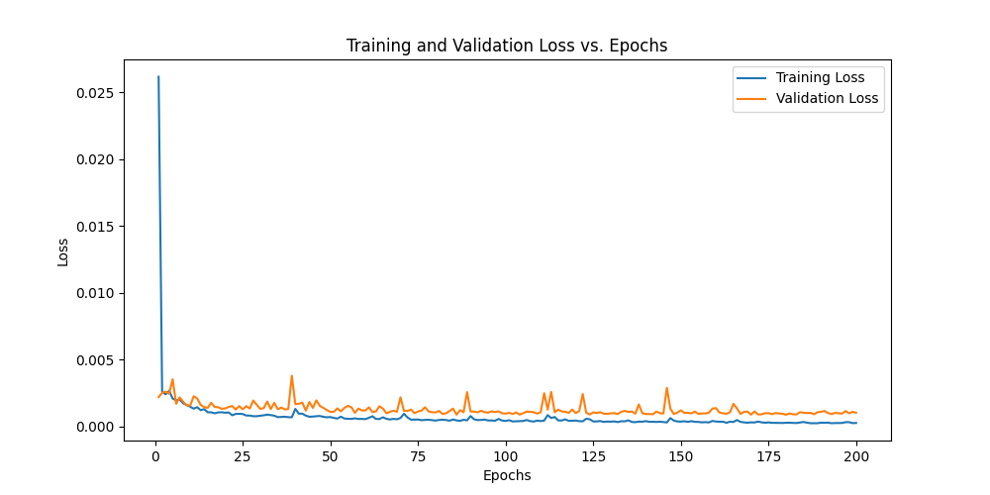
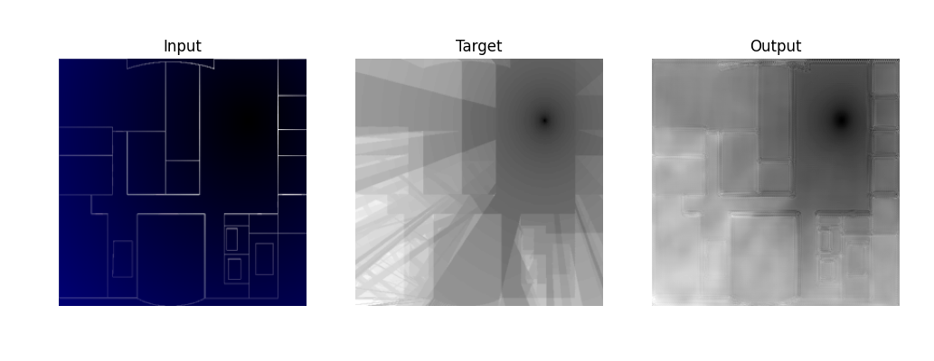
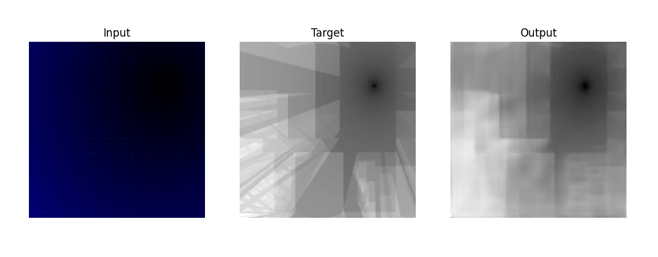
Experiments and Results
Loss Curve for WNet Model with Data Augmentation.
Loss Curves for UNet Model with and without Data Augmentation, respectively.
Prediction v/s Ground Truth with and without LOS, respectively for the UNet Model.

Slide 13
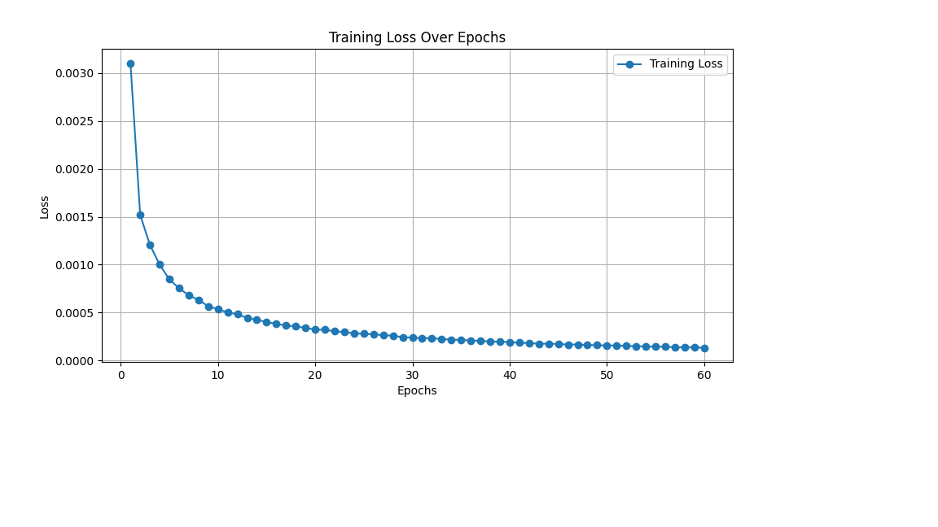
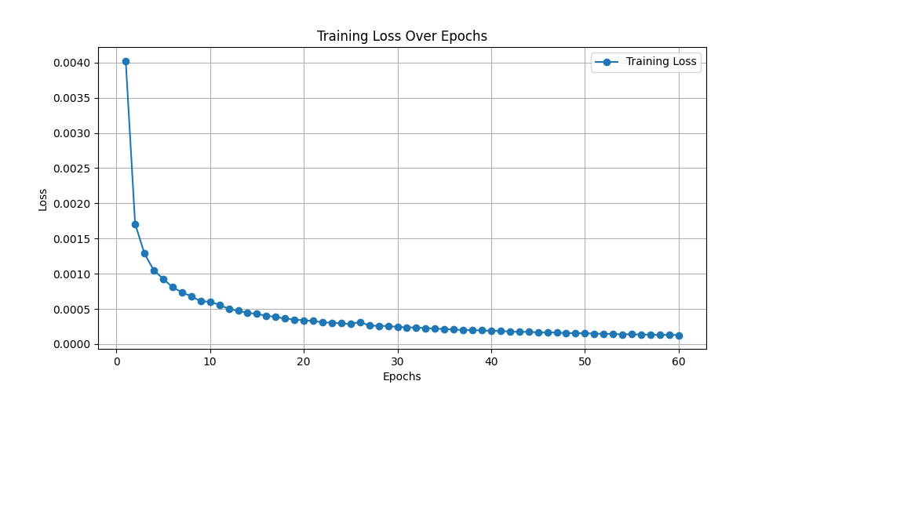
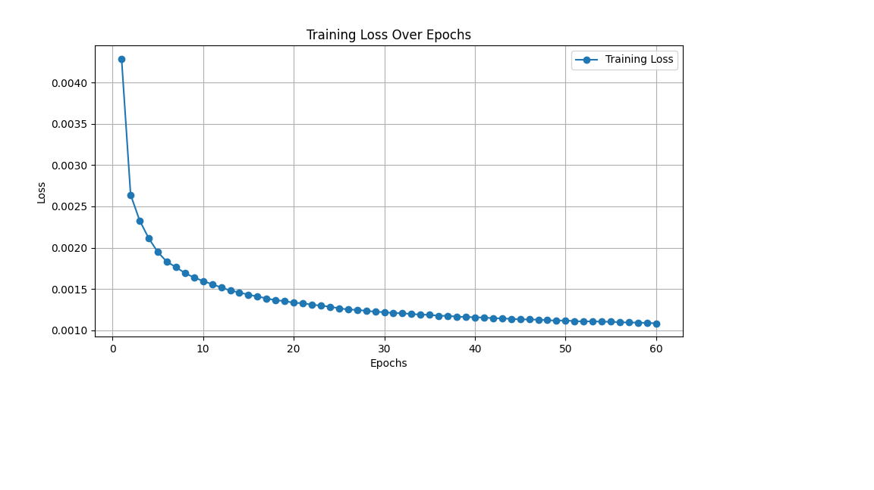
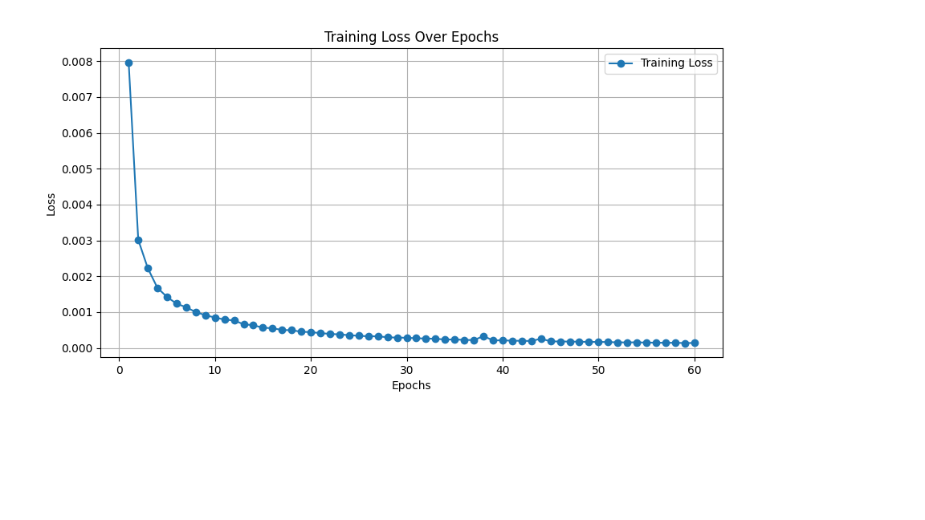
Task 2 without lambda scaler
Task 2 with lambda scaler
Task 3 without radiation pattern
Task 3 with radiation pattern
Notes:
The training curves demonstrate the model's performance across frequency bands (0.868 GHz, 2 GHz, and 3.5 GHz). Despite different initial loss values, both implementations achieve comparable convergence, validating the robustness of our multi-frequency approach.

Slide 14
Conclusions
Our Project demonstrates significant advancements in indoor pathloss prediction through innovative deep learning approaches.
Robust integration of antenna radiation patterns and multi-frequency propagation characteristics has improved prediction accuracy and model stability.
Novel features, such as the custom fourth channel (LOS) and fifth channel (Radiation Patterns), have enhanced input representations, enabling precise handling of omnidirectional and directional antenna configurations.
Advanced techniques like ASPP (Atrous Spatial Pyramid Pooling) have optimized multi-scale feature extraction, while efficient training strategies with dynamic resizing and batching have ensured scalability.
These developments highlight the potential of deep learning in designing reliable models for indoor wireless network planning and optimization, paving the way for future advancements in this field.

Slide 15
References
Ronneberger, O., Fischer, P., & Brox, T. (2015). "U-Net: Convolutional Networks for Biomedical Image Segmentation." arXiv preprint arXiv:1505.04597.
Introduced the UNet architecture for image-to-image translation tasks.
Chen, L. C., Papandreou, G., Kokkinos, I., Murphy, K., & Yuille, A. L. (2017). "DeepLab: Semantic Image Segmentation with Deep Convolutional Nets, Atrous Convolution, and Fully Connected CRFs." IEEE Transactions on Pattern Analysis and Machine Intelligence.
Detailed the use of atrous convolutions and multi-scale context in segmentation tasks.
Task Dataset and Challenge Documentation (ICASSP 2024).
Provides detailed information on the dataset, tasks, and evaluation metrics for indoor pathloss prediction.

