Slide 1
Network Security (CSE350)
Programming Assignment-2
Abhinav Ujjawal (2021120)
Nikhil Suri (2021268)

Slide 2
Data Encryption Standard (DES)
Encryption and decryption of data using DES algorithm
DES (Data Encryption Standard) operates on fixed-size blocks of data, specifically 64 bits. Each 64-bit block of plaintext is processed through a series of permutations and substitutions.
DES uses a 56-bit key, where 8 bits are used for parity checking. The effective key size is 56 bits, making it susceptible to exhaustive key search attacks.

Slide 3
Input Constraints
Plaintext
Plaintext must be 64 bits long (since DES takes 64-bit input)
We have taken a list of 5 plaintexts that have 8 characters. Each character is converted to 8 bits using the character’s ASCII value (adding 0s as padding in-front of the MSB if ASCII value < 256)
Key
Key must be 64 bits long.
We have taken a list of 5 keys. Each character in a key is converted to 8 bits, using the same logic described above

Slide 4
Encryption
DES involves key permutations, initial and final permutations, substitution boxes (S-boxes), and a Feistel network with 16 rounds
The algorithm uses two main permutations: Initial Permutation (IP) and Final Permutation (FP)
DES employs a key generation process to create 16 subkeys from the original 56-bit key
Subkeys are derived using permutations (PC1 and PC2) and left circular shifts
Each round of DES involves a Feistel network that includes expansion, XOR, substitution, and permutation operations

Slide 5
Decryption
Initial Permutation (IP):
Ciphertext undergoes initial permutation using table IP.
Feistel Rounds:
Ciphertext halves (L0, R0) are processed through 16 rounds.
Each round involves expansion, XOR with subkey, substitution, permutation, and swapping.
Final Permutation (FP):
After rounds, left/right halves are swapped.
Final permutation using table FP yields decrypted plaintext.
Output:
Decrypted plaintext is obtained by converting bits back to characters.

Slide 6
Documentation for methods used
permute(data, permutation): Performs permutation on the given data based on the specified permutation list. Returns a list of permuted elements.
hex_to_bits(hex_number): Converts a hexadecimal number to a list of bits (0s and 1s).
initial_permutation(block): Applies the initial permutation (IP) on the block.
final_permutation(block): Applies the final permutation (FP) on the block.
permutation(block): Performs permutation on the given block using the P permutation list.
generate_subkeys(key): Generates a list of subkeys for the DES algorithm.
feistel_network(right_half, subkey): Implements the Feistel network, a fundamental part of DES.
des_encrypt(plaintext, key): Encrypts the plaintext using DES algorithm with the provided key.
des_decrypt(ciphertext, key): Decrypts the ciphertext using DES algorithm with the provided key.
permute(data, permutation): Utility function for permutation, similar to the first one.
rotate_left(data, count): Rotates the elements in the data list to the left by the specified count.

Slide 7
xor(a, b): Performs bitwise XOR operation on two lists a and b.
expansion_permutation(block): Performs expansion permutation on the given block.
substitute(data): Implements the substitution step using the S-boxes.
input_to_8_bit_string(s): Converts a string into a list of 8-bit binary strings.
convert_to_56_bit_key(key): Converts the key to a 56-bit binary string.
hex_to_bits(hex_number): Converts a hexadecimal number to a list of bits.
listOfBits(key, plaintext): Converts the key and plaintext to a list of bits.
bits_to_char(ciphertext): Converts a list of bits to a string of characters.

Slide 8
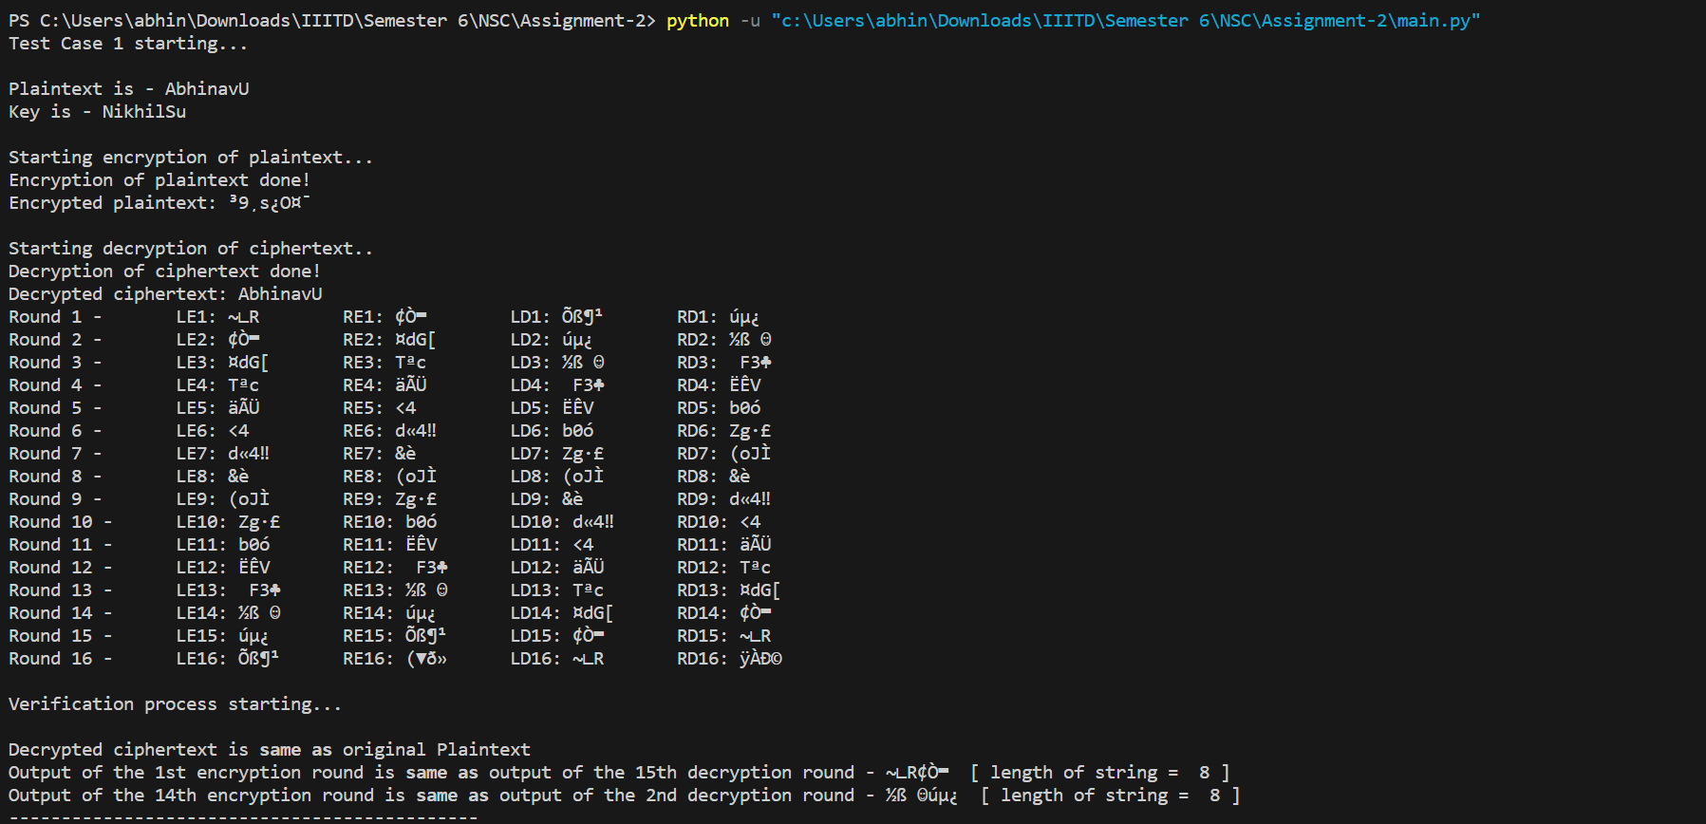
Sample Input/Output

