Slide 1
Network Security (CSE350)
Programming Assignment-3
Abhinav Ujjawal (2021120)
Nikhil Suri (2021268)

Slide 2
RSA-based Public-key Certification Authority
Each user has a “public-key certificate”, issued by a trusted “certification authority” (or CA). This can be shared with anyone.
After a certain duration of time, user has to renew the certificate. The certificate has this duration stored as well.
A receiver must check the certificate, and confirm that received public key is genuine.
CERT_{A}=[(ID_{A}, PU_{A}, T_{A}, DUR_{A}, INFO_{CA})||ENC_{PR-CA}(Hash(ID_{A}, PU_{A}, T_{A}, DUR_{A}, INFO_{CA}))]

Slide 3
RSA Algorithm
Get two prime numbers p and q.
Now, n = p*q and ɸ= (p-1)*(q-1).
Generate the public and private keys. Select e such that 1 < e < ɸ and gcd(e,ɸ) = 1. Get d such that ed = 1 mod ɸ.
Private key and public key are {e,n} and {d,n} respectively.
Next we have to use these keys for encryption and decryption:
C = Me (mod n)
M = C^{d} (mod n)

Slide 4
Encryption and Decryption
We use RSA algorithm for encryption and decryption. Let:
message=(ID_{A}, PU_{A}, T_{A}, DUR_{A}, INFO_{CA})
Now using SHA-256, we get the h = hash(message). Concatenate ‘message’ and encrypt(h) using RSA and send them to the client.
The client decrypts the encrypted part of the certificate and verifies that the hash of the message is equal to the decrypted value.
After this, the clients exchange messages in between them using gRPC. This also involves encryption and decryption.

Slide 5
RSA-based Public-key Certification Authority
A client will get the public key of another client through the help of a CA. Now, our aim is to:
build a public-key CA, that responds to requests from clients that seek their own RSA-based public-key certificates OR that of other clients,
build 2 clients that:
send requests to the CA for their own public-key certificates OR that of other clients, and
exchange messages with each other in a confidential manner, suitably encrypted with public key of receiver, but only after they know the other client’s public key in a secure manner.

Slide 6
Algorithm (at CA)
At CA:
Start listening on the port using gRPC server.
Connect to the two clients and respond to their messages.
Do the following for each of the clients:
Send CA’s public key to the client.
Secondly, register the client by adding it in the dictionary of clients.
Lastly, it issues the certificate of the other client and sends it to the current client. (i.e. Certificate of B is sent to A and vice versa).
The CA stops execution after both the clients have been handled.

Slide 7
Algorithm (at Client)
At Client (A/B):
The client connects to one of the ports of the server.
It starts sending and receiving messages using gRPC.
Depending on the messages:
First, it asks for the public key of CA and stores it in an instance of the client class.
Second, clients sends the request for registering itself.
Lastly, it asks for the Certificate of the other client. (i.e. Certificate B requested by A and vice versa)
After receiving the certificate, client starts the message conversation with other client on receiving the input, via RSA-based encryption and decry

Slide 8
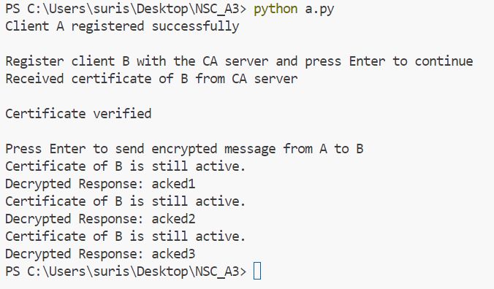
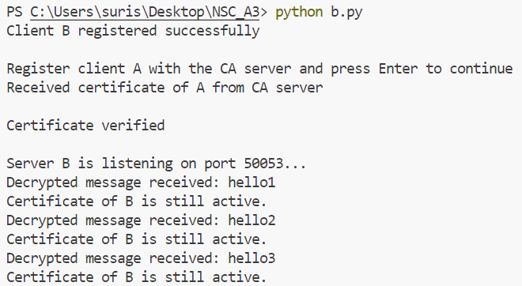
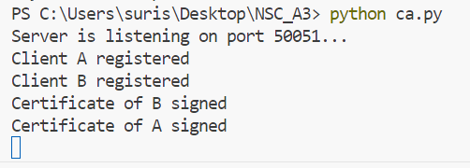
Output

