Slide 1


HACKTHEBOX
SECURE SIGNING
RHOME
$awk -F':' '{ print $1}' /etc/passwd | less
Nikhil Kuchipudi
Darshan Rohit Karkera
Salamat Dauda
Arun Gopal Andalam

Slide 2
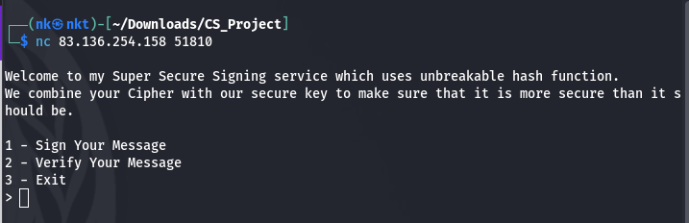
UNDERSTANDING SERVER CODE
SECURE SIGNING
User is presented with 3 options when connected to server.
Option - 1:
The code takes input a message from the user.
The user is given hash for the given message.
Option - 2:
Server asks user to enter a message.
Server asks user to enter their hash.
Server prints either the signature is validated or not.
Option - 3:
Server says goodbye and the connection to the server is closed.

Slide 3
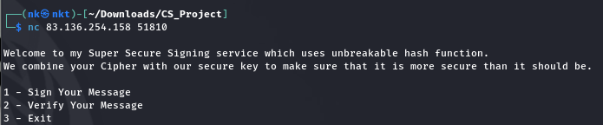



Slide 4

LET’S BREAK DOWN SERVER CODE
Server takes a message from the user.
Pass the given message and FLAG to the XOR function.
Pass the result of XOR operation to the H function.
Print the resulting hash to the screen.

Slide 5


XOR function takes two strings as input.
Characters with same index value from both the strings are taken and are sent to zip function which makes sets of tuples.
Each set is XORed using ^ operator and the resulting bytes are returned from the function.
H function takes in a message and returns SHA256 digest of the message.

Slide 6
THE CODE DOES NOT SEEM VULNERABLE.
WHAT WOULD YOU DO?
ANY LEADS?

Slide 7
PEOPLE WHO ARE FAMILIAR WITH “DIGITAL LOGIC DESIGN” WOULD EASILY GUESS XORING IS THE VULNERABLE PART IN THE CODE

Slide 8
YOU MIGHT SAY,
“TOO EASY; GET THAT FLAG”
Send 0 as input message to the server and get hash of the flag.
Break the hash and voila we have the flag

Slide 9
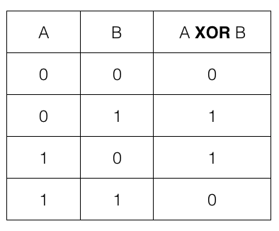
XOR IDENTITY PROPERTY:
An element xored with 0 gives the same elemnt as output.

Slide 10
NOTHING ON HTB IS THAT EASY!
PROBLEMS AT HAND:
We do not know the length of the flag to send exact length of zeroes .
Hash changes completely even if there is a change of 1 bit in the message.
No chance of breaking SHA-256.
We need to make FLAG XOR with binary 0 to get the flag which is not possible.
RULED THIS METHOD OUT! THIS DOES NOT WORK.
LOOKS LIKE THE METHOD IS INFACT SECURE.

Slide 11
“TIME IS WHAT DETERMINES SECURITY. WITH ENOUGH TIME AND RESOURCES, NOTHING IN THIS WORLD IS UNHACKABLE”
-JACK RHYSIDER

Slide 12
PYTHON ZIP FUNCTION
The zip() function in Python takes two strings of unequal length.
It makes character pairs with 1 letter from each string based on their index value.
If strings have unequal length, zip function only considers till the length of shorter string.
ZIP(“Hola”, “Hi”) >> (“H”,”H”), (“o”, “i”)
>>>>It truncates l, a from Hola.

Slide 13
XOR SELF-INVERSE PROPERTY:
An element xored with the same element gives 0 as output

Slide 14
ATTACK PLAN
Send a 0 byte as message, get the hash of the first letter as zip truncates the largest string to the length of the shortest string.
Now, calculate SHA-256 hash of all the printable characters in ASCII and compare with the obtained hash.
Now, keep first letter common and make a list of all the ASCII combinations and repeat the same process by sending two zero bytes this time.
We get the flag character by character from the server.

Slide 15


ATTACK LOGIC

Slide 16
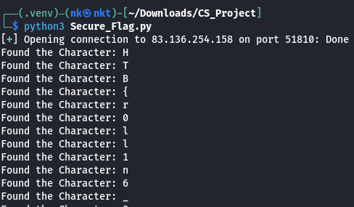
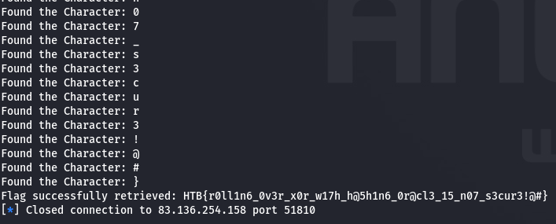
RESULTS

Slide 17
HTB{r0ll1n6_0v3r_x0r_w17h_h@5h1n6_0r@cl3_15_n07_s3cur3!@#}
Rolling over xor with hashing oracle is not secure!@#

Slide 18
WHY IS THE CODE INSECURE?
HOW CAN WE MAKE IT SECURE?
Using XOR operation which has Identity property.
Truncating longer string to the length of smaller string.
Use functions like AND with no Self-Inverse property.
Encrypt message with FLAG.
Pad the shorter string.

Slide 19
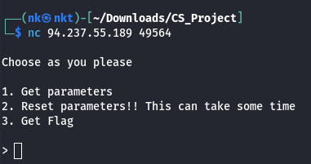
UNDERSTANDING SERVER CODE
RHOME
User is presented with 3 options when connected to server.
Option - 1:
Get parameters option gives the user 4 different long strings of numbers with names p, g, A, B
Option - 2:
Reset Parameters prints nothing to the screen.
It looks like it is deleting the parameters in the server.
Option - 3:
Get Flag gives us the encrypted Flag.

Slide 20
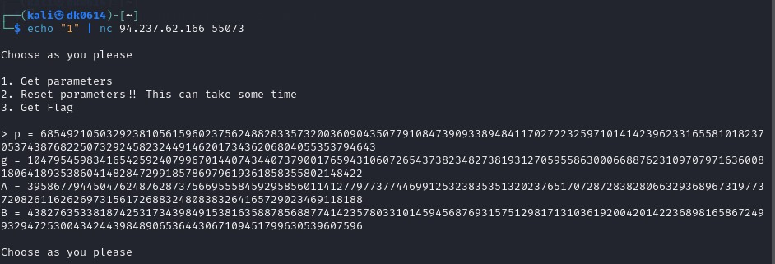


Slide 21





LET’S BREAK DOWN SERVER CODE
The given screenshots show the classical Diffie-Hellman method to generate shared keys.
As a result of the Dh function, we get the p, g, A, B values which are printed by option - 1
Observe carefully, there is a problem in the above code.

Slide 22
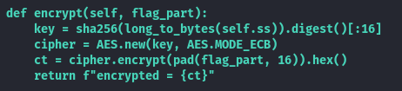
When Option-3 is given the encrypt function is called.
SHA-256 checksum of Shared Secret SS is used as a key by the ECB-mode AES to encrypt the flag.
The function finally returns the encrypted flag in hexadecimal form to the output screen.

Slide 23
TELL ME WHAT YOU WOULD DO?

Slide 24
YOU MIGHT SAY, “AES ECB MODE IS INSECURE. THAT IS THE PROBLEM”.
That is not. It is a decoy set by HTB
Don’t believe me?
Try yourself!

Slide 25
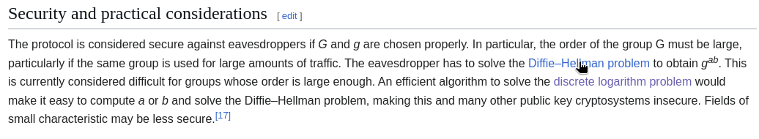
ATTACK RESEARCH
Research started from wikipedia page of Diffie-Hellman

Slide 26
SIZE OF P VALUE
We can see that the size of p-value is very less in the server program.
It is close to 555 bits.
Industry standard is about 2048 bits.
Don’t need a supercomputer to break it luckily!

Slide 27
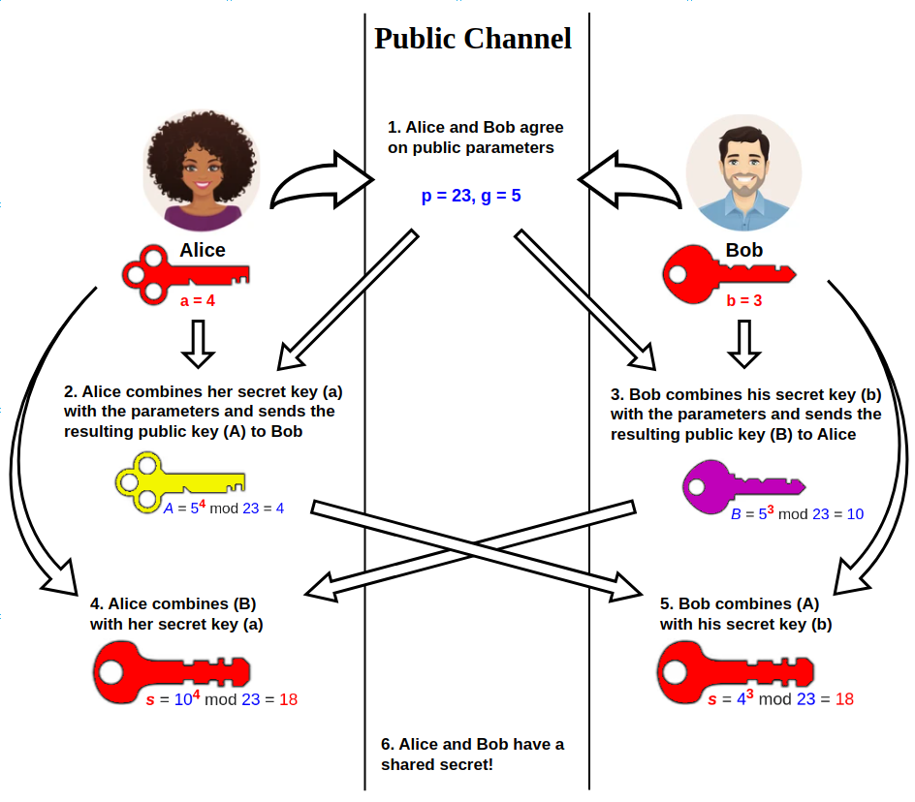

Slide 28


ATTACK RESEARCH
Need to find a function that does Discrete log calculations.
PERFECT!
https://docs.sympy.org/latest/modules/ntheory.html

Slide 29




ATTACK LOGIC

Slide 30
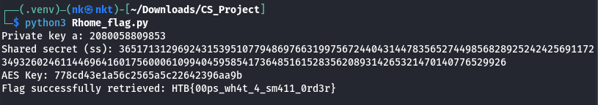
RESULTS

Slide 31
HTB{00ps_wh4t_4_sm411_0rd3r}
Oops what a small order

Slide 32
WHY IS THE CODE INSECURE?
HOW CAN WE MAKE IT SECURE?
Use of very small p value 544 which is vulnerable to discrete logarithms.
Use Standards set by agencies.
In our case p should be at-least 2048 bits to not be vulnerable.

Slide 33
THANK YOU
KEEP HACKING!
LEGALLY

