Slide 1

ABC Racing Company
Technical Architecture Proposal

Slide 2












OPPORTUNITY LEAN CANVAS
PROBLEM STATEMENT:
ABC Racing Company is experiencing a downfall in the people showing interest in their sport. They have decided to increase the fan fare, by revamping their digital presence.
They would like to recruit and increase their fan base by reaching out to fans wherever they are.
They still want to connect to their ageing fan base and provide access to their content (like fixtures, top 5 racers etc.) across all digital platforms.
KEY FEATURES:
Multichannel | Different Geo Themes | Accessible to all | Handle high traffic | Scalable
Extensible | Analytics | Offline | Digital Assets | Bookmark
Notes:
The site must be accessible across different channels – Mobile, Tablet, Desktop
The site must have different themes based on geography
The site must be accessible to all types of users
The site must be able to handle high volumes of traffic
The site must be scalable to support ever increasing user base
The site must be able to extend to connect with commerce and marketing integration
The site should be able to track user interactions and visits
The site should have offline capability
The site should be able to support digital assets like images/videos
The site should have ability to bookmark sections on page

Slide 3
TECHNOLOGY PRINCIPLES & KDD
Technology Principles:
KISS
DRY
Separation of concerns
Prepare for failure
No Single point of failure
Key Design Decisions:
Use of a CMS which gives ability to manage digital assets, provides authoring ability to give contextual content. – Publicly accessible, Manage content
DevOps pipeline will be integral part of solution to manage and automate the builds and releases. – Faster feature releases, less errors
Cloud Native Architecture – Economical, Pay as you use, scalable, secured
Graceful degradation – Support old browsers with some capability, keep best possible solution for new browsers
Single Page Application - Fast load, Optimized, Modular/scalable, Offline Support
Streaming services – For Videos
Microservices Based Architecture – decoupled, flexible, scalable
Responsive design to achieve multi channel support

Slide 4
TECHNOLOGY ASSUMPTIONS
We’ll store data in cloud securely as part of solution
Design team must provide different layouts for responsive UI to support multichannel
Component driven architecture using JS framework making it easier to create and maintain larger applications.
Solution compatibility with different cloud providers (AWS, Azure, Google etc.,).
Availability and performance will be as per industry standards
Role based users for managing content (Authoring content, Digital assets)
ABC Racing Company will provide information on the existing tools to achieve maximum benefits on the investments already made.
We shall provide recommendations on different tools and final choices will be made based on ABC Racing Company choice considering cost and fit to purpose of the specific tool.
Support & maintenance is out of scope.
Multilingual support is in scope.
Environments & infrastructure are in scope.
Offline support is in scope.
Native App is not in scope.
Assumes SPA implementation based on latest JS frameworks.
The designs needs to approved for front end development to kick off.
Agile scrum methodology will be followed.

Slide 5








FUNCTIONAL ARCHITECTURE OVERVIEW
SITE VISITOR
PRESENTATION LAYER
JS EMBED
SITE ANALYTICS
HOME
NEWS
TEAMS
PLAYERS
STATISTICS
SHOP
REGISTER
SEARCH
STANDINGS
REDIRECT
COMMERCE/
MARKETING INTEGRATION
BUSINESS LAYER
CMS
USER MANAGEMENT
LIVE STATS
TOTAL STATS
SOCIAL
CONTENT INDEXING
EDITOR
HTTPS REQ/RES
WEB SOCKETS
HTTPS REQ/RES
USER DATABASE
TOTAL STATS
LIVE STATS

Slide 6
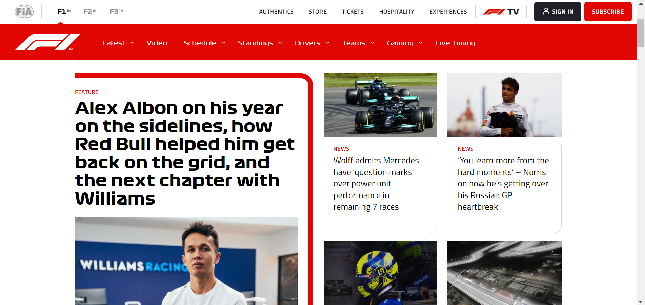
SITE MAP & FOLDER STRUCTURE
dist
template
css
e2e
test
node modules
component
src
service
pipe
directive
Home
News
Game Center
Teams
Drivers
Statistics
Standings
Shop
Register
More News
Scores
Team Details
Driver Details
Team Statistics
By League
Clothing
Edit Profile
Photos/Videos
Schedules
Driver Statistics
Tickets
Events
Top Performances
Merchandise

Slide 7
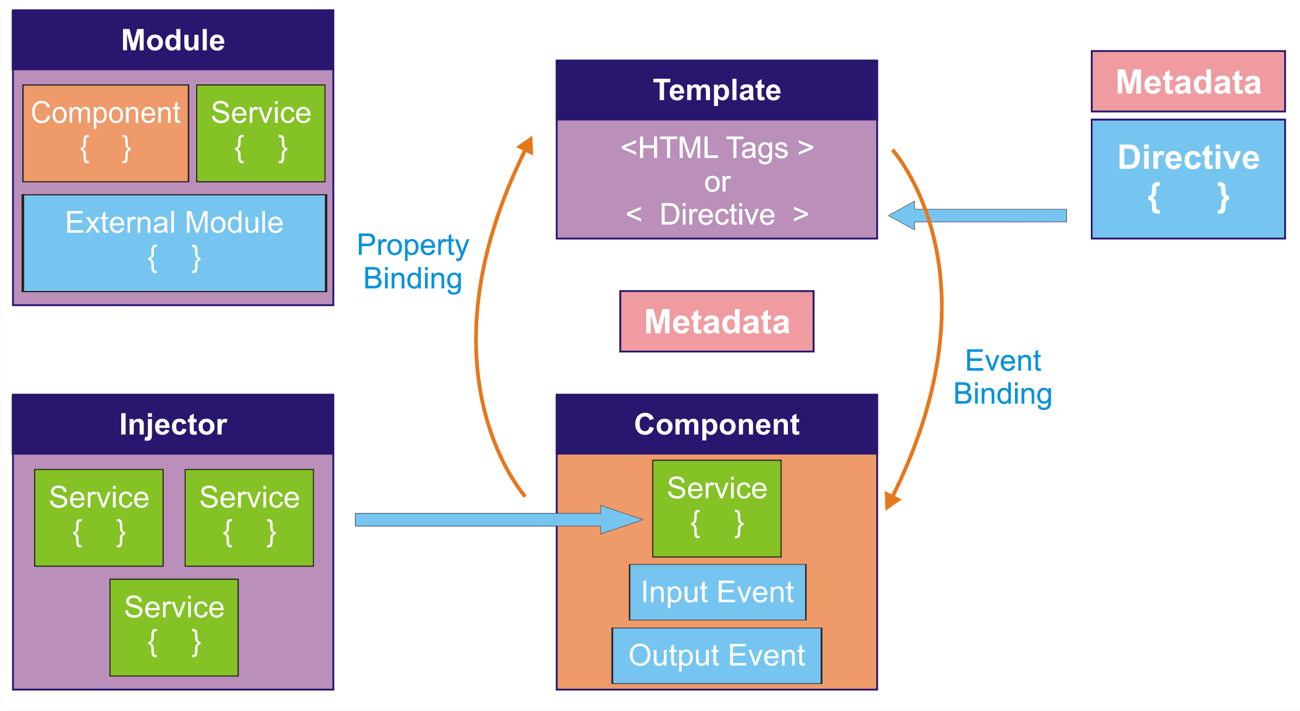








TECHNICAL ARCHITECTURE OVERVIEW
Frontend Change to build
Backend changes to build
CI/CD SERVER
Database
Content author changes the content
Static Website
Developer makes changes to code
Developer
Network
CDN
SITE VISITOR

Slide 8
TECH STACK
Tech Stack | Use | Justification
Angular | JS Framework | Scalable, Modular, Offline Support, a11y CDK, component based
Angular bootstrap/ angular material | Responsive Web Design | Popular, customizable, lots of plugins
SASS | Modular, Reusable, DRY, CSS Preprocessor | Easy to write, lots of features
AXE, WAVE, Lighthouse, Angular CDK a11y | Accessibility | Test accessibility
TSLint | Typescript lint | Error identification
Adobe AEM | CMS | Authoring, Analytics, Multilingual, Search, DAM, Commerce integration, Content as service, SPA Editor, Community Support, Product Support, Contextual, workflow
Jasmine, Protractor | Unit Test, E2E Test | Supported by Angular for unit and E2E testing
Google Analytics, Omniture, Chart beat | JS Analytics | Scripts to embed for tracking

Slide 9



THE FULL SPA ECOSYSTEM
Beyond just the development activity, the optimization of the single page application requires the following disciplines and tools
PERFORMANCE & ARCHITECTURE
PERFORMANCE ARCHITECTURE ECOSYSTEM
Lazy Loading
AOT Compilation
Angular Universal
BUILD / DEPLOY & SECURITY
BUILD / DEPLOY & SECURITY ECOSYSTEM
Angular CLI
Deploy Pipelines & CI
ES Lint for Security
Content Security Policy
TEST
TS Linting
Automated Unit Test Coverage
Pa11y Accessibility Test
Beautification
QUALITY ECOSYSTEM
DEV
ANGULAR DEVELOPMENT ECOSYSTEM
Responsive ng templates
Components, Directives, Pipes
State Management

Slide 10
DEVELOPMENT & OPERATIONS ARCHITECTURE INVENTORY
Planning & Project Management Capabilities | Resource & Collaboration Management | Agile Project Management Capabilities | Analysis Enablement Capabilities | Design Enablement Capabilities | Software Generation Capabilities | Build & Integration Capabilities | Test Management Capabilities | Test Execution & Automation Capabilities
Delivery, Planning, Scope, Release Management | Team Collaboration Enablement | Backlog prioritization & Management | Requirement Capture | Process Design Enablement | Coding writing Enablement | Software Compilation & Validation | Test Case & Script Creation Management | Functional Test Enablement
Progress Tracking & Reporting | Training & Competency Management | Burn down tracking | User Story Definition Enablement | UI design Enablement | Code Generation & Forward Engineering | Development Environment Integration | Test Execution Tracking | Unit Test Enablement
Productivity Measurement & Reporting | Staffing & Resource Planning | Retro Management | Requirement Validation | Architecture Design Enablement |  | Build Orchestration | Test Data Creation & Management | UI Test Enablement
Issue & Risk Management |  |  | Prototype/Mockups | Application Design Enablement |  | CI Enablement |  | Multi Channel Test Enablement
Change Control Board |  |  |  | Environment(s) Specification Enablement |  |  |  | Performance Test Enablement
Estimations |  |  |  |  |  |  |  | Security Test Enablement
Development Architecture Capabilities Inventory
Environment | Accessed By
Development | Developers
Testing | QA Engineers
Staging | QA Engineers/ Clients For UAT
Production | Public
Quality Management Capabilities | Version, Release Capabilities | Deployment Capabilities | Security Operations | System, Workstation Capabilities
Quality Assurance Reviews (QA & Peer reviews) | Version Management (Branching) | Deployment Orchestration | Patch Management | Automation & Scheduling
Defect Tracking & Management | Release Management | Software Distribution | Anti Virus Management | Workstation Management
Static Analysis Enablement | CD Pipeline Management |  | IT Capacity and Performance | Env. configurations
 |  |  |  | Server configuration & Management, Backup, Retrieval
Development Architecture Logical Environments
Operations Architecture Capabilities Inventory

Slide 11





























Dev-OPS Tools and architecture logical environments
Branch created by Admin and work starts on same.
Business requirement documented and assigned a JIRA ticket
JIRA Backlog grooming
JIRA Issues Sprint/Epic/
Stories
DEV
TEST
Test
automation
CI Pipeline
UX Designer
DEV
Deploy and Test functionality in Dev
Selenium
build package and upload to Nexus
Maven
Code Review
Unit Test
Junit
Jasmine
runs code quality tests locally
Istanbul / Plato JS Code coverage
Code is committed to GIT branch
Scheduled Job – CD →
SIT/UAT
PROD
Selection Criteria:
Proven Success
Available Skilled Resource
Pricing
Licensing
Client Preferences
Support
Extensibility
*These tools have worked well based on experience, can be changed based on criteria above
Upload artifacts to Nexus
Repository Manager
Monitors Prod. server and appl.
APP and WEB
Upload/Fetch artifacts rom Nexus
Compile / build package and upload to Nexus
Maven
Test
Selenium and JMeter
Monitor INT/UAT env.
CD - Jenkins to orchestrate continuous deployment and trigger deploy from Nexus repository Manager
CD Pipeline
CD Pipeline

Slide 12
STRATEGIES
Performance Strategy | Security | Scalability | Offline | Accessibility | Analytics | Localization
Minimize HTTP Request | Firewall | Microservices | PWA Support | Use of AXE, Wave, Lighthouse | Use of JS embed analytics like google or chart beat etc. | CMS Support for Multilingual
Enable browser caching | VPN Gateway | Modules | Service worker | Create checklist of AAA Level | Own implementation of analytics can also be used | Design components to support LTR and RTL
Optimize images | XSS protection | Horizontal Scaling(more machines – High availability & scalable) |  | Support by framework |  | Ensure Char limits and Expansion of elements
Lazy load images/components | Identity & Access Management
Use of CDN | Authentication & Authorization
Bundling & minification
Load Balancer
Http2
Gzip compression

Slide 13








TEAM ROLES & SKILLS
UX Designer
Wireframes,
Prototyping,
User research,
Empathy,
Communication,
Human computer interaction
DevOps Engineer
Networking knowledge,
CI/CD,
Infrastructure,
DevOps tools & techniques
Delivery Lead
Resource Planning,
Budget Planning,
Help team deliver desired outcome,
Fill any gaps if exists
Product Owner
Creates product vision,
Decision Maker,
Refines the backlog,
Sets the product roadmap,
Plans releases
Front End Developer
HTML,CSS,JS,
JS Frameworks,
RWD,
OOJS,
Testing/Debugging,
Web Performance
QA Engineer
Test Plan & Execution,
Writing & Executing automated scripts,
Accepting & clarifying requirements,
Conduct stress test
Scrum Master
Facilitator,
Collaborates with team,
Protects team from distractions,
Coach,
Help the team in following scrum principles
CMS Developer
* AEM is considered, if other CMS is used, then relevant expertise on product will be required
Develop & implement AEM components,
Good Knowledge on AEM developer tools,
Java based development
Microservices Developer
Frameworks,
Backend knowledge,
Containers,
Communication

Slide 14
INNOVATIVE IDEAS TO BRING BACK FANS TO SPORT
To Engage the Fans and transform the Fan experience before, during and after each race.
Race Strategy: Ability to create visual insights that allow fans to objectively analyze individual team and driver performance, strategy and tactics that will impact the overall race outcome.
Car Performance: Provide information on aerodynamics, tyre performance, power unit, vehicle dynamics, and vehicle optimization to offer insights that help fans interpret overall car performance.
Battle Forecast: Using track history and projected driver pace, Battle Forecast will predict how many laps before the chasing car is within ‘striking distance’ of the car in front.
Gamification: Online Games, Badges, Leaderboard, Win Merchandise

Slide 15
APPENDIX

Slide 16
Features, Tools comparison
 | React | Angular | Vue
Capability
Language Options | JS ES6+ and JSX (default), TypeScript | TypeScript (default), JS, Dart | JS (default), Typescript
Mobile Cross Platform Support | Ionic, React Native | Ionic, NativeScript | Ionic, Vue Native, NativeScript
PWA Support | built into create-react-app | @angular/pwa | nuxt.js
State Management | Redux, MobX | ngrx | Vuex
Server Side Rendering | Next.js | Angular Universal | Vue Server Renderer
Internationalization | react-i18next | built into @angular/angular-cli | vue-i18n
Lazy Loading | React.lazy, React.suspense (core) | Part of Module and Router config | Vue Router config
Virtual Scrolling | react-virtualized | @angular/cdk | vue-virtual-scroller
Tools
Command Line Interface | create-react-app | @angular/angular-cli | vue-cli
Testing | Jest | Jasmine | Vue Test Utils
Browser Devtools | react-devtools, redux-devtools | Augury | vue-devtools

Slide 17
Applied Use cases
USE CASE | REC. | COMMENTS
You need to staff up a team from scratch on an application and speed to market is a priority | Vue | Developers who know JavaScript can become productive very quickly with Vue as there is low ramp time. Vue is also proven to scale well as the app grows larger when done in the right way.
You are re-platforming an existing application and but would like to phase in updates page by page | React, Vue | Because React and Vue both take the approach of a singular, lightweight core component library- that makes it ideal for gradually re-platforming a legacy application into a system of components (this is in fact how Facebook migrated from server-side PHP, as an example).
You are building a highly complex Enterprise app and have access to a pool of Java developers | Angular | Java developers transition well to TypeScript and should be more equipped than general web developers to ramp up on the Angular framework which is the most complex. The full framework features of Angular should also be able to handle most high complex enterprise apps without introducing new custom code or unorthodox patterns.
You have a single team of web developers and have to quickly build an MVP for mobile and web | React | React Native is used in some of the most world class mobile applications such as Instagram, Facebook, Uber, etc. While frameworks such as Ionic for Angular and Vue-Native for Vue also compete, track record and community size keep React as the preferred framework. As your application grows, you can also replace certain mobile pages with native ones for better performance if needed.
You are building a library of reusable components to be shared by multiple applications | React | Some organizations desire to use an atomic design pattern and create consistent UI widgets that are used throughout different applications and platforms. Because React is actually a small UI library, it is ideally positioned for this purpose- the dependency being to include the react library within the same HTML page. *Consider React + Stencil for a library of reusable component ACROSS frameworks. Since React has a larger community and share of developers, we give it an edge over Vue assuming that more projects will be React projects and be able to include these reusable components.

Slide 18
More applied Use cases
USE CASE | REC. | COMMENTS
You are building an omnichannel experience across a variety of platforms and want to reuse components for consistency and efficiency | React | React has the most abundant custom renderers (for example there is even VR renderer) making it the best choice if you are building an omnichannel type experience
You have a COTS product but would like to add your own modern custom UI on top of it | React, Vue | React or Vue’s flexibility as a standalone UI library enables you to be able to decide whether you would like a complete SPA, a mixture of COTS pages and react pages, or even full COTS pages with a few React components. React or Vue can be used to gradually take over a COTS application to use a fully modern front-end architecture
You are building a largely data entry type application that has many forms with complex rules | Angular | Angular has robust tools for creating dynamic, complex forms and validating those forms directly into the framework
You are building an app that will run on a lower power device | Vue | Though benchmarks are close, Vue has a slight edge on performance
You have a large project with a large distributed team | Angular | Since Angular is more opinionated and structured, it provides less of an opportunity for small teams to stray into their own unique structure and style. Vue provides the most flexibility and simplicity but allows a lot of opportunity for poor code structure and tough debugging.
You are building a system of independently maintained and deployed micro-frontends | React | There are a few different patterns for implementing micro front-ends (including a mix of technologies) and the right choice may also depend on more situational details. However, because React gives you a lot of flexibility with your architecture, and shines as a lightweight component library, we feel that in most cases it is more well suited for this type of architecture.

