Slide 1
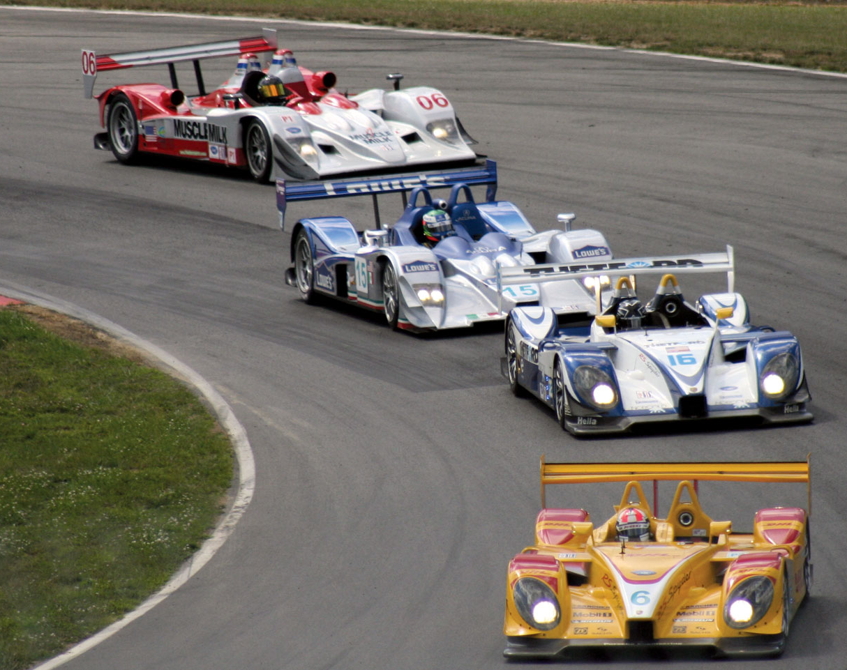
ABC Racing Company
Technical Architecture Proposal

Slide 2












OPPORTUNITY LEAN CANVAS
PROBLEM STATEMENT:
ABC Racing Company is experiencing a downfall in the people showing interest in their sport. They have decided to increase the fan fare, by revamping their digital presence.
They would like to recruit and increase their fan base by reaching out to fans wherever they are.
They still want to connect to their ageing fan base and provide access to their content (like fixtures, top 5 racers etc.) across all digital platforms.
KEY FEATURES:
Multichannel | Different Geo Themes | Accessible to all | Handle high traffic | Scalable
Extensible | Analytics | Offline | Digital Assets | Bookmark
Notes:
The site must be accessible across different channels – Mobile, Tablet, Desktop
The site must have different themes based on geography
The site must be accessible to all types of users
The site must be able to handle high volumes of traffic
The site must be scalable to support ever increasing user base
The site must be able to extend to connect with commerce and marketing integration
The site should be able to track user interactions and visits
The site should have offline capability
The site should be able to support digital assets like images/videos
The site should have ability to bookmark sections on page

Slide 3
TECHNOLOGY PRINCIPLES & KDD
Technology Principles:
KISS
DRY
Separation of concerns
Prepare for failure
No Single point of failure
Key Design Decisions:
Use of a CMS which gives ability to manage digital assets, provides authoring ability to give contextual content. – Publicly Accessible & seamless experience
DevOps pipeline will be integral part of solution to manage and automate the builds and releases. – Faster feature releases, less errors
Cloud Native Architecture – Economical, Pay as you use, scalable, secured,
Graceful degradation – Support old browsers with some capability, keep best possible solution for new browsers
Single Page Application - Fast load, Optimized, Modular/scalable, Offline Support
Streaming servers – For Videos
Microservices Based Architecture – decoupled, flexible, scalable

Slide 4
TECHNOLOGY ASSUMPTIONS
We’ll store data in cloud securely as part of solution
Design team must provide different layouts for responsive UI to support multichannel
Component driven architecture using Angular making it easier to create and maintain larger applications.
Opinionated and structured framework helps developers keep a consistent approach.
Solution compatibility with different cloud providers (AWS, Azure, Google etc.,).
Availability and performance will be as per industry standards
Only Editors will be able to edit the content on the website
ABC Racing Company will provide information on the existing tools to achieve maximum benefits on the investments already made.
We shall provide recommendations on different tools and final choices will be made based on ABC Racing Company choice considering cost and fit to purpose of the specific tool.
Support & maintenance is out of scope.
Multilingual support is in scope.
Environments & infrastructure are in scope.
Offline support is in scope.
Assumes SPA implementation based on Angular Latest Version and TypeScript.
Performance of render timing will vary for complex components based on browser JavaScript Engine capabilities and does not include server-response time.
The designs needs to approved for front end development to kick off.
Agile scrum methodology will be followed.

Slide 5








FUNCTIONAL ARCHITECTURE OVERVIEW
SITE VISITOR
PRESENTATION LAYER
JS EMBED
SITE ANALYTICS
HOME
NEWS
TEAMS
PLAYERS
STATISTICS
SHOP
REGISTER
SEARCH
STANDINGS
REDIRECT
COMMERCE/
MARKETING INTEGRATION
BUSINESS LAYER
CMS
USER MANAGEMENT
LIVE STATS
TOTAL STATS
SOCIAL
CONTENT INDEXING
EDITOR
HTTPS REQ/RES
WEB SOCKETS
HTTPS REQ/RES
USER DATABASE
TOTAL STATS
LIVE STATS

Slide 6
DEVELOPMENT & OPERATIONS ARCHITECTURE INVENTORY
Planning & Project Management Capabilities | Resource & Collaboration Management | Agile Project Management Capabilities | Analysis Enablement Capabilities | Design Enablement Capabilities | Software Generation Capabilities | Build & Integration Capabilities | Test Management Capabilities | Test Execution & Automation Capabilities
Delivery, Planning, Scope, Release Management | Team Collaboration Enablement | Backlog prioritization & Management | Requirement Capture | Process Design Enablement | Coding writing Enablement | Software Compilation & Validation | Test Case & Script Creation Management | Functional Test Enablement
Progress Tracking & Reporting | Training & Competency Management | Burn down tracking | User Story Definition Enablement | UI design Enablement | Code Generation & Forward Engineering | Development Environment Integration | Test Execution Tracking | Unit Test Enablement
Productivity Measurement & Reporting | Staffing & Resource Planning | Retro Management | Requirement Validation | Architecture Design Enablement |  | Build Orchestration | Test Data Creation & Management | UI Test Enablement
Issue & Risk Management |  |  | Prototype/Mockups | Application Design Enablement |  | CI Enablement |  | Multi Channel Test Enablement
Change Control Board |  |  |  | Environment(s) Specification Enablement |  |  |  | Performance Test Enablement
Estimations |  |  |  |  |  |  |  | Security Test Enablement
Development Architecture Capabilities Inventory
Environment | Accessed By
Development | Developers
Testing | QA Engineers
Staging | QA Engineers/ Clients For UAT
Production | Public
Quality Management Capabilities | Version, Release Capabilities | Deployment Capabilities | Security Operations | System, Workstation Capabilities
Quality Assurance Reviews (QA & Peer reviews) | Version Management (Branching) | Deployment Orchestration | Patch Management | Automation & Scheduling
Defect Tracking & Management | Release Management | Software Distribution | Anti Virus Management | Workstation Management
Static Analysis Enablement | CD Pipeline Management |  | IT Capacity and Performance | Env. configurations
 |  |  |  | Server configuration & Management, Backup, Retrieval
Development Architecture Logical Environments
Operations Architecture Capabilities Inventory

Slide 7





























Dev-OPS Tools and architecture logical environments
Branch created by Admin and work starts on same.
Business requirement documented and assigned a JIRA ticket
JIRA Backlog grooming
JIRA Issues Sprint/Epic/
Stories
DEV
TEST
Test
automation
CI Pipeline
UX Designer
DEV
Deploy and Test functionality in Dev
Selenium
build package and upload to Nexus
Maven
Code Review
Unit Test
Junit
Jasmine
runs code quality tests locally
Istanbul / Plato JS Code coverage
Code is committed to GIT branch
Scheduled Job – CD →
SIT/UAT
PROD
Selection Criteria:
Proven Success
Available Skilled Resource
Pricing
Licensing
Client Preferences
Support
Extensibility
*These tools have worked well based on experience, can be changed based on criteria above
Upload artifacts to Nexus
Repository Manager
Monitors Prod. server and appl.
APP and WEB
Upload/Fetch artifacts rom Nexus
Compile / build package and upload to Nexus
Maven
Test
Selenium and JMeter
Monitor INT/UAT env.
CD - Jenkins to orchestrate continuous deployment and trigger deploy from Nexus repository Manager
CD Pipeline
CD Pipeline

Slide 8
STRATEGIES
Performance Strategy | Security | Scalability | Offline | Accessibility | Analytics | Localization
Minimize HTTP Request | Firewall | Microservices | PWA Support | Use of AXE, Wave, Lighthouse | Use of JS embed analytics like google or chart beat etc. | CMS Support for Multilingual
Enable browser caching | VPN Gateway | Modules | Service worker | Create checklist of AAA Level |  | Design components to support LTR and RTL
Optimize images | XSS protection |  |  | Support by framework |  | Ensure Char limits and Expansion of elements
Lazy load images/modules | Identity & Access Management
Use of CDN | Authentication & Authorization
Bundling & minification
SSR
Load Balancer
http2

Slide 9
TECH STACK
Tech Stack | Use | Justification
Angular | JS Framework | Scalable, Modular, Offline Support, a11y CDK, component based
Bootstrap | Responsive Web Design | Popular, customizable, lots of plugins
SASS | Modular, Reusable, DRY, CSS Preprocessor | Easy to write, lots of features
AXE, WAVE, Lighthouse, Angular CDK a11y | Accessibility | Test accessibility
TSLint | Typescript lint | Error identification
Adobe AEM | CMS | Authoring, Analytics, Multilingual, Search, DAM, Commerce integration, Content as service, SPA Editor, Community Support, Product Support, Contextual, workflow
Jasmine, Protractor | Unit Test, E2E Test | Supported by Angular for unit and E2E testing
Google Analytics, Omniture, Chart beat | JS Analytics | Scripts to embed for tracking

Slide 10
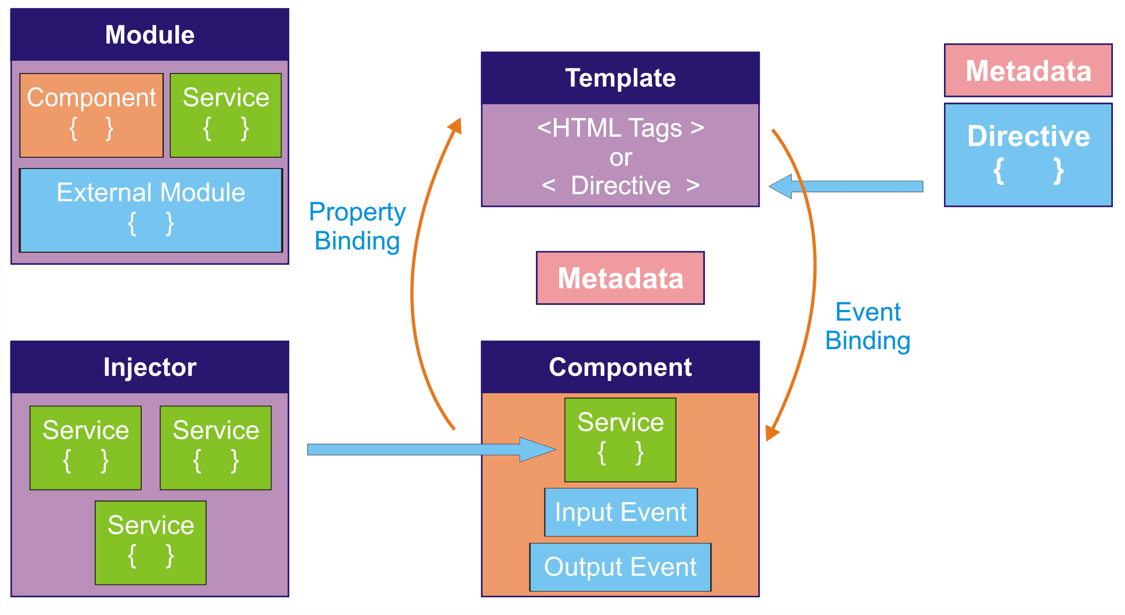









TECHNICAL ARCHITECTURE OVERVIEW
Frontend Change to build
Backend changes to build
CI/CD SERVER
Database
Generate Static Site
Get data from CMS at build time
Content author changes the content
Static Site Builder
Developer makes changes to code
Static Website
Developer
Network
CDN
SITE VISITOR

Slide 11








TEAM ROLES & SKILLS
UX Designer
Wireframes,
Prototyping,
User research,
Empathy,
Communication,
Human computer interaction
DevOps Engineer
Networking knowledge,
CI/CD,
Infrastructure,
DevOps tools & techniques
Delivery Lead
Resource Planning,
Budget Planning,
Help team deliver desired outcome,
Fill any gaps if exists
Product Owner
Creates product vision,
Decision Maker,
Refines the backlog,
Sets the product roadmap,
Plans releases
Front End Developer
HTML,CSS,JS,
JS Frameworks,
RWD,
OOJS,
Testing/Debugging,
Web Performance
QA Engineer
Test Plan & Execution,
Writing & Executing automated scripts,
Accepting & clarifying requirements,
Conduct stress test
Scrum Master
Facilitator,
Collaborates with team,
Protects team from distractions,
Coach,
Help the team in following scrum principles
CMS Developer
* AEM is considered, if other CMS is used, then relevant expertise on product will be required
Develop & implement AEM components,
Good Knowledge on AEM developer tools,
Java based development
Microservices Developer
Frameworks,
Backend knowledge,
Containers,
Communication

Slide 12
INNOVATIVE IDEAS TO BRING BACK FANS TO SPORT
To Engage the Fans and transform the Fan experience before, during and after each race.
Race Strategy: Ability to create visual insights that allow fans to objectively analyze individual team and driver performance, strategy and tactics that will impact the overall race outcome.
Car Performance: Provide information on aerodynamics, tyre performance, power unit, vehicle dynamics, and vehicle optimization to offer insights that help fans interpret overall car performance.
Battle Forecast: Using track history and projected driver pace, Battle Forecast will predict how many laps before the chasing car is within ‘striking distance’ of the car in front.
Gamification: Online Games, Badges, Leaderboard, Win Merchandise

