Slide 1
Unit 2 Lesson 3
The Need For Addressing

Slide 2
Topics
Protocol
Internet Protocol
IP Address
IP Address Hierarchy

Slide 3
Protocol
The official procedure or system of rules governing affairs of state or system
E.g. requirement to carry a passport in order to travel out of a country
Any more examples ??
What happens when the protocol is not followed?
Can't travel without passport
Can't achieve the goal
What is The Goal of a computer network?
To pass information around

Slide 4
Internet Protocol (IP)
A protocol which helps to uniquely identify computing devices connected to the computer network
IP Address is the address of a computing device connected to internet
Similar to your home address, IP address helps to send information to the connected device
IPv4 e.g. 12.239.134.156
4 octets (8 bits) separated by dot ‘.’
[0-255].[0-255].[0-255].[0-255]
More than 4 billion unique addresses
IPv6 e.g. 2001:0db8:0000:0042:0000:8a2e:0370:7334
8 hexadecimal (16 bits) numbers separated by dot ‘.’
Huge number
https://whatismyipaddress.com/ check whats your IP address
Notes:
Why do we need a protocol for internet?
when there are many computing devices how do we ensure our message goes to the right device.
Allow devices to join the internet because Internet Protocol is Open protocol. Unlike closed protocols like : Apple NFC (near filed communication) chip

Slide 5
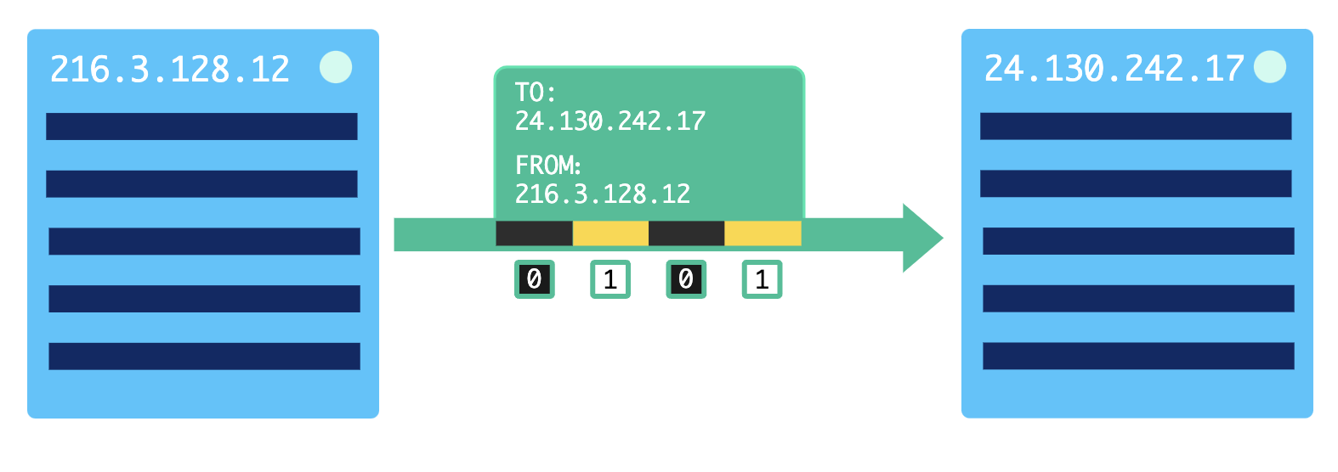
Internet Protocol (IP)

Slide 6
IP Address Hierarchy
Your home address has a hierarchy built in
House number, street, city, state, country
Your phone number has a hierarchy built in
+1 408 707 8689
Country-code area-code local-exchange specific phone
IP Address has a hierarchy as well
12.239.134.156
The first sequence of bits identifies the network and the final bits identify the individual node in the network.
Sometimes network administrators break it down into multiple subnets
12.239 → university
134 → department of computer science
156 → specific computing device

Slide 7
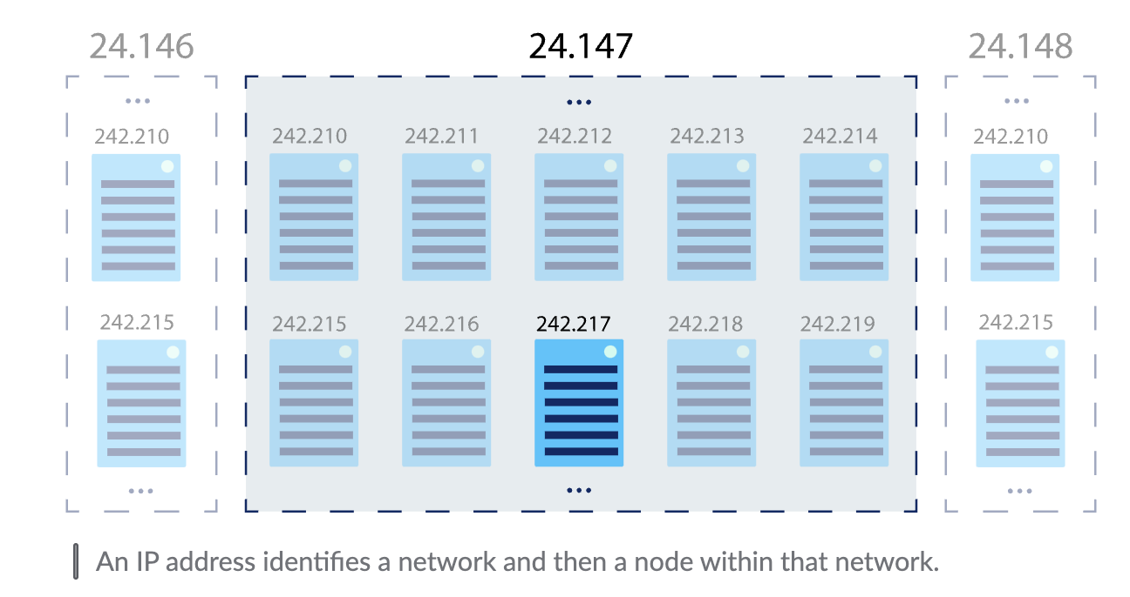
IP Address Hierarchy

