Slide 1
Unit 2 Lesson 9-10
Compression

Slide 2
Topics
Analog to Binary
Lossless Compression
Lossy Compression

Slide 3
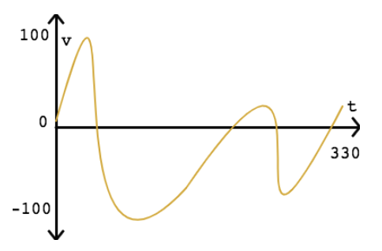
Analog to Binary
Real world is Analog (continuous, unbroken, smooth)
E.g. visual information your eyes can see
Sounds that you hear, songs that you sing
Binary is discrete, not continuous, sampled
Can we store analog info in computers?
Infinite storage to capture change of voice microsecond by microsecond
Three steps to convert Analog to Binary
1. Sampling
2. Quantization
3. Binary encoding

Slide 4
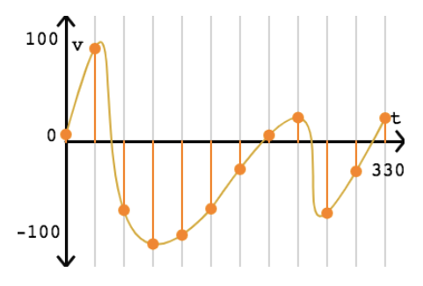
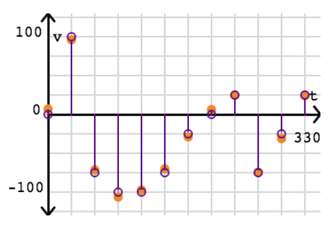
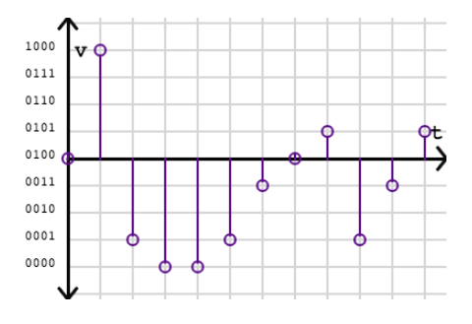
Analog to Binary
1. Sampling
(0, 7)
(30, 95.98765385)
(60, -71.43257238)
2. Quantization
(0, 0)
(30, 100)
(60, -75)
3. Binary Encoding
(0, 0100)
(30, 1000)
(60, 0001)
Reconstructed signal looks very close to original Analog. But not exact same.
Notes:
Why do we need a protocol for internet?
when there are many computing devices how do we ensure our message goes to the right device.
Allow devices to join the internet because Internet Protocol is Open protocol. Unlike closed protocols like : Apple NFC (near filed communication) chip

Slide 5
Analog to Binary
Is it better to have higher Sampling rate?
Yes - why?
No - why?
Increase in Quantization increases number of bits required to store data?
Yes - why?
No - why?
Does Binary encoding helps to secure the data?
Yes - why?
No - why?

Slide 6
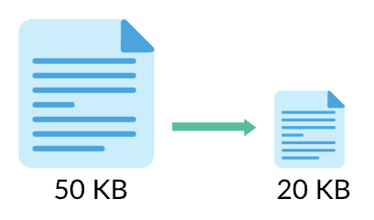
Lossless Compression
Algorithm to reduce size of data without losing ANY information
E.g. “great to see you” → “gr8 to see u”
‘eat’ → ‘8’ and ‘you’ → ‘u’
15 characters → 12 characters (20%)
Text Compression
Find repeated sequences and replace them with shorter representations
ABCDEFGHIJKLMNOPQRSTUVWXYZ → can it be compressed?

Slide 7
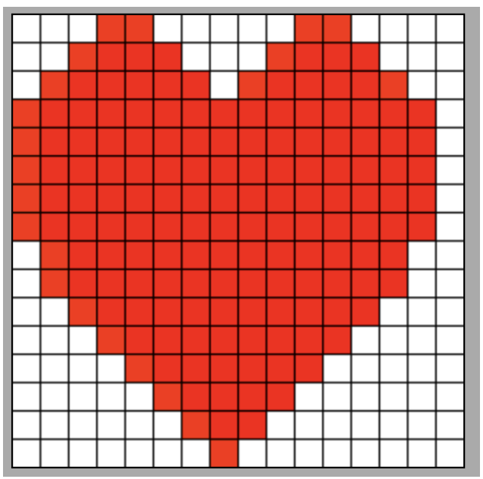
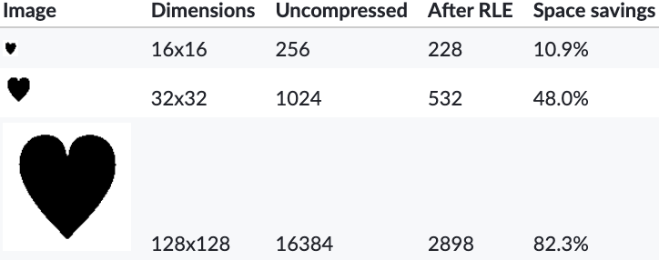
Lossless Compression
Image Compression: RLE(Run Length Encoding) Compression
0001100000110000
0011110001111000
0111111011111100
1111111111111110 …
RLE Encoded
3,2,5,2,4
2,4,3,4,3
1,6,1,6,2
0,15,1
RLE users - FAX machines, JPEG images

Slide 8


Lossy Compression
Algorithm to reduce size of data by discarding less important information
E.g. photos, videos, audio recordings
User can not perceive all details
Clever algorithms remove details without humans noticing
Save disk space
Top pic has 16 different colour values
Bottom pic has 4 different colour values

Slide 9
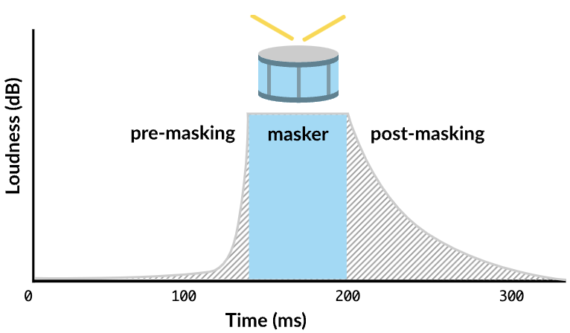
Lossy Compression
Audio Compression algorithms discard sounds that are outside human hearing capacity
Image Compression
Google photos, Amazon photos allow user to choose the compression options
Lossy Compression is about making a trade-off between __ and __.

Slide 10
Compression
Which compression is preferred (lossy or lossless)?
Store songs on phone to maximize number of songs
Store a picture to later get it printed on an enlarged picture frame
Document like your photo identity (passport)
Video of your graduation to show to your grandchildren
When do we do the compression?
Before storing
Before sending on the network
After sending on the network
Before fetching it from disk for reading

