Slide 1
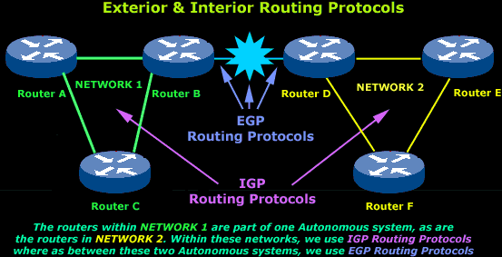
TEAM Name : PROTOCOLS
NEHAL VARSHNEY E18CSE116
NIKHIL AGARWAL E18CSE117
PRACHI GANDHI E18CSE128
………………………………………..
ROUTING PROTOCOLS
Date : 16/06/2020
Computer Science Engineering Department
Bennett University, Greater Noida, U.P.

Slide 2

Introduction
protocol is a set of rules that reveals how computer systems communicate with each other across network.
It is a combination of rules and procedures that lets routers in the Internet inform each other about any changes that have taken place and delivers messages(data) from the sender to the receiver.
Routing protocols are of two types static and dynamic routing protocols.
In static routing protocols all the routes between nodes are entered manually and if any changes take place between he routes of two nodes , the information is updated manually
In dynamic protocols the changes (In routes) are updated automatically and the best path is chosen for the transfer of data.
We will be discussing three types of dynamic protocols , namely RIP , OSPF and BGP protocols.

Slide 3
Our objective is to create a simulation of the Routing Protocols for a better understanding , by visualizing the working of these Routing protocols
Objectives

Slide 4
Data resources used
For the implementation of our stimulation we will be using our own data set which will be generated by user randomly. To make our simulative project we have used html, canvas , JavaScript and sublime as our text editor.

Slide 5
Static Routing Protocol: For the implementation of static protocol we have used canvas as the base for making our model in which we have taken 5 nodes (representing the routers) and the edges between them representing the distance between the routers.
Below the nodes we have shown 5 tables (each table for each node), as of now we are generating the graph by ourselves, i.e when the graph button has been clicked by the user, a graph will be generated by itself and also the tables will be filled automatically , making the job convenient for the user (our future prospect aims at taking the information from the user as well).
In the table we can see that the value 0 has been used for depicting self loop and the value 1000 has been used to show that there is no connection between those two nodes.
The user can now decide between which two nodes they wish to see the shortest path, as soon as the user will enter the two nodes it wishes to check and then clicks on the submit option, the user will see a visual of the shortest path being chosen between the two nodes they selected and the distance between them.
Methodology

Slide 6
Routing Information Protocol: To visualize the working of this protocol the user can click on the graph option which will generate a graph, now the user can also add additional edges along with their weights between the nodes if they wish to.
Five tables have been used to depict the connections of each node in the graph. In the table we can see that the value 0 has been used for depicting self loop and the value 1000 has been used to show that there is no connection between those two nodes .
If the user enters a new edge along with the weight, the table will get updated accordingly by acquiring the information from the table of it’s neighboring node. For the working of this protocol Bellman Ford algorithm has been used. Using this algorithm, we will find the shortest path between the source node and destination node (as chosen by the user) in the following way-
This algorithm finds the shortest path from every node to every other node. in the first step we initialize the distance from the source to all vertices as infinite and distance to the source itself as 0. Then we relax the node V-1 times (where V is the number of vertices), in relaxation we perform the following step:
Do following for each edge u-v
If dist[v] > dist[u] + weight of edge uv, then update therefore, dist[v] = dist[u] + weight of edge uv
By following this algorithm, the RIP returns the shortest path to the user.
Methodology

Slide 7
Open Shortest Path First:
The algorithm used here to find the shortest path between the nodes is Djikstra algorithm which works as follows-
We create a empty array (suppose min[])
The algorithm assigns a distance value to all vertices in the input graph it initializes all distance values as infinite and assigns distance value as 0 for the source vertex so that it is picked first.
While min[] doesn’t include all vertices
Pick a vertex u which is not there in min[] and has minimum distance value.
Update distance value of all the adjacent vertices of the vertex u. To update the distance values, iterate through all the adjacent vertices. For every adjacent vertex v, if sum of distance value of u (from source) and weight of edge u-v, is less than the distance value of v, then update the distance value of v.
Methodology

Slide 8
Through our simulation we are able to depict the shortest path between the source node and the destination node using the various routing protocols , i.e the static as well as the dynamic routing protocols.
Our result achievement is shown by the updation of the tables as well as the path is depicted through a red marking.
Results Achieved

Slide 9
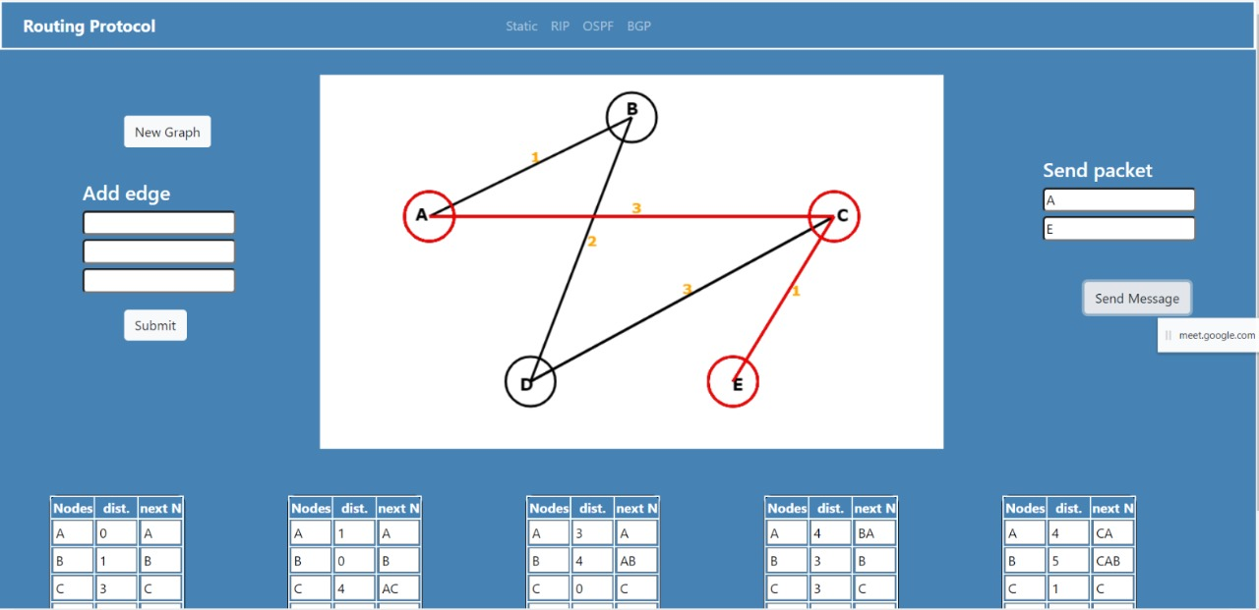
Performance evaluation
In our model the desired result , that is of the shortest path is being evaluated correctly in all the protocols demonstrated by us.
The red lines depict the shortest path chosen between the desired nodes.
The table gets updated accordingly as the new information is entered or any changes take place.

Slide 10
The main purpose as we can see from the results is to give a brief idea of the working of the static as well as the dynamic routing protocols that are used for delivering the message(data) form sender to the receiver.
Through this project we have tried to show how the various algorithms work to select the shortest(best) path possible to transmit the data .
The path is chosen automatically in the case of dynamic routing protocols and manually(usually by the user) in case of static routing protocol.
Conclusion

Slide 11
D Sidhu, T Fu, S Abdallah, R Nair… - ACM SIGCOMM Computer …, 1993 - dl.acm.org
SL Murphy, MR Badger - Proceedings of Internet Society …, 1996 - ieeexplore.ieee.org
D Xu, L Trajkovic - 2011 - summit.sfu.ca
V Vetriselvan, PR Patil, M Mahendran - International Journal of Computer …, 2014 - Citeseer
Loan fitigau and Gavril Toderean, "Network Performance Evaluation for RIP, OSPF and EIGRP Routing Protocols", IEEE 2013
IKram Ud Din, Saeed Mahfooz and Muhammad Adnan, “Analysis of the routing protocols in the Real Time Transmission: A Comparative study”, Global Journal of Computer Science and Technology, Vol. 10, Issue 5, Ver. 1.0, July 2010, pages 18-22.
P Rakheja, P Kaur, A Gupta, A Sharma - International Journal of Computer …, 2012 – Citeseer
Shah. A and Waqas J. Rana, "Performance Analysis of RIP and OSPF in Network Using OPNET", IJCSI International Journal of Computer Science Issues, Vol. 10, Issue 6, No.2, Novermber 2013
https://www.geeksforgeeks.org/classes-of-routing-protocols/
https://en.wikipedia.org/wiki/Routing_protocol
References

Slide 12


