Slide 1
CYBERSECURITY
MAJOR PROJECT
BOUNTY
HACKER
Authorized Penetration Testing Case Study
Presented by: Nikhil Kumar
B.Tech CSE • 4th Semester
Rungta College of Engineering
CSVTU, Bhilai
BOUNTY HACKER LAB
Faculty Guide: [Add name] | Group: [Add members]
TryHackMe profile: [Add your profile URL]

Slide 2
Project Overview
01 • INTRODUCTION
A hands-on study of the TryHackMe Bounty Hacker room, using evidence from the completed lab to explain exposed services, initial access, privilege review and defensive lessons.
Project Aim
Lab Environment
Deliverables
Identify exposed services, understand the access path demonstrated in the room, and convert observations into practical security recommendations.
TryHackMe Bounty Hacker. All testing and screenshots must come from the assigned lab instance.
A clear project presentation, screenshot archive, risk discussion and remediation plan.
Scope note: Bounty Hacker may not demonstrate every technique in the college’s separate full-chain brief. Record missing phases as gaps, not completed results.
CYBERSECURITY MAJOR PROJECT • AUTHORIZED LAB ONLY
02

Slide 3
Problem Statement & Scope
02 • SCOPE
Security Problem
Assessment Scope
Exposed services, weak credential practices or excessive privileges can give an attacker a path from service discovery to unauthorized access.
Review only the assigned TryHackMe target, document the attack path actually completed, and propose controls tied to observed evidence.
IN SCOPE
OUT OF SCOPE
• Target discovery and service enumeration
• Authorized vulnerability investigation
• Access and privilege findings from the completed room
• Defensive recommendations and evidence management
• Testing public or third-party systems without permission
• Claiming unperformed exploit steps
• Using lab access outside the assigned target
• Publishing credentials, flags or sensitive data
CYBERSECURITY MAJOR PROJECT • AUTHORIZED LAB ONLY
03

Slide 4
Methodology
03 • PROCESS
01
02
03
04
05
Service Discovery
→
Service Enumeration
→
Initial Access
→
Privilege Escalation
→
Reporting & Defense
Find open ports and visible services.
Review available service information and files.
Document the access method used in the room.
Verify the user and privilege level reached.
Organize screenshots, assess impact and recommend fixes.
For each major step, record the command, output and screenshot. Never include passwords, tokens or sensitive secrets.
CYBERSECURITY MAJOR PROJECT • AUTHORIZED LAB ONLY
04

Slide 5
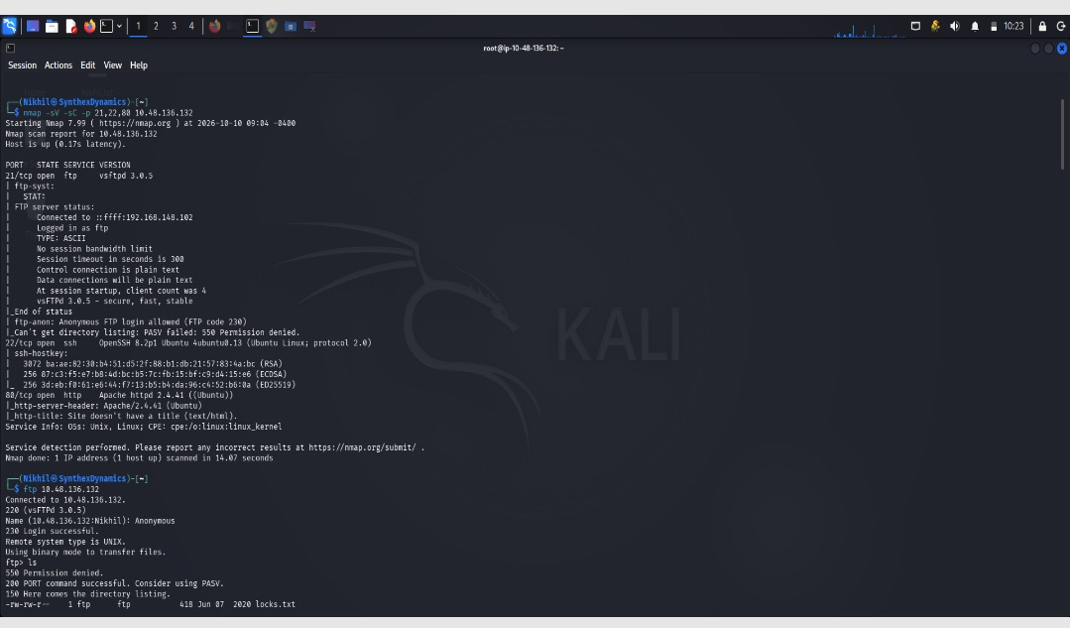

Phase 1 — Reconnaissance
04 • EVIDENCE
Purpose: identify which services are exposed on the active Bounty Hacker target before choosing what to examine next.
SCREENSHOT PLACEHOLDER
Capture
Target IP, scan options, open ports, service names/versions and timestamp.
Your observation
[Summarize the services shown by your actual scan. Verify every detail before submission.]
Replace this box with your own screenshot
CYBERSECURITY MAJOR PROJECT • AUTHORIZED LAB ONLY
05

Slide 6
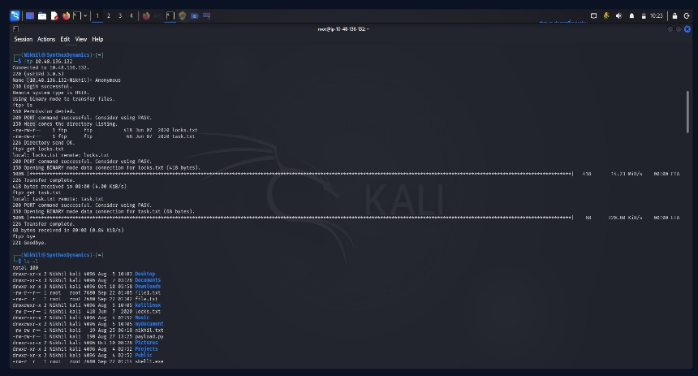
Phase 2 — Enumeration & Initial Access
05 • EVIDENCE
SCREENSHOT PLACEHOLDER
Evidence notes
Explain what you inspected, what information was exposed, and what the output actually showed.
Initial access path
[Describe the actual steps used in Bounty Hacker. Do not publish passwords or flags.]
Replace this box with your own screenshot
Scope reminder: the college brief separately names file-upload testing and PHP web shells. If these were not part of Bounty Hacker, list them as additional requirements to verify.
CYBERSECURITY MAJOR PROJECT • AUTHORIZED LAB ONLY
06

Slide 7
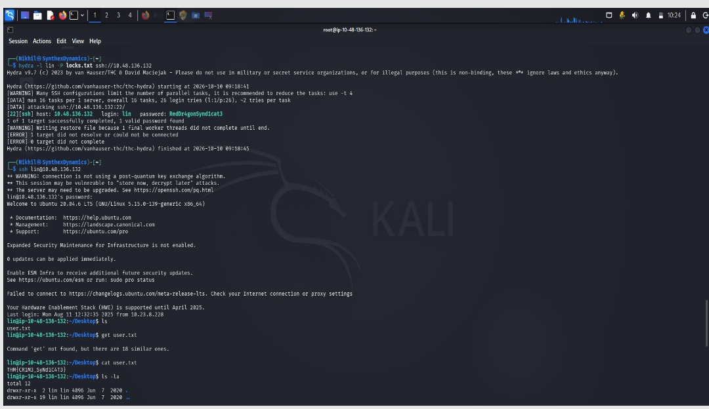
Phase 3 — Access & Privilege Review
06 • EVIDENCE
SCREENSHOT PLACEHOLDER
Proof of access
Show the successful session and harmless verification output. Redact secrets.
What it demonstrates
[State the user and privilege level actually shown by your evidence.]
Replace this box with your own screenshot
Do not claim web-shell persistence, Meterpreter or root access unless your evidence demonstrates it.
CYBERSECURITY MAJOR PROJECT • AUTHORIZED LAB ONLY
07

Slide 8
Findings & Risk Assessment
07 • ANALYSIS
Finding
Proof
Risk / impact
Control
[Observed issue 1]
[Screenshot / output]
[Possible impact]
[Recommended fix]
[Observed issue 2]
[Screenshot / output]
[Possible impact]
[Recommended fix]
[Observed issue 3]
[Screenshot / output]
[Possible impact]
[Recommended fix]
Rate each verified finding as Critical, High, Medium or Low, and explain the reasoning.
CYBERSECURITY MAJOR PROJECT • AUTHORIZED LAB ONLY
08

Slide 9
Cyber Kill Chain Mapping
08 • ANALYSIS
Reconnaissance
Ports, services and relevant target details identified.
Weaponization
Record only if applicable to your actual work.
Delivery
Describe the lab access route you used.
Exploitation
Summarize the weakness supported by evidence.
Installation
Mark Not observed if the room did not involve persistence.
Command & Control
State what session type, if any, was actually obtained.
Actions on Objectives
Document the verified user/privilege level or task outcome.
Use Observed / Not observed / Not applicable. Do not imply the room covered every college-required phase.
CYBERSECURITY MAJOR PROJECT • AUTHORIZED LAB ONLY
09

Slide 10
Defensive Remediation & Hardening
09 • DEFENSE
Service & application
Linux host
Monitoring
Disable unnecessary services; restrict access to exposed files; validate all input server-side; avoid storing secrets in web-accessible locations.
Use least privilege; review sudo rules and SUID binaries; patch software; remove unnecessary elevated permissions.
Monitor authentication failures, unusual service access and privilege changes; protect and review logs.
Defensive checklist
• Disable anonymous access where not needed
CYBERSECURITY MAJOR PROJECT • AUTHORIZED LAB ONLY
10

Slide 11
Evidence Archive & Submission
10 • DELIVERABLES
Google Sheets — Evidence Archive
PDF — Project Report
• Scan logs and notes
• Screenshots with captions
• Commands and actual outputs
• Link to the final report
• Executive summary
• Findings and evidence
• Cyber Kill Chain mapping
• Defensive recommendations
Required details
• TryHackMe profile: https://tryhackme.com/p/nikhil7509227819?utm_campaign=social_share&utm_medium=social&utm_content=profile&utm_source=copy&cardVersion=10927bd50b8b&sharerId=69ddc93e3c963b7609ab8956
Verify link permissions before submission. Never include passwords, tokens or private information.
CYBERSECURITY MAJOR PROJECT • AUTHORIZED LAB ONLY
11

Slide 12
Conclusion & Learning Outcomes
11 • CONCLUSION
Bounty Hacker offers practical experience in service enumeration, access validation and Linux privilege review. The value of the assessment is in clear evidence and useful defensive recommendations.
Technical skills
Responsible testing
Defensive value
Build a repeatable workflow for enumeration and evidence capture.
Stay within scope and separate verified findings from assumptions.
Turn lab observations into prioritized security controls.
Thank You
Questions & Discussion
TryHackMe profile: [Add your profile URL]
CYBERSECURITY MAJOR PROJECT • AUTHORIZED LAB ONLY
12

