Slide 1
Python
Presented by: nikhil

Slide 2
contents
Introduction
Features
Difference between Java and Python
Application
Example of Programs
Execute Python

Slide 3
Introduction
Python is a general purpose, dynamic, high level and interpreted programming language.
It supports Object Oriented programming approach to develop applications.
It is simple and easy to learn and provides lots of high-level data structures.
Python supports multiple programming pattern
We don't need to use data types to declare variable because it is dynamically typed so we can write a=10 to assign an integer value in an integer variable.

Slide 4
Cont..
It supports the features and syntax of the existing version of the language
Python 2 uses print as a statement and used as print "something" to print some string on the console. On the other hand, Python 3 uses print as a function and used as print("something") to print something on the console.
In python 2, the implicit string type is ASCII whereas, in python 3, the implicit string type is Unicode.

Slide 5
Features
Easy to Learn and Use
Expressive Language
Interpreted Language
Cross-platform Language
Free and Open Source
Object-Oriented Language
GUI Programming Support

Slide 6
Applications
Web Applications
Software Development
Audio or Video based Applications
Applications for Images

Slide 7
Examples of Program
Python provides us the two ways to run a program:
1. Using Interactive interpreter prompt
Python provides us the feature to execute the python statement one by one at the interactive prompt
2. Using a script file
Interpreter prompt is good to run the individual statements of the code. However, we cannot write the code every-time on the terminal.

Slide 8
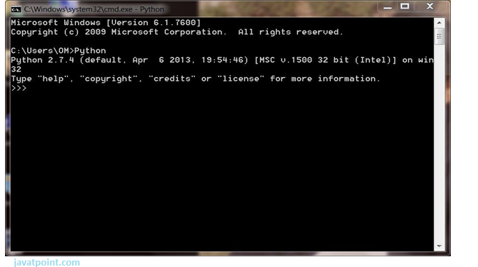
Execute Program
1. Interactive Mode

Slide 9
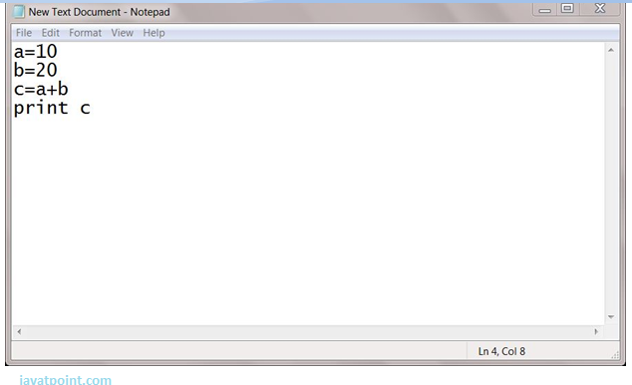
Cont..
2. Script Mode

Slide 10
Thank you

