Slide 1
General Packet Radio Service
(GPRS)
Petteri Lappalainen
23.11.1998
IP Tech School
Seminar Presentation
Based on the material by
Tuomas Niemelä (-97), Hannu H. Kari (-98) and ETSI

Slide 2





















Wireless roadmap

Slide 3
Contents
1. Introduction to GPRS
  What is GPRS ?
  GPRS characteristics
  Applications
2. GPRS architecture
  Network elements
3. GPRS Operations
  Radio interface resource reservation
  Security operations
  Connecting to GPRS
  Data transfer
  Mobility management
  Interworking with GSM services
4. Special issues
  SMS
  Charging
  O&M
  Supplementary services
  QoS
  Performance
5. GPRS business view
  What must be invested…
  How to make money with GPRS
  Users' benefits of GPRS
  Business model
6. GPRS specifications

Slide 4
1. Introduction to GPRS
1.1. What is GPRS ?
1.2. GPRS access interfaces and reference points
1.3. How is GPRS seen by external networks and GPRS users
1.4. Air interface resources
1.5. GPRS characteristics
1.6. Applications

Slide 5
1.1. What is GPRS ?
Part of GSM phase 2+
General Packet Radio Service
  General -> not restricted to GSM use (DECT ?, 3rd generation systems ?)
  Packet Radio -> enables packet mode communication over air
  Service, not System -> existing BSS (partially also NSS) infrastructure is used
Requires many new network elements into NSS
Provides connections to external packet data networks (Internet, X.25)
Main benefits
  Resources are reserved only when needed and charged accordingly
  Connection setup times are reduced
  Enables new service opportunities

Slide 6
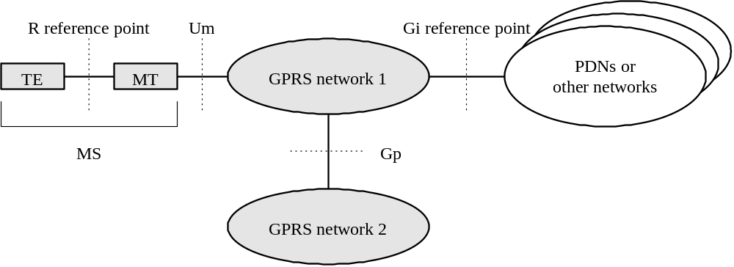
1.2. GPRS access interfaces and reference points
GPRS provides packet switched connections from MS to packet data networks (PDN)
Different operator’s GPRS networks are connected through Gp interface

Slide 7
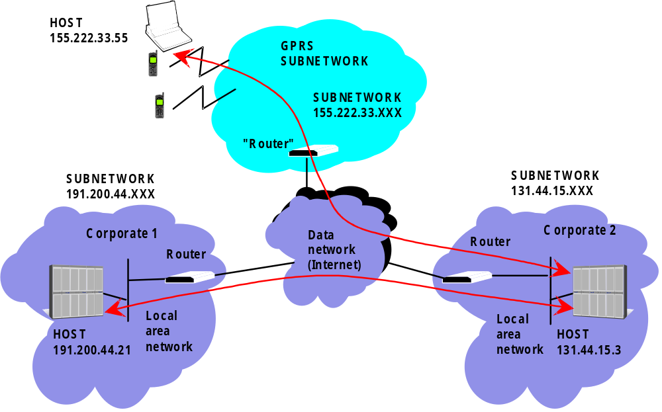
1.3. How is GPRS seen by external networks and GPRS users?

Slide 8
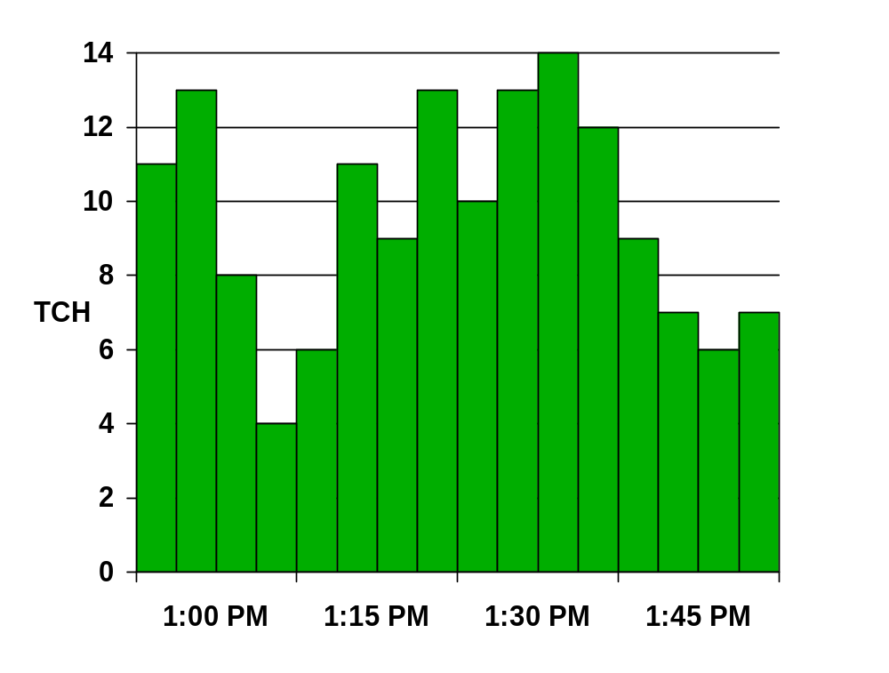
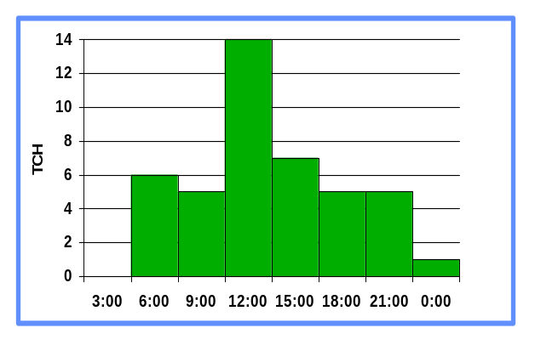
1.4. Air interface resources
An example of occupied TCH capacity by CS traffic during busy hour with n% blocking
Free
Capacity
GPRS "steals" any TCH
capacity not used by CS
traffic
Capacity occupied by CS traffic

Slide 9
1.5. GPRS characteristics
GPRS uses packet switched resource allocation
  resources allocated only when data is to be sent/received
Flexible channel allocation
  one to eight time slots
  available resources shared by active users
  up and down link channels reserved separately
  GPRS and circuit switched GSM services can use same time slots alternatively
Traffic characteristics suitable for GPRS
  Intermittent, bursty data transmissions
  Frequent transmissions of small volumes of data
  Infrequent transmission of larger volumes of data

Slide 10
1.6. Applications
  Standard data network protocol based
    IP based applications
      WWW, FTP, Telnet, ...
      Any conventional TCP/IP based applications
    X.25 based applications
      Packet Assembly/Disassembly (PAD) type approach
  GPRS specific protocol based
    Point-to-point applications
      Toll road system, UIC train control system
    Point-to-multipoint applications
      Weather info, road traffic info, news, fleet management
  SMS delivery (GPRS as a bearer for SMS)

Slide 11
2. GPRS architecture
2.1. Interfaces, reference points and network elements
2.2. Functional view on GPRS
2.3. Subscription of GPRS service
2.4. New network elements
  2.4.1. GGSN
  2.4.2. SGSN
  2.4.3. Other elements
  2.4.4. GPRS backbones
2.5. GPRS Mobile classes
2.6. MS multislot capabilities

Slide 12
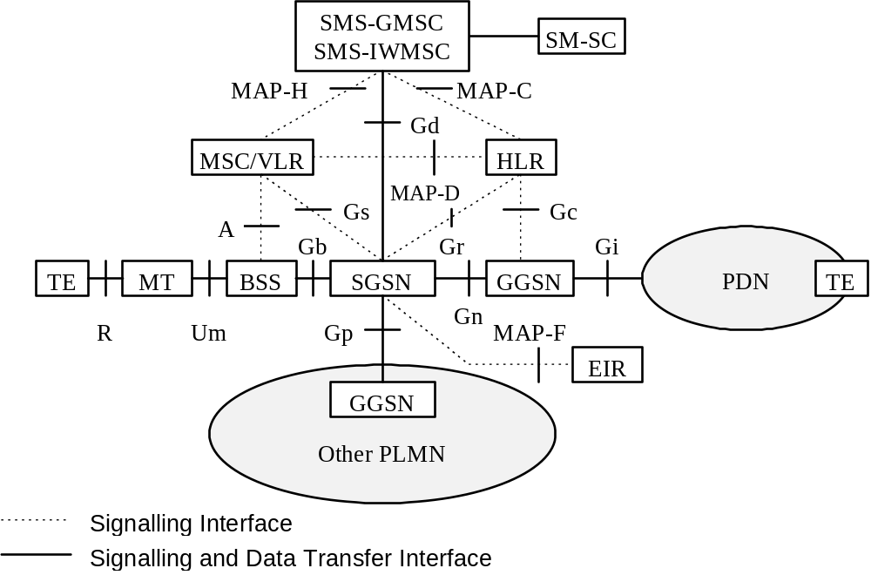
2.1. Interfaces, reference points and network elements

Slide 13
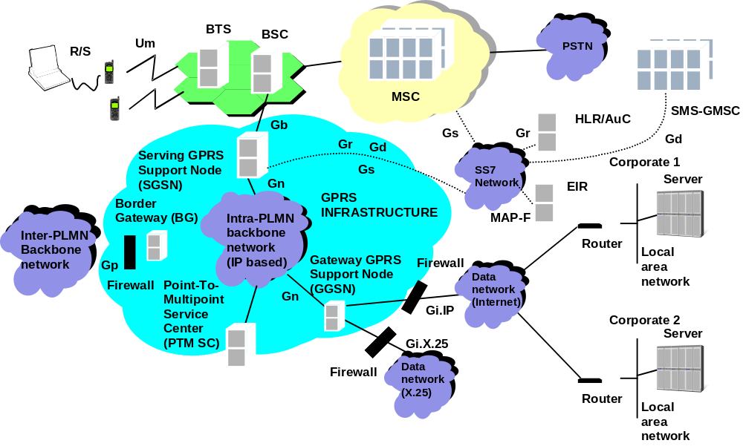
2.2. Functional view on GPRS

Slide 14
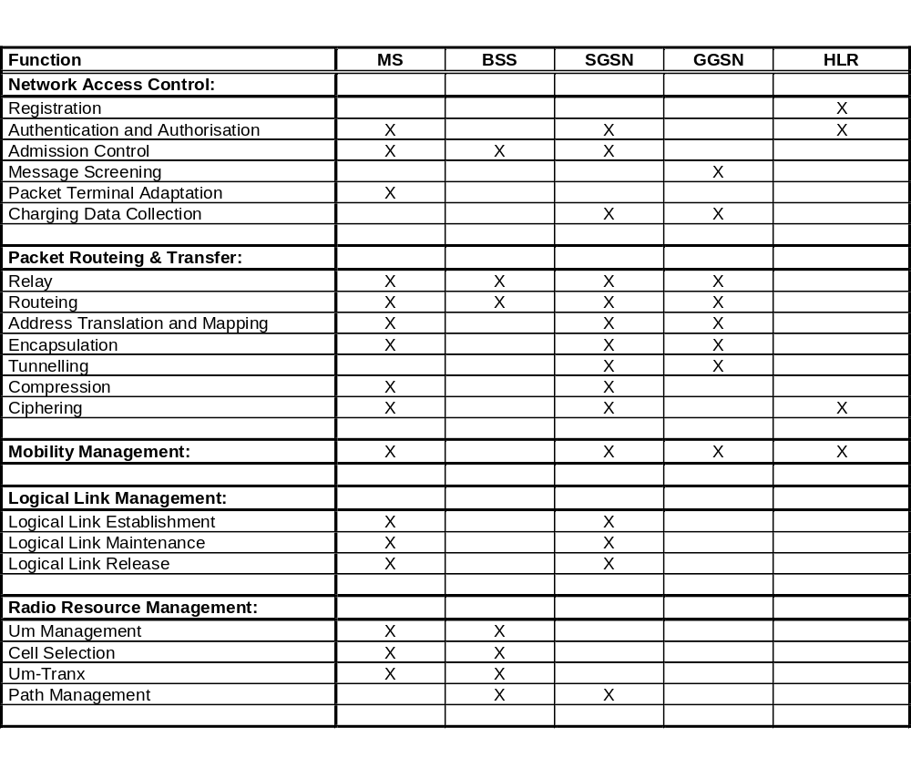
Assignment of functions to general logical architecture

Slide 15
2.3. Subscription of GPRS service (1/2)
Subscription storage: HLR
Supports Multiple Subscriber Profile (MSP)
Mobile identification: IMSI
One or several PDP addresses per user
  Each subscribed configuration contains
    PDP type (e.g., IP, X.25)
    PDP address (static, e.g. 128.200.192.64)
    Subscribed QoS (level 1…4)
    Dynamic address allowed
    VPLMN address allowed
    GGSN address
    Screening information (optional)

Slide 16
2.3. Subscription of GPRS service (2/2)
Subscription is copied from HLR to SGSN during GPRS Attach
Part of PDP context is copied to relevant GGSNs when a PDP address is activated
Possible PDP address allocation alternatives
  Static address allocated from HPLMN
  Dynamic address allocated from HPLMN
  Dynamic address allocated from VPLMN
HPLMN operator specifies which alternatives are possible

Slide 17
2.4.1. Gateway GPRS Support Node
GGSN
Typically located at one of the MSC sites
One (or few) per operator
Main functions
  Interface to external data networks
  Resembles to a data network router
  Forwards end user data to right SGSN
  Routes mobile originated packets to right destination
  Filters end user traffic
  Collects charging information for data network usage
  Data packets are not sent to MS unless the user has activated the PDP address

Slide 18
2.4.2. Serving GPRS Support Node
SGSN
Functionally connected with BSC, physically can be at MSC or BSC site
One for few BSCs or one (or few) per every BSC
One SGSN can support BSCs of several MSC sites
Main functions
  Authenticates GPRS mobiles
  Handles mobile’s registration in GPRS network
  Handles mobile’s mobility management
  Relays MO and MT data traffic
    TCP/IP header compression, V.42bis data compression, error control MS- SGSN (ARQ)
  Collect charging information of air interface usage

Slide 19
2.4.3. Other elements
BG (Border Gateway)
(Not defined within GPRS)
Routes packets from SGSN/GGSN of one operator to a SGSN/GGSN of an other operator
Provides protection against intruders from external networks
DNS (Domain Name Server)
Translates addresses from ggsn1.oper1.fi -format to 123.45.67.89 format (i.e. as used in Internet)
Charging Gateway
Collects charging information from SGSNs and GGSNs
PTM-SC (Point to Multipoint -Service Center)
PTM Multicast (PTM-M): Downlink broadcast; no subscription; no ciphering
PTM Group call (PTM-G): Closed or open groups; Down/up -link; ciphered
Geographical area limitation

Slide 20
2.4.4. GPRS backbones
Enables communication between GPRS Support Nodes
Based on private IP network
  IPv6 is the ultimate protocol
  IPV4 can be used as an intermediate solution
Intra-PLMN backbone
  Connects GPRS Support Nodes of one operator
  Operator decides the network architecture
    LAN, point-to-point links, ATM, ISDN, ...
Inter-PLMN backbone
  Connects GPRS operators via BGs
  Provides international GPRS roaming
  Operators decide the backbone in the roaming agreement

Slide 21
2.5. GPRS mobile types
Class A:
  Simultaneous GPRS and conventional GSM operation
  Supports simultaneous circuit switched and GPRS data transfer
Class B:
  Can be attached to both GPRS and conventional GSM services simultaneously
  Can listen circuit switched and GPRS pages (via GPRS)
  Supports either circuit switched calls or GPRS data transfer but not simultaneous communication
Class C:
  Alternatively attached in GPRS or conventional GSM
  No simultaneous operation
  ‘GPRS only’ mobiles also possible (e.g. for telemetric applications)

Slide 22
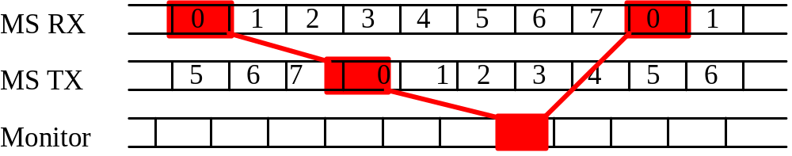
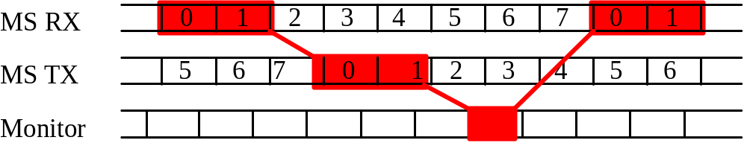
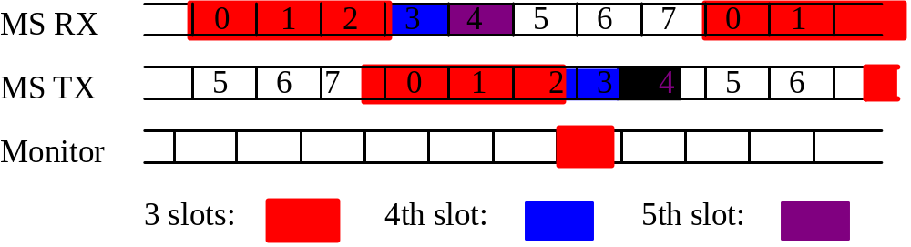
2.6. GPRS multislot capabilities
1-slot
2-slot
3-8 -slot

Slide 23
3. GPRS operations
3.1 Security: Basic security rules
  Authentication, key management, ciphering
3.2 GPRS attach
3.3 Data transmission
  MO, MT, MO+MT
3.4 Mobility management
3.5 Interworking with GSM services

Slide 24
3.1. Security: Based on GSM phase 2
Authentication
  SGSN uses same principle as MSC/VLR:
    Get triplet, send RAND to MS, wait for SRES from MS, use Kc
  MS can’t authenticate the network
Key management in MS
  Kc generated same way from RAND using Ki as in GSM
Ciphering
  Ciphering algorithm is optimized for GPRS traffic (‘GPRS - A5’)
  Ciphering is done between MS and SGSN
User confidentiality
  IMSI is only used if a temporary identity is not available
  Temporary identity (TLLI) is exchanged over ciphered link

Slide 25
3.2. GPRS Attach
GPRS Attach function is similar to IMSI attach
  Authenticate the mobile
  Generate the ciphering key
  Enable the ciphering
  Allocate temporary identity (TLLI)
  Copy subscriber profile from HLR to SGSN
After GPRS attach
  The location of the mobile is tracked
  Communication between MS and SGSN is secured
  Charging information is collected
  SGSN knows what the subscriber is allowed to do
  HLR knows the location of the MS in accuracy of SGSN

Slide 26
3.3. Data transfer: Basic rules (1/4)
SGSN:
  Does not interpret user data, except
    SGSN may perform TCP/IP header compression
  Does not interpret source or destination addresses
  Sends all packets to specified GGSN that handles the PDP context
GGSN:
  Performs optional filtering
  Decides where and how to route the packet

Slide 27
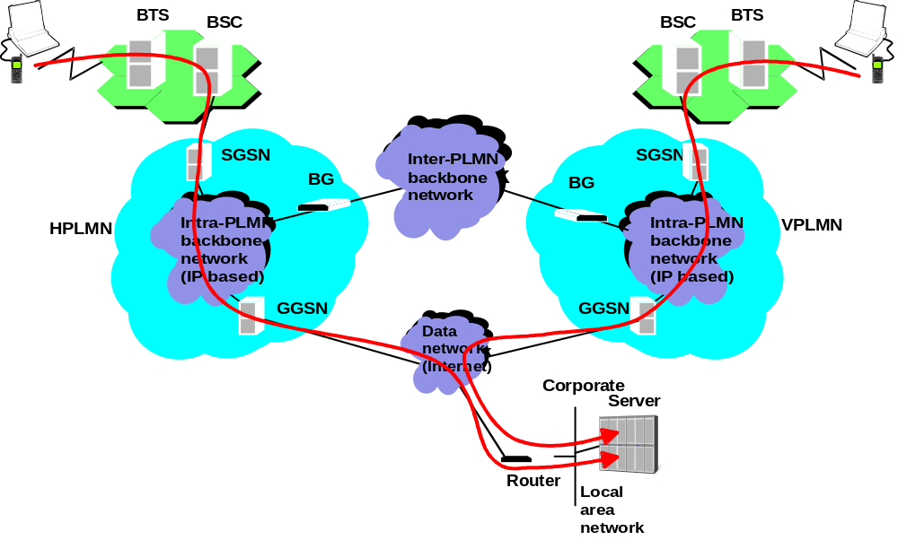
3.3. Data transfer (2/4)
Mobile originated (left when MS in HPLMN, right when in VPLMN, no filtering/screening)

Slide 28
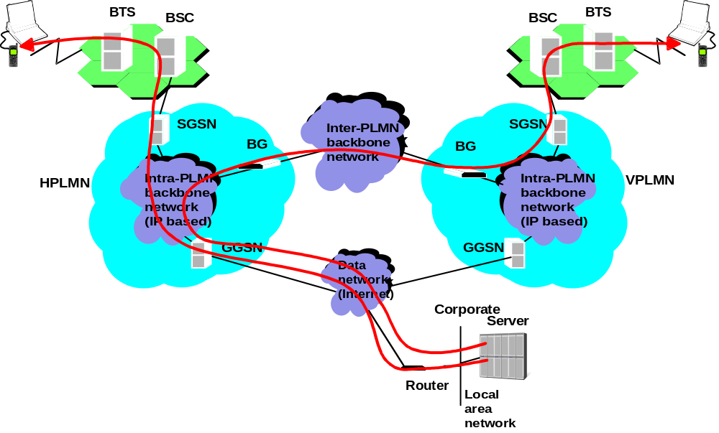
3.3. Data transfer (3/4)
Mobile terminated (left when MS in HPLMN, right when in VPLMN, with/without filtering/screening)

Slide 29
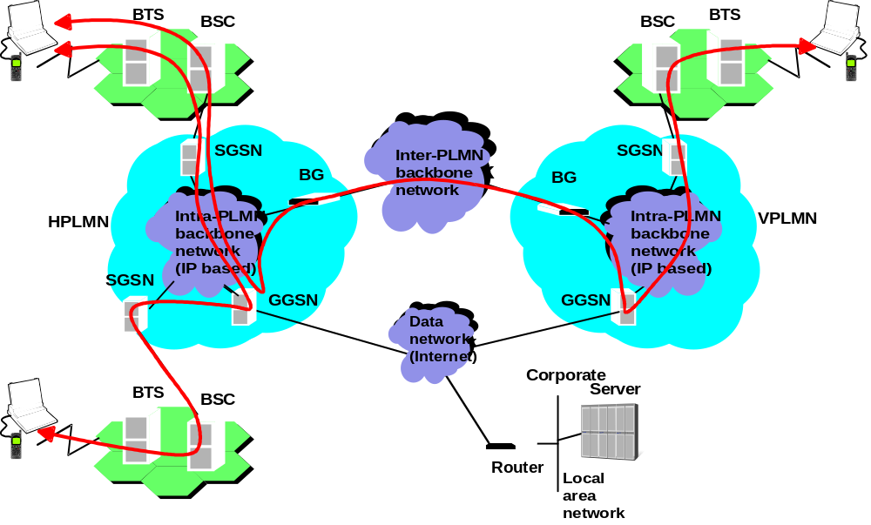
3.3. Data transfer (4/4)
Mobile originated and terminated (left MSs in same PLMN, right MSs in different PLMN)

Slide 30
3.4. Mobility management (1/3)
Instead of Location Area, GPRS uses Routing Areas to group cells. RA is a subset of LA.
IDLE:
  MS is not known by the network (SGSN)
STANDBY:
  MS’s location is known in accuracy of Routing Area
  MS can utilize DRX (to save battery)
  MS must inform its location after every Routing Area change (no need to inform if MS changes from one cell to another within same Routing Area)
  Before the network can perform MT data transfer MS must be paged within the Routing Area
  MS may initiate MO data transfer at any time

Slide 31
3.4. Mobility management (2/3)
READY:
  MS’s location is known in accuracy of cell
  MS must inform its location after every cell change
  MS can initiate MO data transfer at any time
  SGSN does not need to page the MS before MT data transfer
  MS listens continuously GPRS PCCCH channel
    DRX in READY state is optional

Slide 32
3.4. Mobility management (3/3)
Mobility management messages:
  Cell update (implicit, with any message)
    When MS changes the cell within a Routing Area in READY state
  Routing Area update
    When MS changes the cell between two Routing Areas in READY or STANDBY state
    Two types of Routing Area Updates (from MS’s point of view only one type)
      Intra-SGSN Routing Area Update
      Inter-SGSN Routing Area Update
  Periodic Routing Area updates are applicable

Slide 33
3.5. Interworking with GSM services (1/3)
GPRS can interwork with GSM services through Gs-interface
If no Gs interface exists:
  Type of the location update procedure is indicated by the network in the response message to MS
Effects on different MS classes if Gs does not exist:
  A-class mobiles must use conventional GSM services via normal GSM channels
  B-class mobiles won’t get simultaneous support from the network. Depending on MS design
    MS can try listen both paging channels simultaneously by themselves
    MS does IMSI detach and use only GPRS service
  No effect on C-class mobiles as simultaneous services are not supported

Slide 34
3.5. Interworking with GSM services (2/3)
Combined GPRS and IMSI attach
  To save radio resources
  MS indicates its request for combined attach
  MS sends combined GPRS and IMSI attach to SGSN
  SGSN may authenticate the MS
  SGSN informs MSC/VLR about the new MS
Combined Location and Routing Area update
  To save radio resources
  MS indicates its request for combined update
  This is done when both Location Area and Routing Area changes at the same time
  Combined Location and Routing Area update is not done if MS has CS connection

Slide 35
3.5. Interworking with GSM services (3/3)
Paging CS services via GPRS network
MSC/VLR gets MT call or SMS
In VLR, presence of SGSN address tells that the MS is in GPRS attached state
MSC/VLR sends the paging request to SGSN address (not to BSC)
SGSN checks the location of MS (identified by IMSI)
SGSN pages the MS via GPRS channels indicating “CS page” status
MS replies to the page using normal GSM channels

Slide 36
4. Special issues
4.1. SMS
4.2. Charging
4.3. O&M
4.4. Supplementary services
4.5. Quality of Service
4.6. Performance

Slide 37
4.1 Special issues: SMS support
MO and MT SMSs can be carried via GPRS network
HLR stores and returns two SS7 addresses to GMSC:
  SGSN address
  MSC/VLR address
Primary route:
  Via SGSN, if available
Secondary route:
  Via MSC/VLR, if available and primary failed

Slide 38
4.2 Special issues:
GPRS charging of PTP (1/2)
SGSN gathers charging:
  usage of radio resources (packets, bits)
  usage of packet data protocols (time)
  usage of general GPRS resources
    e.g. signaling messages, GPRS backbone
GGSN gathers charging :
  based on destination/source of data packets
  usage of external data networks (packets, bits)
  usage of general GPRS resources
Operator selects what information is used for billing

Slide 39
4.2 Special issues:
GPRS charging of PTM (2/2)
SGSN gathers usage of:
  usage of radio resources
    amount of data
    geographical areas
    number of repetition
  usage of general GPRS resources
PTM Service Center gathers charging :
  usage of general GPRS resource
  usage of PTM-G groups

Slide 40
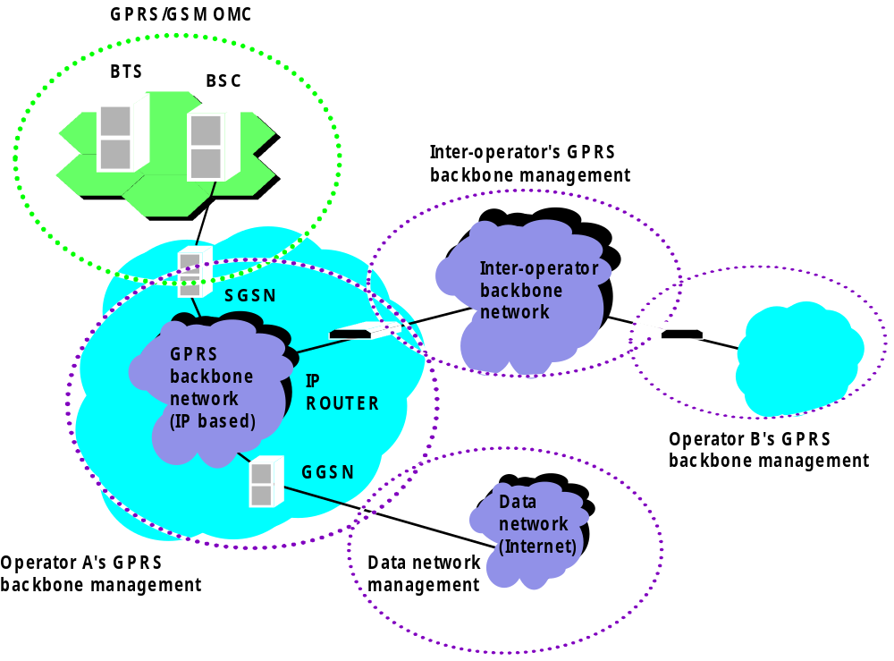
4.3 Special issues:
Operation and management
GSM related parts can be handled with Q3
GPRS backbone network is based on IP network
  IP network uses Simple Network Management Protocol (SNMP)

Slide 41
4.4 Special issues:
Supplementary services
Most of the conventional GSM supplementary services are not applicable for GPRS
  E.g., Call forwarding when busy, Calling line identification, Call waiting
Some supplementary services may be applicable
  Advice of charge (can be difficult to realize)
  Closed user group (can be implemented as part of external data network)
GPRS has its own supplementary services
  Barring of GPRS Interworking Profile(s)

Slide 42
4.5 Quality of Service
Precedence class (1,2,3)
Delay class (1-4)
Reliability class
Peak throughput class; and
Mean throughput class.

Slide 43
4.5.1 Reliability Class
Data reliability is defined in terms of the residual error rates for the following cases (see GSM 02.60):
Probability of data loss
Probability of data delivered out of sequence
Probability of duplicate data delivery
Probability of corrupted data

Slide 44
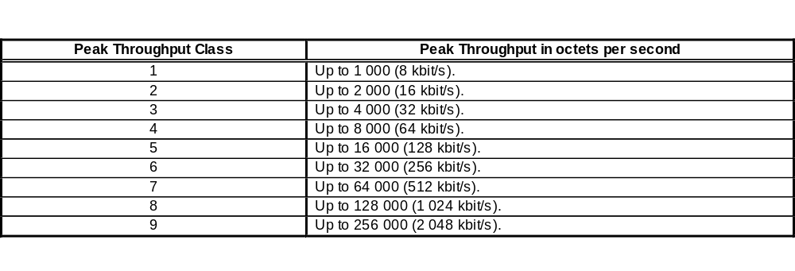
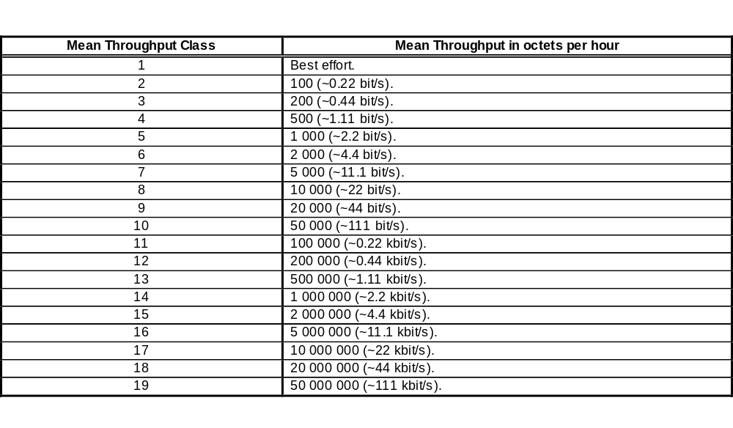
4.5.2 Throughput classes

Slide 45
4.6 Performance 1/3
Example
SGSN that handles 2 Mbps up and downlink traffic
  Average packet size 500 octets (4000 bits)
  => Each packet must be processed totally every 1 milliseconds
    IP stack in backbone
    possible UDP (de)fragmentation, IP checksums
    GTP header processing, finding the right context
    possible paging of the MS
    compression in SNDCP level, possible segmentation
    LLC CRC, LLC acknowledges, LLC timers
    handle GPRS ciphering/deciphering
    BSSGP protocol
    Frame relay protocol

Slide 46
4.6 Performance 2/3
Example continued
Background tasks
  Ensuring the QoS for every mobile
    Scheduling pending packets to time horizon
    Rescheduling everything after MS has changed the cell
  Handling charging data collection
  Performance monitoring
  Handle SGSN operating system, task switching, etc.
  Handle diagnostics of the network element
If SGSN handles 65 Mbps, instead of 2 Mbps?
  => SGSN has just about 30 micro seconds to do all above

Slide 47
4.6 Performance 3/3
Solution to the example
Each network element has limited capacity (x packets/second)
If operator needs more capacity (e.g. 50x)
  use 50 parallel boxes
  for example,
    every GGSN boxes are really independent of each other
    each SGSN handles its own area (list of cells)
Capacity grows linearly but complexity in each box remains the same
Reliability? Configuration?

Slide 48
5. GPRS Business View
5.1. What must be invested to get GPRS up and running?
5.2. How to launch GPRS with minimised incremental cost
5.3. How to make money with GPRS?
5.4. Users' benefits of GPRS
5.5. Business model

Slide 49
5.1 What must be invested to get GPRS up and running?
Updates on existing network elements
  BTS, BSC, MSC/HLR, O&M, billing system, network planning
New network elements
  Totally new network for GPRS backbone, based on IP
  New packet network nodes
  A lot of Internet "stuff" (routers, DNS servers, firewalls, …)
Totally new skills needed
  "Internet way" of thinking
New mobiles and new type of users
New type of business thinking

Slide 50
5.2 How to launch GPRS with minimised incremental cost
A single SGSN/GGSN combined functional unit
BTSs support basic GPRS services with software update only, BSCs need HW upgrade to add connection to SGSN
Use existing paging and control channels for GPRS
Limit the number of radio channels available for GPRS
Gs interface can be deleted => no MSC developments

Slide 51
5.3. How to make money with GPRS?
New users
  More subsribers
New services
  New ways to get money from users
  New intances to pay instead of the users (e.g. advertisers)
New applications
  New ways to get money from users
More data traffic
  More data traffic
  Small payments per packet, but huge number of packets

Slide 52
5.4. Users' benefits of GPRS
GPRS Selling arguments:
  Higher capacity Internet access
    Up to 171,2 kbps in theory, 40 kbps in practice
  Quicker access to Internet
    No set up time, Iternet access all the time available
  Lower cost
    Flat rate or volume based billing
  Or no cost
    via anonymous access (somebody else pays the bill)

Slide 53
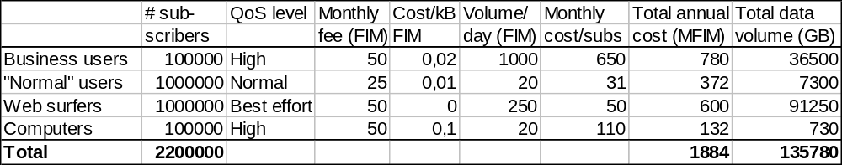
5.5. Business model
1/2
If the users are paying little (or nothing), how does this make profit to the operator?
  Not the high cost per time but the large number of packets
  Somebody else may pay the bill (e.g. anonymous access)
Example business model

Slide 54
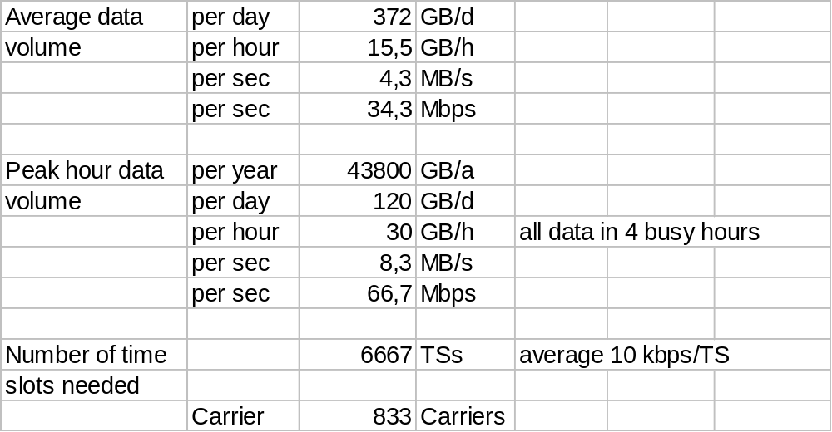
5.5. Business model 2/2
Volume calculations

Slide 55
6. GPRS Standardization
GPRS Phase 1: Release 97
  Basic set of GPRS functionality
  Optional features
GPRS Phase 2: GPRS for UMTS
  Certain issues defined in stage 1 documents are not included in the first release of the GPRS standard
  New requirements have been pointed out for UMTS
Standard was approved March/June 1998

Slide 56
6.1 List of participants
The following companies and organizations have been participating in GPRS work in last 3 years
Some of the manufacturers, operators and others participating GPRS standardization:
  Alcatel, BT, CNET, CSELT, Detemobil, Eplus, Ericsson, France Telecom, IBM, Inmarsat, Lucent, Mannesmann, Motorola, NEC, Nokia, Nortel/Matra, Omnipoint, OPI, Philips, SFR, Siemens, Telecom Finland, Telia, UIC, Vodafone
EU sponsored project team PT8OV to expedite GPRS standardization
Support of PT12

Slide 57
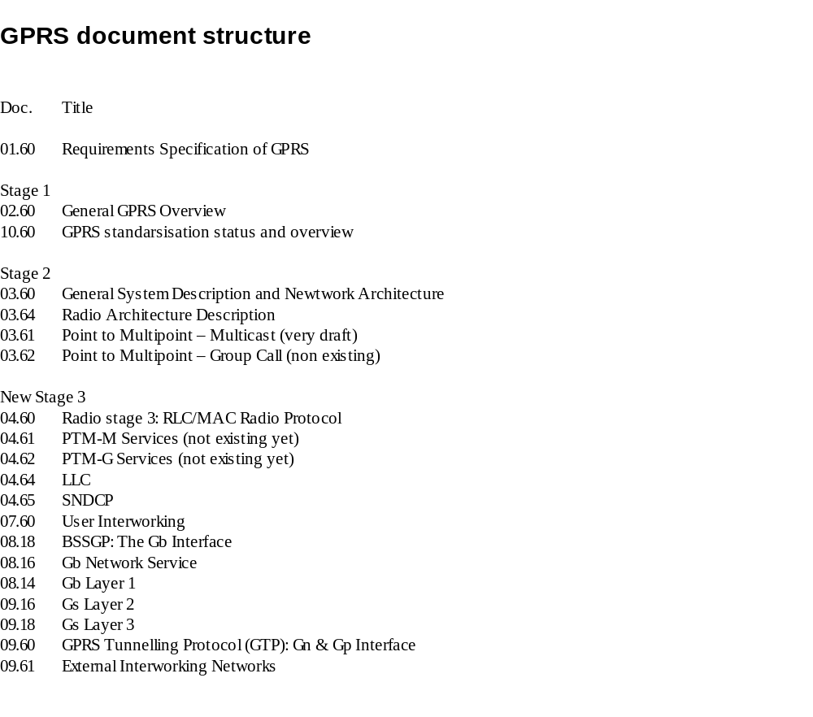
6.2 GPRS Specifications

